Slide 1
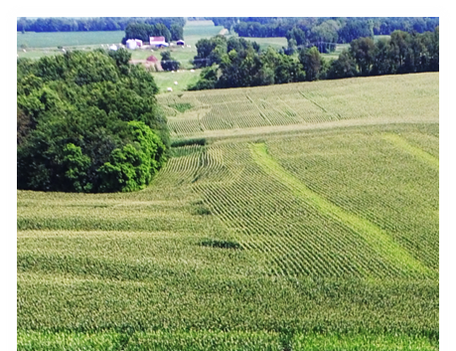
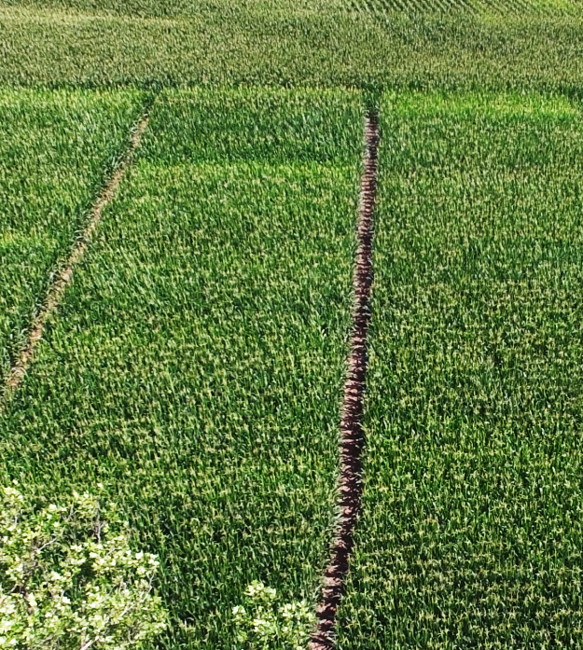
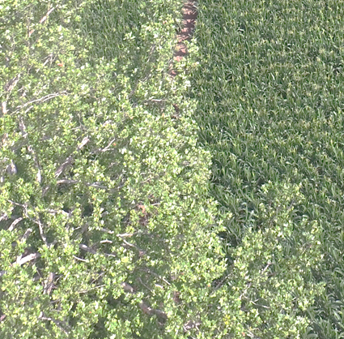
Finding the “Holy Grail” Reflectance Sensing Corn Nitrogen Algorithm
Newell R. Kitchen
USDA-ARS
Cropping Systems and Water Quality
Columbia, Missouri
Notes:
a thing that is being earnestly pursued or sought after

Slide 2
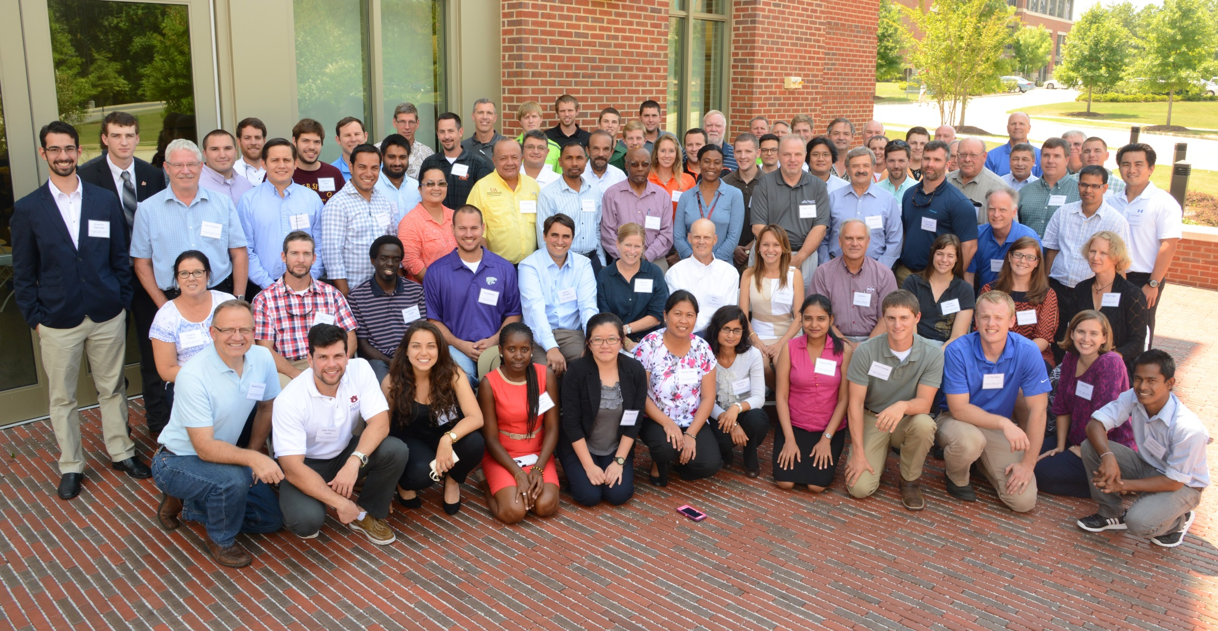
Cornerstone of the
NUE Workshop
“To delineate the components needed within functional algorithms that employ active sensors.”

Slide 3
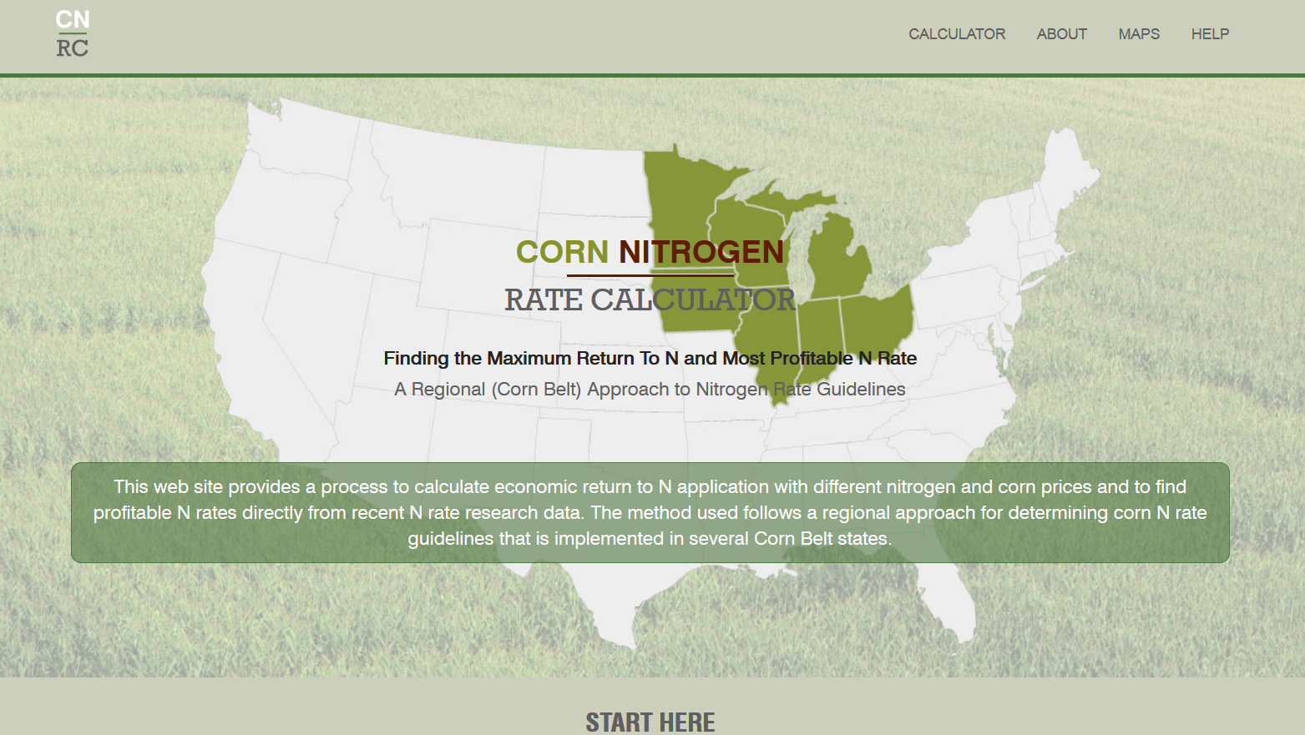
Maximum Return to Nitrogen (MRTN)

Slide 4


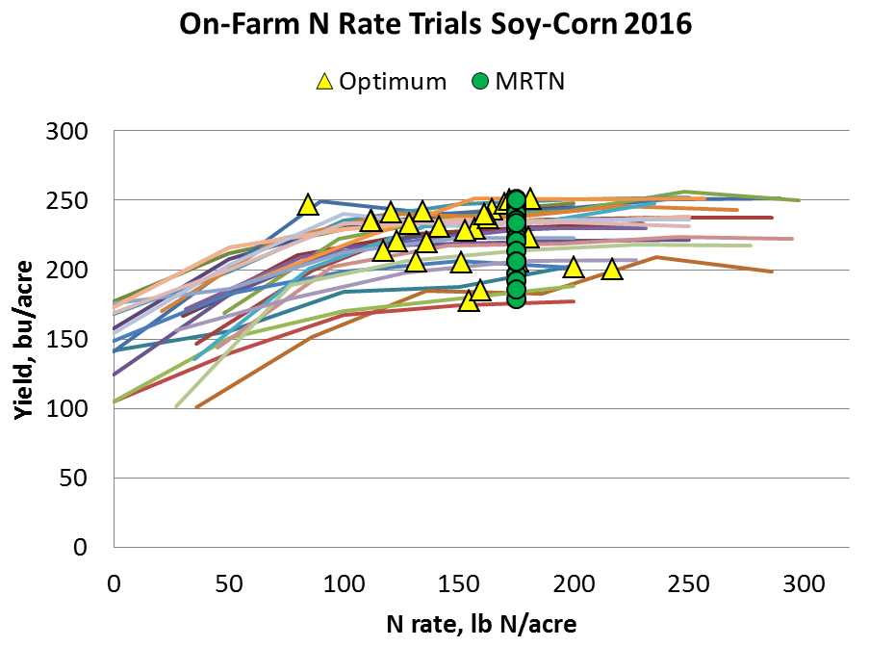

Courtesy of Emerson Nafziger, UI

Slide 5
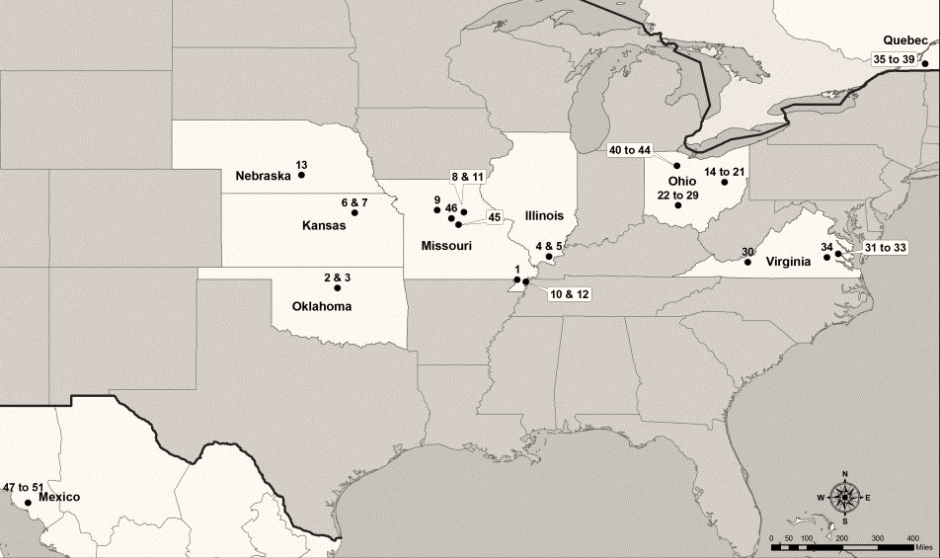
National/International NUE Project
(Tremblay et al., 2012)
Notes:
Meta-analyses on aggregated large datasets
Wide range in soil types, (textural classes) precipitation, distribution of precipitation, growing degree days

Slide 6


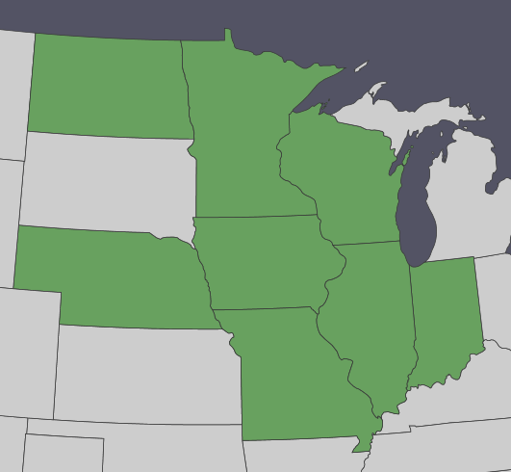







Performance and Refinement of
Nitrogen Fertilization Tools
A Public-Private Collaboration
David Franzen
North Dakota St. University
Fabián Fernández
University of Minnesota
John Sawyer
Iowa State University
Carrie Laboski
University of Wisconsin
Richard Ferguson
University of Nebraska
Emerson Nafziger
University of Illinois
Newell Kitchen
USDA-ARS
University of Missouri
James Camberato
Purdue University

Slide 7
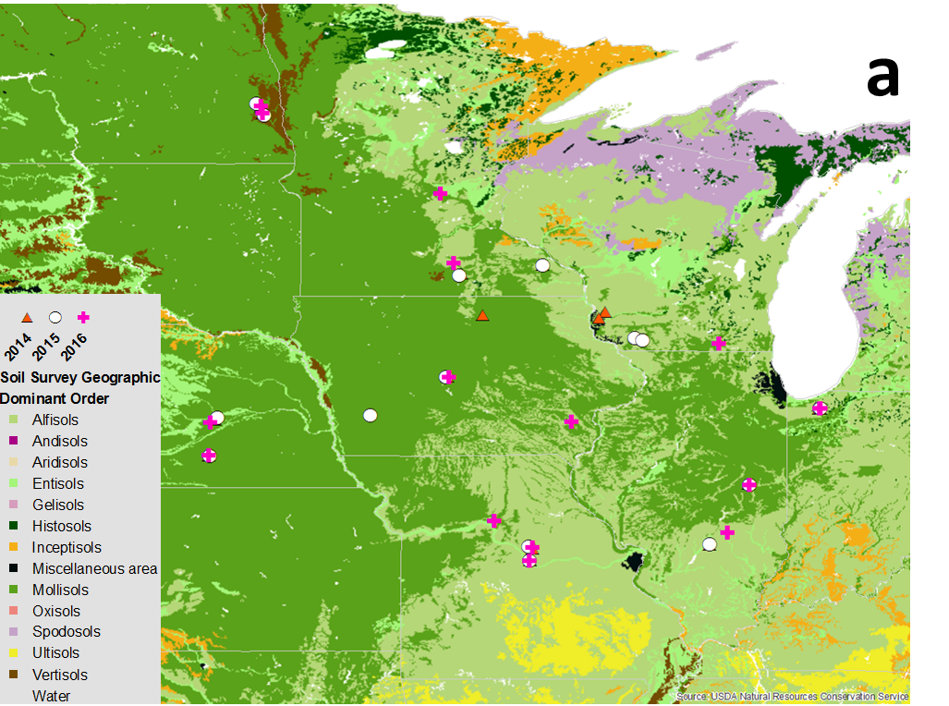
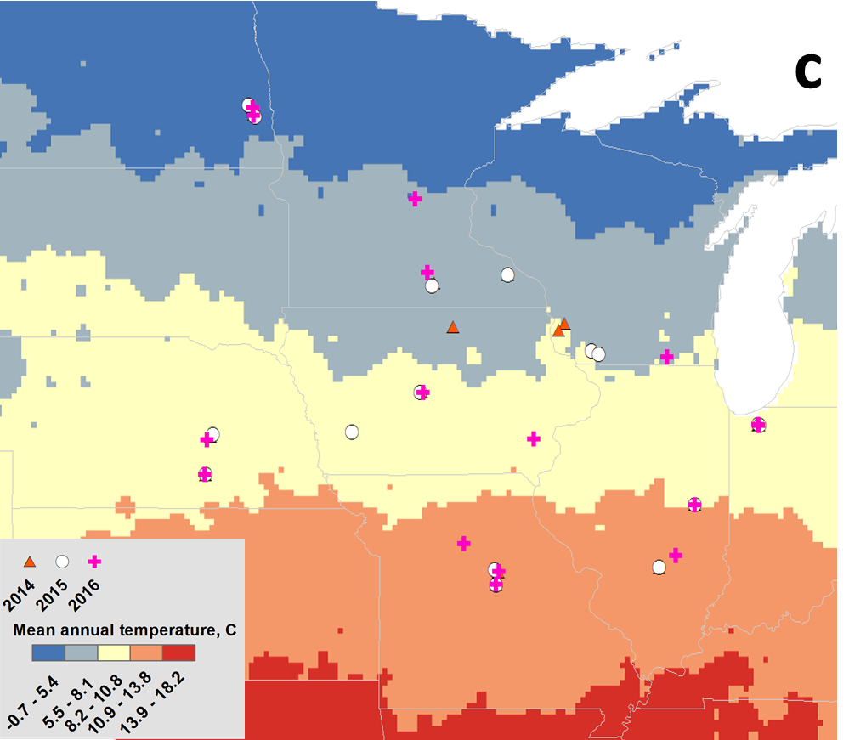
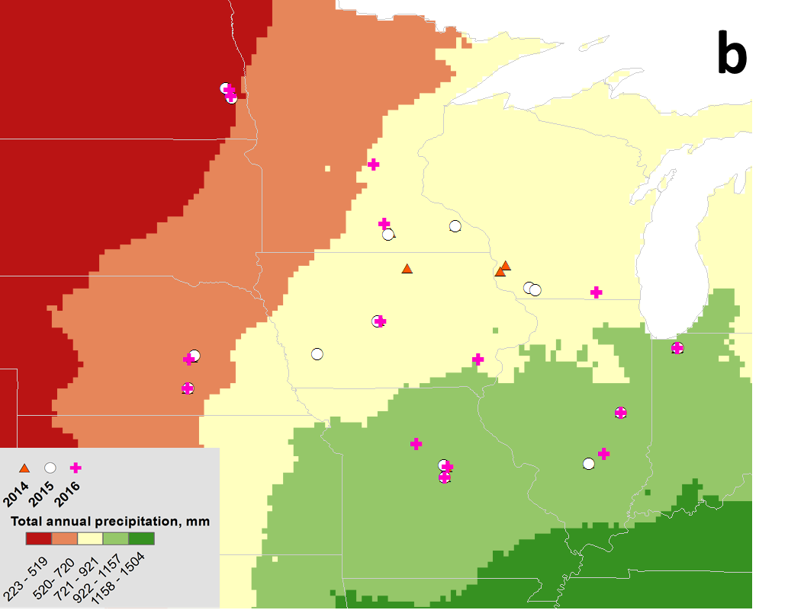
Research Locations 16 Locations/Year Total 49
Soil Orders
Temperature
Precipitation

Slide 8
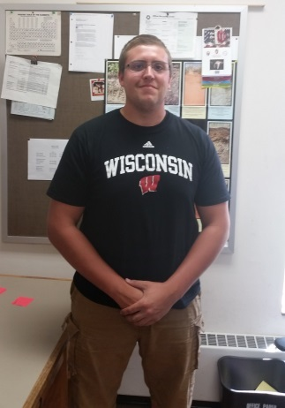
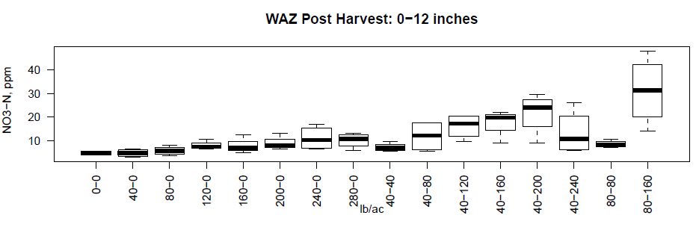
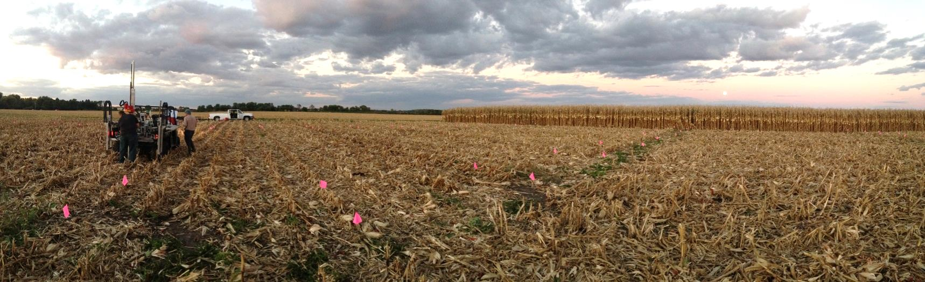
Chris Bandura, MS
University of Wisconsin
How does N fertilization timing impact loss of N?

Slide 9
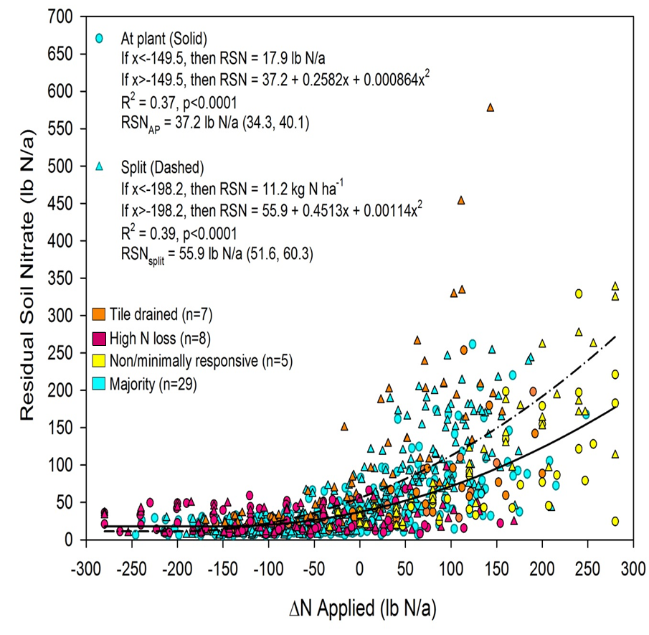
How does N rate and timing affect end-of-season soil nitrate?
Nitrate increased quickly once EONR was reached
Nitrate was greater with split applied N vs at-planting N (56 vs 37 lb N/a at EONR)
N Rate – EONR (lb N/a)

Slide 10
Variation in Economic Optimal N Rate
2014
2015
2016

Slide 11
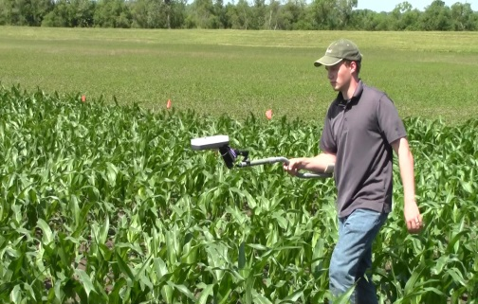
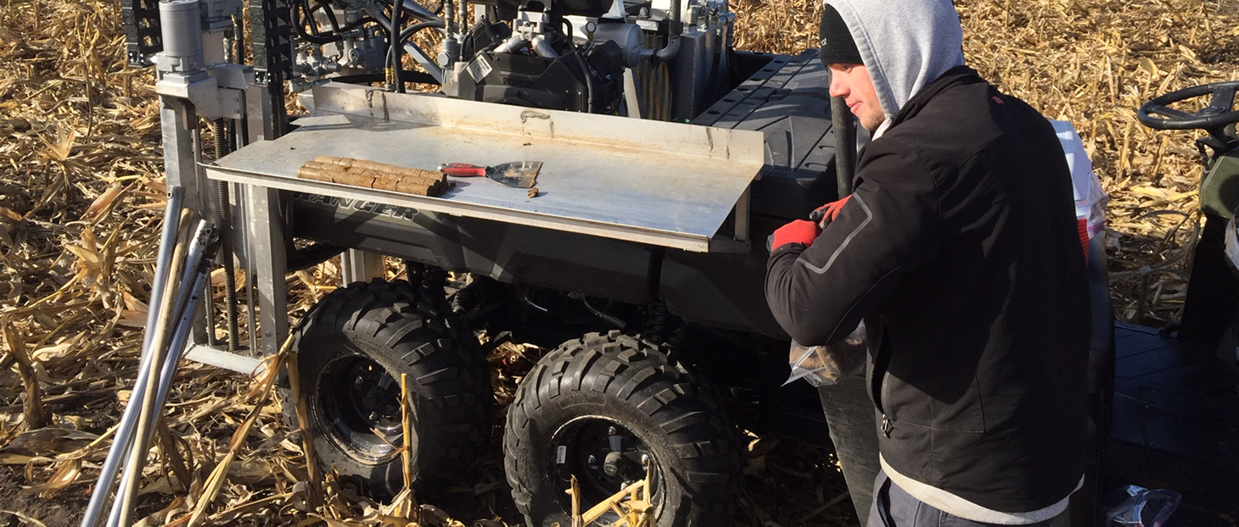
Curtis Ransom, PhD
Project Operations Manager
University of Missouri
Which N fertilization decision tool is the most accurate for N rate recommendations?

Slide 12
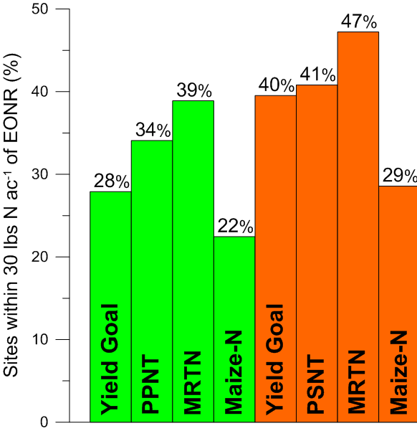
Percent of Sites within 30 lbs/A of EONR
At Planting
Split

Slide 13
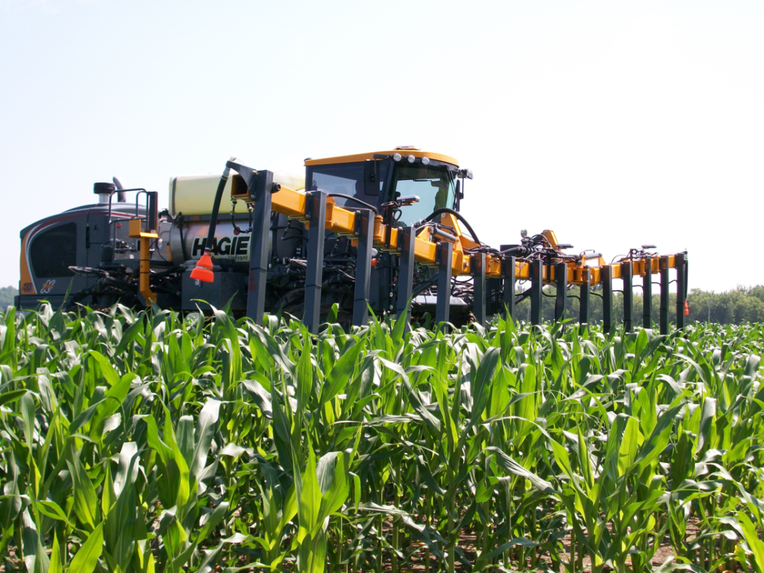
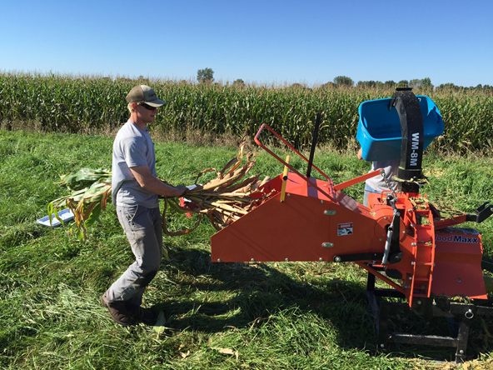
Gregory M. “Mac” Bean, MS
University of Missouri
Can crop canopy-sensing algorithms work across the corn-belt, and can these algorithms be improved?

Slide 14
University of Missouri Algorithm Performance

Slide 15
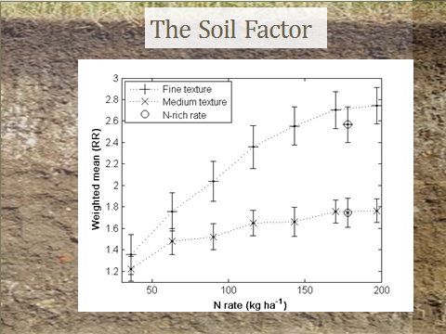
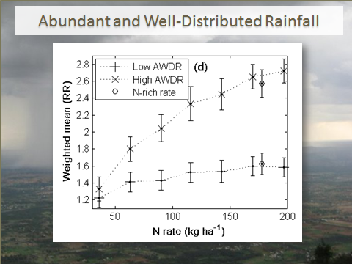
National/International NUE Project
(Tremblay et al., 2012)
Notes:
Meta-analyses on aggregated large datasets
Wide range in soil types, (textural classes) precipitation, distribution of precipitation, growing degree days

Slide 17
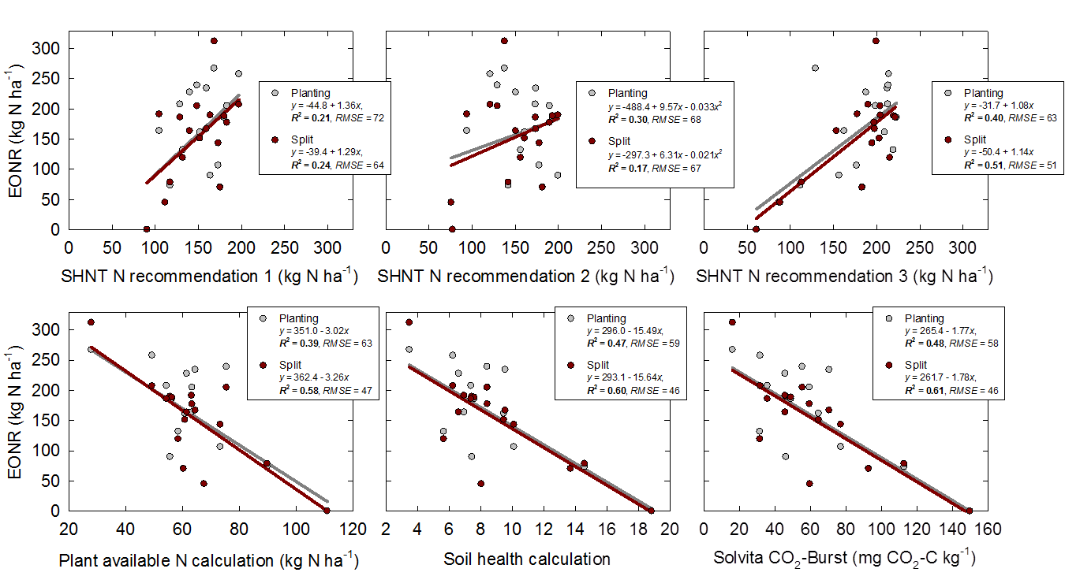
EONR Related to Quick Carbon Mineralization (2016 )

Slide 18
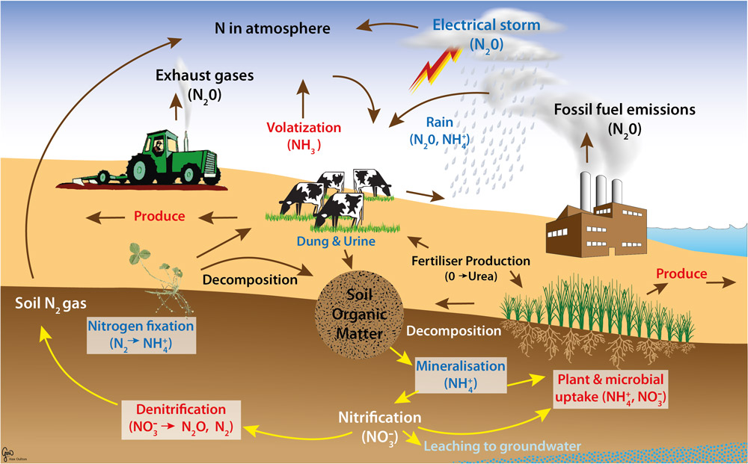
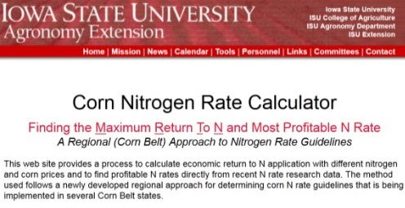
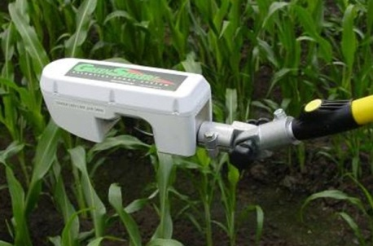
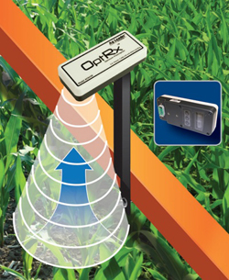
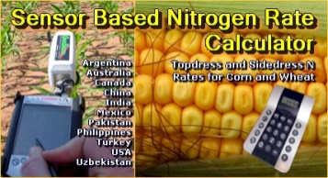
Crop Growth Models
Empirical-Based Models
Encirca
Maize-N
Climate: Nitrogen Advisor
Adapt-N
“To delineate the components needed within functional algorithms that employ active sensors.”
Proximal Canopy Sensing
Soil Tests
PPNT Pre-Plant Soil Nitrate Test
SDNT Side-Dress Soil Nitrate Test
Notes:
There are many new tools, to go along with some tools that have been in place for some time, for performing N fertilizer rate recommendations? The question looms: (slide)

