Slide 1
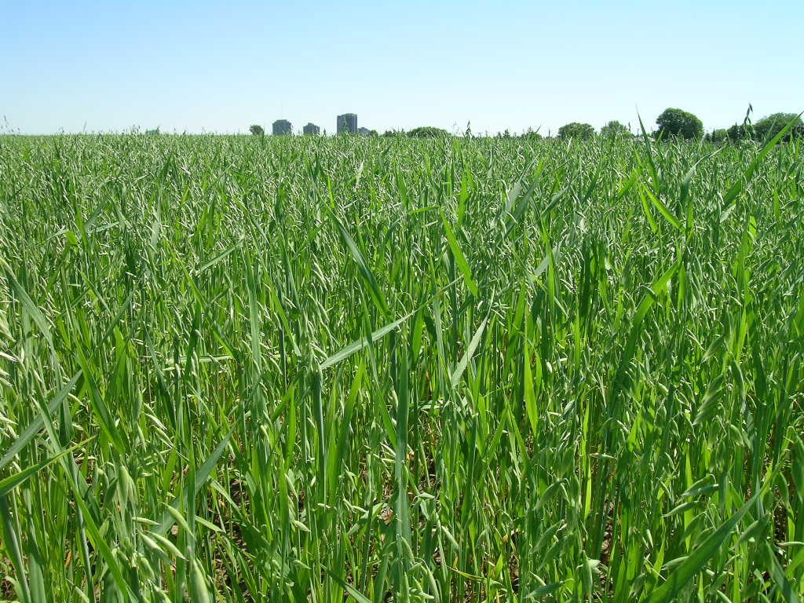
Recent Work on Oat and Canola N Management Projects in ON, Canada
Dr. Bao-Luo Ma
Senior Research Scientist, Crop Physiology
Ottawa Research and Development Centre, Ottawa, ON
613-759-1521 baoluo.ma@agr.gc.ca
Canada

Slide 2
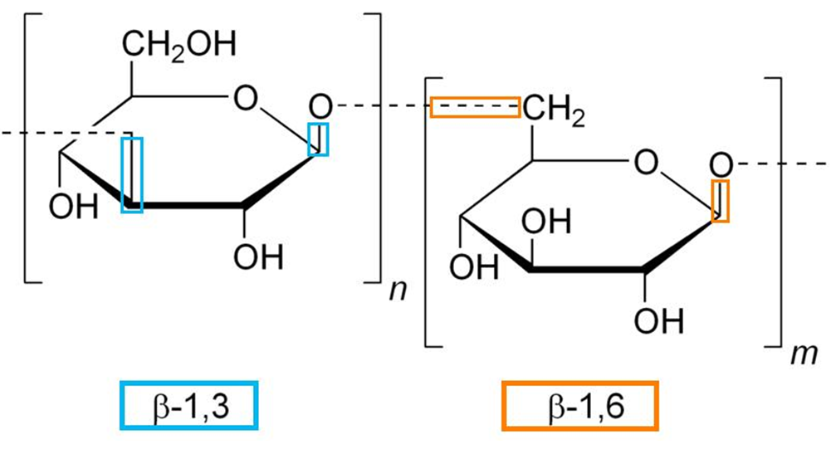
Oat
Cultivated increasingly as a promising healthy food crop
High protein, lysine, fibre and β-glucan
Fibre and β-glucan coloratory health

Slide 3
Objectives
Understand the effects of location and N fertilization on the yield and quality of Quaker preferred oat cultivars
Determine site-specific maximum economic rate of N (MERN)
Identify suitable cultivar x N application rates for improving β-glucan and yield in specific locations.

Slide 4
Materials and Methods
Cultivars:
  10 varieties in all location-years
N rates: 0, 50, 100, and 150 kg N ha⁻¹
3 locations: Ottawa, Normandin, Melfort
Split-plot design with 3-4 replications

Slide 5
Measurements
Soil basic fertility (OM, pH, available NPK)
Belgian lodging score index
Biomass at heading
Canopy reflectance with GreenSeeker
Yield and yield components, harvest index
Grain and straw N and P concentrations
Groat yield
Groat protein, oil, and β-glucan concentrations

Slide 6
RESULTS

Slide 7
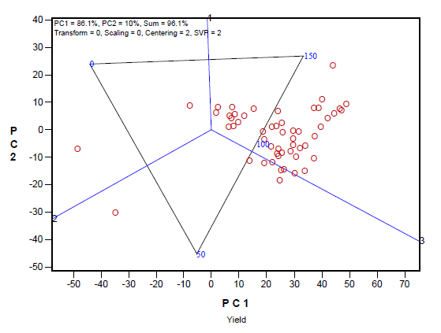
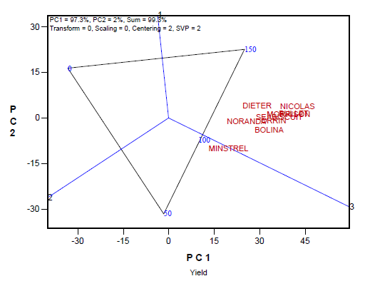
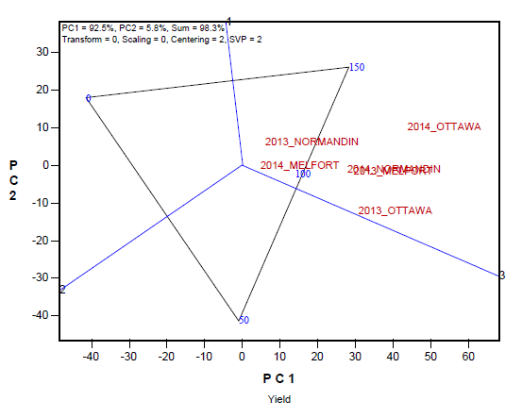
A
B
C
Yield at different N rates A) in individual genotype-trial combinations, B) for individual genotypes across trials, and C) in individual trials across genotypes
Notes:
A: most of the circles are placed in the biplot sector in which the 150 kg N ha-1 rate is at the vertex, meaning that most genotype-environment combinations had their highest grain yield at this N rate. A few circles are placed in the 0 or 50 kg N ha-1 sector, indicating N rate and genotype or N rate and environment interactions
B: C x N interaction _ most genotypes had their highest yield at the 150 kg N ha-1 rate; CDC Minstrel reached its highest yield under the 100 kg N ha-1 rate
C: N x E differences in grain yield among the 50, 100, and 150 kg N ha-1 rates were quite small in Melfort in 2014 and Ottawa in 2013

Slide 8
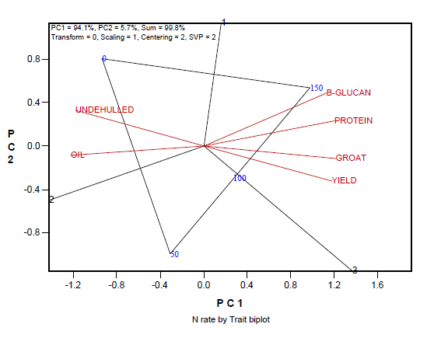
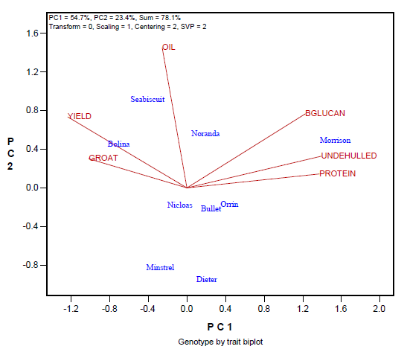
A
B
Associations among yield, groat, b-glucan, protein, oil, and undehulled kernels across A) N rates and B) genotypes
Notes:
A: increased N fertilizer from 0 to 150 kg ha⁻¹ led to significantly higher levels of grain yield (38.1% ), groat (1.8%), β-glucan (3%), and protein (13.5%and significantly lower levels of oil (4.4%) and undehulled kernels (71%). All these effects are favorable for milling oat
B: unfavorable correlations across genotypes (the positive correlation between β-glucan and undehulled kernels, the negative correlation between β-glucan and protein on one hand and yield and groat on the other), e.g. Morrison good for b-glucan, low yield; Bolina the opposite

Slide 9
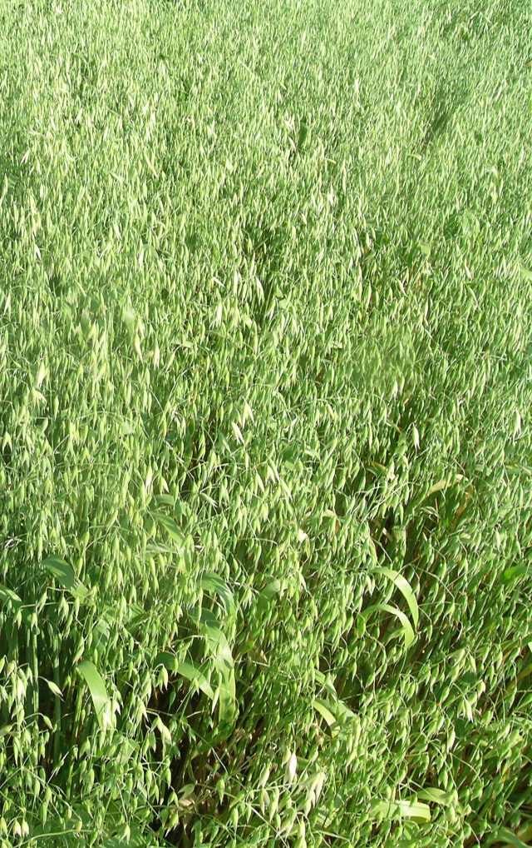
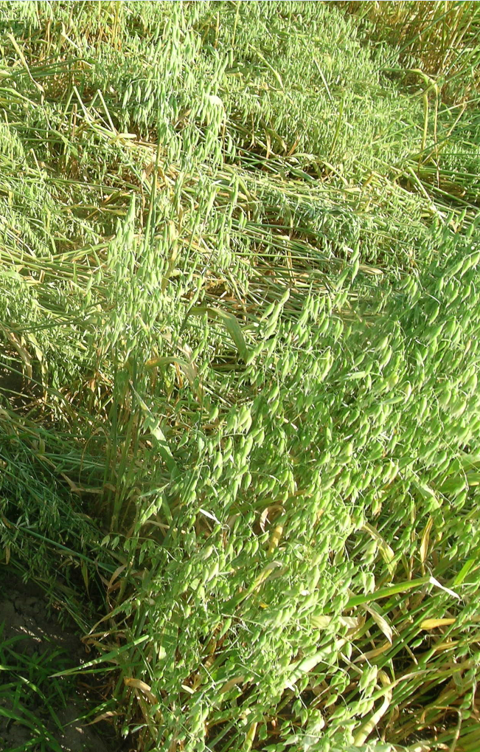
Notes:
Lodging: main constraint for increasing oat yield and quality under favorable weather; limits the effectiveness of fertilizer N in maximizing grain yield; due reduced light penetration through the canopy, reduced Pn, and DM translocation to filling the grain, causing diseases and making harvest unduly difficult.

Slide 10
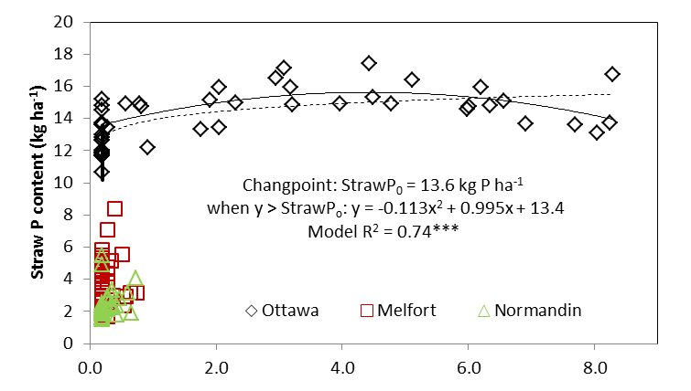
Belgian Lodging Index
Ma, B.L., Z.M. Zheng, D. Pageau, C. Vera, J. Fregeau-Reid, A. Xue, and W. Yan. 2017. Nitrogen and phosphorus uptake, yield and agronomic traits of oat cultivars as affected by fertilizer N rates under diverse environments. Nutr. Cycl. Agroecosyst. 108:245-265
Notes:
Dry matter accumulation, yield and plant N and P uptake were positively responsive to fertilizer N rates.
However, crop lodging was the key trait limiting oat grain yield response to N application, and lodging was site- and cultivar-specific.
Straw P content, stimulated by high N supply, was likely associated with crop lodging, and lodging occurred only when straw P was > 13.6 kg P ha-1.

Slide 11
Summary
High rates of N simultaneously increased grain yield, milling quality (high groat content, low undehulled kernels), and compositional quality (high β-glucan, high protein, and low oil content).
High N rates also induced crop lodging. Crop lodging is associated with nutrient uptake; a changing point is identified for straw P.
Multi-site-year study (2018-22) is planned to identify optimal N application rate and method (PP vs. SP) to achieve high and stable oat yield and groat quality.

Slide 12
Canola
Canola, a made-in-Canada cash crop
Low erucic acid (< 2%) in oil, low glucosinolates (< 30 µmol/g) in the meal
3.47 mil ac in 1961, now 20.61 mil ac in 2016
$26 billion (CAN) industry
A minor crop in Eastern Canada

Slide 13
Objectives
Identify nutrient deficiencies through plant and soil determinations with consideration of genotype by environment by management interactions for improved NUE and yield.
Determine a threshold level of micronutrient B deficiency and nutrient balance (N:S) in canola production.
Develop improved guidelines for canola site-specific nutrient management.

Slide 14
Materials and Methods
A 4-year study (2013-2016).
Field experiment: 8 combinations of timing (PP vs. SP) and rates of N (0, 50, 100, 150, 200, 50+50, 50+100, 50+150 kg ha⁻¹).
Test sites:
  AAFC – ORDC, Ottawa, ON
  University of Guelph, Elora, ON
  McGill University, QC
  Laval University, QC
  Dalhousie University, Canning, NS

Slide 15
RESULTS

Slide 16
Yield
Seed yields increased with the amount of N applied both preplant (PP) and split-N (SP).
At 16 of the 20 site-years, SP application (50+50, 50+100, 50+150 kg N ha⁻¹) had greater yields than the plots receiving the same amount of N only at PP.
Regression analysis indicates that seed yield increased by 17.2 kg ha⁻¹ for each kg ha⁻¹ N applied as SP, compared to 14.9 kg ha⁻¹ for PP application.

Slide 17
MERN Calculation
MERN calculated for each site-year that showed a positive yield response to N.
Yield as a function of N rate, and quadratic polynomial equations created for each method.
B value ($1/kg N /canola
$0.55/kg was used to
determine MERN for
each site-year.
SP-MERN
PP-MERN

Slide 19
Conclusions
Sidedress N at the rosette stage, did seem to improve yields, compared to the same amount of N all applied at preplant.
A location-sensitive MERN recommendation is important to achieve profitable and environmentally sustainable canola production in Eastern Canada.
Using sensors such as Greenseeker can be a promising method to improve NUE. Need to derive an algorithm for sidedress application, which is sensitive to the environment.

Slide 20
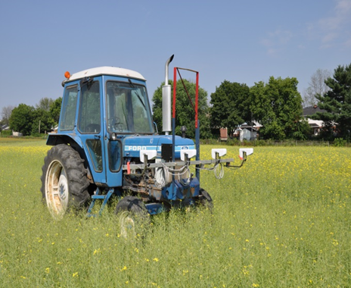
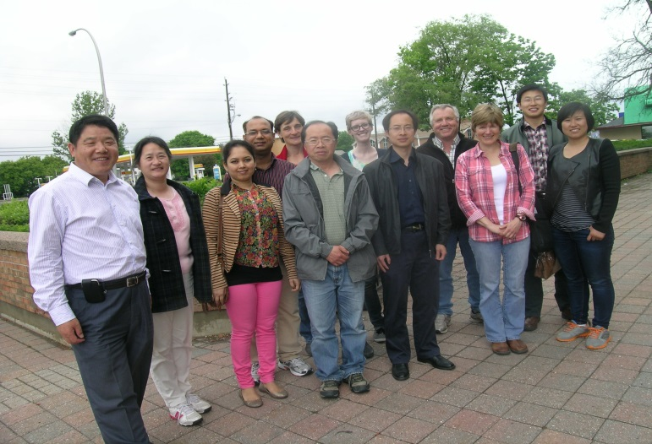

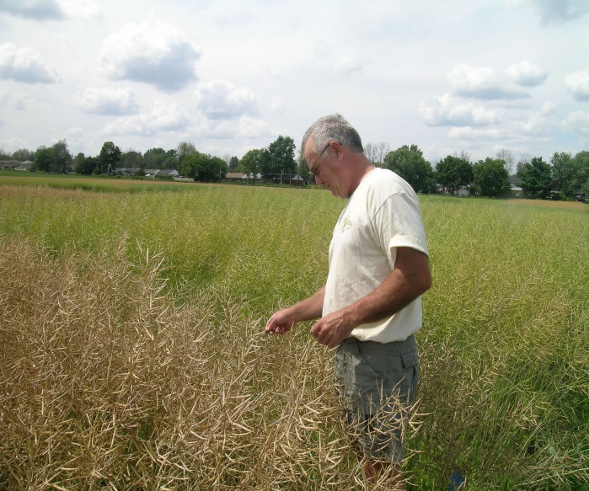
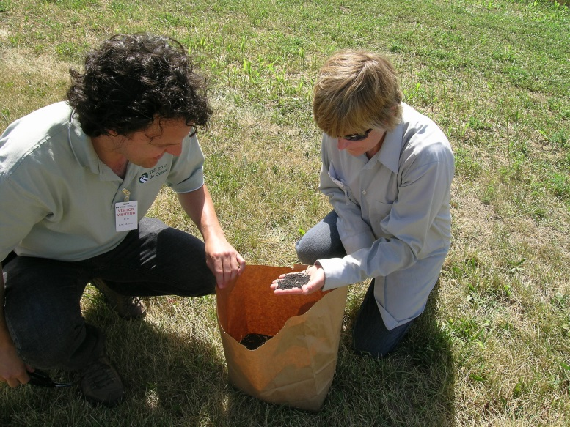
Acknowledgements
Financial support:
  AAFC – Growing Forward II AIP
  Eastern Canada Oilseed Research Alliance (ECODA)
Research Teams: Smith, Vanasse, Caldwell, Earl
Technical support staff, PDF and students

Slide 21
THANK YOU
Any
Questions ?

