Slide 1



Nitrogen use efficiency in corn:
A Review & new Research
Ignacio A. Ciampitti, Associate Professor,
Cropping Systems Specialist
K-State Research & Extension
ciampitti@ksu.edu, 785-410-9354
@KSUCROPS (TWITTER/FACEBOOK)

Slide 2
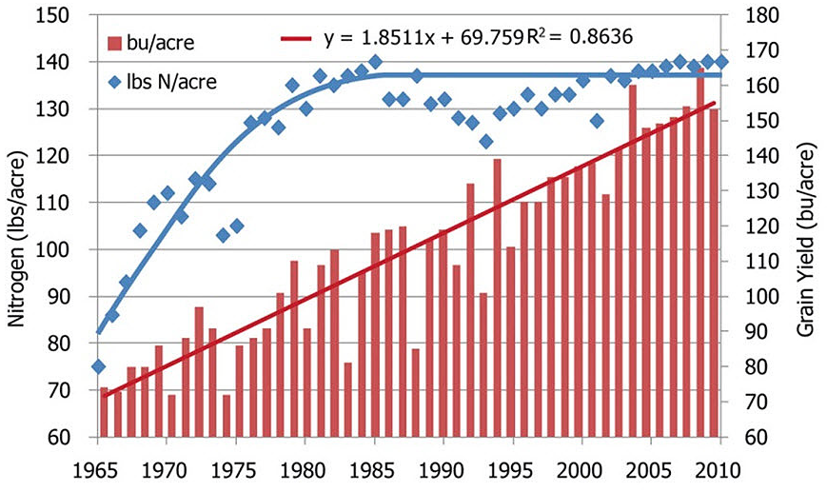

Historical N and Grain Yield Changes
USDA Source; Pioneer Website
© IA Ciampitti, K-State Univ

Slide 3
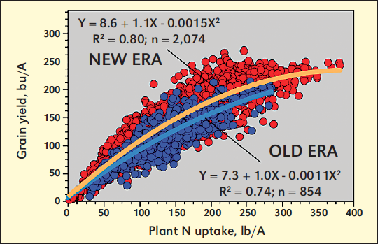
Gap #1: Relationship between Yield and N uptake
Review Paper: 100 reports (~3000 treatment means)
Hybrid Era (1940-1990 vs. 1991-2011)
Community-Level
Ciampitti and Vyn (2012, Review Paper, Field Crops Research 133, 48-67)
© IA Ciampitti, K-State Univ

Slide 4
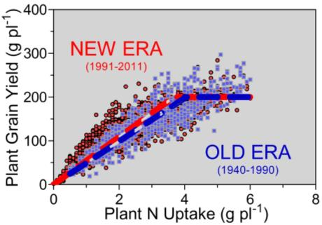
Gap #1: Relationship between Yield and N uptake
Review Paper: 100 reports (~3000 treatment means)
Hybrid Era (1940-1990 vs. 1991-2011)
Plant-Level, adjusted by plant density
Grain yield vs. plant N uptake relationship was very similar for both OLD vs. NEW corn hybrids.
NEW ERA presented a slightly greater efficiency (higher slope) and lower N uptake to reach maximum YIELD
(but similar plateau for maximum YIELD and N uptake).
Ciampitti and Vyn (2012, Review Paper, Field Crops Research 133, 48-67)
© IA Ciampitti, K-State Univ

Slide 5
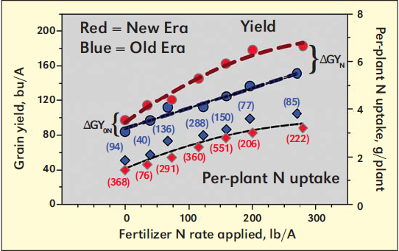
Gap #2: Yield and Plant N Uptake versus N rate
Review Paper: Hybrid Era (1940-1990 vs. 1991-2011)
~15
Bu a⁻¹
~30
Bu a⁻¹
Ciampitti and Vyn (2012, Review Paper, Field Crops Research 133, 48-67)
© IA Ciampitti, K-State Univ
Notes:
Last point of plant N uptake is 3.8 for New versus 3.2 for Old Era, but the slope (model) is equivalent for both Eras.

Slide 6
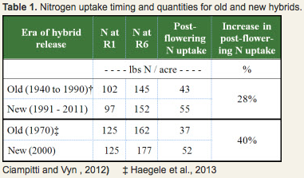
GAP #3: Post-Flowering N Uptake
Pioneer website
Greater post-flowering N uptake was observed when OLD vs. NEW corn HYBRIDS were compared. Overall an increase of 30% of post-flowering N UPTAKE.
© IA Ciampitti, K-State Univ

Slide 7
In summary, historical corn NUE improvements…
Yields
Harvest Index
Biomass
N uptake
N harvest index
Superior N efficiencies were related to higher yields, lowering
Grain %N
© IA Ciampitti, K-State Univ

Slide 8
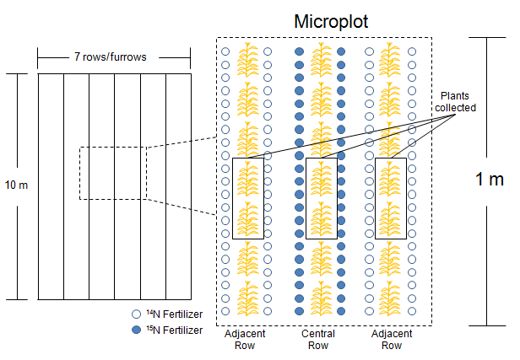
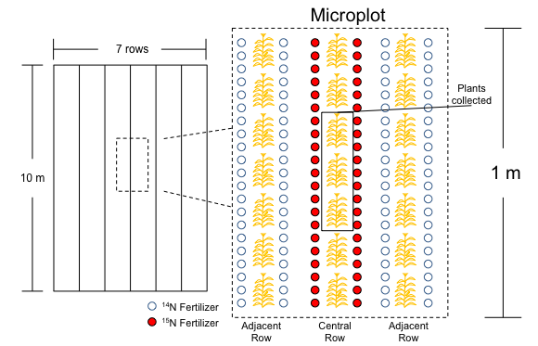
New Research on Isotopic-labeled N in corn
1) Fertilizer N Recovery Efficiency
Study timing of N fertilization in corn - applied in the cover crop, at planting for corn, V3, or a combination V3/V6
3) Late-N Application and N sources
2) Foliar N application and N partitioning
Study timing of N fertilization in corn - foliar application late vegetative in 3 N rates
Study timing of N fertilization x hybrid in corn - applied at flowering and 2-weeks after flowering x 3 hybrids (1990s, 2000’s, and 2010’s)
© IA Ciampitti, K-State Univ

Slide 9
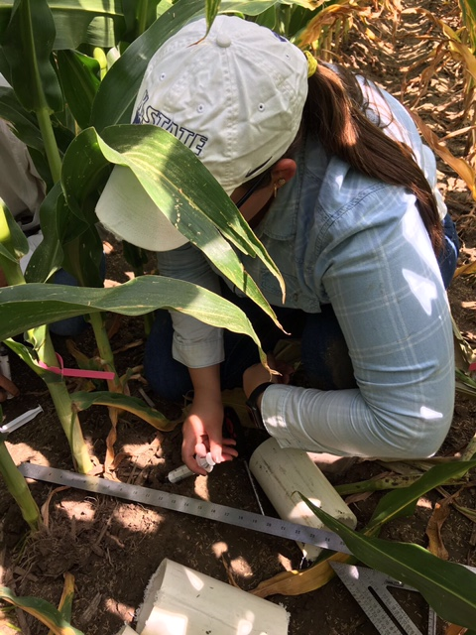
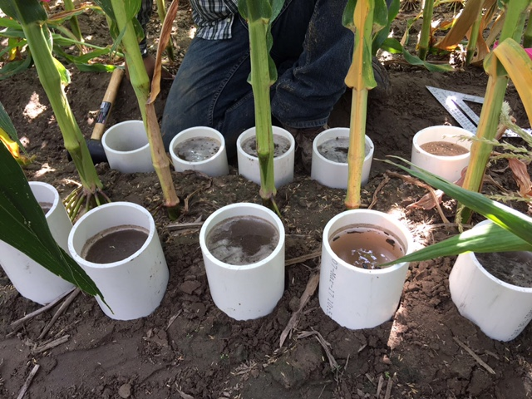
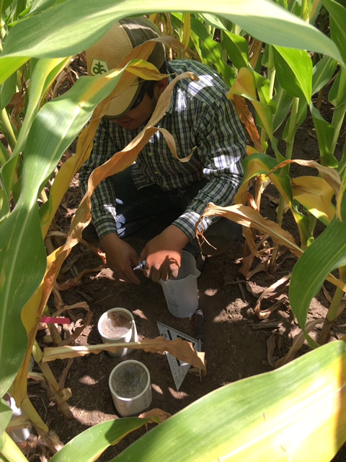
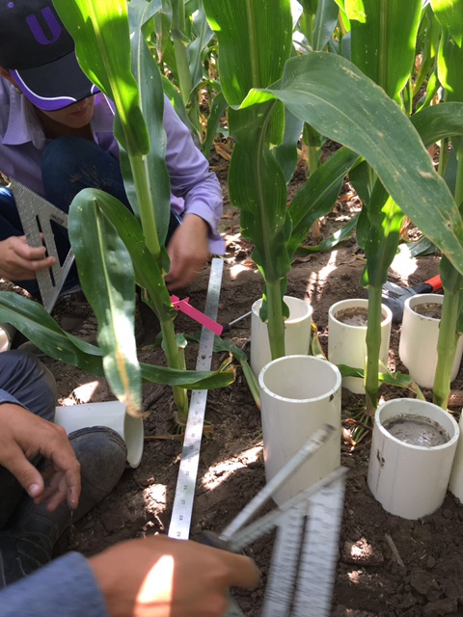
New Research on Isotopic-labeled N in corn
© IA Ciampitti, K-State Univ

Slide 10
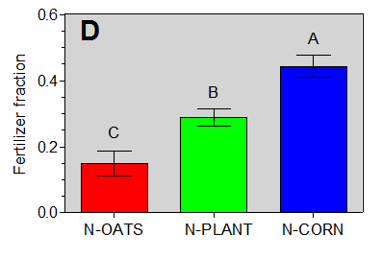
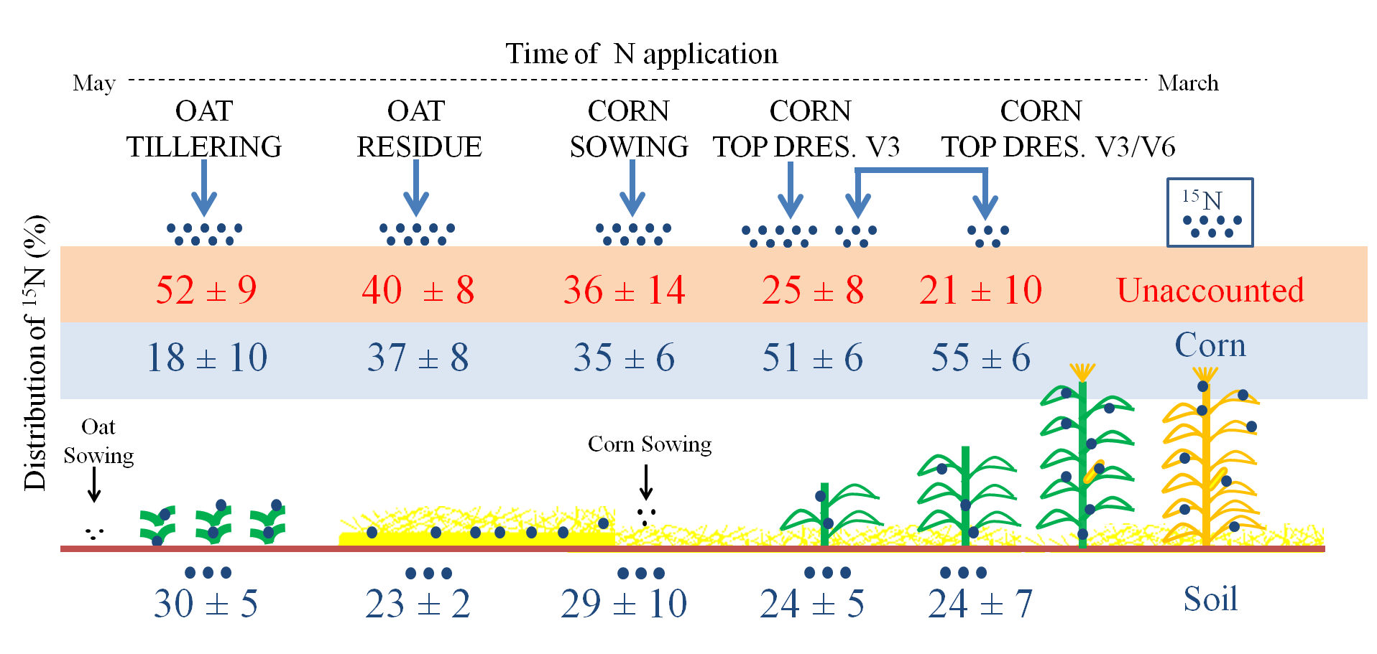
1) Fertilizer N Recovery Efficiency
The fertilizer fraction recovered increased as the fertilizer N timing was applied later in the season.
© IA Ciampitti, K-State Univ

Slide 11
2) Foliar N application and N partitioning
2013, 90 bu/acre
For the lower yield environment, the % of N partitioned to the grain increased as the foliar N rate was reduced (from close to 30 to +80%).
2014, 150 bu/acre
For the superior yield environment, the % of N partitioned to the grain was still larger as compared with the N in the shoot organ but ranging from 28 to 43% 15N allocated to the grain organ.
© IA Ciampitti, K-State Univ

Slide 12
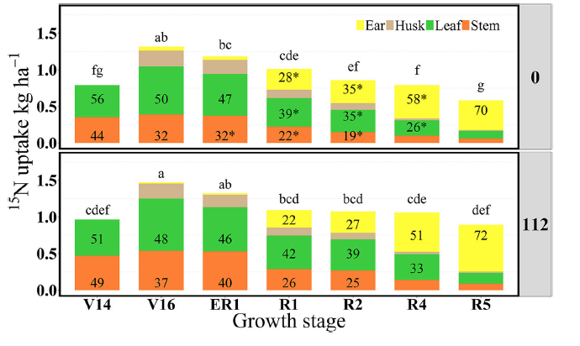
3) Late-N Application and N sources
Studying N partitioning (Oliveira; Vyn et al., 2017)
As 15N fertilizer was applied late in the season, proportionally +N was allocated to the grain in detriment to the stem %N in the zero N treatment compared to the 112 lbs/a – (continuing until R4)*
Late-N and Grain-fill in corn (Fernandez; Ciampitti et al.)
Evolution (every 3-4 days) of changes in grain dry weight and water volume changes during the grain filling to understand if late N can still impact final grain weight via “longer duration” or “higher rate” or combination of both.
© IA Ciampitti, K-State Univ

Slide 13
General Conclusions
From the REVIEW analysis:
GAP #1: On per-plant basis, nutrient uptake at maturity had not changed between Eras despite changes in modern hybrids.
GAP #2: Improvement in historical yield were also accompanied by greater fertilizer N response.
GAP #3: Greater post-flowering N uptake for MODERN hybrids.
In summary, from the plant perspective, improvements in NUE were primarily resulted from the grain N dilution.
From the NEW research (isotopic-labeled N):
Research #1: Improving synchrony (supply-demand), +NRE.
Research #2: Foliar N application did not change yields, but +N was allocated to the grains when plant was more deficient.
Research #3: Similar to #2, but showing depression on %stem N.
© IA Ciampitti, K-State Univ
Notes:
Thus, progress on this trait should be pursued.

Slide 14



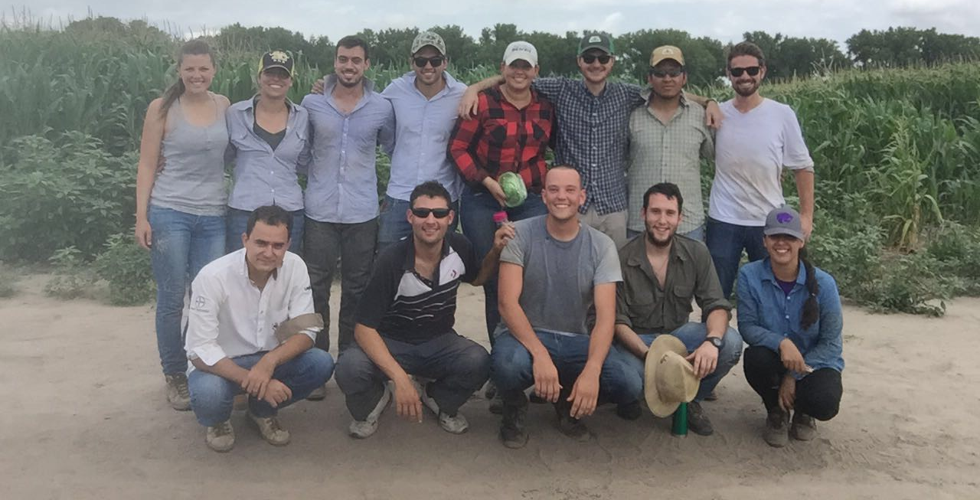

QUESTIONS. THANKS!
Ignacio A. Ciampitti
Associate Professor, K-State University
Cropping Systems Specialist
ciampitti@ksu.edu
@KSUCROPS
/KSUCROPS
© K-State Univ, IA Ciampitti
Dr. Ignacio Antonio Ciampitti • Assistant Professor Crop Production/ Cropping Systems • Agronomy Department • Kansas State University

Slide 15
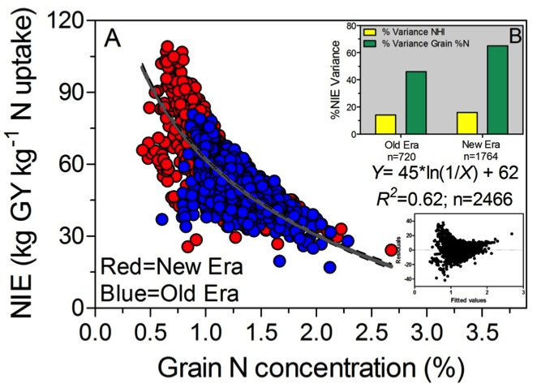
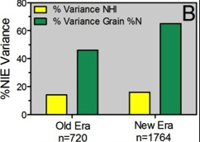
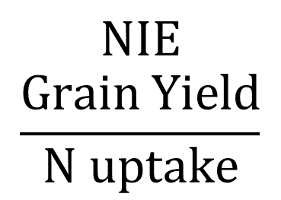
Gap #3: Effect on NIE and Grain N Concentration
Review Paper: Hybrid Era (1940-1990 vs. 1991-2011)
$$NIE$$
$$\frac{Grain \text{Yield}}{N \text{uptake}}$$
Ciampitti and Vyn (2012, Review Paper, Field Crops Research 133, 48-67)
© IA Ciampitti, K-State Univ

Slide 16
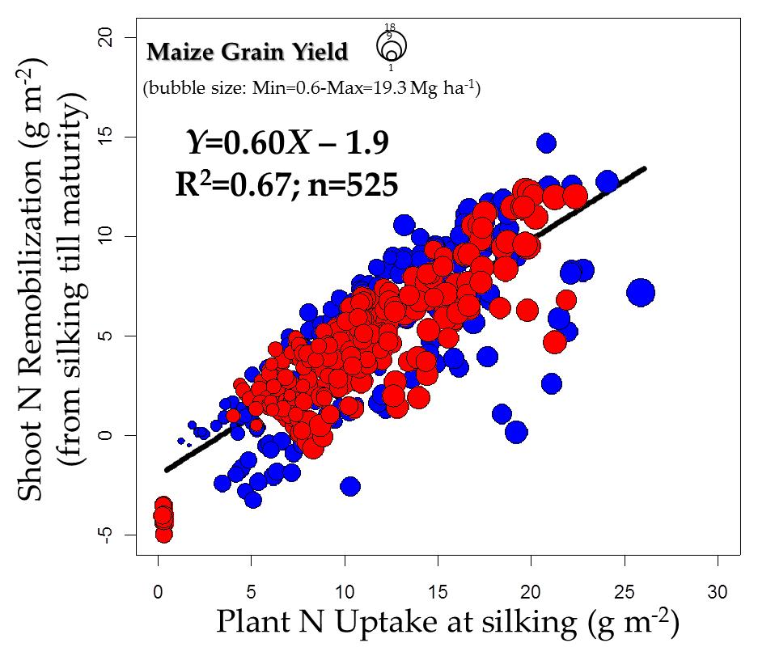
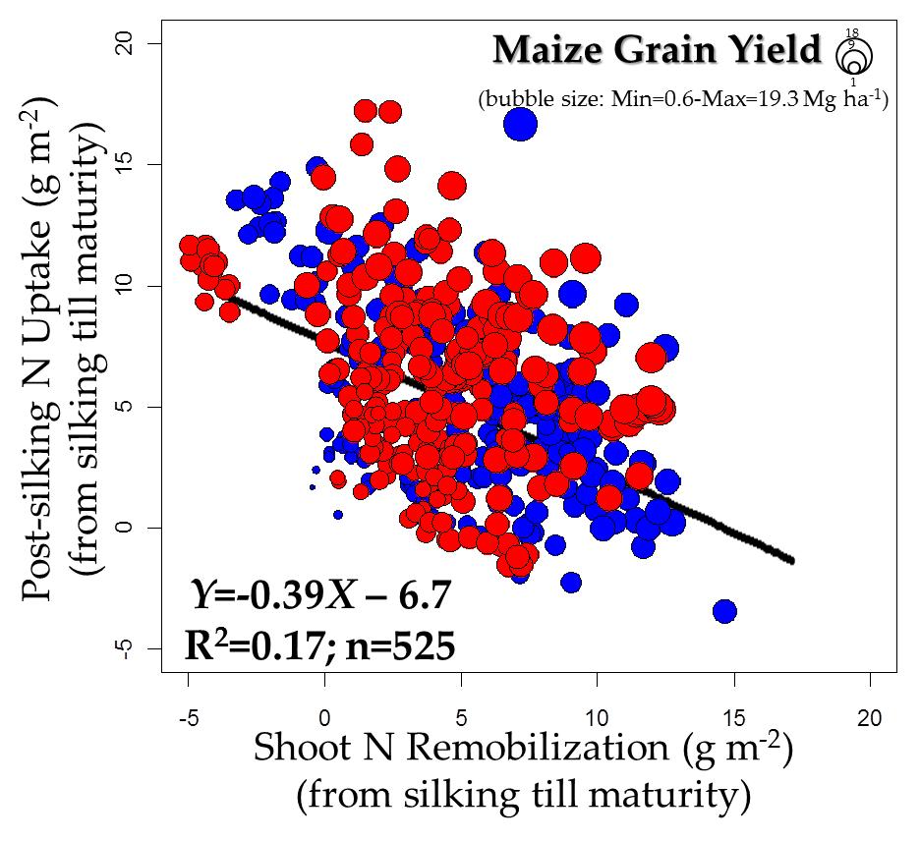
GAP #4: Post-Flowering N Uptake
Effects on vegetative and reproductive N uptake versus the reproductive shoot N remobilization?
Review Investigation
NEW ERA
(1991-2011)
NEW ERA
(1991-2011)
OLD ERA
(1940-1990)
OLD ERA
(1940-1990)
GAP #4: Shoot N remobilization was more associated with
vegetative rather than with reproductive N uptake (≠ trends).
© IA Ciampitti, K-State Univ

