Slide 1

World Phosphorus Use Efficiency in Cereal Crops
Jagman Dhillon,
Guilhereme Torres, Ethan Driver,
Bruno Figueiredo, and William Raun
August 8, 2017
15th Annual NUE Conference, LSU.
Dhillon, J., G. Torres, E. Driver, B. Figueiredo, and W. R. Raun. 2017. World Phosphorus Use Efficiency in Cereal Crops. Agron. J. 109:1670-1677. doi:10.2134/agronj2016.08.0483

Slide 2
Introduction
Phosphorus is the second most limiting nutrient in crop production
Essential component of
  Adenosine triphosphate (ATP), energy currency that drives most biochemical processes
  Deoxyribonucleic acid (DNA), seat of genetic inheritance
  Ribonucleic acid (RNA), direct protein synthesis in both plants and animals
  Phospholipids, critical role in cellular membrane

Slide 3
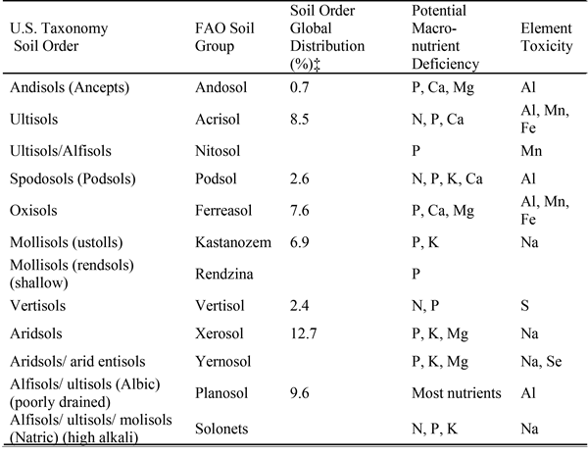
Nearly 67% of land designated for crop production is P deficient (Batjes 1997)
Soil orders with potential P deficiency account for 51% of the world soils (Brady and Weil, 2008)
Data from Baligar et al.(2001)

Slide 4
Soil P Cycle
Plant Uptake
Root uptake
Residue return to the soil
Form 3 – Soluble
Soil Solution
< 1%
Immobilization
“Tie-up”
Weathering
Microbial Activity
Mineralization
Solubility
Adsorption
“Tie-up”
Form 1 – Organic
Organic matter
40-60%
Form 2 – Inorganic
Mineral compounds
40-60%

Slide 5
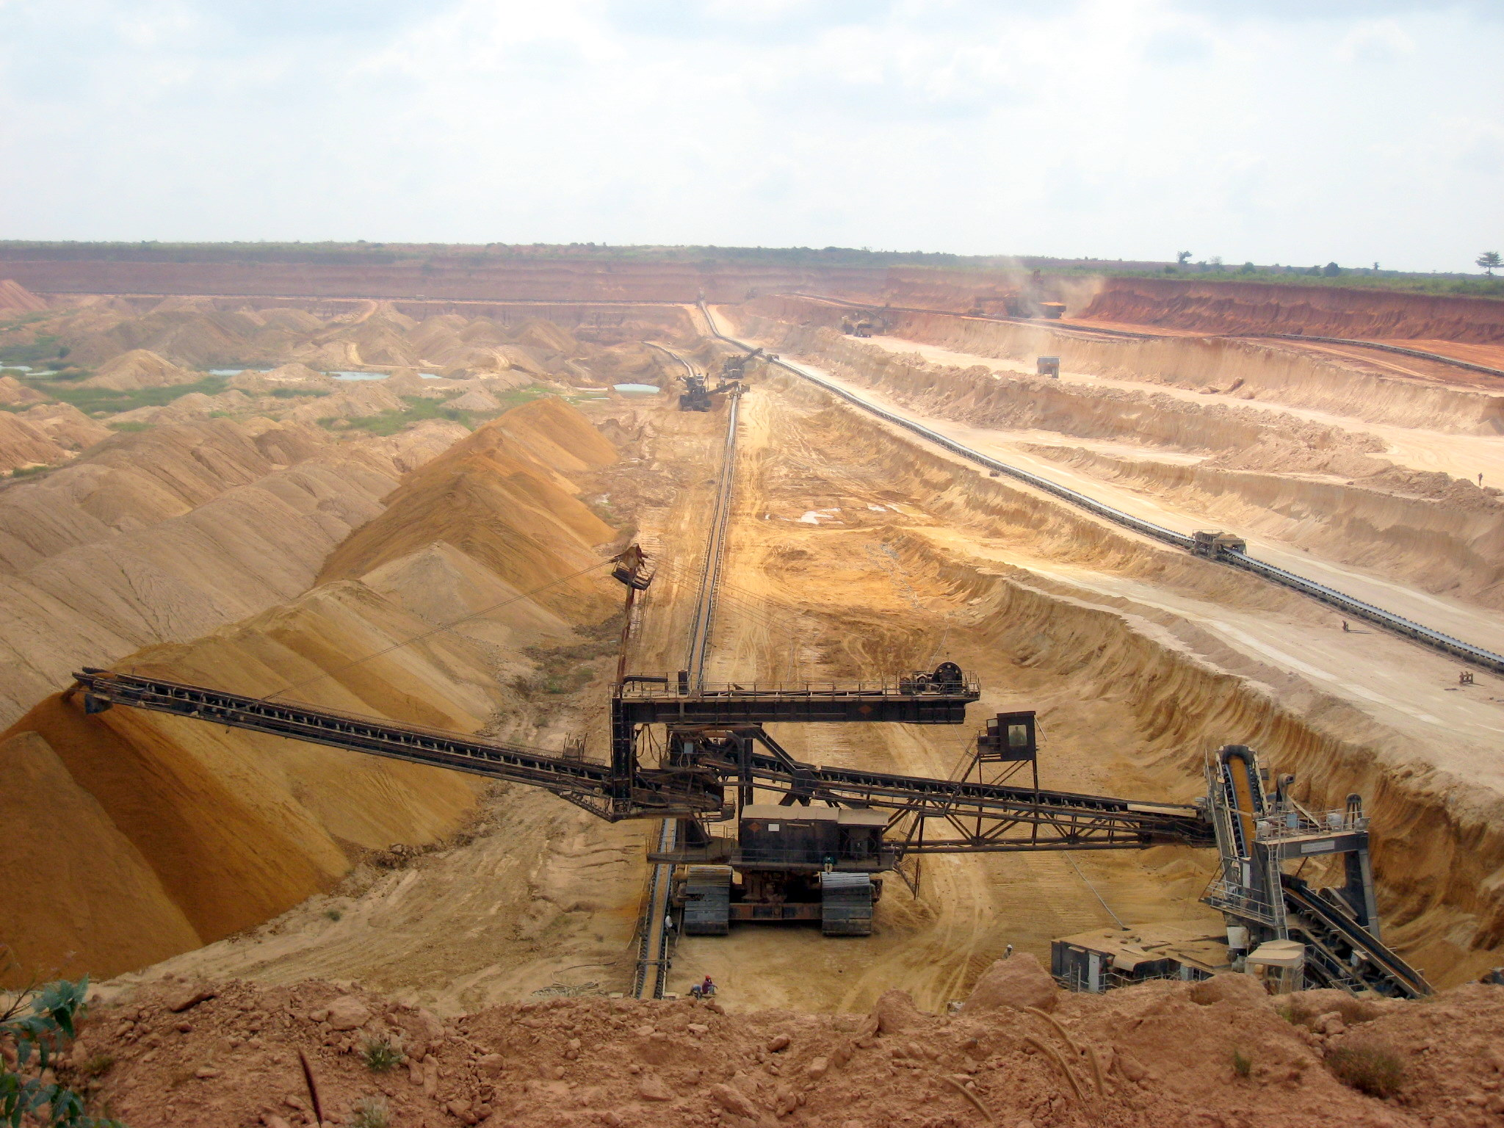
Plant available P concentration is low (0.1 – 10 µM)
For optimal production P fertilizers are required
  Phosphorus mining
Different accounts for life-span of phosphate reserves
P reserves (Years till extinction) | Reference
50-100 | Smil (2000)
343 | Robert and Stewart (2002)
100 | Heffer et al. (2006)
300-400 | IFDC (2010)
300 | Van Kauwenbergh et al. (2013)

Slide 6
When P is applied as fertilizer, it quickly becomes unavailable
Only 10 to 15% is available for uptake (within yr)
Developed countries have overused P resulting in environmental pollution (eutrophication, lakes and streams)
Developing countries underuse P fertilizers resulting in Land Degradation
Brady and Weil, 2008

Slide 7
Objective
To estimate global P use efficiency for cereal crops
To review methods for improvement of PUE

Slide 8
Materials and Methods
Fifty-three years of world cereal harvested area, cereal production, and world fertilizer P consumption data was obtained from the FAOSTAT database.
Cereal crops included maize, rice, wheat, sorghum, barley, millet, oats, rye, triticale, canary seeds, buckwheat, mixed grains, and quinoa.
P uptake of cereal grain was calculated using crop specific grain P content obtained from the United States Department of Agriculture (USDA).
‘summary’ and ‘means’ procedures in SAS were used to calculate descriptive statistics.

Slide 9
P use efficiency was calculated using
Balance method
  𝑃𝑈𝐸_𝐵=(𝐶𝑒𝑟𝑒𝑎𝑙 𝐺𝑟𝑎𝑖𝑛 𝑃 𝑈𝑝𝑡𝑎𝑘𝑒)/(𝑃 𝐹𝑒𝑟𝑡𝑖𝑙𝑖𝑧𝑒𝑟 𝐴𝑝𝑝𝑙𝑖𝑒𝑑 𝑖𝑛 𝐶𝑒𝑟𝑒𝑎𝑙 𝐶𝑟𝑜𝑝𝑠)∗100
Difference method
  𝑃𝑈𝐸_𝐷=(𝐶𝑒𝑟𝑒𝑎𝑙 𝐺𝑟𝑎𝑖𝑛 𝑃 𝑈𝑝𝑡𝑎𝑘𝑒−𝑃 𝑅𝑒𝑚𝑜𝑣𝑒𝑑 𝑓𝑟𝑜𝑚 𝑡ℎ𝑒 𝑆𝑜𝑖𝑙)/(𝑃 𝐹𝑒𝑟𝑡𝑖𝑙𝑖𝑧𝑒𝑟 𝐴𝑝𝑝𝑙𝑖𝑒𝑑 𝑖𝑛 𝐶𝑒𝑟𝑒𝑎𝑙 𝐶𝑟𝑜𝑝𝑠)∗100
P removed in the grain coming from the soil was calculated by multiplying the total cereal grain P removed by 79.3%. This value was based on P fertilizer recovery of 20.7% reported in various studies using difference and direct methods.

Slide 10
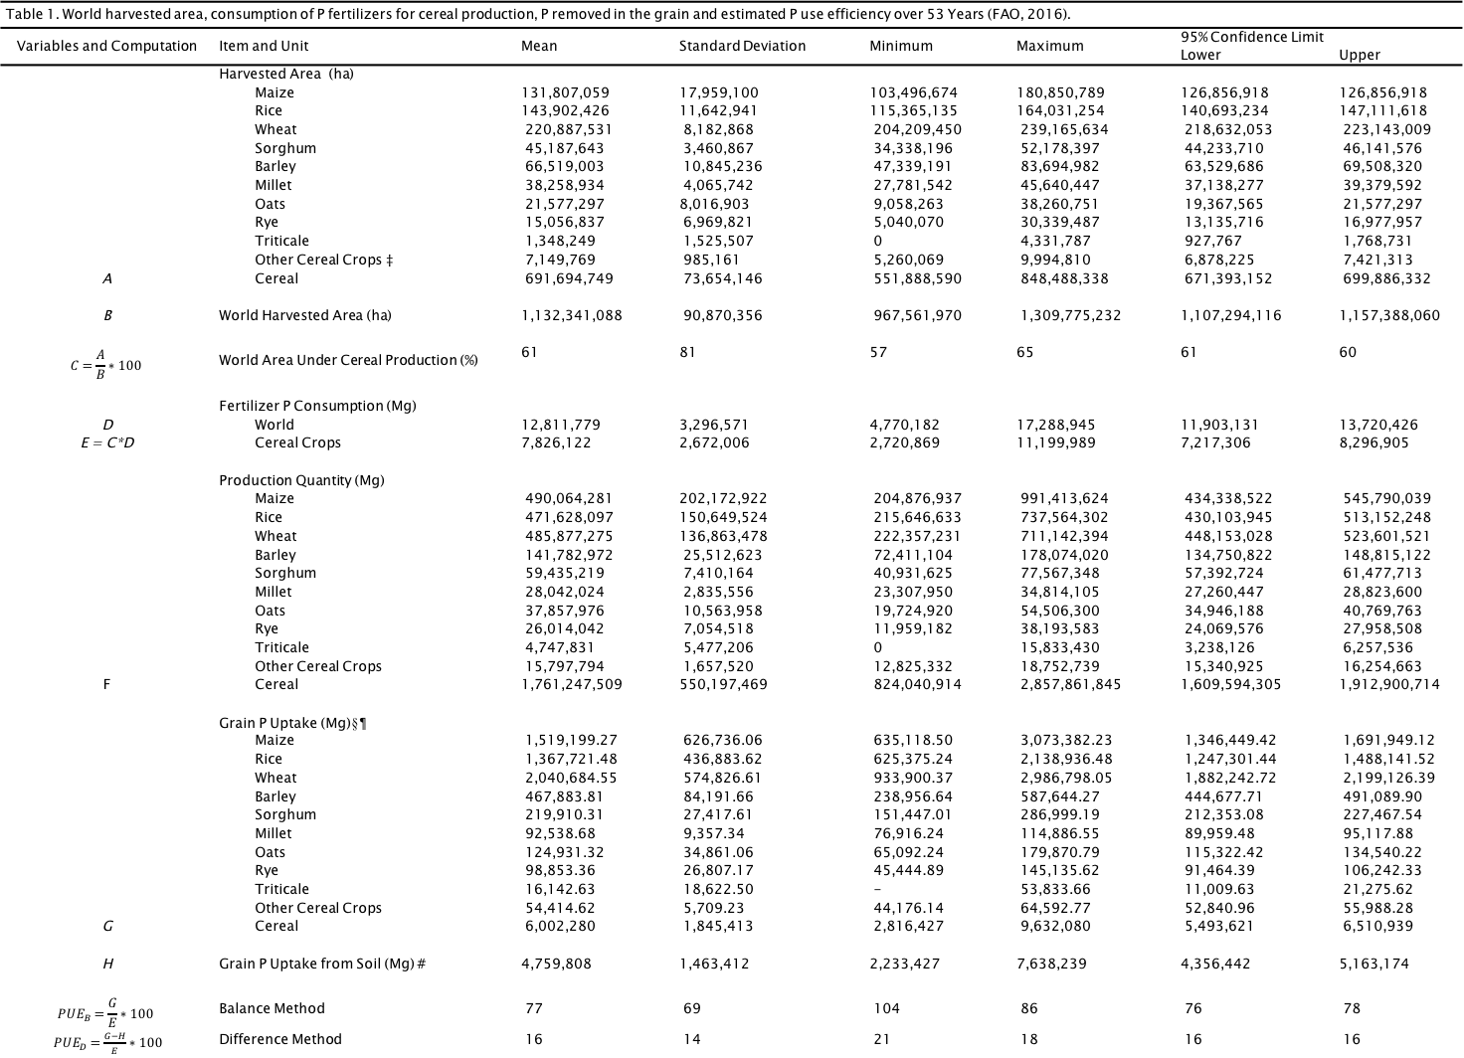
Results
Table 1. World harvested area, consumption of P fertilizers for cereal production, P removed in the grain and estimated P use efficiency over 53 Years (FAO, 2016).
Variables and Computation | Item and Unit | Mean | Standard Deviation | Minimum | Maximum | 95% Confidence Limit
 |  |  |  |  |  | Lower | Upper
 | Harvested Area (ha)
 | Maize | 131,807,059 | 17,959,100 | 103,496,674 | 180,850,789 | 126,856,918 | 126,856,918
 | Rice | 143,902,426 | 11,642,941 | 115,365,135 | 164,031,254 | 140,693,234 | 147,111,618
 | Wheat | 220,887,531 | 8,182,868 | 204,209,450 | 239,165,634 | 218,632,053 | 223,143,009
 | Sorghum | 45,187,643 | 3,460,867 | 34,338,196 | 52,178,397 | 44,233,710 | 46,141,576
 | Barley | 66,519,003 | 10,845,236 | 47,339,191 | 83,694,982 | 63,529,686 | 69,508,320
 | Millet | 38,258,934 | 4,065,742 | 27,781,542 | 45,640,447 | 37,138,277 | 39,379,592
 | Oats | 21,577,297 | 8,016,903 | 9,058,263 | 38,260,751 | 19,367,565 | 21,577,297
 | Rye | 15,056,837 | 6,969,821 | 5,040,070 | 30,339,487 | 13,135,716 | 16,977,957
 | Triticale | 1,348,249 | 1,525,507 | 0 | 4,331,787 | 927,767 | 1,768,731
 | Other Cereal Crops ‡ | 7,149,769 | 985,161 | 5,260,069 | 9,994,810 | 6,878,225 | 7,421,313
A | Cereal | 691,694,749 | 73,654,146 | 551,888,590 | 848,488,338 | 671,393,152 | 699,886,332
B | World Harvested Area (ha) | 1,132,341,088 | 90,870,356 | 967,561,970 | 1,309,775,232 | 1,107,294,116 | 1,157,388,060
$$C=\frac{A}{B}∗100$$ | World Area Under Cereal Production (%) | 61 | 81 | 57 | 65 | 61 | 60
 | Fertilizer P Consumption (Mg)
D | World | 12,811,779 | 3,296,571 | 4,770,182 | 17,288,945 | 11,903,131 | 13,720,426
E = C*D | Cereal Crops | 7,826,122 | 2,672,006 | 2,720,869 | 11,199,989 | 7,217,306 | 8,296,905
 | Production Quantity (Mg)
 | Maize | 490,064,281 | 202,172,922 | 204,876,937 | 991,413,624 | 434,338,522 | 545,790,039
 | Rice | 471,628,097 | 150,649,524 | 215,646,633 | 737,564,302 | 430,103,945 | 513,152,248
 | Wheat | 485,877,275 | 136,863,478 | 222,357,231 | 711,142,394 | 448,153,028 | 523,601,521
 | Barley | 141,782,972 | 25,512,623 | 72,411,104 | 178,074,020 | 134,750,822 | 148,815,122
 | Sorghum | 59,435,219 | 7,410,164 | 40,931,625 | 77,567,348 | 57,392,724 | 61,477,713
 | Millet | 28,042,024 | 2,835,556 | 23,307,950 | 34,814,105 | 27,260,447 | 28,823,600
 | Oats | 37,857,976 | 10,563,958 | 19,724,920 | 54,506,300 | 34,946,188 | 40,769,763
 | Rye | 26,014,042 | 7,054,518 | 11,959,182 | 38,193,583 | 24,069,576 | 27,958,508
 | Triticale | 4,747,831 | 5,477,206 | 0 | 15,833,430 | 3,238,126 | 6,257,536
 | Other Cereal Crops | 15,797,794 | 1,657,520 | 12,825,332 | 18,752,739 | 15,340,925 | 16,254,663
F | Cereal | 1,761,247,509 | 550,197,469 | 824,040,914 | 2,857,861,845 | 1,609,594,305 | 1,912,900,714
 | Grain P Uptake (Mg)§¶
 | Maize | 1,519,199.27 | 626,736.06 | 635,118.50 | 3,073,382.23 | 1,346,449.42 | 1,691,949.12
 | Rice | 1,367,721.48 | 436,883.62 | 625,375.24 | 2,138,936.48 | 1,247,301.44 | 1,488,141.52
 | Wheat | 2,040,684.55 | 574,826.61 | 933,900.37 | 2,986,798.05 | 1,882,242.72 | 2,199,126.39
 | Barley | 467,883.81 | 84,191.66 | 238,956.64 | 587,644.27 | 444,677.71 | 491,089.90
 | Sorghum | 219,910.31 | 27,417.61 | 151,447.01 | 286,999.19 | 212,353.08 | 227,467.54
 | Millet | 92,538.68 | 9,357.34 | 76,916.24 | 114,886.55 | 89,959.48 | 95,117.88
 | Oats | 124,931.32 | 34,861.06 | 65,092.24 | 179,870.79 | 115,322.42 | 134,540.22
 | Rye | 98,853.36 | 26,807.17 | 45,444.89 | 145,135.62 | 91,464.39 | 106,242.33
 | Triticale | 16,142.63 | 18,622.50 | - | 53,833.66 | 11,009.63 | 21,275.62
 | Other Cereal Crops | 54,414.62 | 5,709.23 | 44,176.14 | 64,592.77 | 52,840.96 | 55,988.28
G | Cereal | 6,002,280 | 1,845,413 | 2,816,427 | 9,632,080 | 5,493,621 | 6,510,939
H | Grain P Uptake from Soil (Mg) # | 4,759,808 | 1,463,412 | 2,233,427 | 7,638,239 | 4,356,442 | 5,163,174
$$PUE_{B}=\frac{G}{E}∗100$$ | Balance Method | 77 | 69 | 104 | 86 | 76 | 78
$PUE_{D}=\frac{G−H}{E}∗100$ | Difference Method | 16 | 14 | 21 | 18 | 16 | 16

Slide 11
Fertilizer Consumption

Slide 12
Phosphorus use efficiency

Slide 13
Phosphorus use efficiency

Slide 14
Conclusions
It was estimated that cereal production accounts for 61% of the total harvested cropland.
Cereal grain yields increased 3x from 1961 to 2013.
P fertilizer consumption increased by 3.5x since 1961. (is more being applied than is removed?)
P use efficiency estimated using the balance method was 77%.
Using the difference method, PUE for cereal production in the world was estimated to be 16%.

Slide 15
STRATEGIES TO IMPROVE PUE
Technologies: no-till cropping, reduced tillage, crop rotation, terracing, cover crops and wind-breaks can help to reduce water and wind erosion which are significant factors that contribute to low world PUE.
Location and soil | Management | kg P/ha/yr.
 |  | Dissolved P | Particulate P | Total P
El Reno, OK, Paleustolls, 3% slope | Wheat with conventional plow and disk | 0.21 | 3.51 | 3.72
 | Wheat with No till | 1.04 | 0.43 | 1.42
 | Native grass heavily grazed | 0.14 | 0.10 | 0.24
Woodward,OK, Ustochrepts, 8% slope | Wheat with conventional plow and disk | 0.23 | 5.44 | 5.67
 | Wheat with No till | 0.49 | 0.70 | 1.19
 | Native grass heavily grazed | 0.02 | 0.07 | 0.09
Data from Smith et al. (1991)

Slide 16
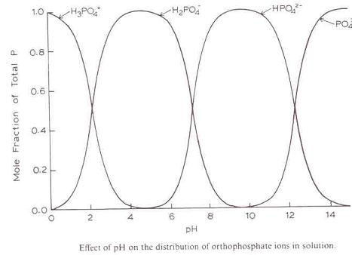
Adjusting soil pH and base saturation to reduce the amount of P that is bound by Al and Fe, reducing the effects of Al toxicity to plants, which can inhibit uptake, and use of P by the plant

Slide 17
Fertilization method, source, rate, time of application and the interaction between these variables can be managed to achieve better PUE.
Precision agriculture technologies such as geographic information systems (GIS), remote sensing and variable rate application can provide more efficient use of P fertilizer.

Slide 18
Questions

