Slide 1
In Search of Optimal On-the-go Nitrogen Application Rates for Cotton
Terry Griffin, PhD, CCA
Cropping Systems Economist
Department of Agricultural Economics
@SpacePlowboy
NUE Conference
Baton Rouge, LA August 8-9, 2017

Slide 2
Lookup table v equation
Ultimate goal:
lookup table of N rec index to
load into automated controller
NDVI | Nrec
0.00 | 10.6
0.05 | 16.1
0.10 | 20.9
0.15 | 24.9
0.20 | 28.2
0.25 | 30.7
0.30 | 32.4
0.35 | 33.5
0.40 | 33.7
0.45 | 33.2
0.50 | 32.0
0.55 | 30.0
0.60 | 27.2
0.65 | 23.7
0.70 | 19.4
0.75 | 14.4
0.80 | 8.6
0.85 | 2.1
0.90 | 0.0
0.95 | 0.0
1.00 | 0.0

Slide 3
Pooled Analysis of Combined Primary Data across Multiple States and Investigators for the Development of a NDVI-Based On-the-Go Nitrogen Application Algorithm for Cotton. Annual Meeting of the American Society of Agricultural and Biological Engineers. Paper No. 1900279
Continuation of 2014 ASABE paper:
Terry Griffin, Barnes, E.M., Allen, P.A., Andrade-Sánchez, P., Arnall, D.B., Balkcom, K., Barber, L.T., Bauer, P., Bronson, K.F., Buschermohle, M.J., Jones, A.P., Khalilian, A., Ge, Y., Roberson, G., Taylor. R.K., Tubana, B.S., Varco, J.J., Vellidis, G., Vories, E.D., Wilkerson, J.B., and Yin, X.
2014 ASABE and CSBE | SCGAB Annual International Meeting
July 13 – 16, 2014, Montreal, Quebec Canada

Slide 4
Barnes, E.M.,
Allen, P.A.,
Andrade-Sánchez, P.,
Arnall, D.B.,
Balkcom, K.,
Barber, L.T.,
Bauer, P.,
Bronson, K.F.,
Buschermohle, M.J.,
Jones, A.P.,
Khalilian, A.,
Ge, Y.,
Porter, W.,
Roberson, G.,
Taylor. R.K.,
Tubana, B.S.,
Varco, J.J.,
Vellidis, G.,
Vories, E.D.,
Wilkerson, J.B.,
Yin, X.

Slide 5
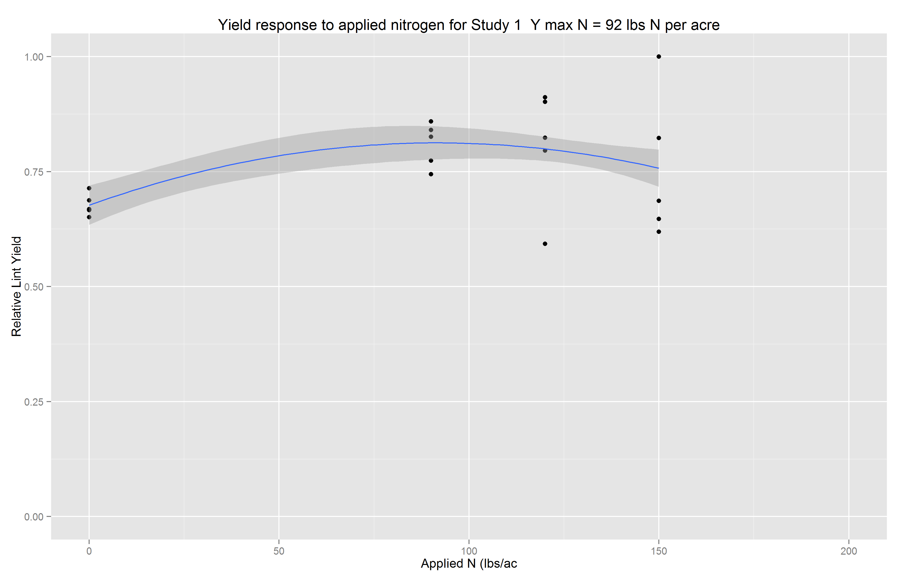
Sub-setting Primary Studies
Identify ‘well-behaved’ studies
$relyld=N+N^{2}$

Slide 6
Confounding Factors: Plant Height

Slide 7
Identifying Optimal Time Period
Dataframe construction
$$relyld=N+N^{2}+NDVI+N∗relheight$$

Slide 8
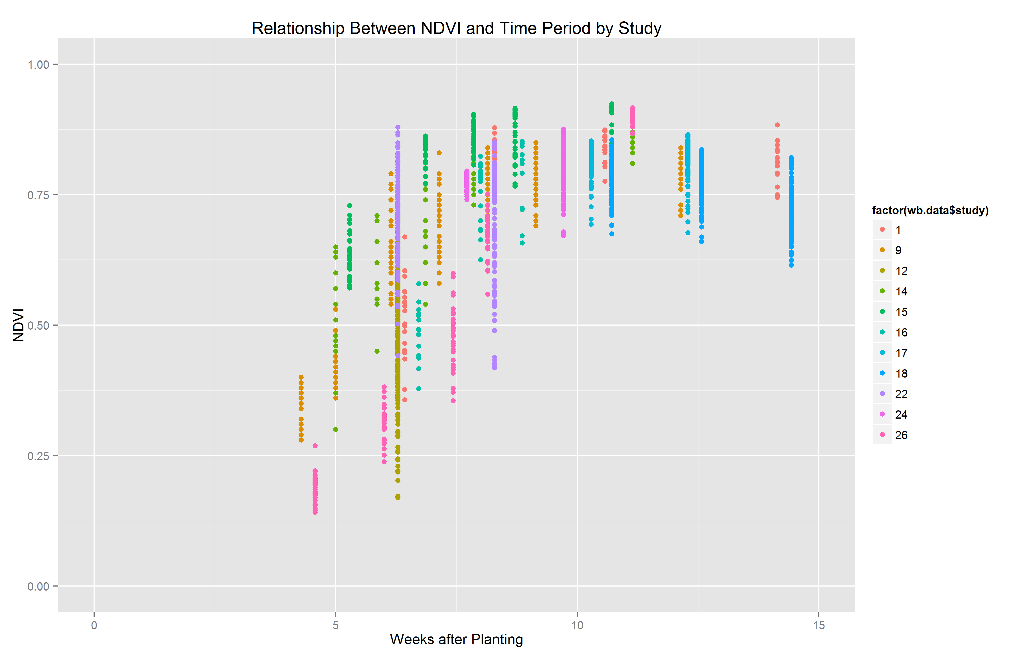
Identifying Optimal Time Period
Dataframe construction
$$relyld=N+N^{2}+NDVI+N∗relheight$$
Table 3. Select model diagnostics for NDVI timing analysis
 | All Timings | <= 6 WAP | 6 to 8 WAP | 8 to 10 WAP | 10 to 12 WAP | 12 to 14 WAP
p-value on NDVI | 0.72 | 0.17 | 0.07 | 0.00 | 0.51 | 0.71
R-squared | 0.17 | 0.48 | 0.19 | 0.22 | 0.37 | 0.51
sample size | 1978 | 192 | 428 | 498 | 331 | 262

Slide 9
Duration of NDVI Measurements
Dataframe construction

Slide 10
Pooled Database Construction
Dataframe construction
Yield data were standardized by study
Relative yield, relyld, by study
Highest yield in field study = 1.0
Nitrogen rate normalized by study
Relative to AONR
$relN=\frac{N_{app}}{AONR}−1$
NDVI values remained same as primary studies
Estimate maximum NDVI wrt N application
${NDVI}^{∗}=NDVI\sim relN$

Slide 11
NDVI bounds for final dataframe
Dataframe construction
study | soil | year | AONR (lbs/ac) | NDVIref* | minNDVI | NDVI_{AONR}**
1 | silt loam | 2008 | 92 | 0.75 | 0.36 | 0.75
9 | loam | 2008 | 71 | 0.66 | 0.28 | 0.64
12 | sand | 2010 | 92 | 0.57 | 0.17 | 0.52
14 | sandy loam | 2009 | 67 | 0.73 | 0.30 | 0.70
15 | sandy loam | 2010 | 85 | 0.82 | 0.57 | 0.81
16 | sandy loam | 2011 | 100 | 0.72 | 0.38 | 0.72
22 | silt loam | 2010 | 79 | 0.72 | 0.42 | 0.72
24 | silt loam | 2011 | 89 | 0.80 | 0.67 | 0.80
26 | Silty clay loam | 2008 | 97 | 0.54 | 0.14 | 0.54
* mean NDVI across highest N rate plots
**expected NDVI at AONR estimated using ordinary least squares

Slide 12
Random Effects Model
Methods
The general specification of the random effects model:
$$y_{ij}=x_{it}^{′}β+(a_{i}+e_{ij})$$
$$j=1,…,n_{i}, i=1,…,k$$
$where a_{i}\sim \left(α,σ_{a}^{2}\right)$ and $ε_{ij}\sim \left(0,σ_{u}^{2}\right)$
$$u_{it}= \left(a_{i}+e_{ij}\right) where Corr\left(u_{it}, u_{is}\right)=\frac{σ_{α}^{2}}{σ_{α}^{2}+ σ_{ε}^{2}} for all s≠t$$

Slide 13
Algorithm Development
Analysis
Calculate ‘nitrogen deficiency’, Ndef
Estimate relationship between Ndef and NDVI
$${N_{def}}_{ik}=\left\{\begin{aligned}{AONR}_{k}−{N_{app}}_{ik} \text{for}{{ N}_{app}}_{ik}<{=AONR}_{k} \\ 0 \text{for} {N_{app}}_{ik}>{AONR}_{k}\end{aligned}\right.$$
$$Ndef=NDVI+ {NDVI}^{2}$$

Slide 14
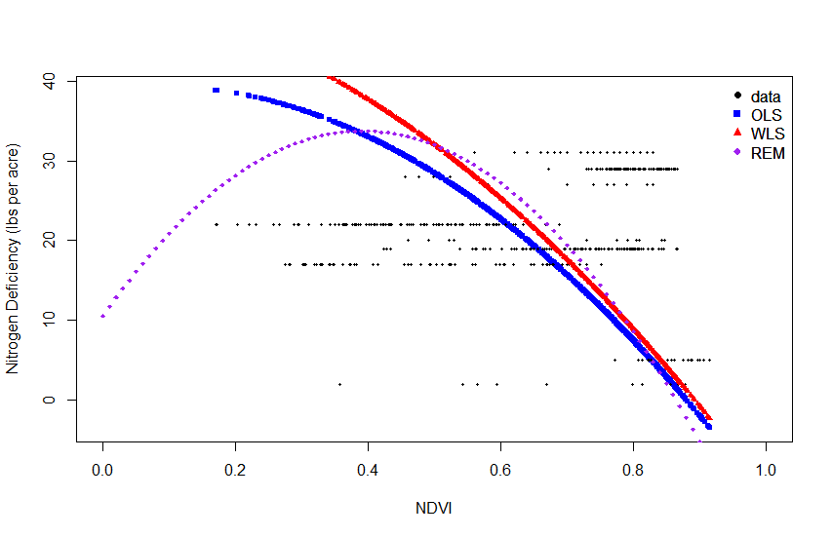
Regression Model Results
Estimated coefficients (standard errors)
 | OLS | WLS | REM
Intercept | 39.01 (15.86) | 50.37 (16.62) | 10.56 (16.87)
NDVI | 9.34 (54.70) | -11.79 (57.22) | 118.16 (57.25)
NDVI^2 | -60.91 (44.84) | -50.01 (46.72) | -150.70 (48.52)

Slide 15
Regression Model Results

Slide 16
Comparison of Candidate Algorithms

Slide 17
Future Work
Revisit ETL procedure
Include all 31 studies
Not just ‘well behaved’
Additional studies welcome
Recombinant data
Deviations from norm weather data
Well-distributed precipitation e.g. Shannon’s
Apply additional pooled analysis methodologies

Slide 18
Terry Griffin
twgriffin@ksu.edu
501.249.6360
@SpacePlowboy

