Slide 1

Influence of Late Nitrogebn Applications on Corn Yield on Mississippi River Alluvial Soils
2017 NUE Conference
Baton Rouge, LA – August 7 - 9, 2017
Rick Mascagni, Brenda Tubana, Marilyn Dalen
LSU AgCenter

Slide 2
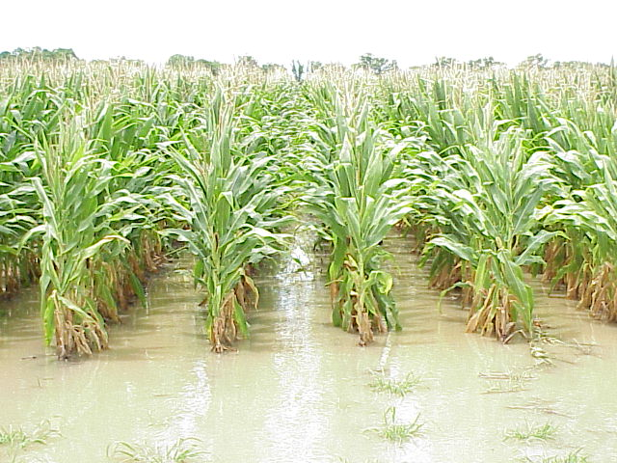
Introduction
Excessive rainfall often occcurs during the corn growing season in the lower Mississippi Delta.
N deficiency may occur late in the season due to N fertilizer loss via denitrification and reduced N fertilizer use efficiency or to increased plant demand and higher yield potential as a result of good growing conditions.

Slide 3
Objective
More information is needed on the efficacy of supplemental N at late growth stages of corn on Mississippi River alluvial soils

Slide 4
PROCEDURES
Field experiments were conducted from 2006 to 2014 on Commerce silt loam and Sharkey clay at the Northeast Research Station (NERS) near St. Joseph, LA to evaluate the efficacy of late-applied N fertilizer at tassel emergence.
Commerce silt loam –
For early-season N rates (ESN), N fertilizer was injected as UAN after emergence at rates of 0, 120, 150, 180, 210, and 240 lb N/a.
Supplemental N at 60 lb N/acre was also applied at tassel at the 120 lb N/a ESN rate.

Slide 5
PROCEDURES
Sharkey clay (non-irrigated and irrigated) –
For ESN rates, N fertilizer was injected as UAN after emergence at rates of 0, 180, 210, 240, and 270 lb N/a.
Supplemental N at 60 lb N/a was also applied at tassel at the 180 lb N/a ESN rate.
Relative SPAD meter values were determined at silk emergence from the ear leaf.

Slide 8
Cultural information on non-irrigated Sharkey clay at the NERS.
Year | Planting date | Hybrid | ESN - GS | Late-N application | Date of LN and act.
2006 | Mar 16 | P 33R81 | 2-lf | AN-BC | 6/2-6/19
2007 | Mar 16 | P 33R81 | 2-lf | AN-BC | 5/31
2008 | Mar 28 | DG 58P59 | 2-lf | UAN-DR | 6/2-6/20
2009 | Apr 17 | DG 58P59 | 2-lf | UAN-DR | 6/15-7/5

Slide 9
Influence of ESN and supplemental N at R1 growth stage on yield on non-irrigated Sharkey clay at
the NERS.
N tmt | 1 | 2 | 3 | 4
lb N/a |  | bu/acre
0 | 38.9 | 14.9 | 12.1 | 15.6
180 | 142.1 | 125.3 | 162.7 | 93.2
180+60 | 145.8 | 124.3 | 169.1 | 94.4
210 | - | 128.2 | 165.1 | 108.1
240 | 146.6 | 126.4 | 166.4 | 106.0
270 | 143.8 | 124.9 | 170.7 | 108.4
LSD (0.10) | 24.9 | 12.6 | 9.2 | 6.4

Slide 11
Cultural information on irrigated Sharkey clay at the NERS.
Expt. No. | Year | Planting date | Hybrid | ESN - GS | Late-N application | Date of LN and act.
5 | 2006 | Mar 16 | P 33R81 | 2-lf | AN-BC | 6/2
6 | 2007 | Mar 16 | P 33R81 | 2-lf | AN-BC | 5/31
7 | 2008 | Mar 28 | DG 58P59 | 2-lf | UAN-DR | 6/2
8 | 2009 | Apr 17 | DG 58P59 | 2-lf | UAN-DR | 6/15
9 | 2010 | Apr 1 | DG 58P59 | 2-lf | UAN-DR | 6/7
10 | 2012 | Mar 29 | 6 hybrids | 3-lf | UR-BC | 6/5
11 | 2012 | Apr 9 | 2 hybrids | 2-lf | URAS-BC | 6/6
12 | 2013 | Mar 28 | 2 hybrids | 3-lf | UR-BC | 6/11

Slide 12
Influence of ESN and supplemental N at R1 growth stage on yield on irrigated Sharkey clay at the NERS.
N tmt | 5 | 6 | 7 | 8 | 9 | 10 | 11 | 12
lb N/a |  |  |  | bu/a
0 | 41.1 | 25.0 | 20.3 | 22.3 | 3.9 | - | - | 6.4
180 | 176.1 | 185.3 | 189.5 | 127.6 | 129.7 | 190.6 | 177.6 | 149.7
180+60 | 191.8 | 191.1 | 194.0 | 152.0 | 140.3 | 200.6 | 217.0 | 187.0
210 | 184.6 | 200.1 | 194.1 | 143.1 | 138.7 | 198.9 | 193.7 | -
240 | 199.0 | 210.0 | 202.8 | 147.3 | 149.1 | 204.1 | 209.2 | 186.9
270 | 192.2 | 204.1 | 194.5 | 163.5 | 157.7 | - | 215.3 | -
LSD (.10) | 20.7 | 12.3 | 8.8 | 6.0 | 6.5 | 4.9 | 6.5 | 13.5

Slide 14
Influence of ESN rates on relative SPAD values at tassel on Sharkey clay at the NERS.
N rate | 1 | 2 | 3 | 4 | 5 | 6 | 7 | 8 | 12
lb N/A
 | -------Non-irrigated----------- |  |  |  | -----------------Irrigated----------------------
0 | 0.53 | 0.56 | 0.58 | 0.49 | 0.52 | 0.55 | 0.45 | 0.55 | 0.53
180 | 0.96 | 0.92 | 0.97 | 0.98 | 0.97 | 0.98 | 0.97 | 0.97 | 0.98
210 | - | 0.94 | 0.98 | 1.00 | 0.95 | 0.94 | 1.00 | 0.97 | -
240 | 1.02 | 0.97 | 0.98 | 0.94 | 0.95 | 1.00 | 1.01 | 0.98 | 1.00
270 | 1.00 | 1.00 | 1.00 | 1.00 | 1.00 | 1.00 | 1.00 | 1.00 | -
LSD (.10) | 0.09 | 0.13 | 0.26 | 0.05 | 0.06 | 0.10 | 0.03 | 0.04 | 0.06

Slide 15
Cultural information on Commerce silt loam at the NERS.
Expt. No. | Year | Planting date | Hybrid | ESN - GS | Late-N application | Date of LN and act.
17 | 2006 | Mar 16 | P 33R81 | 2-lf | AN-BC | 6/6-6/19
18 | 2007 | Mar 16 | P 33R81 | 2-lf | AN-BC | 5/27-5/31
22 | 2011 | Mar 24 | REV 28HR20 | 3-lf | UR-BC | 6/7-6/9
24 | 2012 | Mar 29 | P 31P42 | 4-lf | UR-BC | 5/31
25 | 2014 | Apr 13 | 2 hybrids | 3-lf | UR-BC | 6/16-6/25
26 | 2014 | Apr 13 | REV 28HR20 | 4-lf | UR-BC | 6/20-6/25

Slide 16
Influence of ESN and supplemental N at R1 growth stage on yield on Commerce silt loam at the NERS.
N tmt | 17 | 18 | 22 | 24 | 25 | 26
lb N/a |  |  | bu/a
0 | 20.0 | 26.4 | 39.6 | 116.8 | 27.4 | 45.8
120 | 108.3 | 123.1 | 145.8 | 190.8 | 160.6 | 149.5
120+60 | 119.7 | 129.7 | 177.0 | 185.3 | 179.8 | 188.8
150 | 142.7 | 128.6 | 166.2 | 192.0 | 173.4 | -
180 | 164.0 | 133.9 | 169.8 | 198.7 | 188.0 | 185.4
210 | 175.8 | 131.7 | 178.8 | 197.1 | 194.2 | 193.9
240 | 171.9 | 121.8 | - | 192.6 | 194.3 | -
LSD (.10) | 13.9 | NS | 14.0 | 14.4 | 13.2 | 15.8

Slide 18
SUMMARY
Optimum N rates occurred between 180 and 270 lb N/acre, depending on soil type and irrigation.
In irrigated clay and silt loam trials, there was a consistent response to the supplemental N treatment at R1 growth stage.
Averaged across experiments, there was little difference between the supplemental treatment and the equivalent rate applied early season in the irrigated clay trials.
Relative SPAD meter readings at R1 averaged 0.53 for the no-N control and 0.97 for the 180 lb n/a ESN rate.

Slide 19
ThankS FOR YOUR ATTENTIVENESS
Questions??

