Slide 1
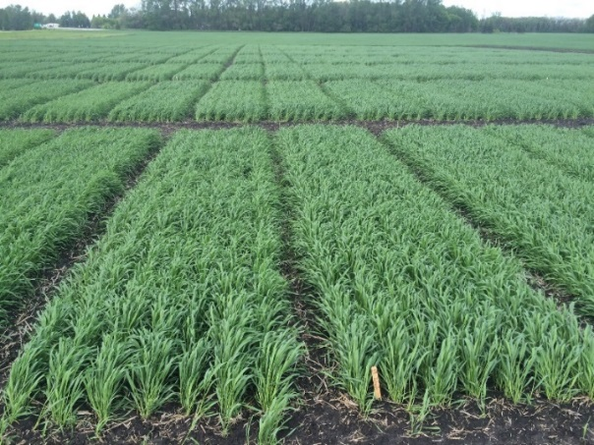
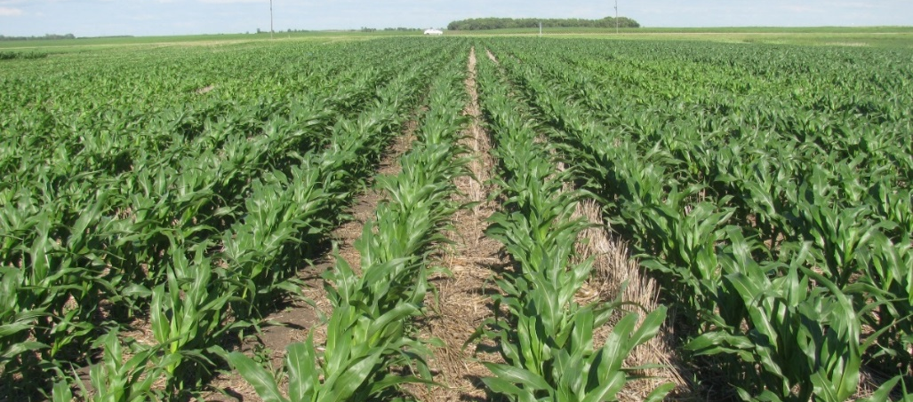

Effect of Sulfur Fertilization on Nitrogen Use Efficiency for Spring Wheat and Corn in Minnesota and North Dakota
Presenter: Dr. Jasper M Teboh, Soil Scientist, NDSU-Carrington Res. Ext. Center
Co-PI: Dr. Joel Ransom, Extension Agronomist – Cereal Crops, Dept. Plant Sciences, NDSU
Co-PI: Szilvia Yuja, Soil Research Specialist NDSU-Carrington REC
  Contact: Jasper.Teboh@ndsu.edu
  Tel: 701-652-2951
Notes:
"But if we have enough organic matter naturally in soil, that should provide sulfur for crop needs," Lentz said

Slide 2
RESEARCH QUESTIONS
Would wheat or corn respond to S application? If so,
How would wheat response to S affect NUE of wheat?
How might responses differ from one soil to another?

Slide 3
Materials and Methods
Rates in North Dakota were,
N Rates: 0, 50, 100, 150, 200 lbs/ac; and S Rates: 0, 10, 20, lbs/ac
Split-plot RCBD, replicated four times

Slide 4
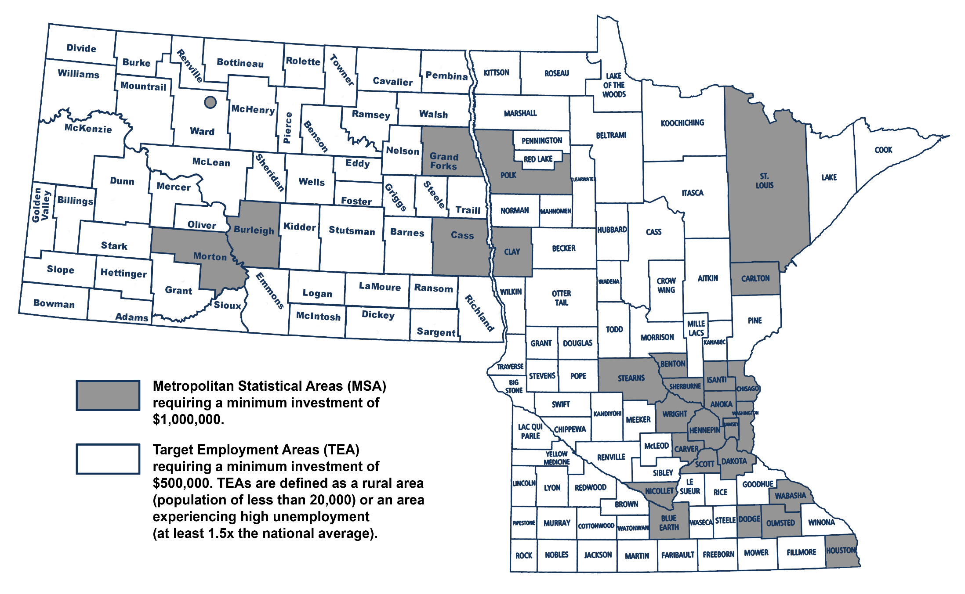
Locations of Trials
Williston
Minot
EGF
TRF
RLF
Ada
CREC
Forman
Map Courtesy: http://geology.com/county-map/minnesota.shtml

Slide 5
Analysis of Variance for wheat grain yield and protein in response to N and S in MN (2015, 2016)
RESULTS
Site | Soil Type | SOM (%) | Effect | 2015 |  | 2016
 |  |  | SOV | Yield | Protein | Yield | Protein
Ada | SandyLoam |  | N rate (N) | <0.0001 | <0.0001 | <0.0001 | <0.0001
 |  | 2.6 | S rate (S) | 0.0004 | 0.0435 | 0.6094 | 0.831
 |  |  | N x S | 0.59 | 0.7622 | 0.5705 | 0.7063
EGF | Silty Clay Loam |  | N rate | 0.2726 | 0.0067
 |  | 3.7 | S rate | 0.2529 | 0.5038
 |  |  | N x S | 0.2035 | 0.6340
RLF | Loam |  | N rate |  |  | 0.028 | <.0001
 |  | 3.6 | S rate |  |  | 0.441 | 0.9974
 |  |  | N x S |  |  | 0.631 | 0.3255
TRF | Sandy Loam |  | N rate | 0.51 | <.0001 | 0.003 | <.0001
 |  | 2.3 | S rate | 0.51 | 0.0456 | <.0001 | 0.5785
 |  |  | N x S | 0.94 | 0.3622 | 0.1908 | 0.1645

Slide 6
Yield response of HRS wheat to N rates at three S rates, averaged across 6 site years

Slide 7
Yield response of spring wheat to N rates at three S levels, averaged across four site years

Slide 8
Agronomic Efficiency of N at three S levels for wheat (Ada, MN, 2016)

Slide 10
Agronomic efficiency of N at three S levels (TRF, MN, 2016)

Slide 13
Analysis of Variance for wheat grain yield and protein in response to N and S in North Dakota (2015, 2016)
Site | Soil Type | SOM (%) | Effect | 2015 |  | 2016
 |  |  | SOV | Yield | Protein | Yield | Protein
CREC | Loam |  | N rate | 0.5106 | <.0001 | 0.9271 | <.0001
 |  | 4.2 | S rate | 0.6852 | 0.0705 | 0.5063 | 0.9611
 |  |  | N x S | 0.1562 | 0.9328 | 0.3969 | 0.8743
MINOT | Silty Clay Loam |  | N rate | <.0001 | 0.0997 | 0.0002 | 0.0028
 |  | 3.7 | S rate | 0.0015 | 0.273 | 0.2558 | 0.819
 |  |  | N x S | <.0001 | 0.253 | 0.0006 | 0.9139
Forman | Loam |  | N rate |  |  | 0.1053 | <.0001
 |  | 3.6 | S rate |  |  | 0.6857 | 0.1651
 |  |  | N x S |  |  | 0.9738 | 0.1845
Williston REC | Sandy Loam |  | N rate |  |  | 0.1507 | <.0001
 |  | 2.3 | S rate |  |  | 0.0002 | 0.0049
 |  |  | N x S |  |  | 0.988 | 0.0001

Slide 14
AEN of N at three S levels (Minot, ND, 2016)

Slide 15
Agronomic efficiency of N at three S levels (Minot, ND. 2016)

Slide 16
Agronomic Efficiency of N at three S levels (Two-year average for Minot, ND)

Slide 17
Agronomic Efficiency of N at three S levels (Williston, ND)

Slide 18

Corn yield response to S at Forman, ND (2016)

Slide 19
Materials and Methods

Slide 20
RESULTS

Slide 22
Corn yield response to S at recommended N rate of 210 lbs (Forman, 2016)

Slide 23
Agronomic efficiency of S for corn at two N rates

Slide 24
SUMMARY
Wheat response to sulfur was weak in soils with SOM less > 3.5%
The amount of N needed to maximize yield and protein was less with S application, suggesting S improved NUE
Agronomic efficiency of N was improved with S application to wheat at S responsive
Sulfur application increased corn yields by at least 21 bushels
Agronomic efficiency of S was higher when adequate, or close to adequate N was available to corn
Soil organic matter is likely a key determinant (including climatic factors) to the effect of S on wheat response

Slide 25
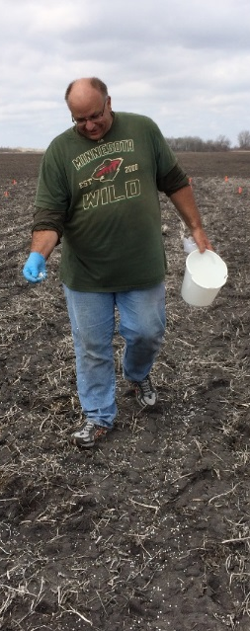
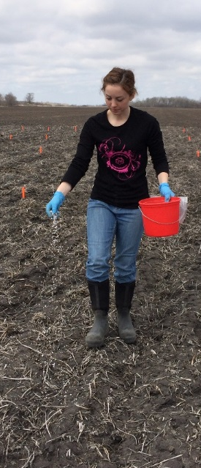

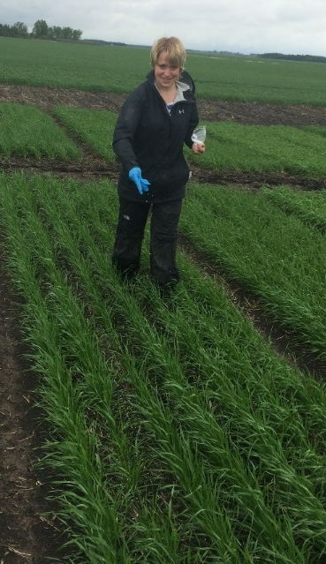
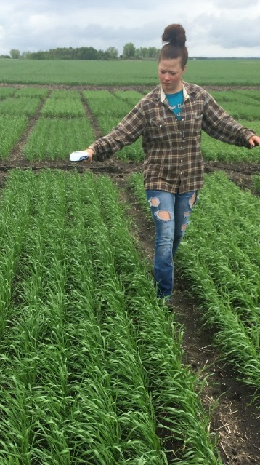
ACKNOWLEDGEMENT
The Minnesota Wheat and Promotion Council
Producers: Mr. Pete Kappes; Mr. Ken Asp; Mr. John Barrett (East GF)
Technicians: Russ Severson, Bill Craig, Nathan Johnson
Grad students: Melissa Geiszler, Matthew Rellaford, Nicholas Schimek
Researchers: Mr. Chad Deplazes (Research Specialist, NDSU); Drs. Grant Mehring, Gautam Pradhan, and Dan Kaiser
Dave Torgerson Kaylina Paulley
Lauren Proulx
Katie Kainz

