Slide 1

Acquiring Crop NDVI Readings via Drone Equipped with a Single NDVI Camera
By
Dr. Randy R. Price
LSU AgCenter
Dean Lee, Alexandria, LA
Co-P.I.’s – Dustin Harrell and Jimmy Flanagan

Slide 2
Summary:
Compare NGB type cameras to higher end multispectral cameras
Compare typical drone camera readings (NDVI, single band, etc.) to Greenseeker NDVI
Greenseeker currently most used device to evaluate NUE plots and predict nitrogen levels
Relationship of different camera and ratios to NUE plots in rice

Slide 3
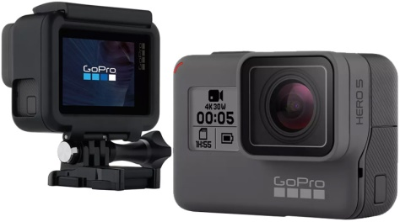
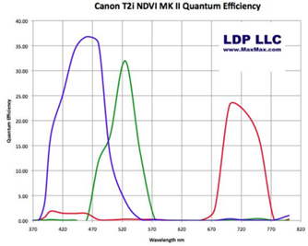
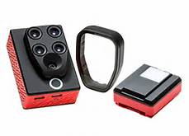
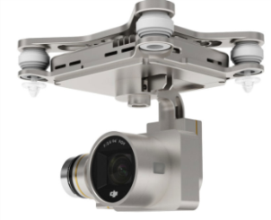
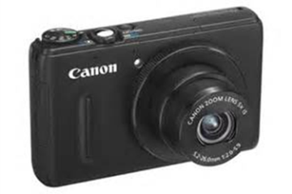
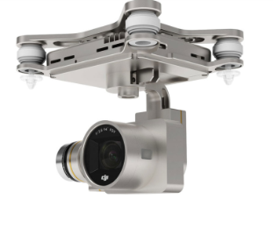
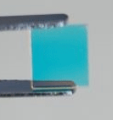
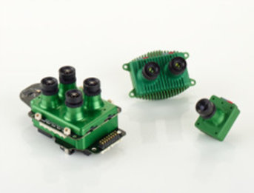
Three Types of Cameras on Drones:
(1)
RGB - Regular Cameras
Low cost – come with drone
(2)
NGB – RGB Converted Camera to receive NIR
(3)
Dedicated Multispectral Cameras:
Sequoia / MicaSense Sentara, etc.
$100 - $300
$300 - $900
$3000 - $5000

Slide 4
Evaluating Two Different Types of Readings:
NDVI (Normalized Difference Vegetative Index
Ratio of NIR to color difference
Allows numbers to be normalized from 0 (soil) to 1 (very healthy plant)
Color bands related to plant absorption
Summation, subtraction, etc.
ex: red and blue, etc.

Slide 5
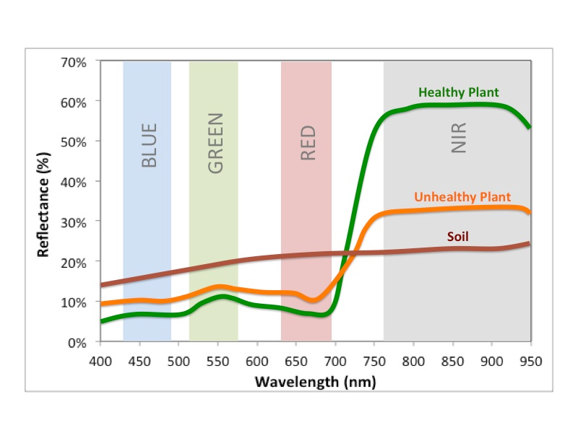
Plant and Soil Reflectance:

Slide 6
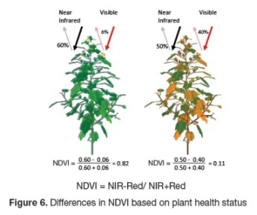

Slide 7
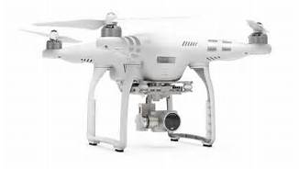
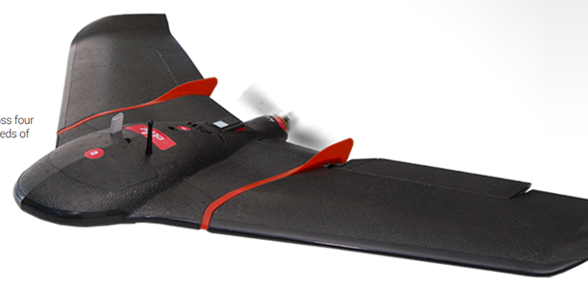
Types of UAS Used in Project:
DJI Phantom 3 multi-rotor:
Both RGB and NGB camera
Pix 4D mapper for flight paths
Agisoft Photoscan
AgPixel for analysis
Sequioa Ebee Airplane:
Longer flight times:
40 minutes to 1 hours (on battery)
Mutli-Spectral Camera:
NIR, Red, Red edge, Green

Slide 8
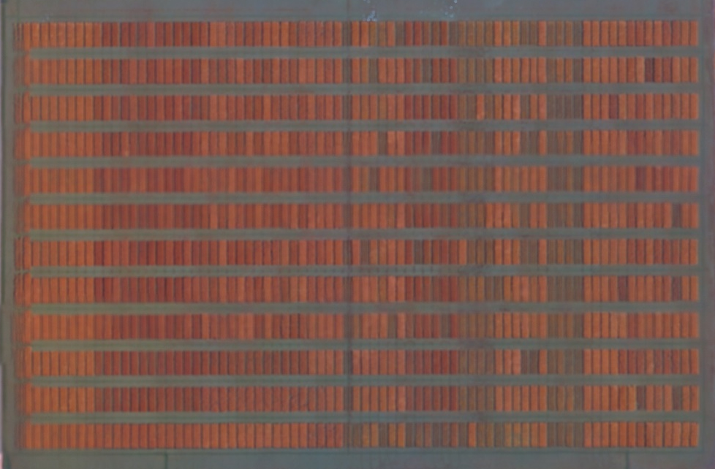
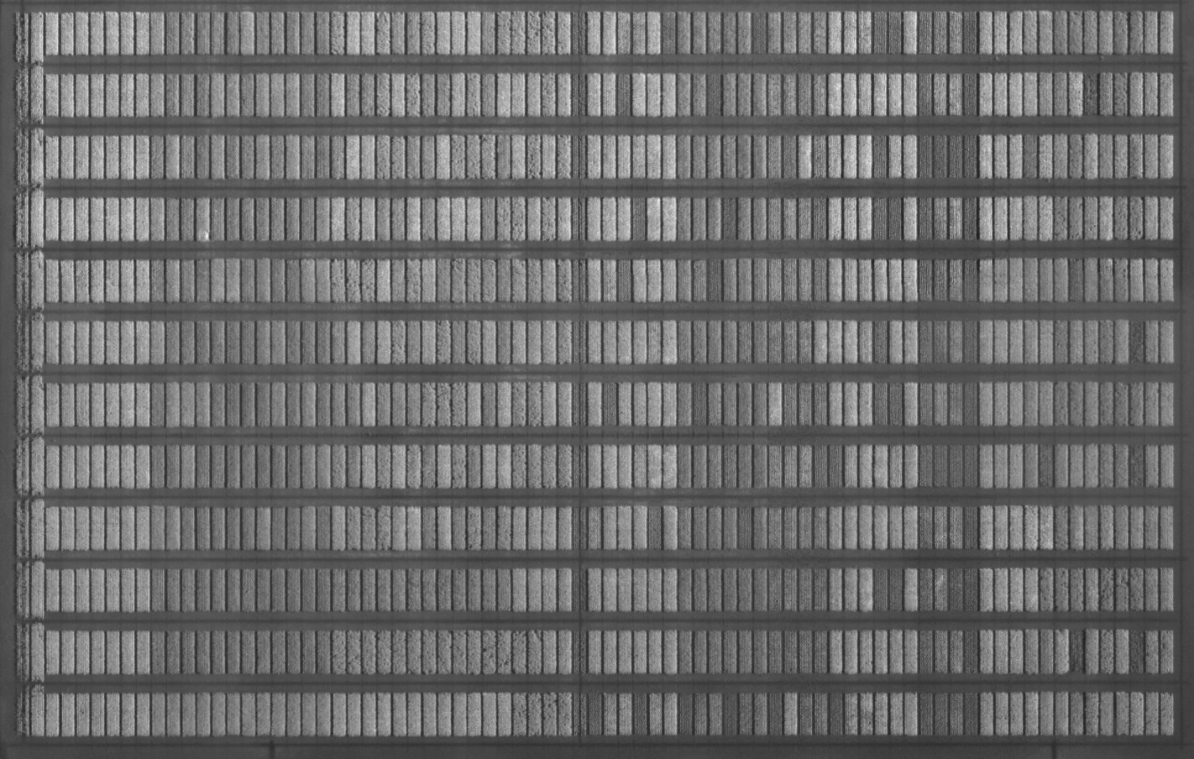
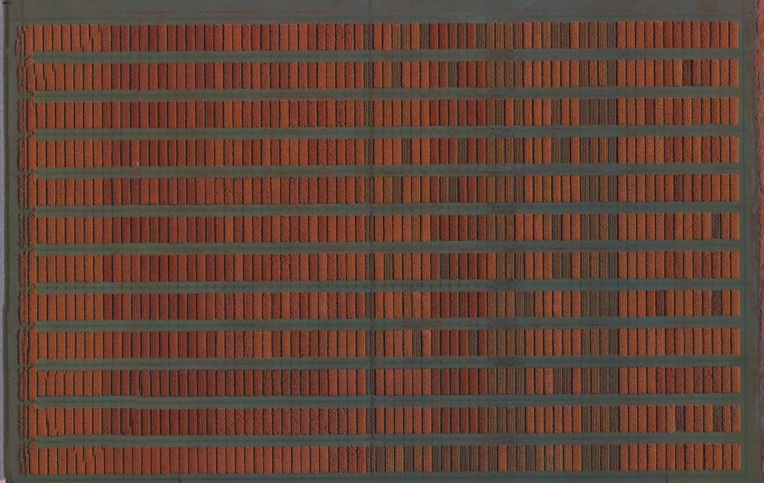
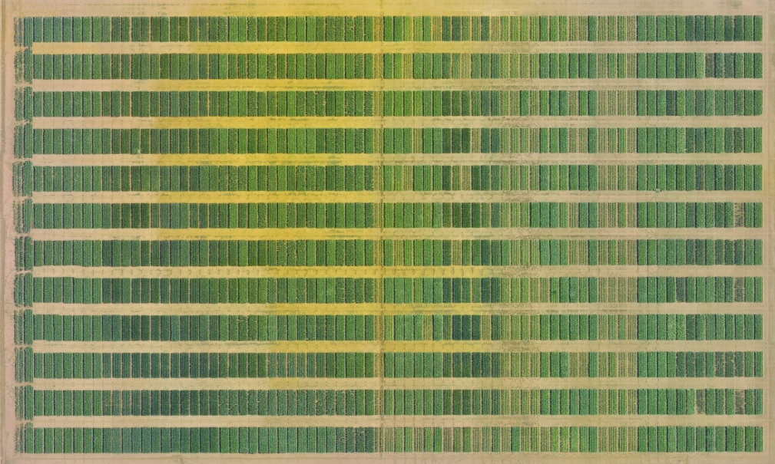
Results from Different Cameras:
Event 38 Filter
Sequoia Camera
NDVI – 7 Filter
RGB Camera

Slide 9
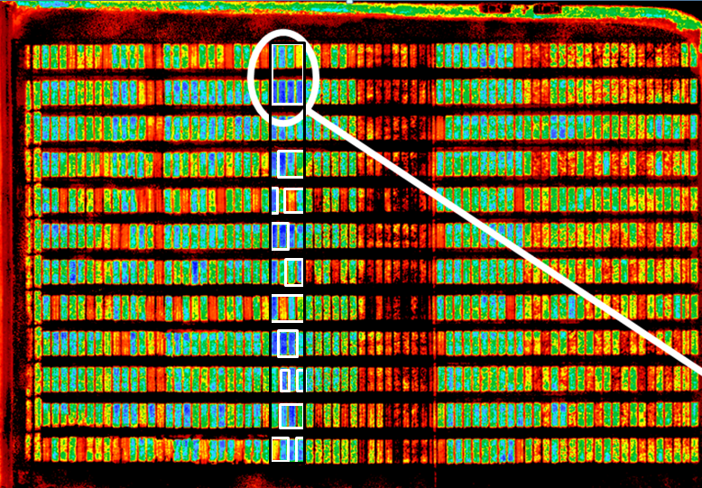
Rice Plots Evaluated:

Slide 10
NDVI Values of Different Cameras to Greenseeker for All Rice Plots:

Slide 11
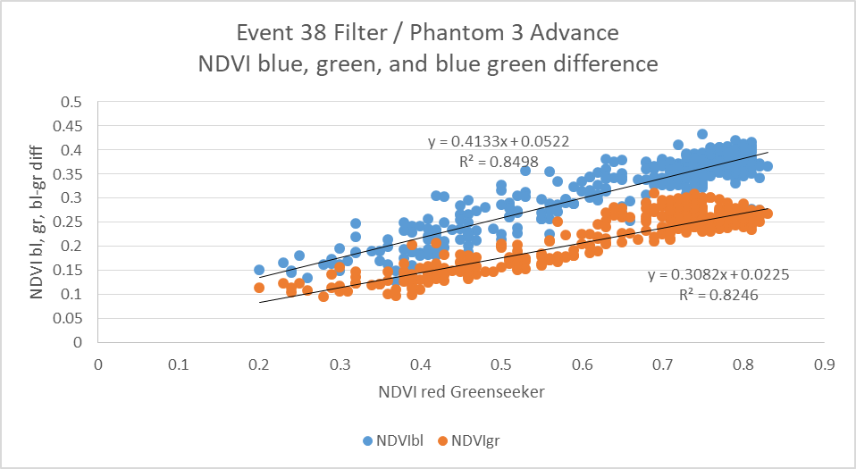
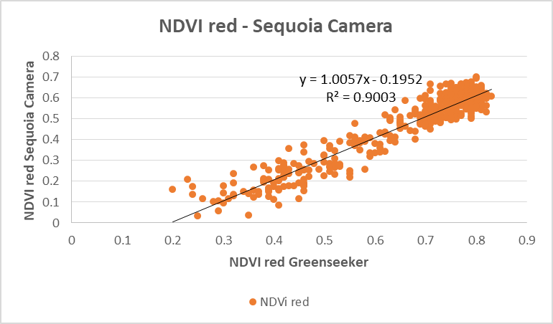
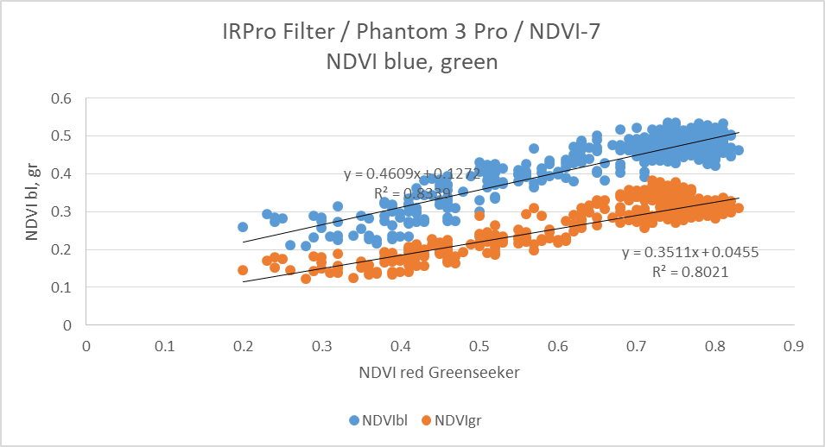
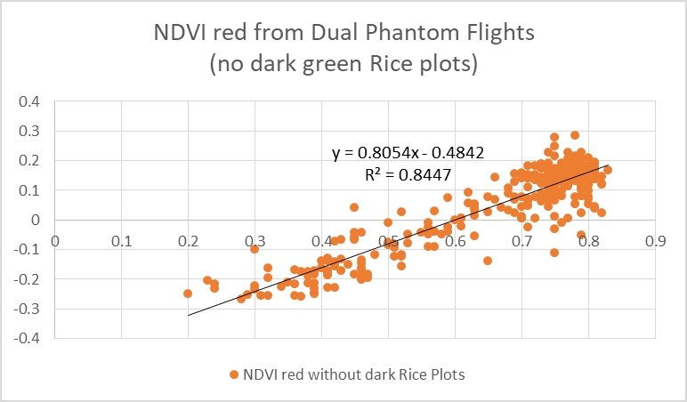
Comparison of NDVI Values from Different Cameras to Greenseeker NDVI:

Slide 12
Blue Color Band:
Event 38 filter’s blue band performed slightly better than NDVI – 7 filter’s blue band:

Slide 13
NIR – Blue Difference:

Slide 14
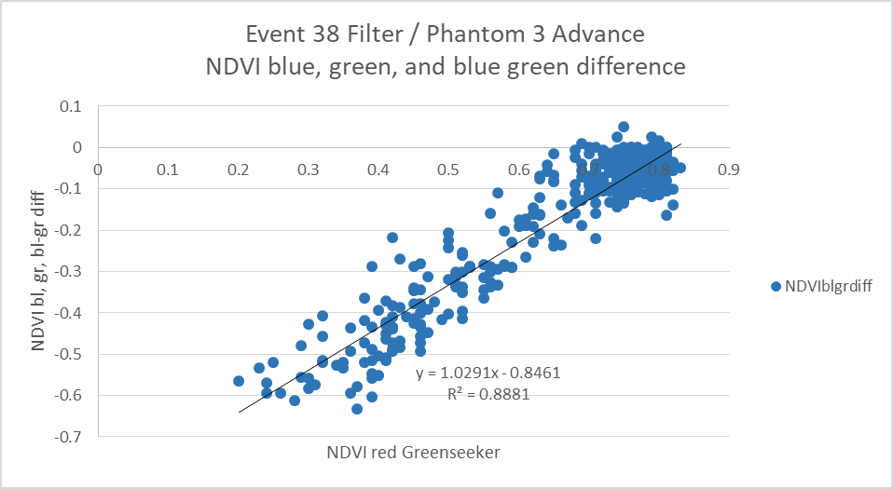
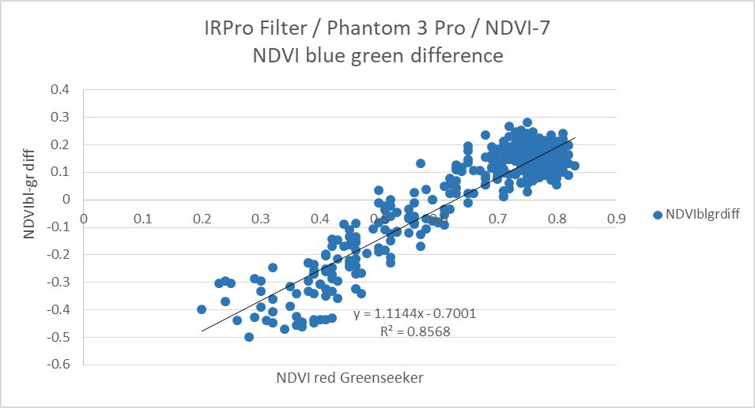
Comparison of NDVI blue-green difference to Greenseeker NDVI:

Slide 15
Rice NUE Plots:

Slide 16
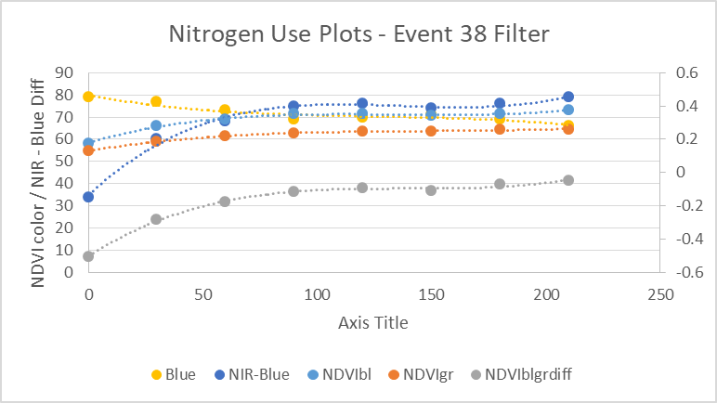
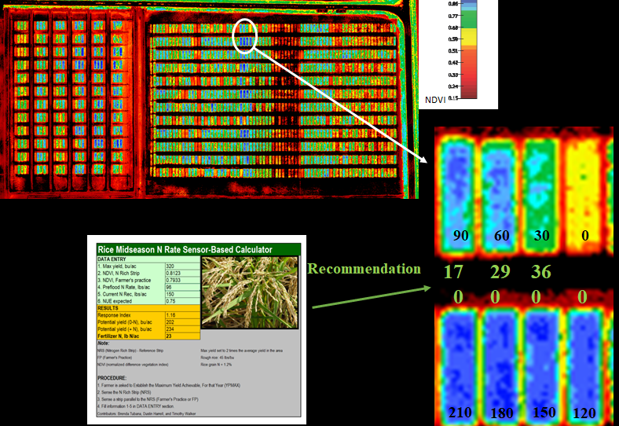
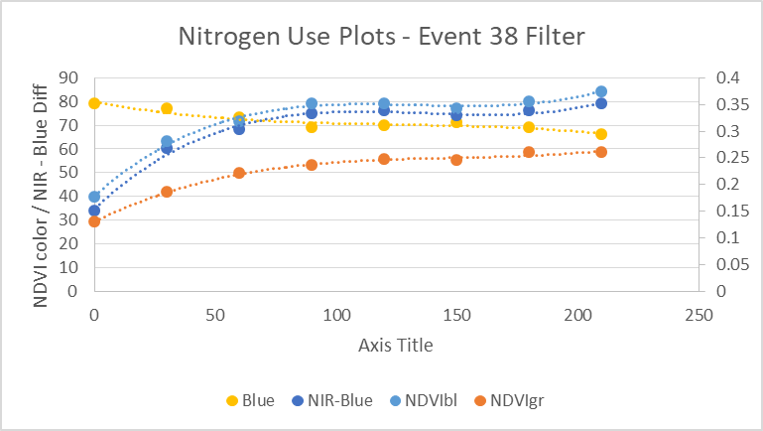
Nitrogen Detection in Rice:
Is NGB Good Enough to Distinguish Desired NUE Differences in the Field?

Slide 17
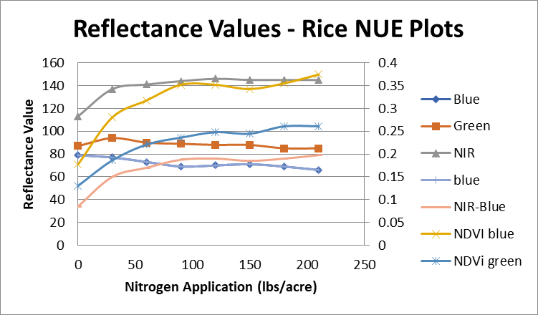
All Reflectance Values:

Slide 18
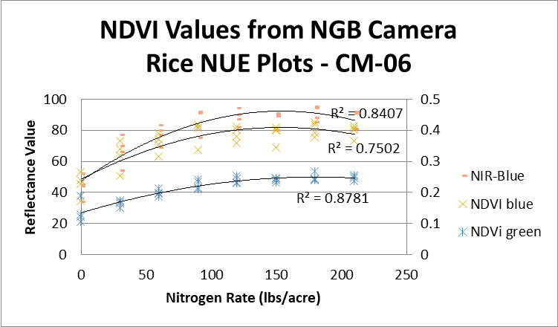
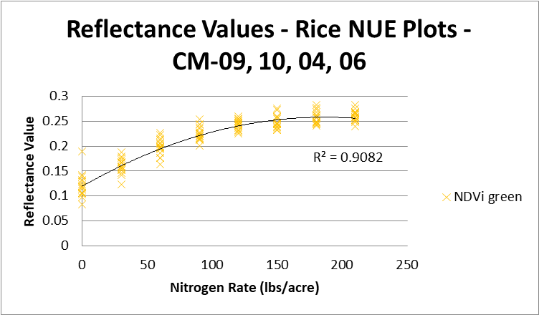
NUE Plot Results for NDVI from NGB Cameras:
NDVI gave fairly good results across all conditions
Individual Variety 4 Varieties

Slide 19
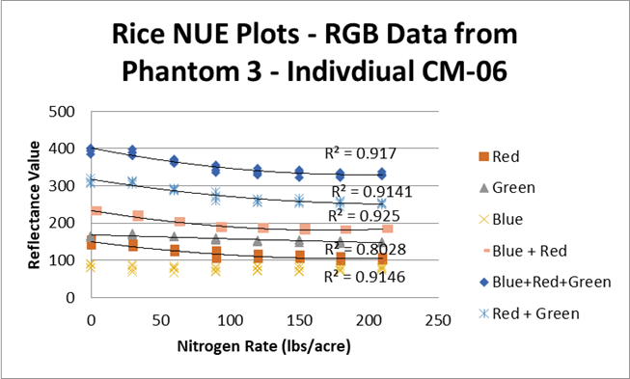
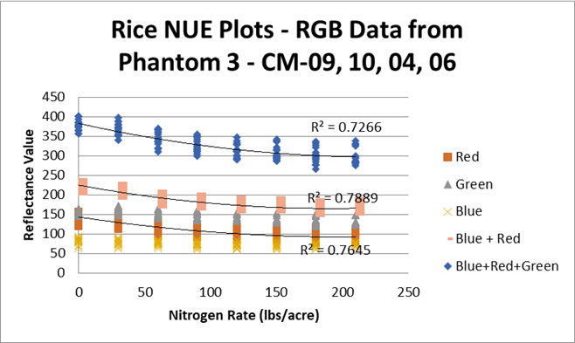
RGB Camera:
Per Field Results Look Better than All Varieties:
Individual Varieties: 4 Varieties Combined:

Slide 20
Conclusion:
General NDVI Readings:
Good relationship between all NDVI type cameras (NGB or multispectral cameras) and Greenseeker Output
High-end Multispectral was slightly better
Relationship to Nitrogen Level in Rice Plots:
NDVI (NGB) camera performed well per field, or combined
RGB performed well on individual plot varieties, but not as well when all varieties were combined

Slide 21
Comparison of NDVI in Other Crops:

Slide 22
Support:
Louisiana Rice Research Board
Louisiana Soybean and Small Grains Research Board
American Sugarcane League (AMSCL)

Slide 23
The End
Questions?

Slide 24
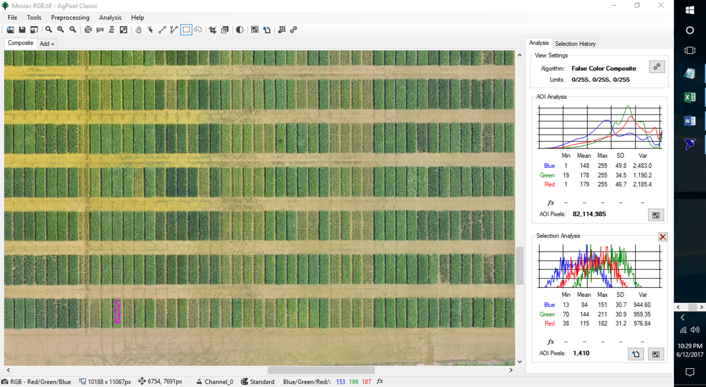
Analysis:

