Slide 1
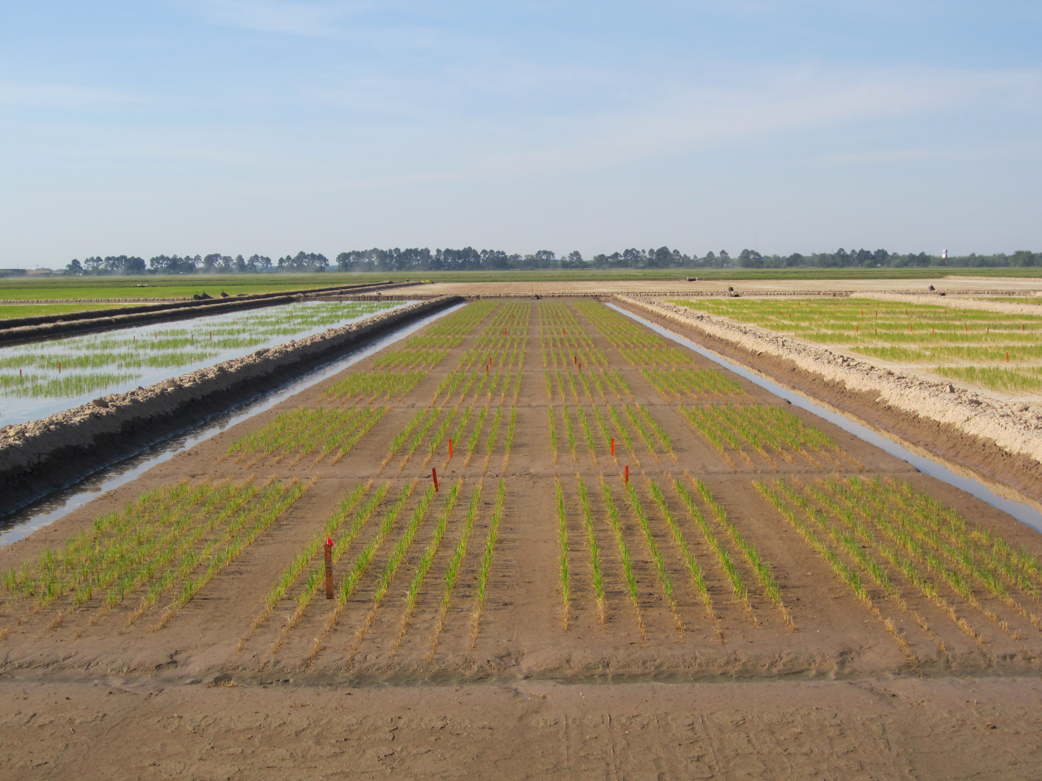




Effect of soil moisture on the efficiency of pre-flood N applications in rice
Harrell, D., M. Kongchum, G. Schwab, N. Adotey, J. Li, J. Leonards, and J. Fluitt
15th Annual Nitrogen Use Efficiency Conference
Baton Rouge, Louisiana
Aug. 7 – 9, 2017

Slide 2
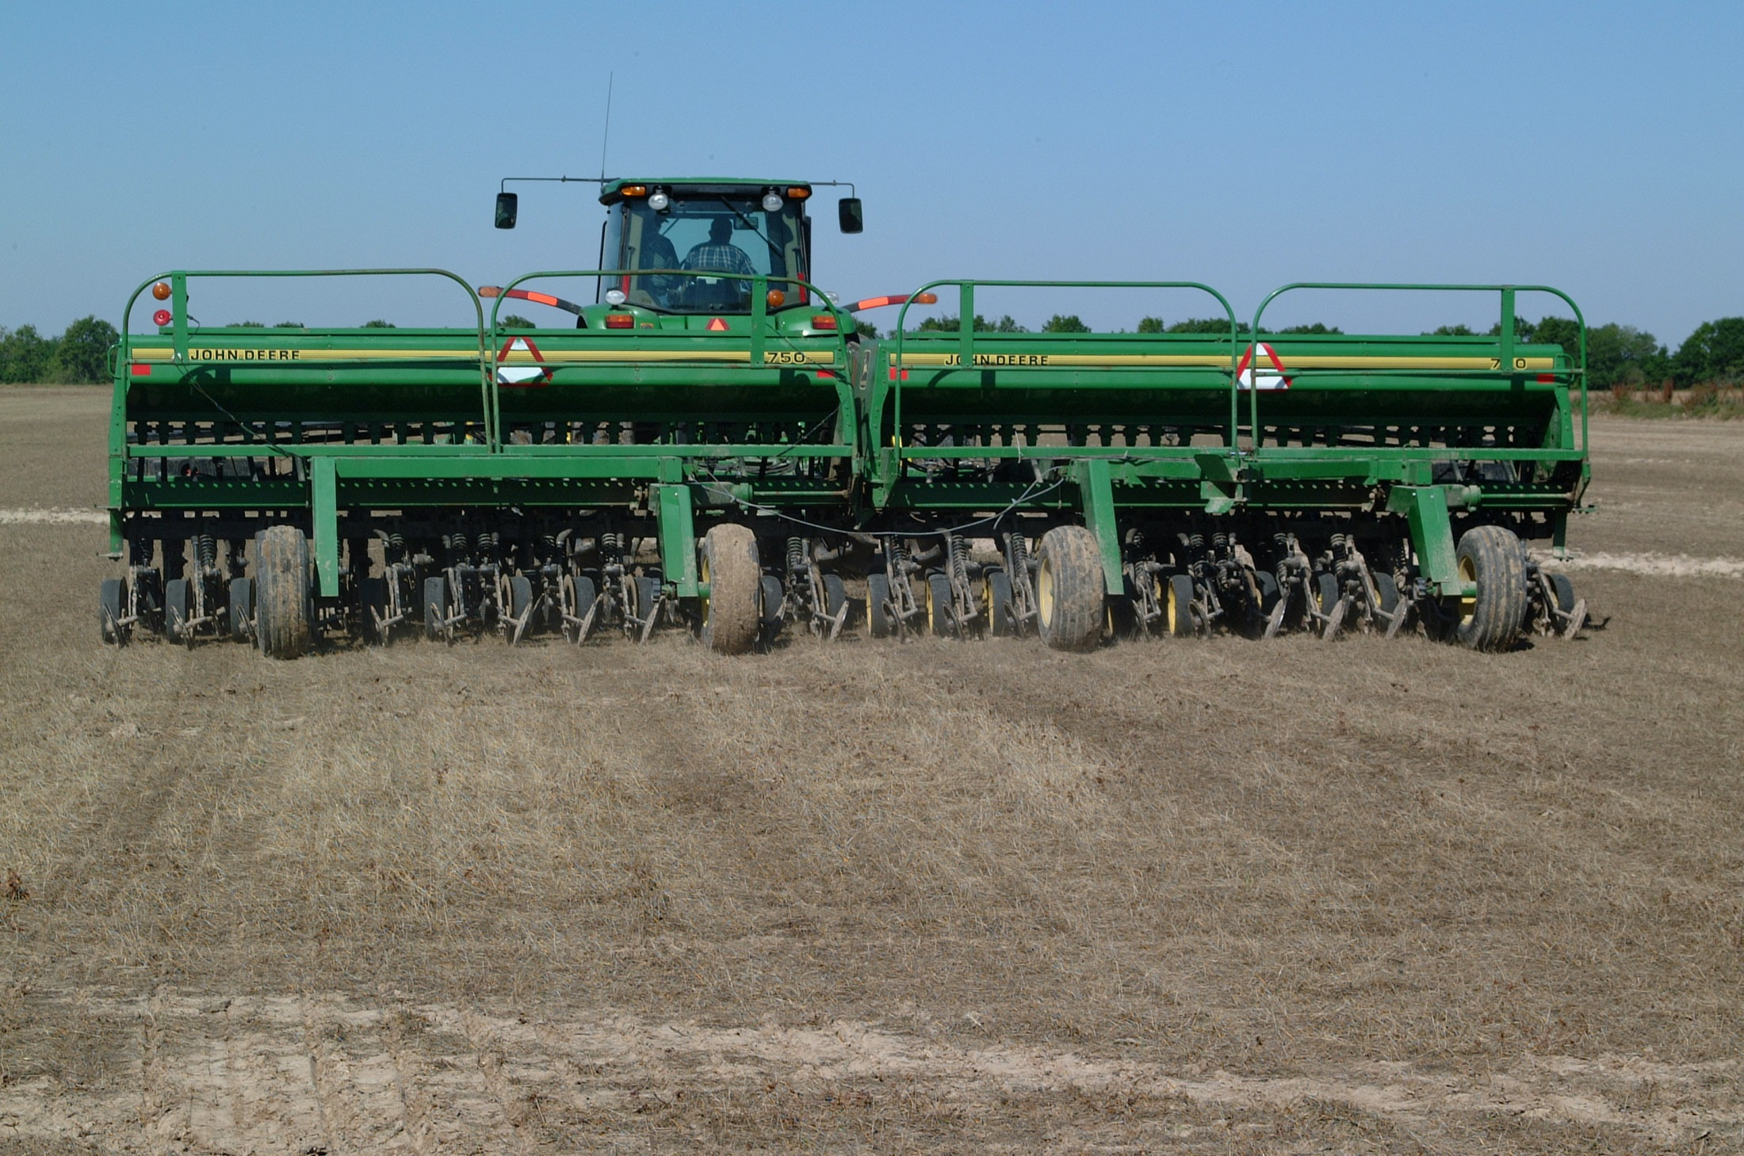
≈ 70% dry-seeded (drill seeded)
≈ 30% water seeded

Slide 3
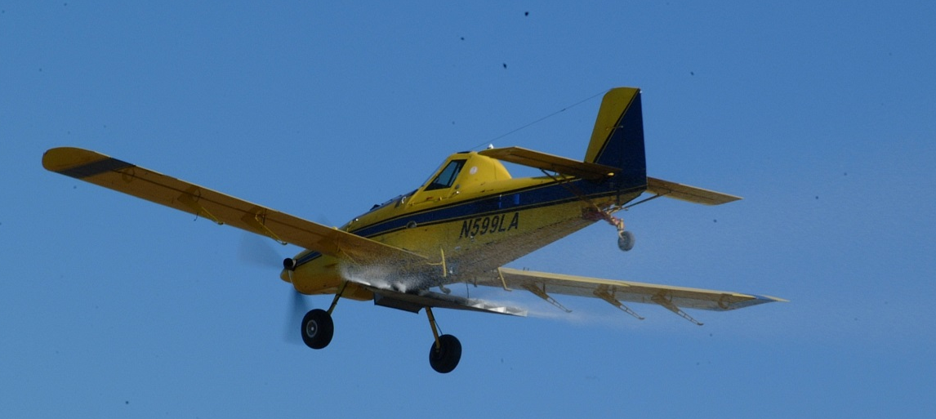
Nitrogen Fertilizer Recommendations
Only use NH₄⁺ or NH₄⁺ forming fertilizers
Apply first application on DRY soil and flood ASAP.
  Approximately 2/3 of seasonal need
Apply 2nd application at midseason
  Remaining 1/3 of seasonal need

Slide 4
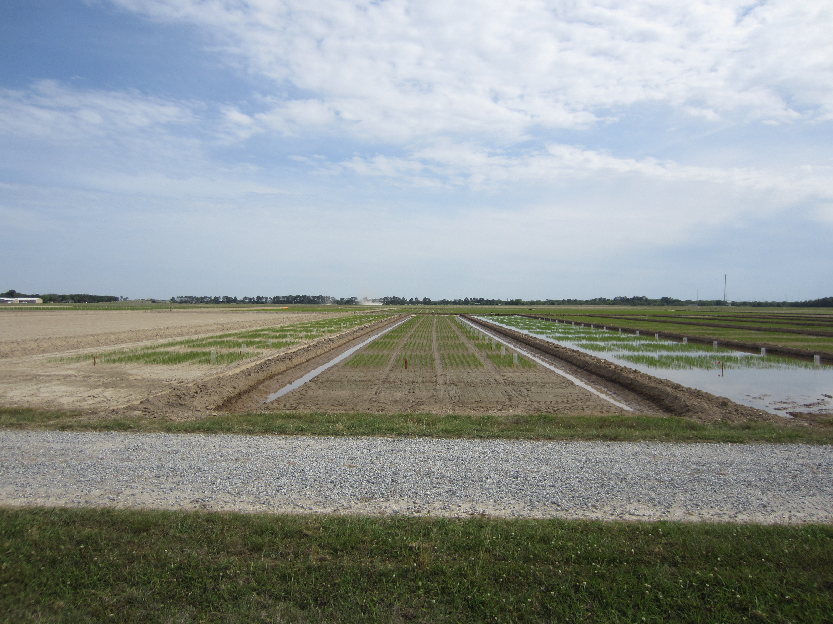
Common producer questions:
Why does the soil have to be dry?
Is there a N fertilizer source that I can use, like NBPT-urea, which can increase NUE and yield when applied into on moist or flooded soils?
If I get a large rainfall event , why can’t I just apply the N in the water instead of waiting for the soil to dry?

Slide 5
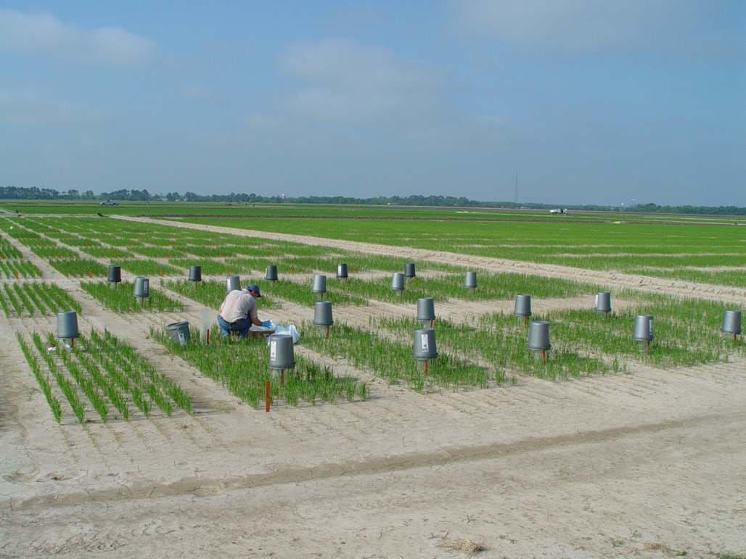
Objectives:
Volatilization trial:
  Quantify ammonia volatilization losses of 4 N sources when applied on a dry, moist or flooded soil.
Field trial:
  Quantify rice yield and NUE when fertilizer N sources are applied on a dry, moist or flooded soil

Slide 6
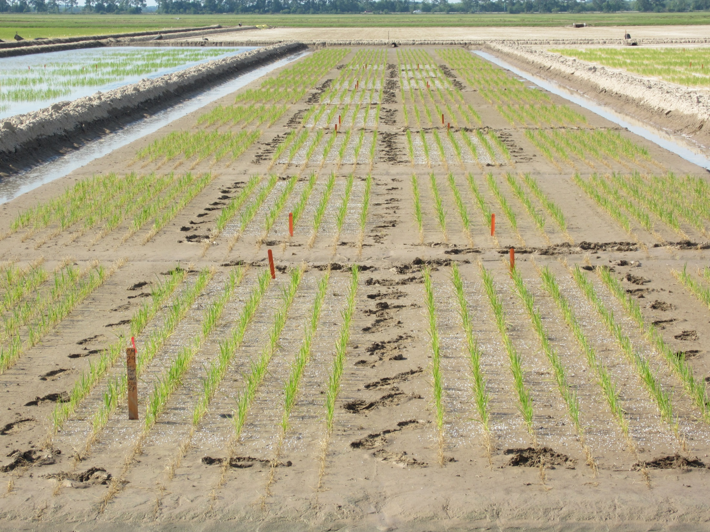
  Flooded (2.5 cm)
  Moist (field capacity)
  Dry

Slide 7
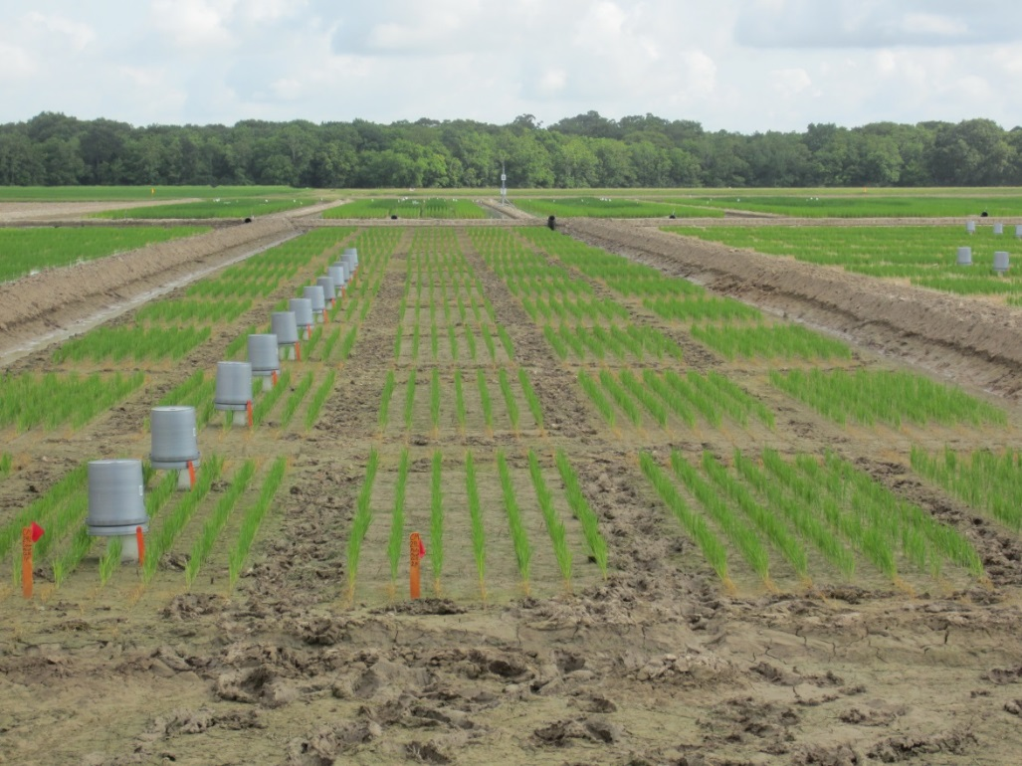

Volatilization and Field Trials
4 N Sources
  urea
  AGROTAIN® ULTRA (AU)
    NBPT surface applied
    26.7% NBPT
    3.17 mL kg⁻¹
  AGROTAIN® FERTILIER (MAU)
    NBPT added during urea formation
  SUPERU®
    NBPT + DCD
    Added during urea formation
134 kg N ha⁻¹
10 days pre-flood (10 DPF)
AGROTAIN® and SUPERU® are a trademarks of Koch Agronomic Services, LLC

Slide 8
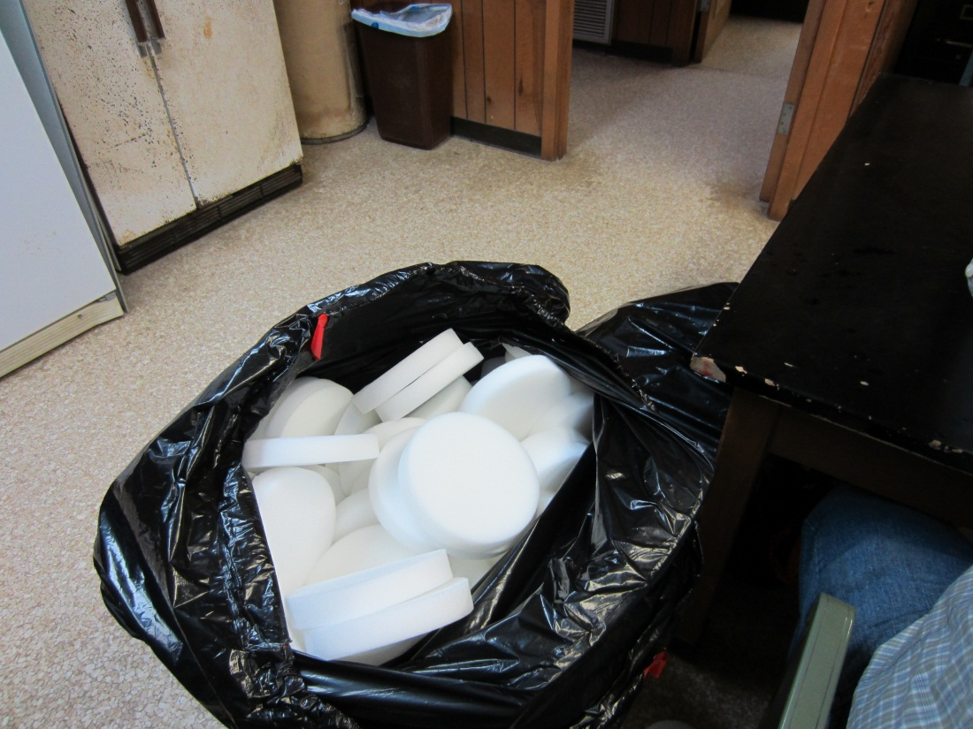
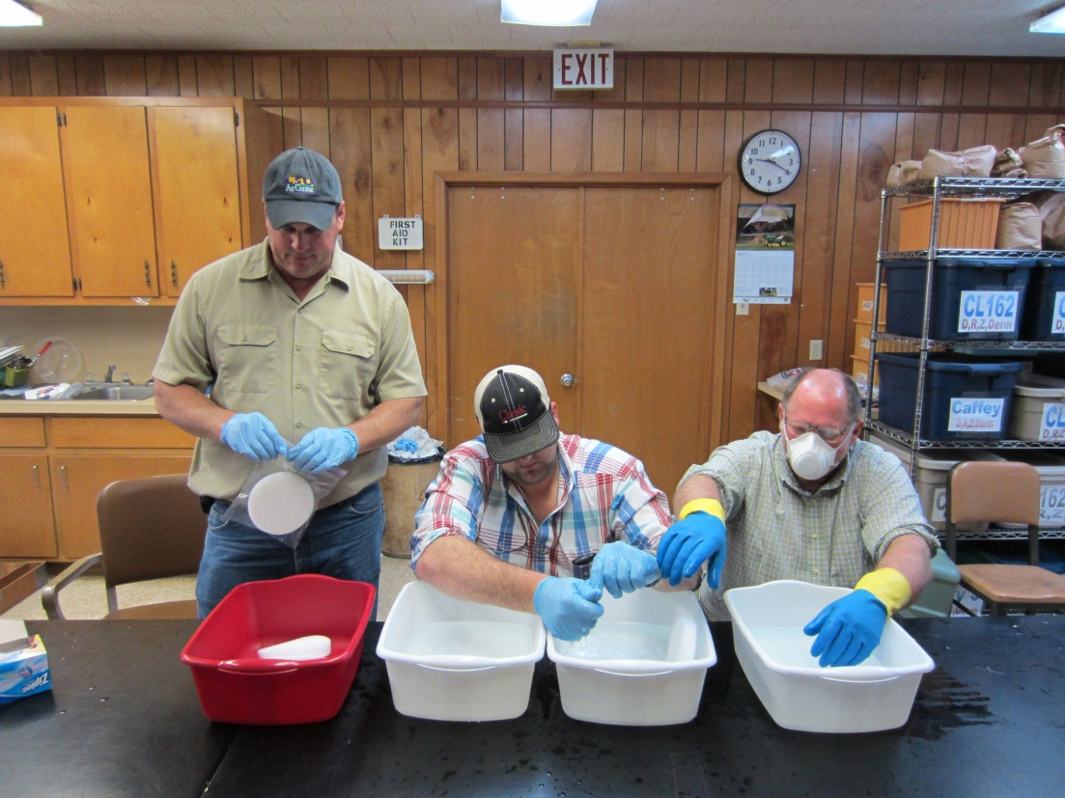
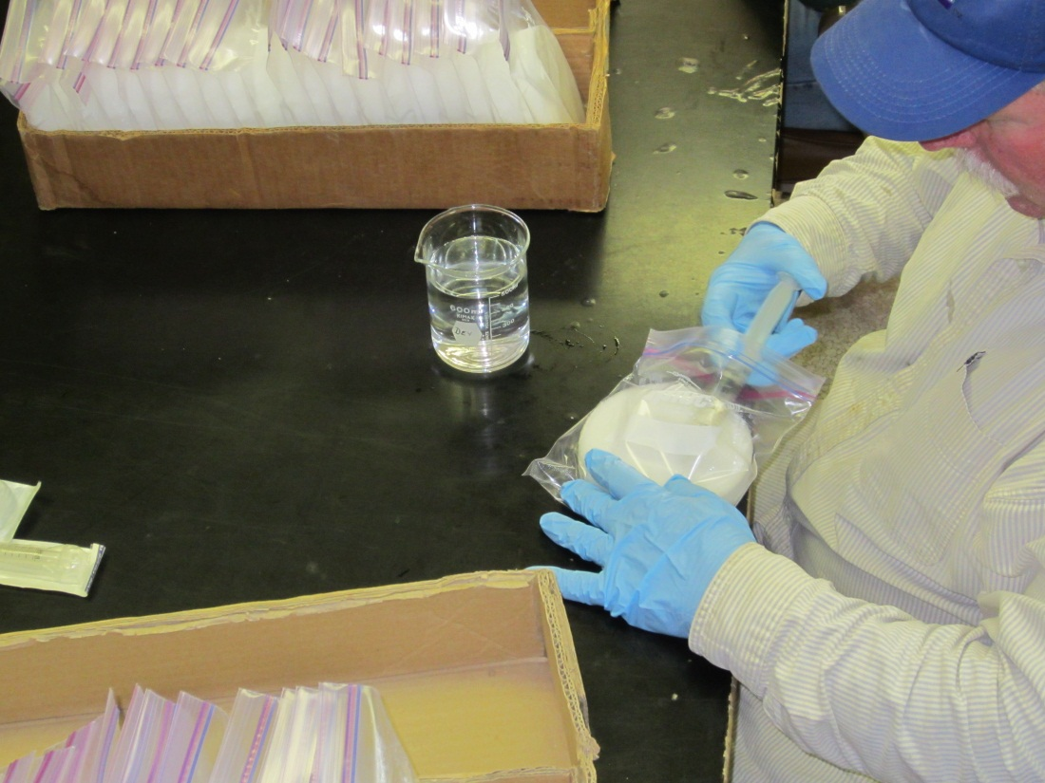
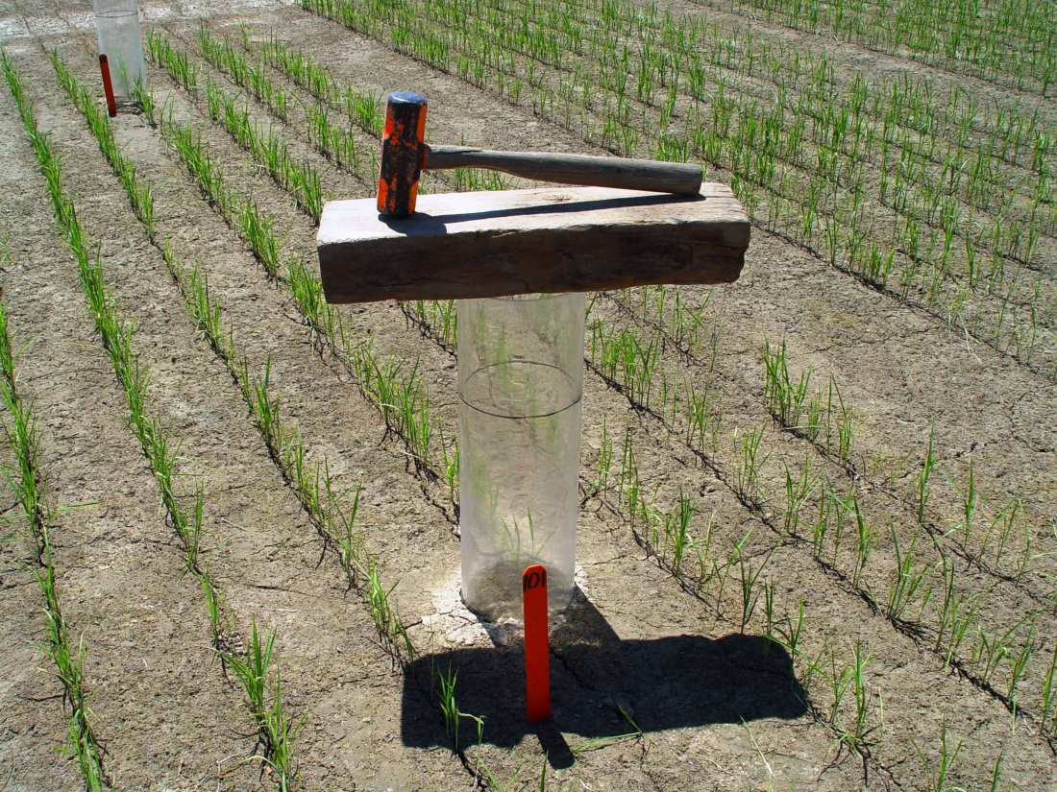
0.73M H₃PO₄ + 33% Glycerine

Slide 9
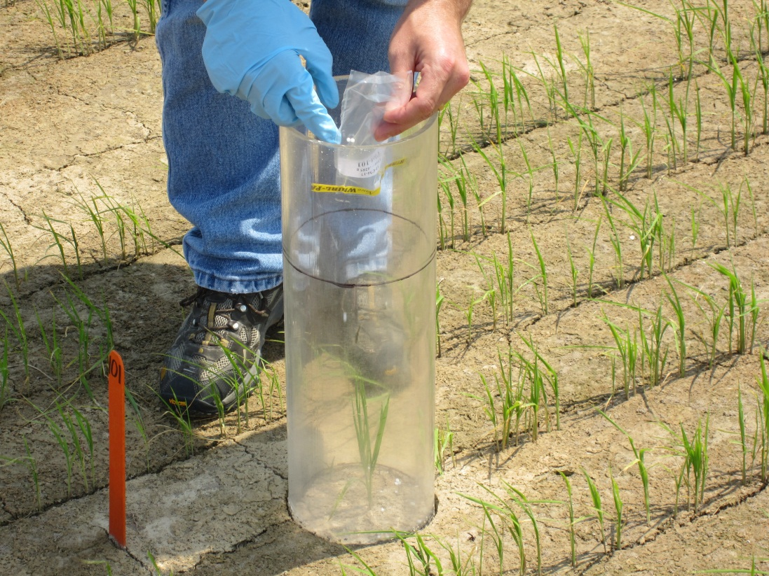
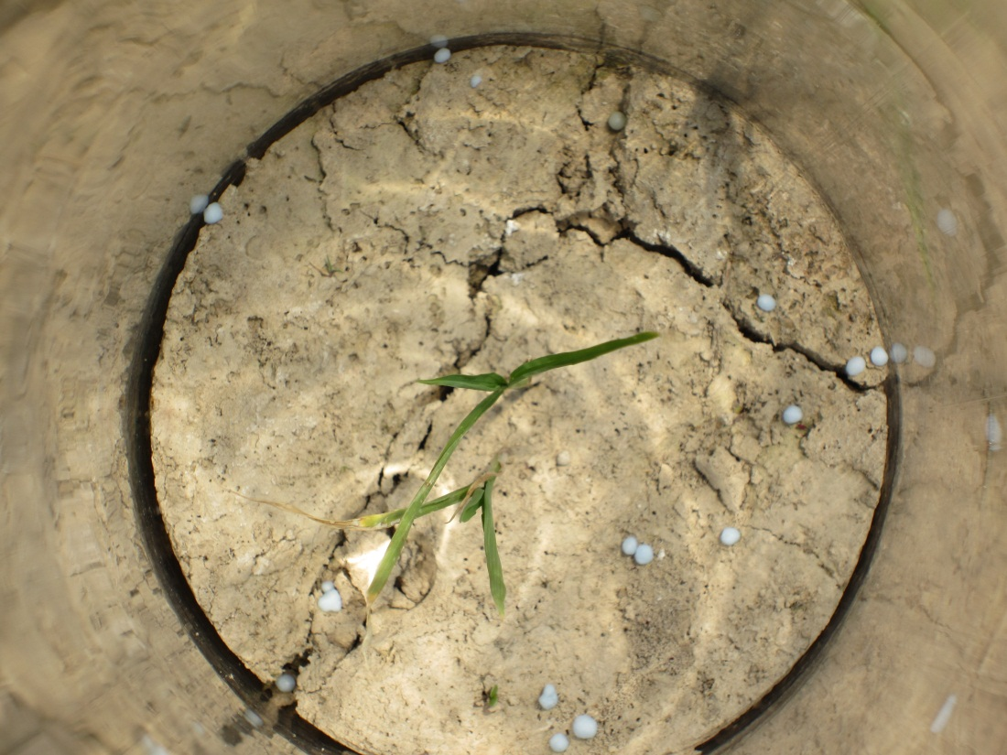
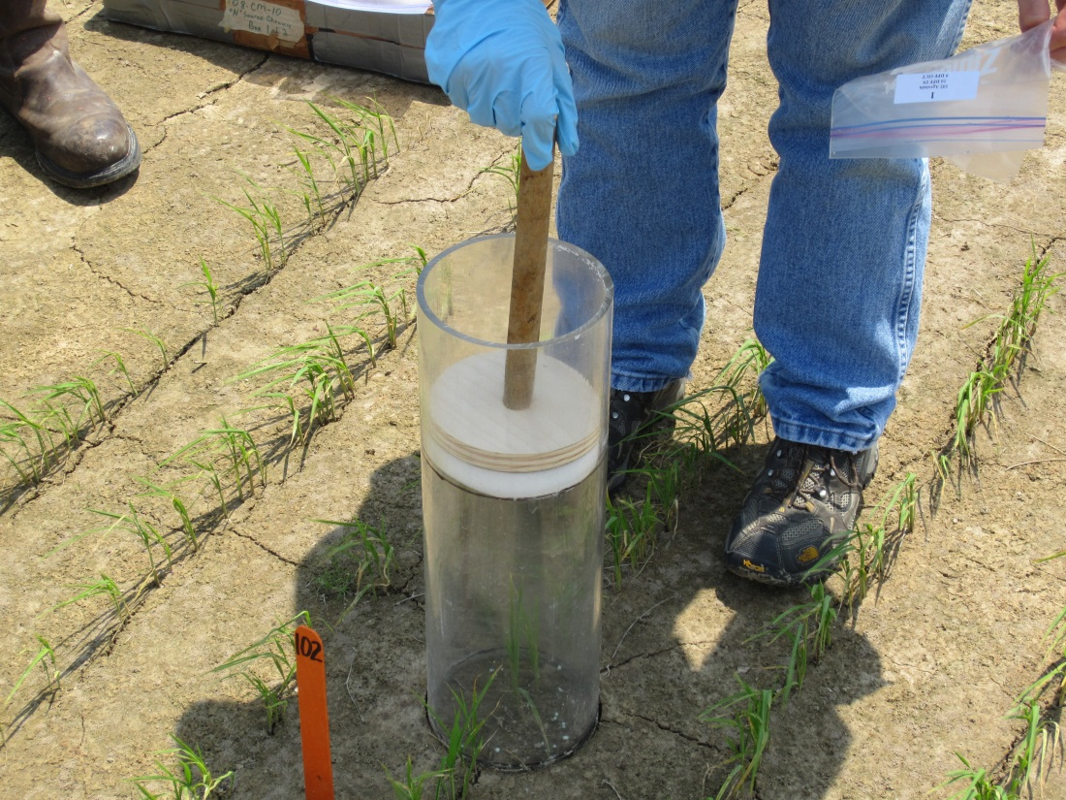
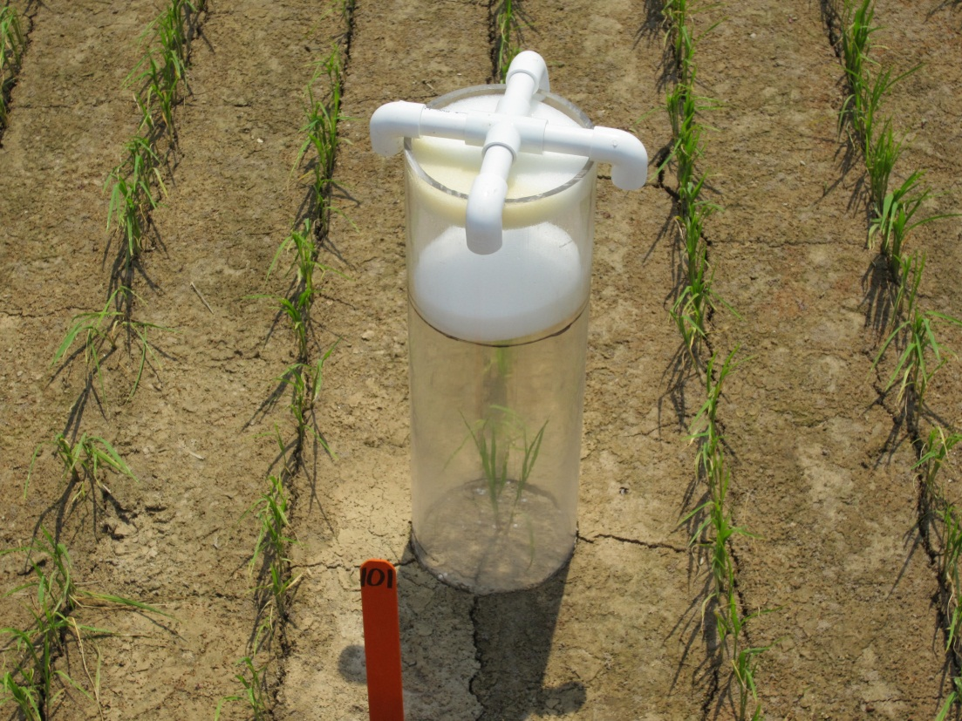

Slide 10
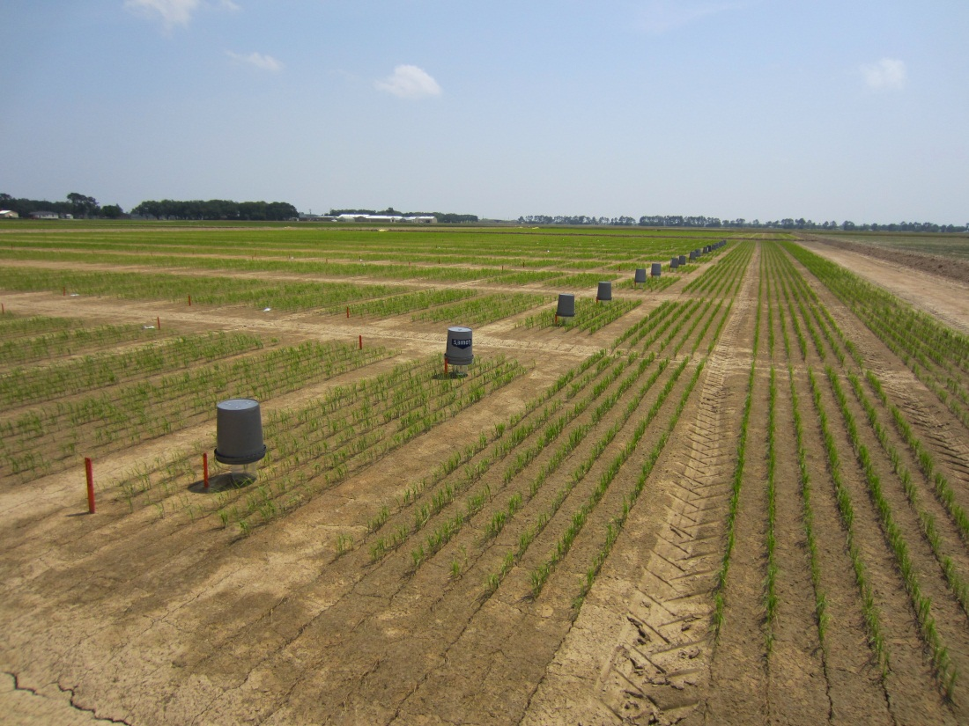
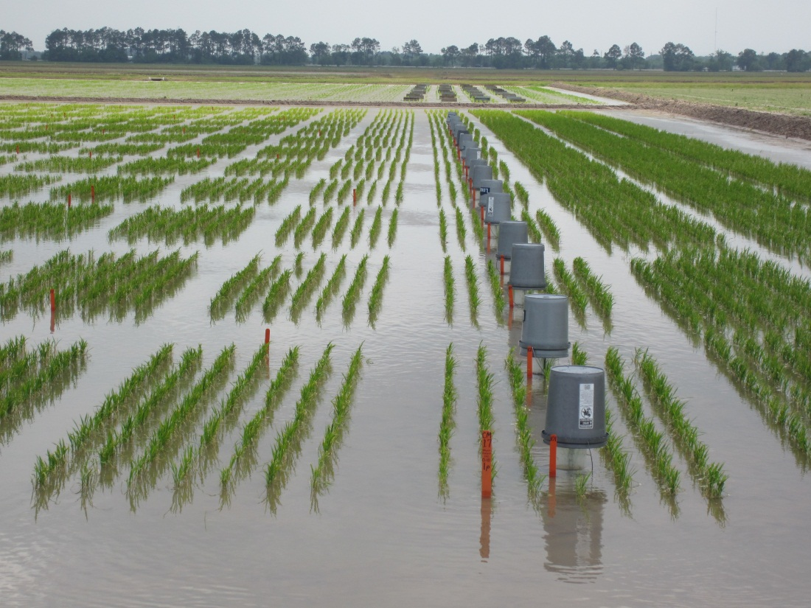
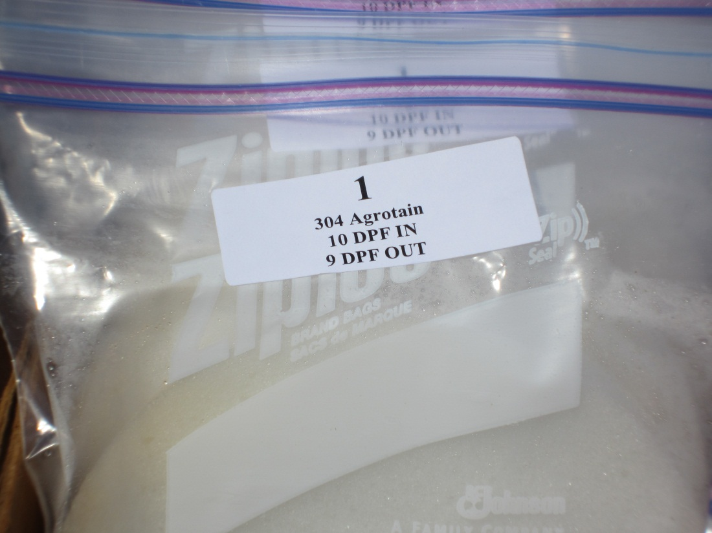
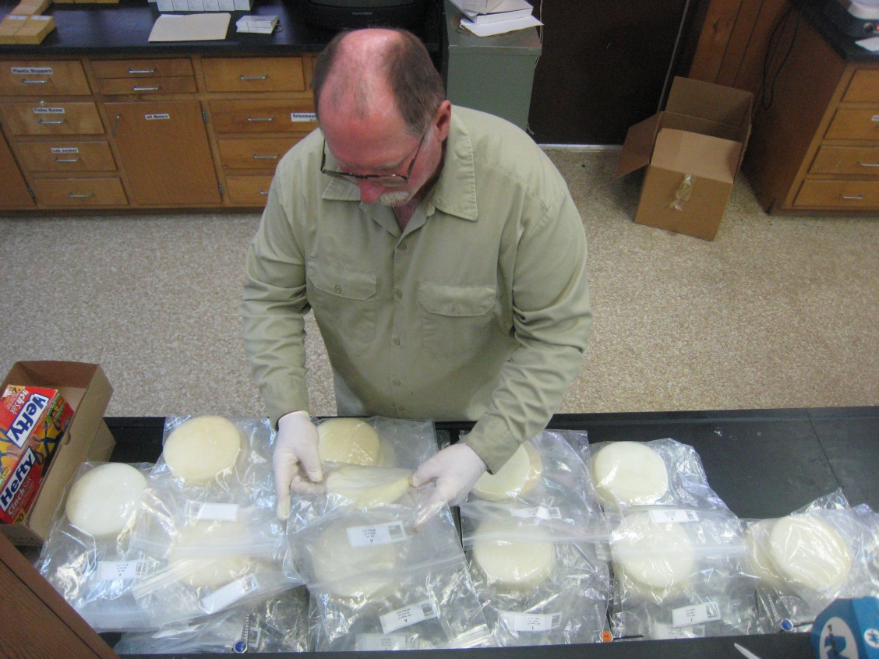
Changed 8 times over 15 day period

Slide 11
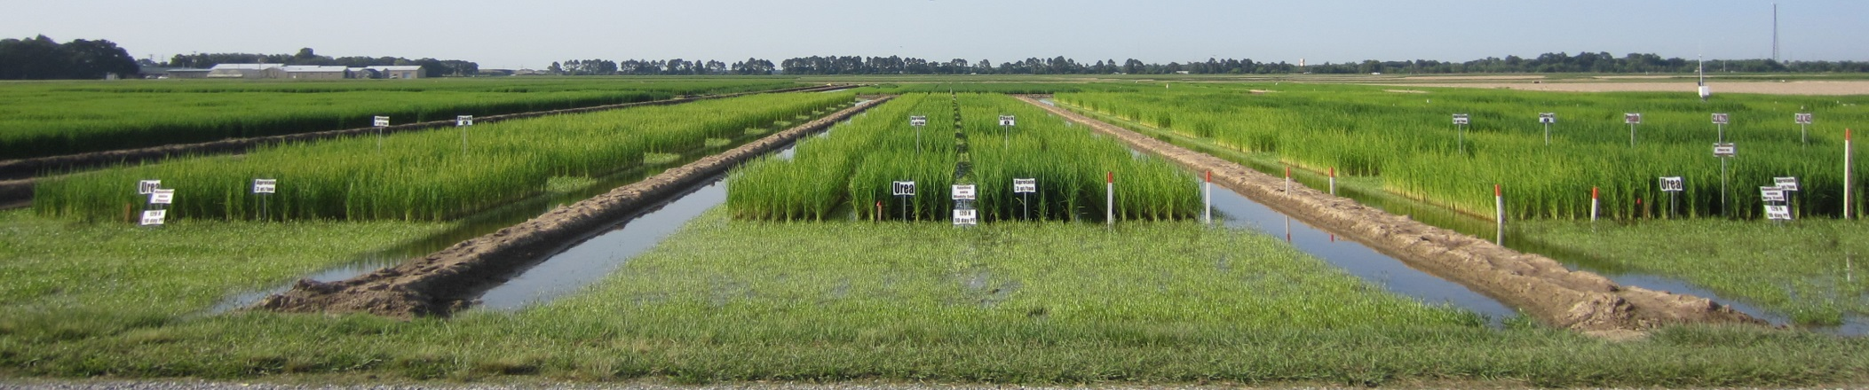
Field Trial
3 Soil moistures
  dry, moist, flooded
4 N sources
  Urea, AU, AIU, SUPERU
3 check plots (no N)
  Wet, dry, moist
N rate 134 kg ha⁻¹
N applied 10 days pre-flood
Split-plot design

Slide 12
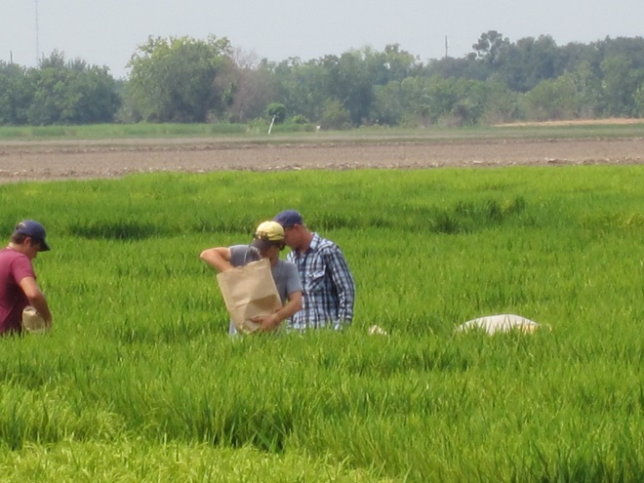
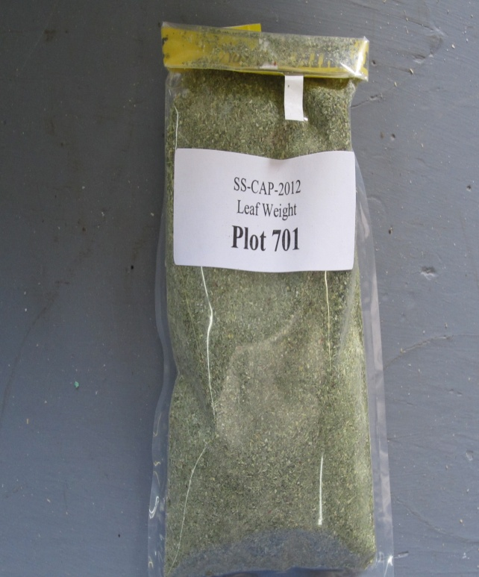
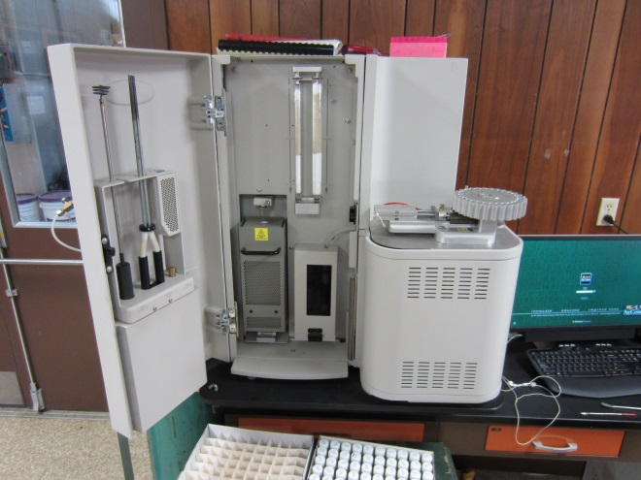


  $$\text{Apparent} \text{N} \text{Recovery} \text{Efficiency}\text{ (}\text{ANRE}\text{)}$$
  $$\text{ANRE}\text{ =[}\text{Total} \text{N} \text{uptake} \text{with} \text{N}\text{ − }\text{Total} \text{N} \text{uptake} \text{w}\text{/}\text{o} \text{N} \text{]}$$
  N rate
x 100
Within soil moisture treatment
(wet, dry, moist)

Slide 13
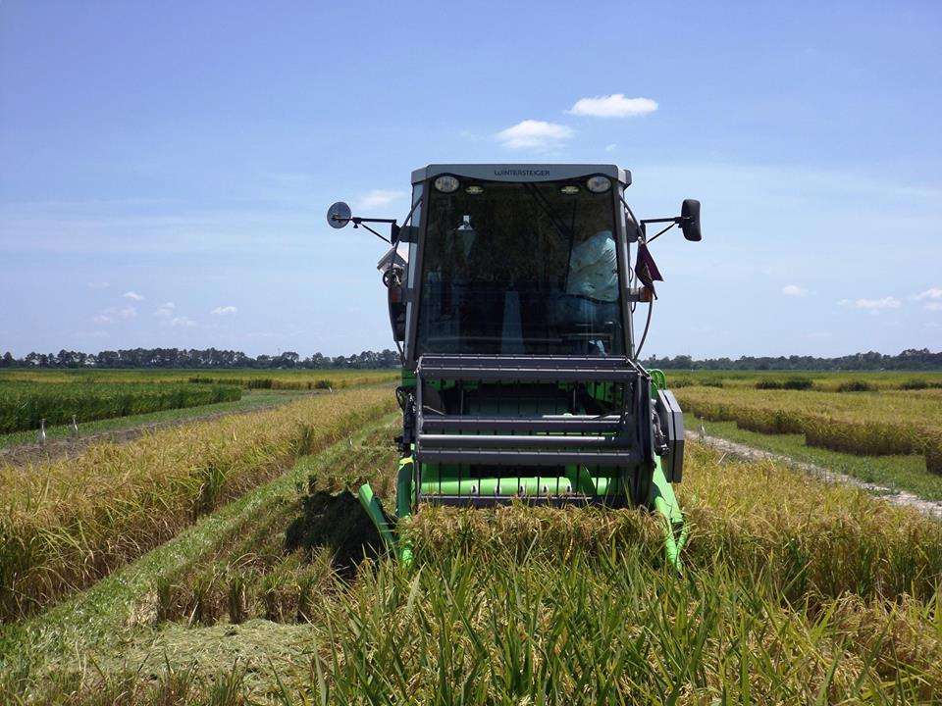
2014
Drill-seeded April 30
fall-stale seedbed
Flood established June 24
Harvest Aug. 25
4 rainfall events occurred :
June 10 1.50 inches
June 11 1.59 inches
June 13 0.24 inches
June 15 0.07 inches
2015
Drill-seeded March 20
  fall-stale seedbed
Flood established April 30
Harvest: July 20 (flood)
July 27 (moist/ dry)
No rainfall events occurred during 10DPF

Slide 14
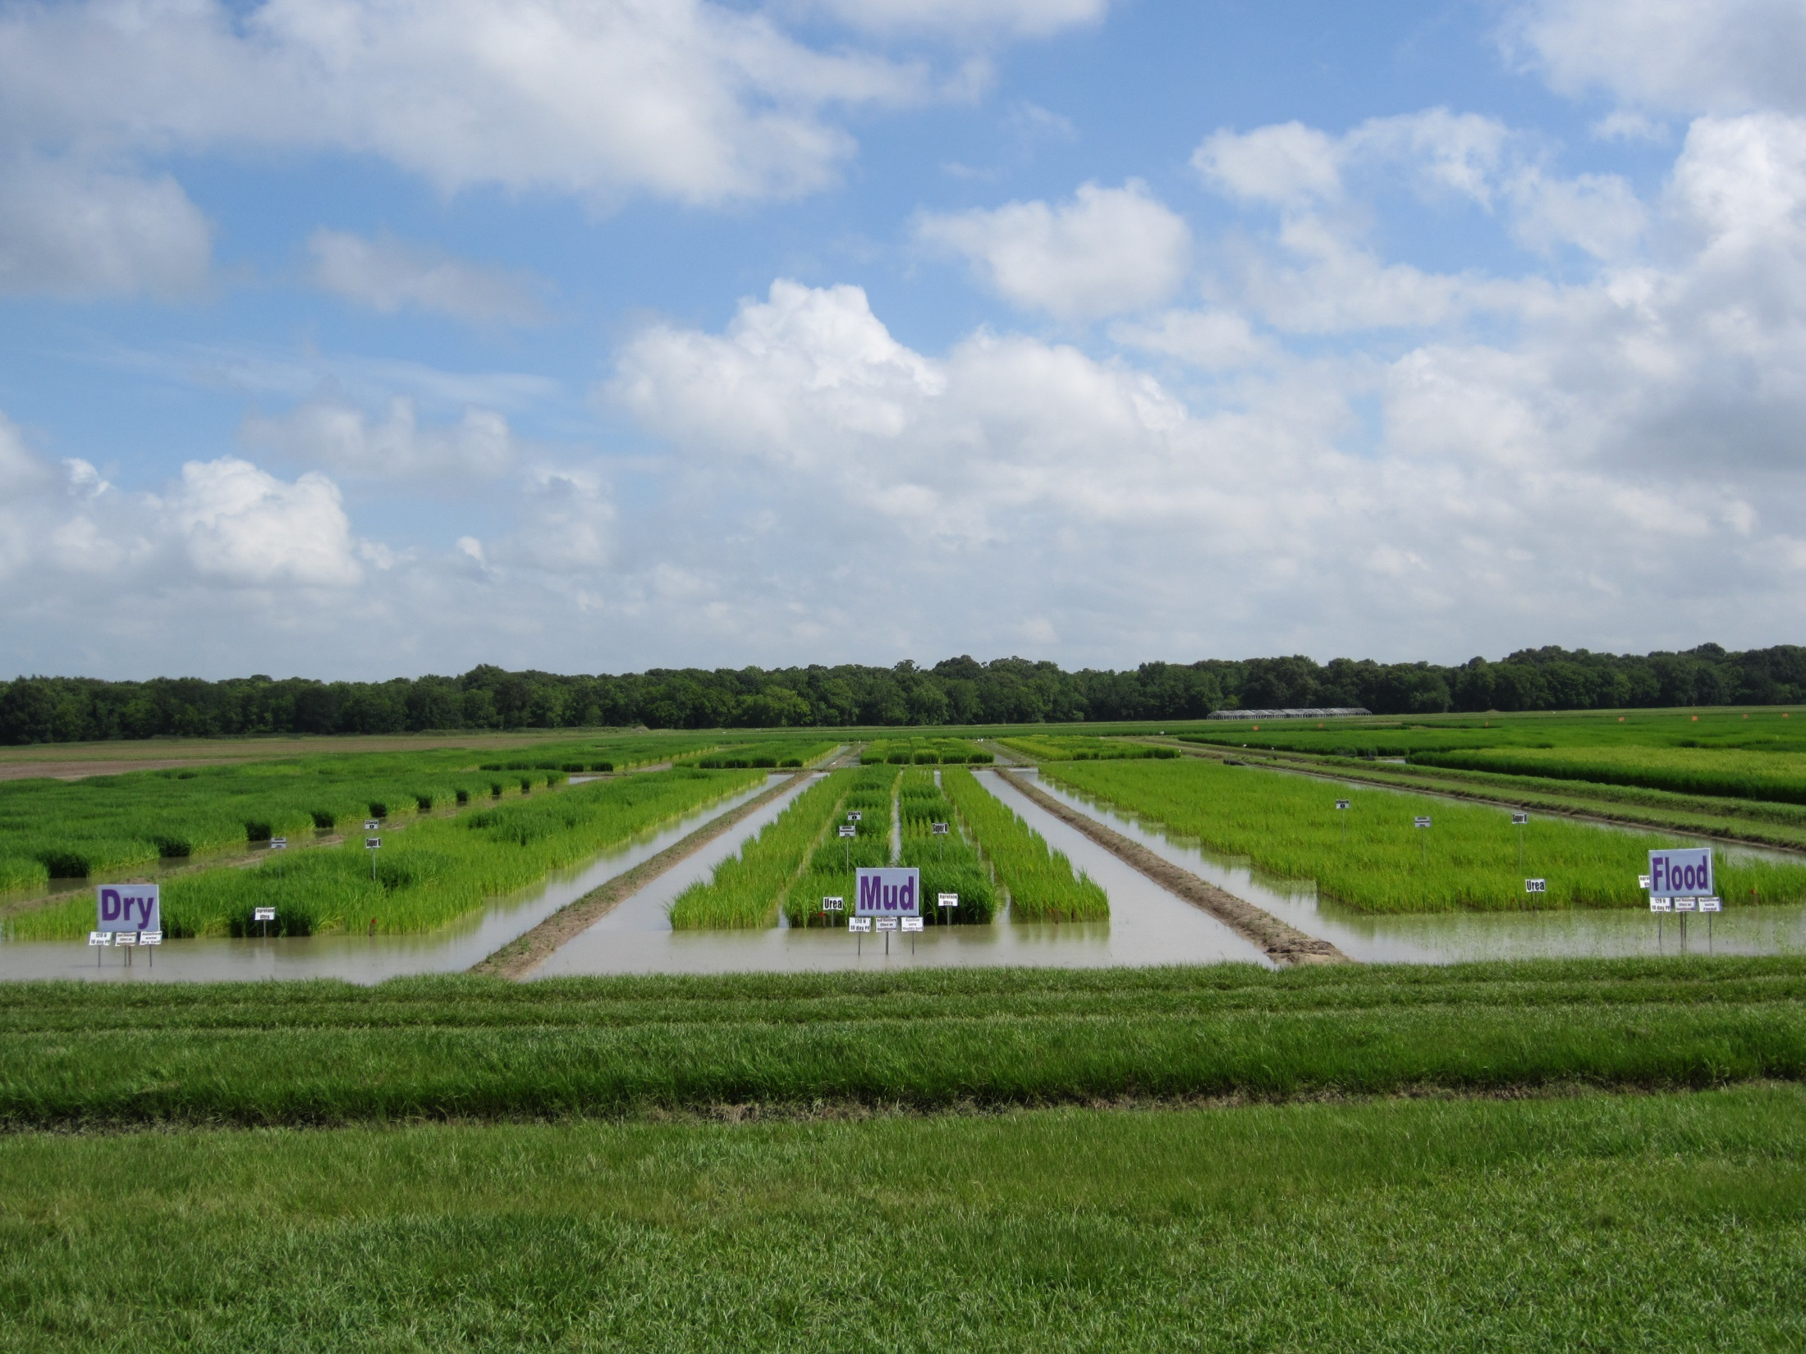

Slide 15
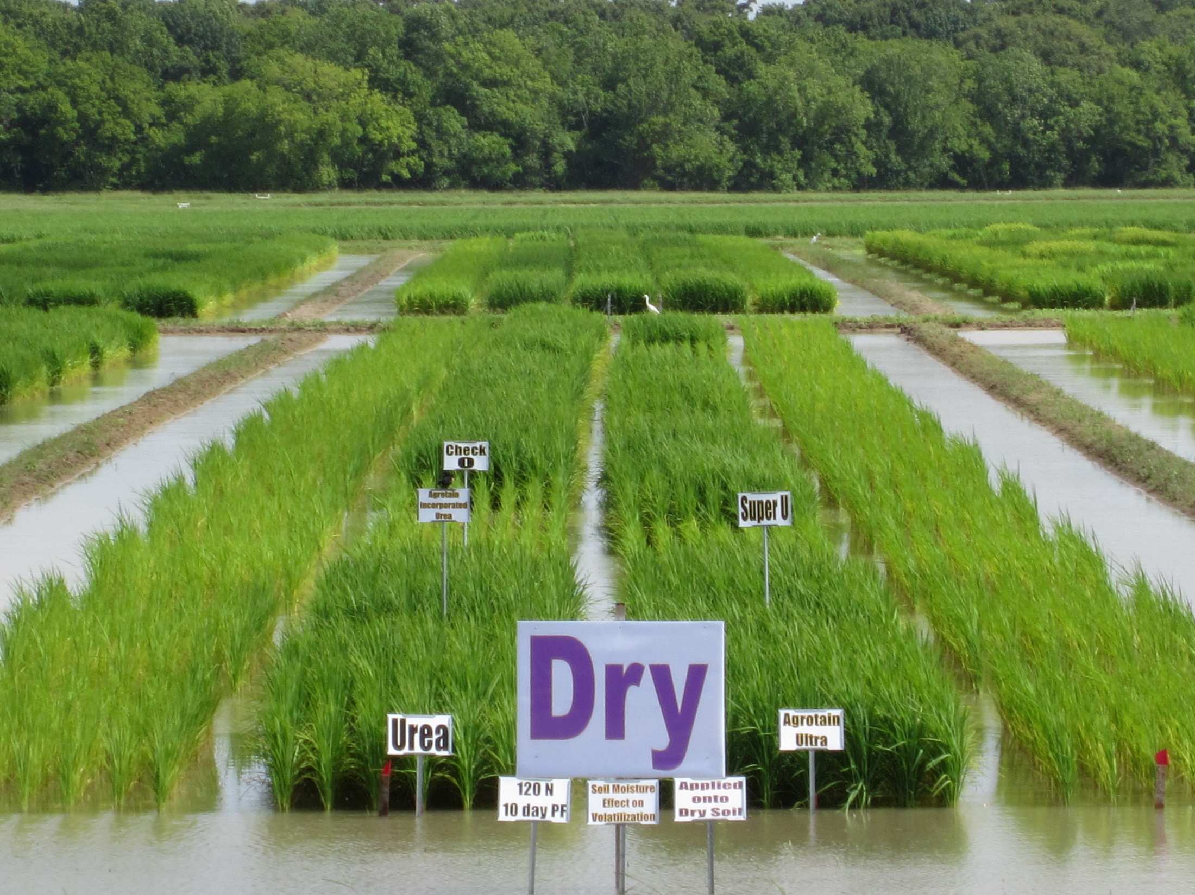
MAU

Slide 16
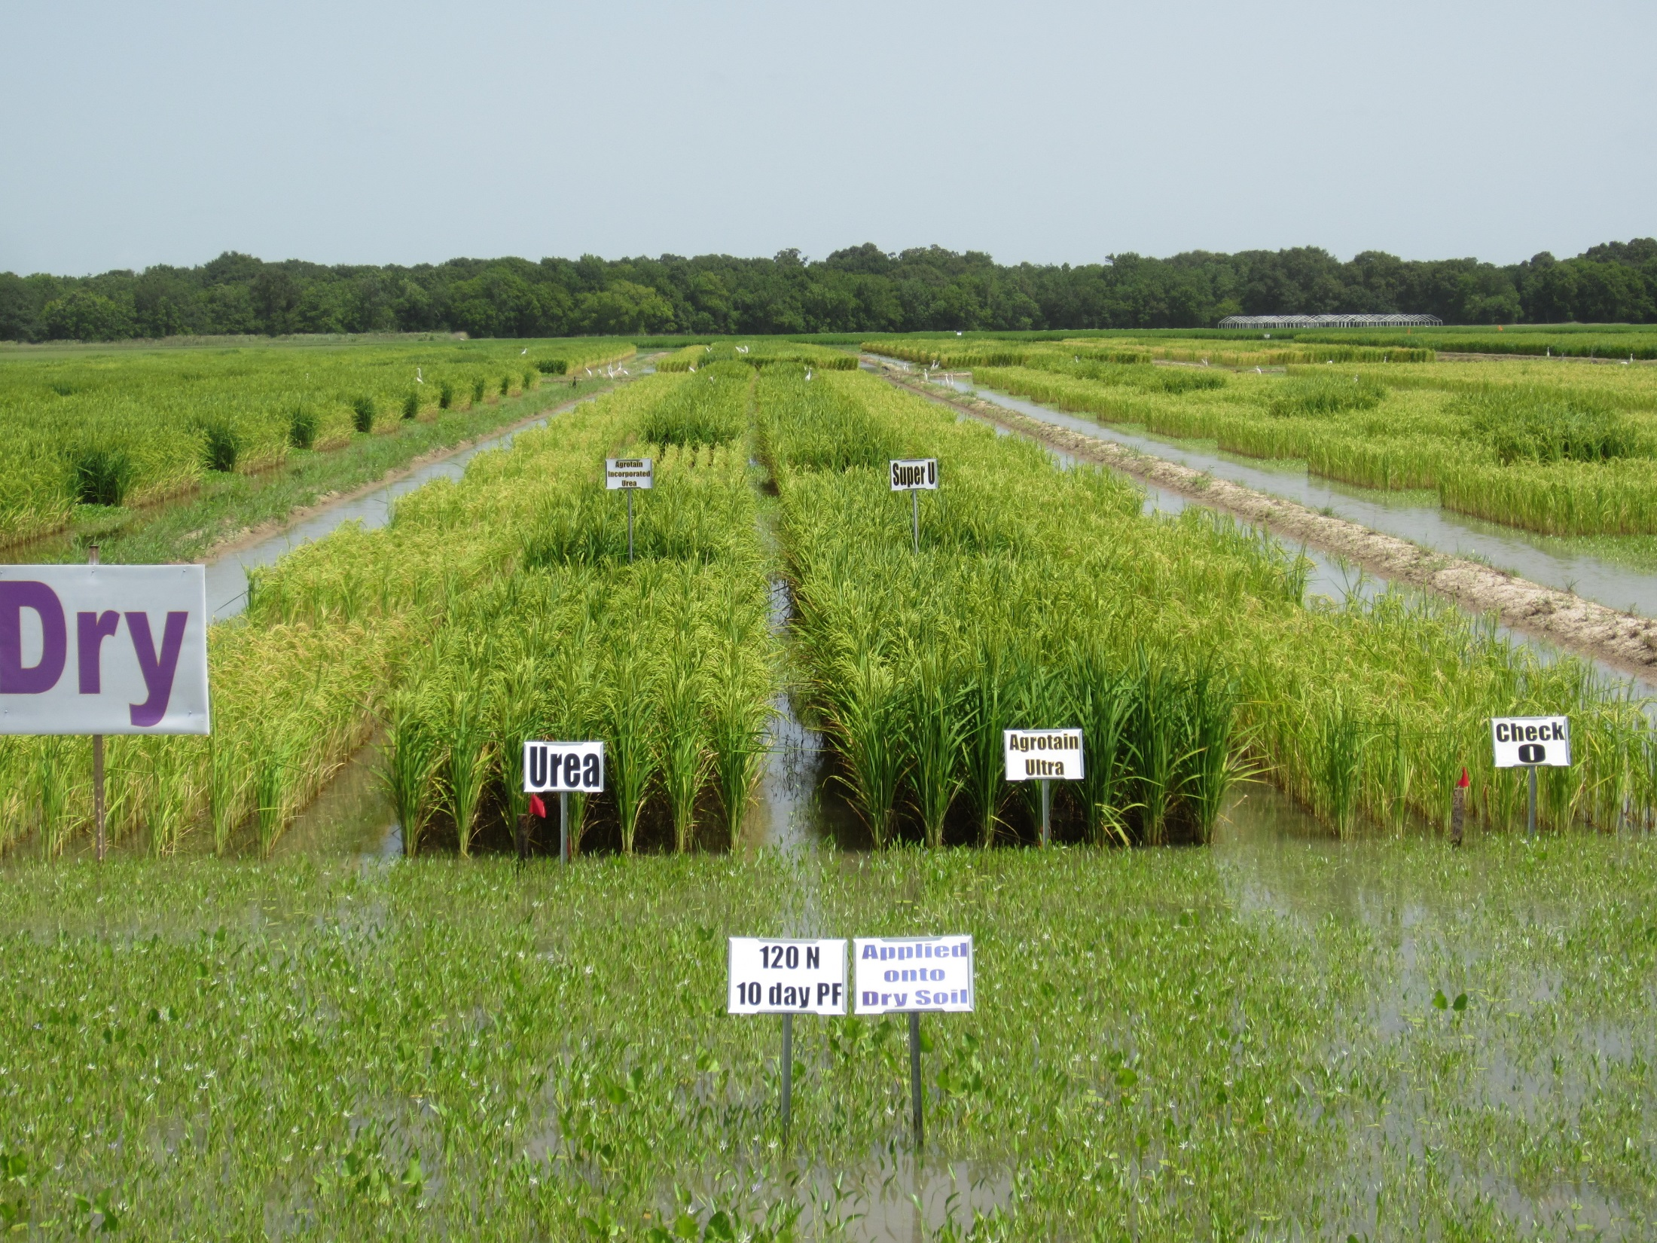
MAU

Slide 17
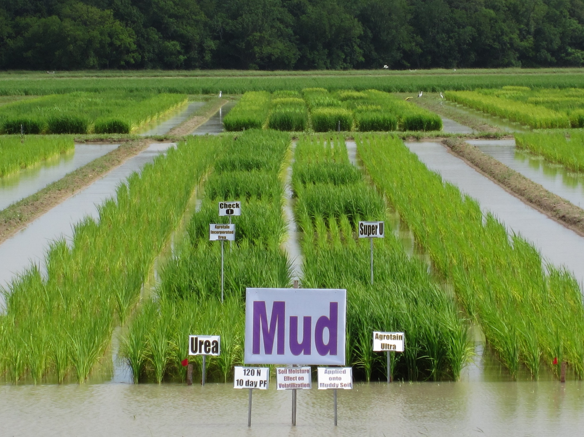
MAU

Slide 18
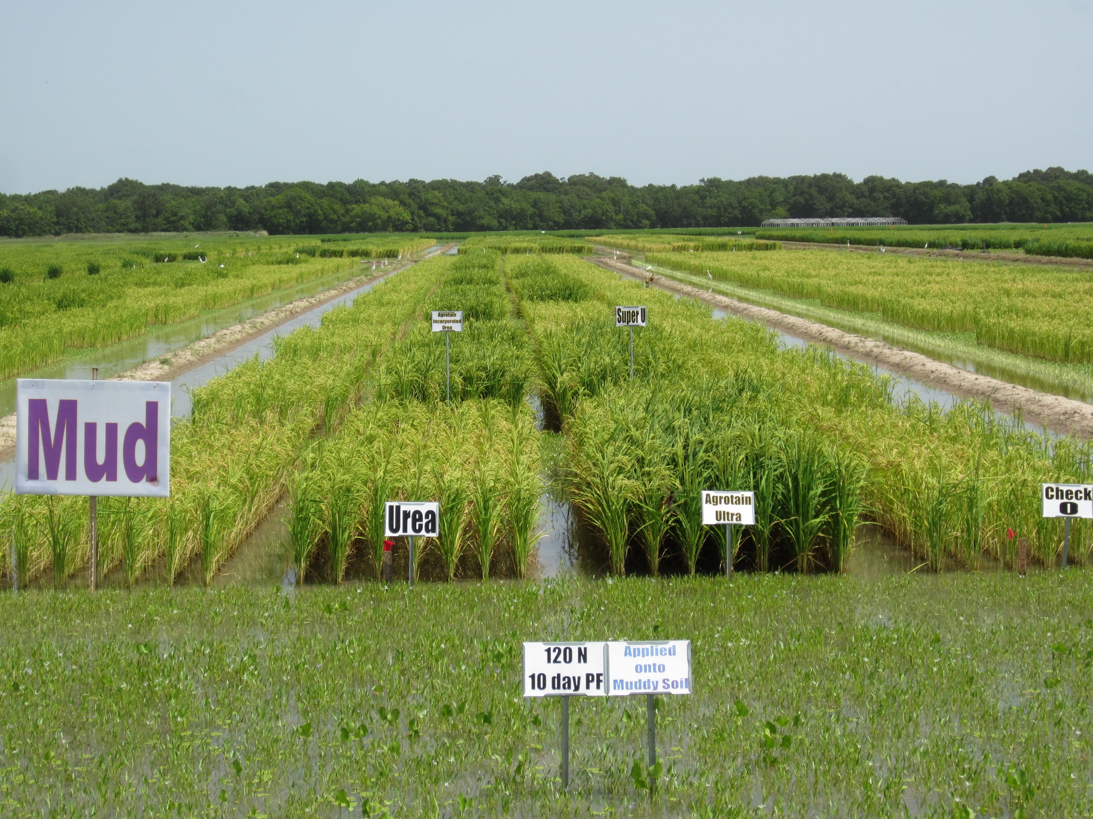
MAU

Slide 19
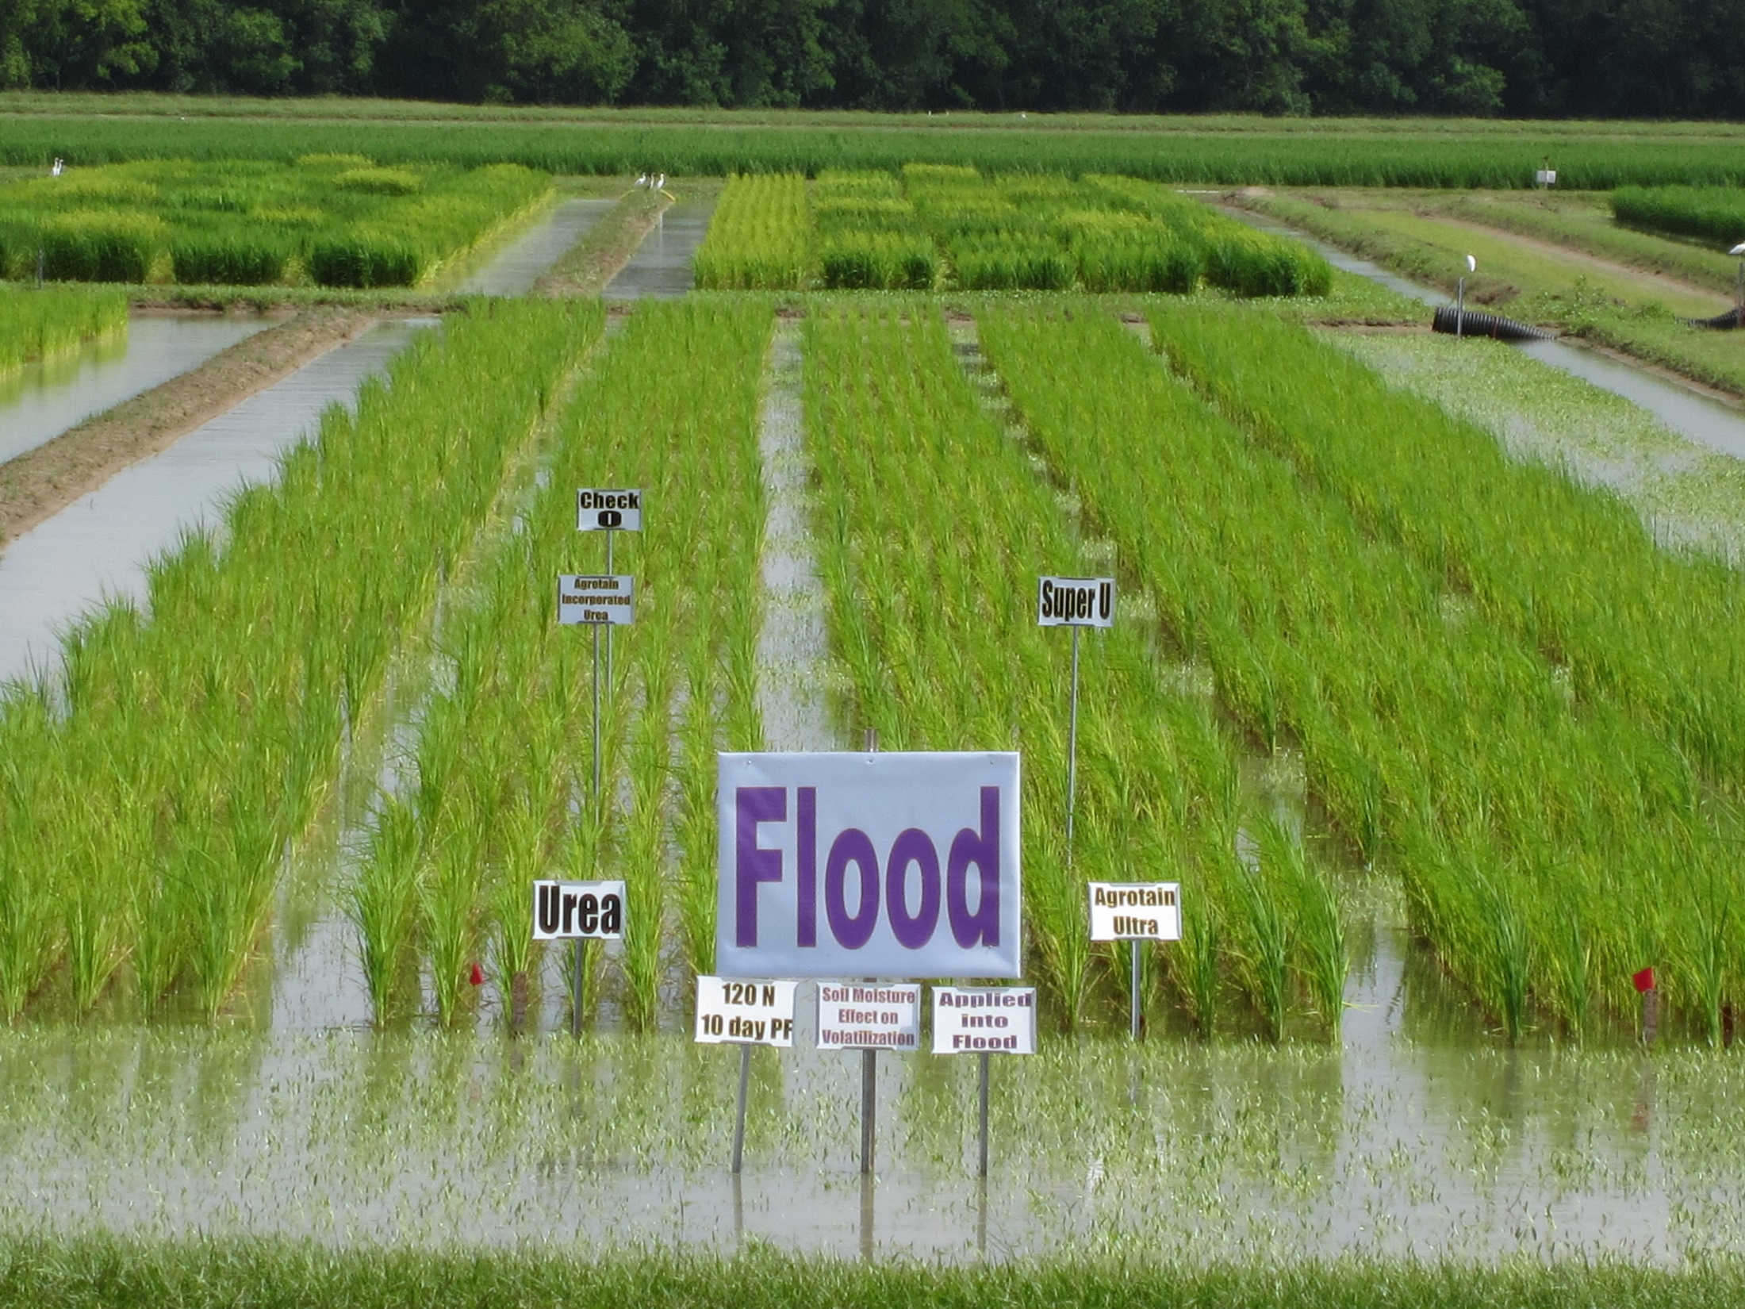
MAU

Slide 20
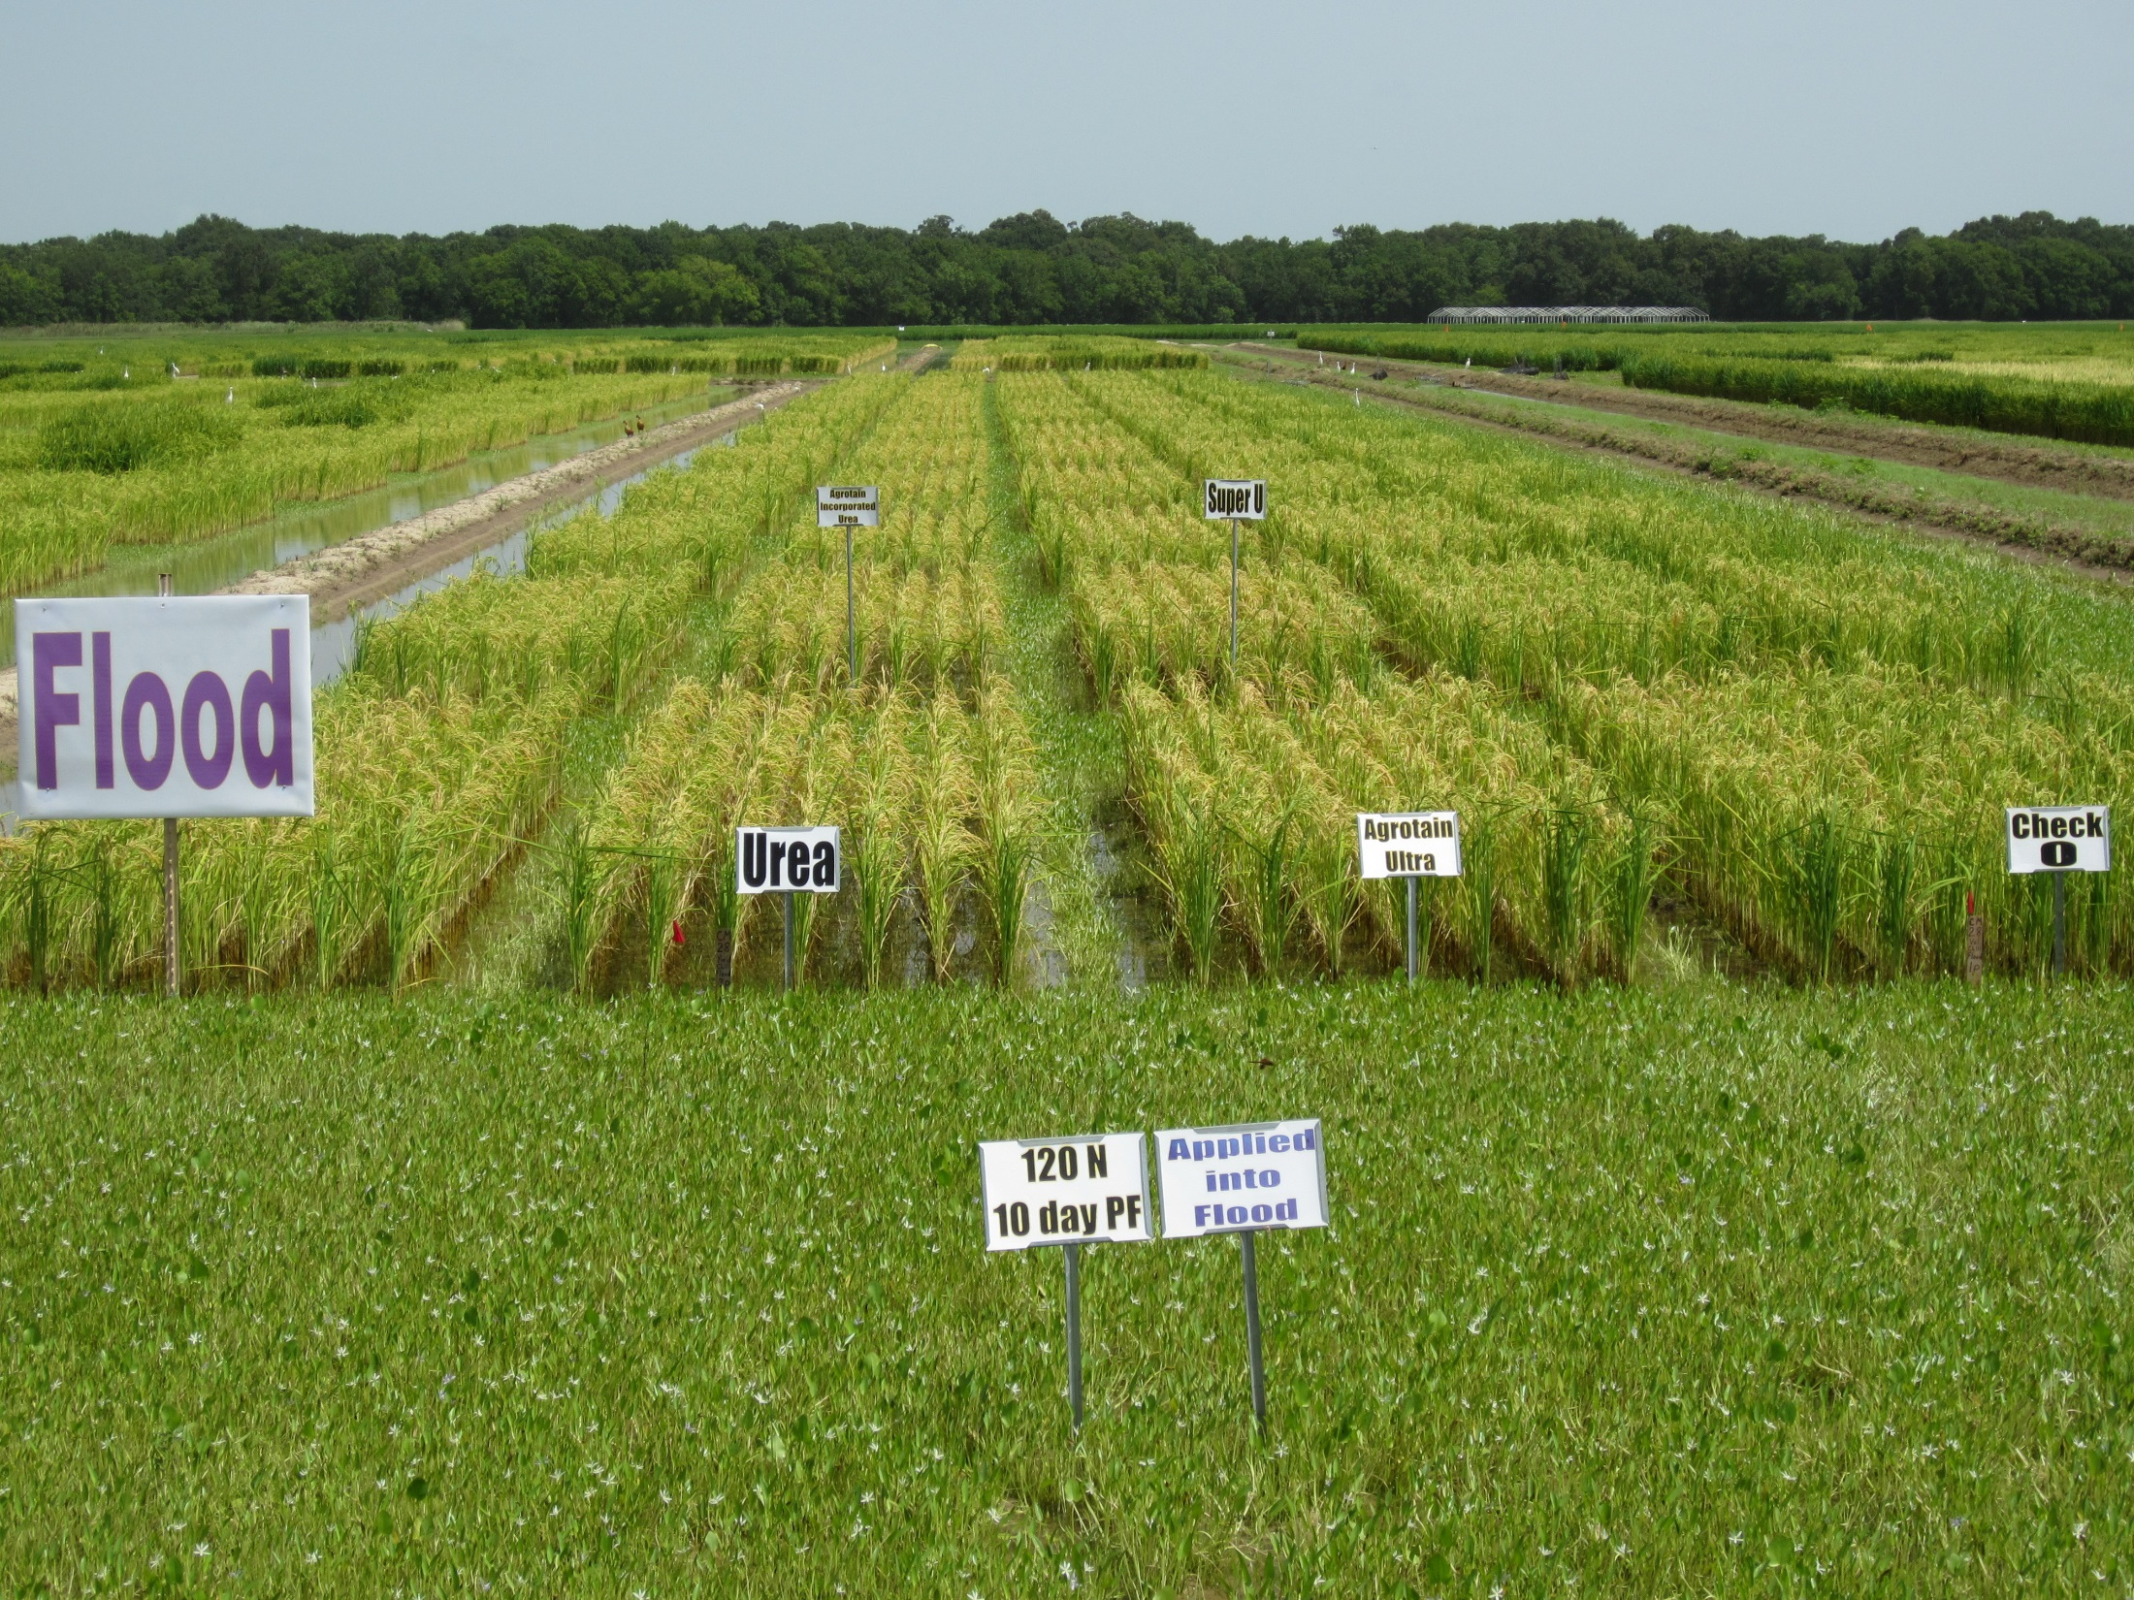

Slide 21
2015
MAU

Slide 22
2015
MAU

Slide 23
2015
MAU

Slide 24
2015
MAU

Slide 25
2015
MAU

Slide 26
2014
MAU
MAU
MAU

Slide 27
2014
MAU

Slide 28
2014

Slide 29
Conclusions
Rice yield and NUE were greatest when N fertilizer was applied onto dry soil
  (dry > moist > flood)
NBPT-ureas reduced volatilization losses and increased NUE and yield when applied on a moist soil as compared with untreated urea.
NBPT-ureas did not reduce volatilization when applied into a standing flood.

Slide 30
Conclusions
Ammonia volatilization was major N loss mechanism when applications were made on a dry or moist soil.
We hypothesize that other N loss mechanisms were dominant when N was applied into a standing flood (nitrification/denitrification).
Future controlled environment trials needed to validate this hypothesis.

Slide 31
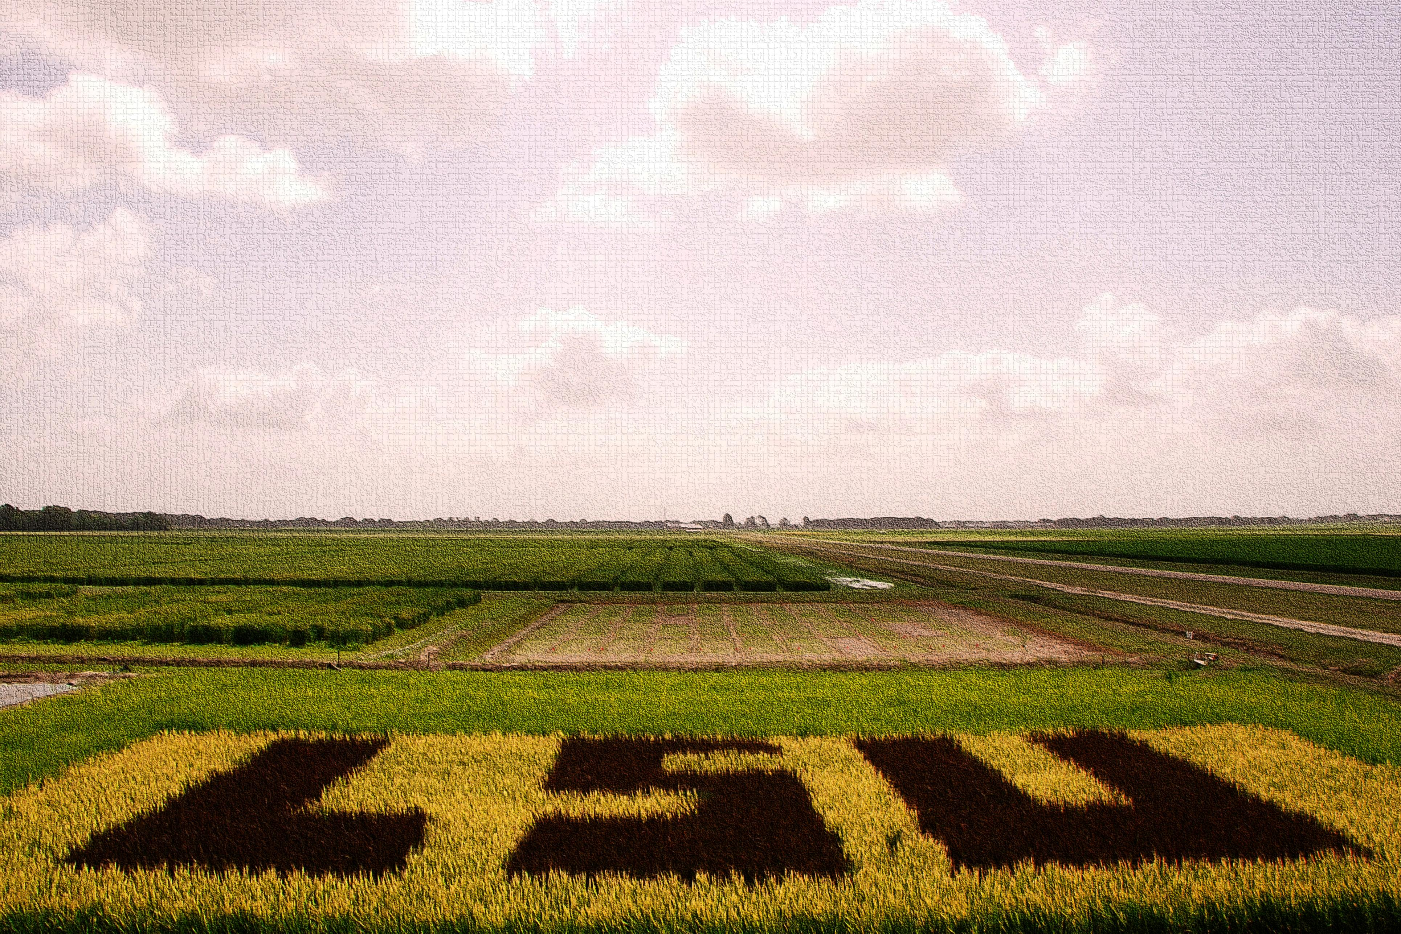
Questions

