Slide 1
Can Crop Growth Modeling Inform Management Practices that Improve NUE in Wheat
Joel Ransom and Nicholas Schimek

Slide 2
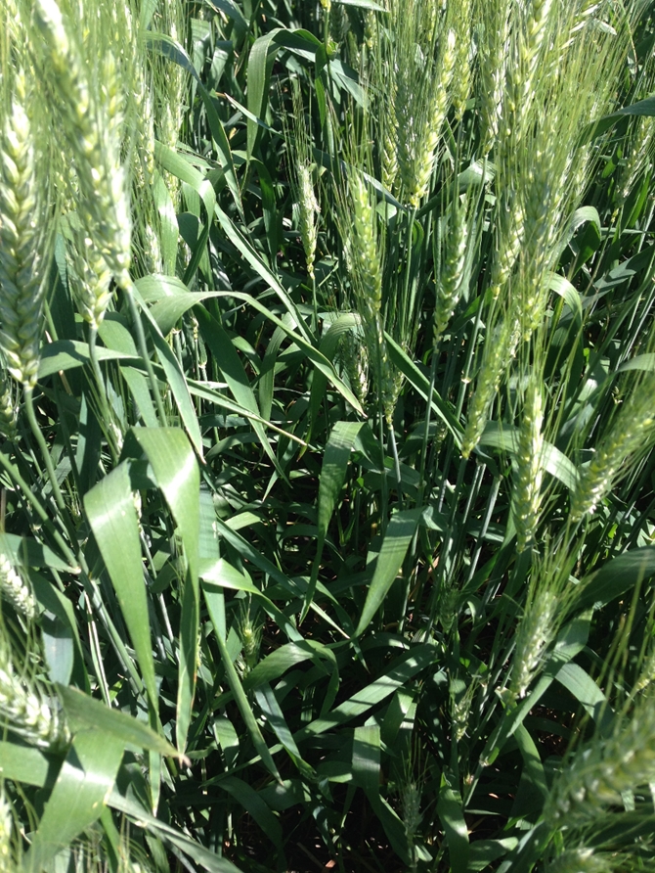
Background
Spring wheat has high nitrogen requirement
2.5 lbs N per bu expected yield (old recommendation)
Concerns for both yield and protein
Most common practices
All nitrogen applied at planting (no-till systems) or pre-plant (fall or spring)
AA and urea commonly used
Limited split applications – UAN at 4 to 5 leaf stage

Slide 3
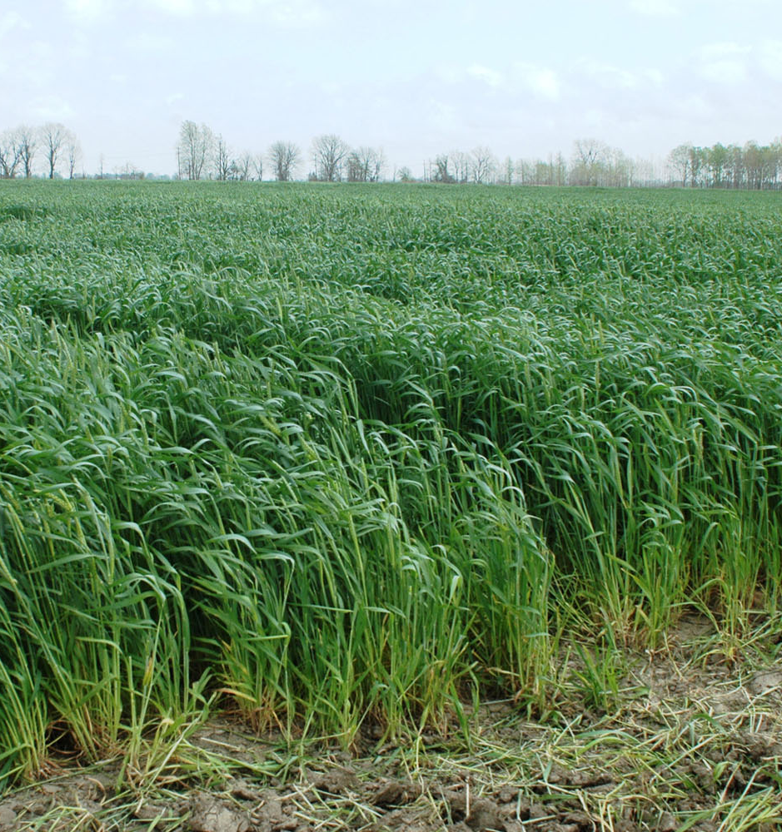
Background
Matching amount of N to apply to crop need difficult
Rainfall and to a lesser extent temperature impact yield
Weather impacts nitrogen
Spring wheat cultivars vary in yield potential and N requirement per unit of applied N

Slide 4
The relationship between yield and protein across varieties is strong and negative, (data from Langdon 2013 as example).
Brennen
Linkert

Slide 5
Background
Relationship between yield and protein is often negative
Foliar application of UAN, post flowering to augment protein
30 lbs N (10 gal UAN plus 10 gal water)
Consistent increase of at least 0.5%
More efficient use of N for protein enhancement than other timings?

Slide 7
Can modeling crop growth (DSSAT) inform N fertilizer needs
How well can we predict yield during the season
If high yields are predicted early enough, additional in-season N might be applied
If yields are known by flowering, can the profitability of a foliar application can be calculated for protein enhancement

Slide 8
Our experience with crop modeling
DSSAT: Decision Support System for Agrotechnology Transfer
Application program that comprises crop simulation models for over 42 crops (as of v4.6).
Based on a rigorous understanding of plants, soil, weather and management interactions
Morphological and phenological development
Photosynthesis, respiration, partitioning and growth
Root water and nitrogen uptake
Stress effects on growth processes
Predict growth, yield, timing of outputs
Open source (not cost for software)
Inputs: Multiple soil parameters, crop genetic coefficients, and nearby weather data
Fairly steep learning curve and need to stay in practice

Slide 11
Methodology
Calibrated model for the variety Glenn using weather data historic weather data and yields from variety trials
Predicted yield using this year’s weather up to key growth stages (4 leaf, boot and flowering) followed by historical weather data (normal, 25 previous years ran individually, analogue years)
Can’t predict the weather but you know past weather

Slide 16
Relationship between yield and premium on returns when protein amount increased by 0.5% (in $ per acre).
 | Expected yield (bu/acre)
Premium/Discount ($/bu/half point protein) | 37 | 45 | 52 | 67
$0.15 | -14.33 | -13.13 | -12.08 | -9.83
$0.30 | -8.78 | -6.38 | -4.28 | 0.22
$0.45 | -3.23 | 0.37 | 3.52 | 10.27
$0.60 | 2.32 | 7.12 | 11.32 | 20.32
Cost of UAN per acre is $14.88
Cost of Application $5.00
Total Cost of Application per acre $19.88

Slide 17
What about soil N dynamics
DSSAT simulates soil N:
Total N
Total Nitrate
Total Ammonium
N mineralization
Nitrification
Denitrification
Immobilization
Ammonium volatilization
Nitrogen uptake

Slide 18
Year-to-year variability in total soil N at flowering, Carrington.

Slide 20
Conclusions
Yield cannot be predicted with confidence using DSSAT until after boot stage
Analogue years were only marginally helpful
In environments with little N loss, soil N and crop yield tightly and negatively related
DSSAT can provide valuable insight into the profitability of a post flowering applications (at flowering stage)
Yields above 70 bu and total soil N below ~75 lbs total N at flowering
Relationship between total N in soil and protein needs investigation

