Slide 1
How High Should NUE Be, and Can Knowing Soil N Help Us Get There? NUE Conference, Baton Rouge, LA August 7-8, 2017
Emerson Nafziger, Crop Sciences
University of Illinois

Slide 2
How we’ll talk about NUE today
A common way to calculate NUE: divide fertilizer N rate by yield to come up with lb. N per bushel of yield – we’ll call that “unadjusted” NUE
We’ll use the economic optimum N rate (using value of one bushel pays for 10 lb. N) and the yield at the EONR from trials
One modification is to divide the EONR by the yield increase from zero N to EONR (ΔY) – we’ll call this the “adjusted” (fertilizer) NUE
By these NUE calculations, lower NUE is “better”, and any NUE <1 or 1.2 lb N/bu is “good”

Slide 5
How high (or low) should NUE be?
Efficiency as measured by how many lb. N is required per bushel of yield is not an indicator of what the “best” N rate is:
Efficiency is highest at low N rates
Efficiency is not maximized at the “optimum” N rate
High yields make for high efficiency, but it’s hard to know how “efficient” N really was unless we know the actual N need
Getting close to the EONR produces the “best”, if not the highest (lowest) NUE
Maximizing NUE does minimize leftover N

Slide 6
In 2015, wet June weather meant the need for higher N rates – this lowered efficiency

Slide 7
8 of 33 sites needed more N than MRTN rate Optimum N averaged 18 lb. N less than MRTN
Yield at opt. N averaged 0.8 bu > yield at MRTN
Using optimum N rate returned $10/ac more than using MRTN rate

Slide 11
Soil N supply
We’ll assume that the N requirement for corn is 1 lb. N taken up for each bushel of yield
About 0.65 lb. N per bushel is removed with grain
The soil N supply can be measured as
yield (=lb. of N from soil) at zero N (Y₀)
Can also be measured at EONR as
Y_{EONR} – EONR (EONR = plant N uptake)

Slide 12
Warning:
autocorrelation

Slide 18
Soil N and N fertilizer
The pre-sidedress N test (“PSNT”) was originated by Magdoff and adapted by Blackmer:
Nitrate-N in top foot at V5-V6 used to adjust sidedressed N rate: full rate if <10 ppm; prorate from 10 to 25 ppm; no more N if >25 ppm
Current commercial products use models to show current soil N based on prior application, weather, soil, and plant growth, then to estimate how much more N is needed

Slide 19
Can soil N improve NUE?
Seems reasonable, but in practice it’s complicated:
Soil N levels change rapidly during vegetative growth as the crop takes up N
Effective rooting (uptake) zone changes
Nitrate moves out of (and into?) the uptake zone
Mineralization produces plant-available N
Popular “opinion” is that soil N (nitrate) levels need to be “high” (10, 20 ppm?) during the season to assure an adequate N supply and prevent deficiency

Slide 20
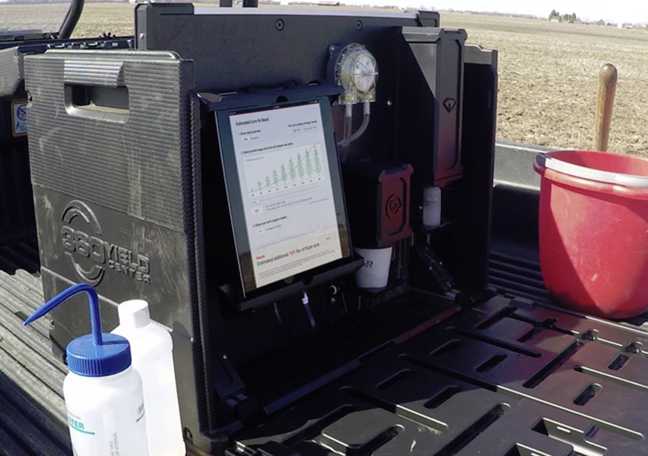
The Soil Scan 360® - analyzes a soil slurry for nitrate and uses yield goal and growth stage to turn this into an N recommendation

Slide 21
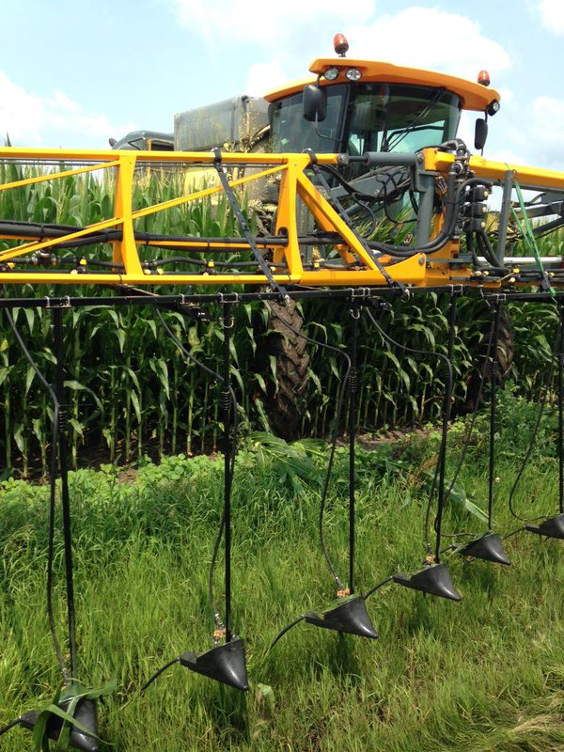
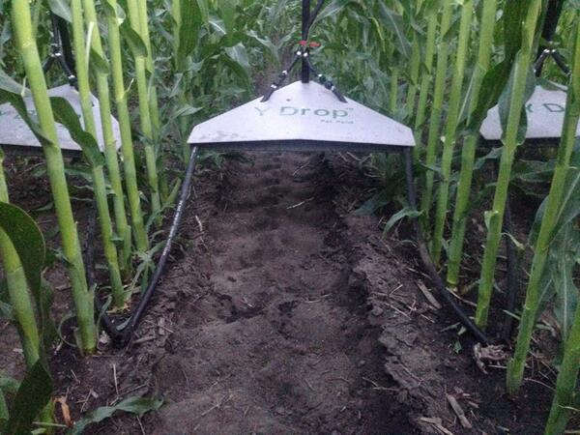
Y-Drop Tubes
-the means to apply N anytime during vegetative growth

Slide 22
Tracking soil N
Project funded by NREC to sample soils every 2 weeks from preplant to VT/R1 following application of 200 lb. N with different forms and at different times
We sample using a template (11 holes 3” apart across a 30-inch row)
0-1 and 1-2 ft samples combined and analyzed for NH₄⁺ and NO₃⁻
Reporting in ppm or lb N/acre(=ppm x 4 per foot of depth; x 8 for 2 ft. depth)
Also taking grain yield

Slide 32
Plant uptake:
67 lb. N in 18 days
= 4.2 lb/ac/day
Plant uptake:
74 lb. N in 18 days
= 5.8 lb/ac/day
19 ppm NO₃
19 ppm NO₃
9 ppm NO₃

Slide 36
←10 ppm

Slide 39
Soil N and yield
At mid-vegetative stages (about V10), 150 lb N/acre (~16 ppm nitrate) in the top 2 ft of soil will often maximize yield
This drops to <10 ppm nitrate by VT (tasseling)
Plant N uptake between early June and tasseling may be as large as, or larger than, the drop in soil N; any net gain is from mineralization
The soil is clearly both a supplier and a reservoir for N; we need to trust it to do that

Slide 41
Issues with using soil N to adjust N rate
Most programs require setting a yield goal, even though (across trials) yield is poorly correlated to the amount of fertilizer N needed
Not knowing soil N dynamics means that we don’t know with accuracy how much soil N at a certain growth stage is enough to prevent future deficiency
The idea of “spoon-feeding” N (based on soil N) involves real costs and risks related to weather (too wet to apply/too dry for uptake)
The ability of soils to both supply N and to store N for the crop is often discounted
Needing to “make sure” pushes many to “apply more” N

Slide 42
Soil N, fertilizer N, and yield-it’s not simple
The amount of soil N available prior to certain growth stages may be more critical than the amount available at that stage – a timing/priming factor that won’t be easy to sort out
Crop N content (or sensor reading?) at V9-V10 may often tell us nothing about adequacy of supply
A dark green crop at VT has no need for added N, no matter what soil N might be:
Late-season N stress is almost always associated with inadequate soil water, not lack of soil N
We tend to lose less N than we imagine we lose, so applying all of the N at planting is often hard to improve upon

Slide 43
Thank you ↓No N 200 lb. N↓

