Slide 1
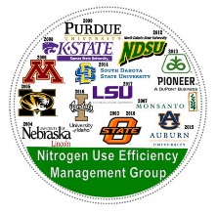
Assessing Grower Adoption
of Crop Sensor
Olga Walsh, Sanaz Shafian,
Steven Blanscet, Jordan McClintick-Chess
Dept. of Plant Sciences
University of Idaho, Parma, ID
2017 Annual Nitrogen Use Efficiency Conference | Aug. 7-9 | Baton Rouge, LA

Slide 2
Why Adaption is Important
In the past
Increase production
Profits
Productivity
Currently
Internationally competitive
High quality agricultural products
Sustainability goals

Slide 3
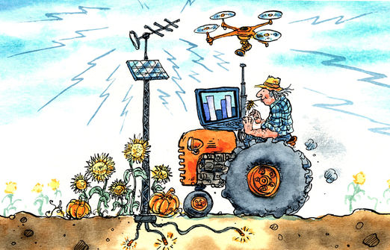
Precision Ag Adoption in US
Farmers - 20%
Dealers - 80%

Slide 4
Factors affecting adoption
Demographic characteristics
Education
Social networks
Farm size
Income level
Age
Motivation
Vary from individual to individual

Slide 5
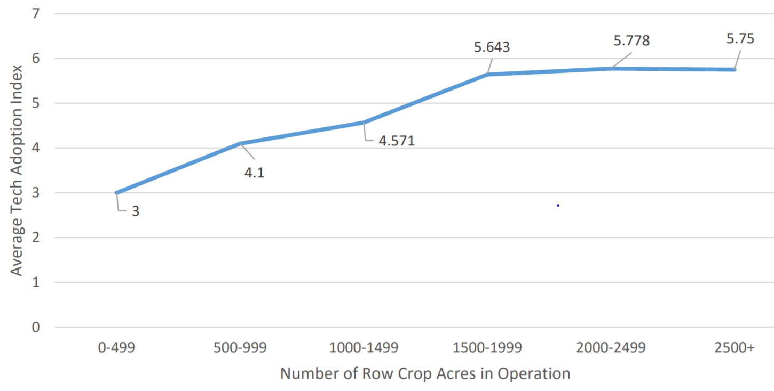
Tech Adoption & Crop Acres
Castle et al., 2016, University of Nebraska, Lincoln

Slide 6
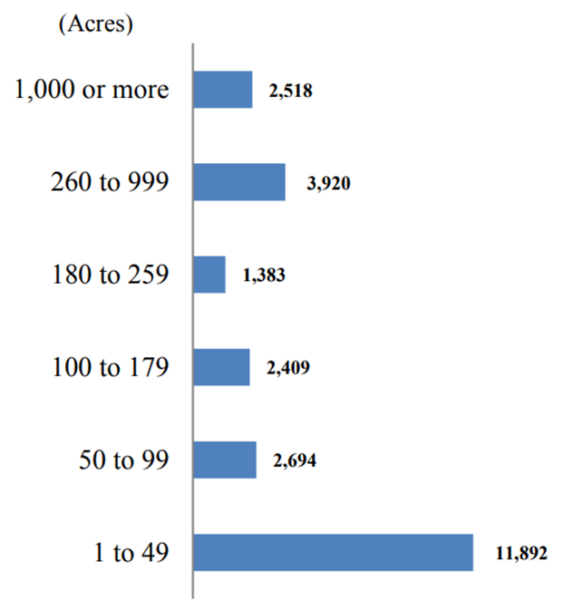
Farm size in Idaho
55% of Idaho farms are 50 ac or less
Small farms can have hard time justifying new technologies OR
Simply don’t bother with changes, even though can bring many positive results
ISDA, 2016

Slide 7
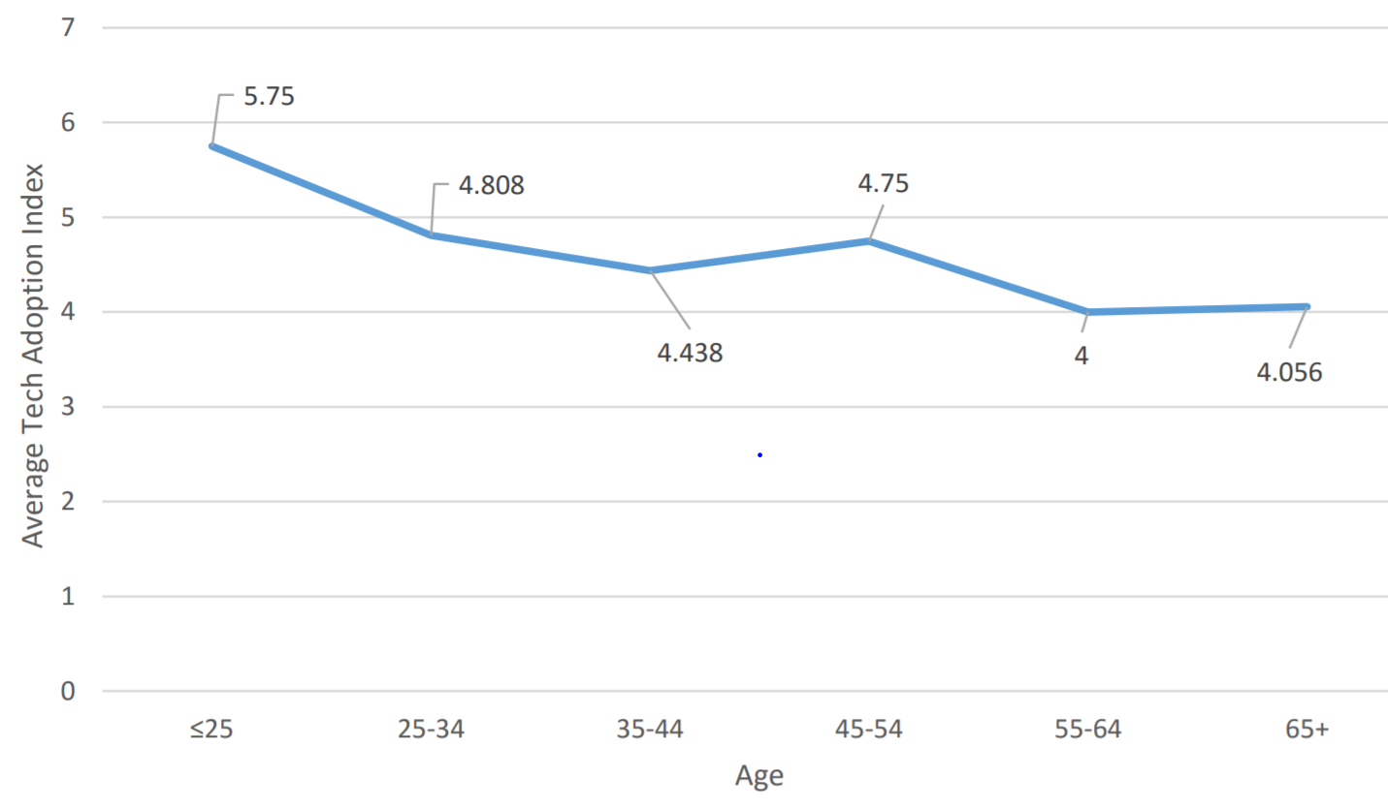
Tech Adoption & Farmer Age
Castle et al., 2016, University of Nebraska, Lincoln

Slide 8
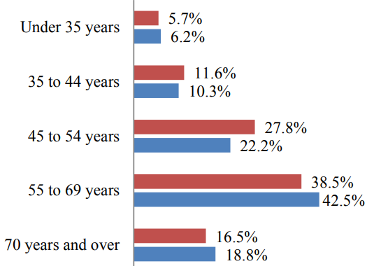
Average age of farmers in ID
50% of Idaho farmers are 55 and older
Long-term relationships with local fertilizer dealers, advisors
Follow plan set up long time ago
ISDA, 2016

Slide 9
Operators by Principal Occupation
Farming is NOT primary occupation for 50% of Idaho farmers
Attention is shifting to other industries
ISDA, 2016

Slide 10
Survey basics
Purpose – to access approach to Nitrogen management and crop sensors in Idaho
2015 and 2016
Grower meetings, cropping schools, commodity-specific events, precision ag workshops, ag technology fairs, field days
Email: send via commodity groups and listservs
Online (Twitter, Blog)
11 questions
Anonymous

Slide 11
Occupation
7% of Growers are Crop Consultants as well
3.5% of Growers are Industry Representatives as well

Slide 12
Most Costly Input
Nitrogen is most costly, followed by equipment and labor
Water availability becomes an issue, will be paid attention to

Slide 13
Nitrogen Management
!

Slide 14
Awareness of PA Research
Generation of interest (individuals are interested in new ideas and look for information)
More extension & communication

Slide 15
Awareness of Crop Sensor
Needs for more mass communication media
Education
Computer confidence
Perceived ease of use
Innovations are
knowledge intensive

Slide 16
N Management and Field Uniformity
100% of responders said they would like/need to improve their N management
100% said their fields are not uniform, variable
100% said their yields and quality varies
Using traditional method (like field record alone) often result in non uniform fields, yield potential loss
Crop sensor can estimate mid season nitrogen need
Nitrogen rate application
Helps to address spatial variability

Slide 17
N management Changes Field to Field
Spatial variation
Field condition
Soil type and texture
Residuals
Crop type
Crop rotation
About 25% of growers sample their fields every year.

Slide 18
N Management Change Year to Year
Temporal variation
Weather condition
Precipitation
Temperature
Grower perception: more variability between the fields than between years in same fields

Slide 19
University Extension Role
In Idaho:
On campus: 70% research & 30% extension
Research centers/off campus: 30% research & 70% extension
Only 13.2% use University Extension as primary N management resource
Extension needs to shift attention to crop advisors and fertilizer industry

Slide 20
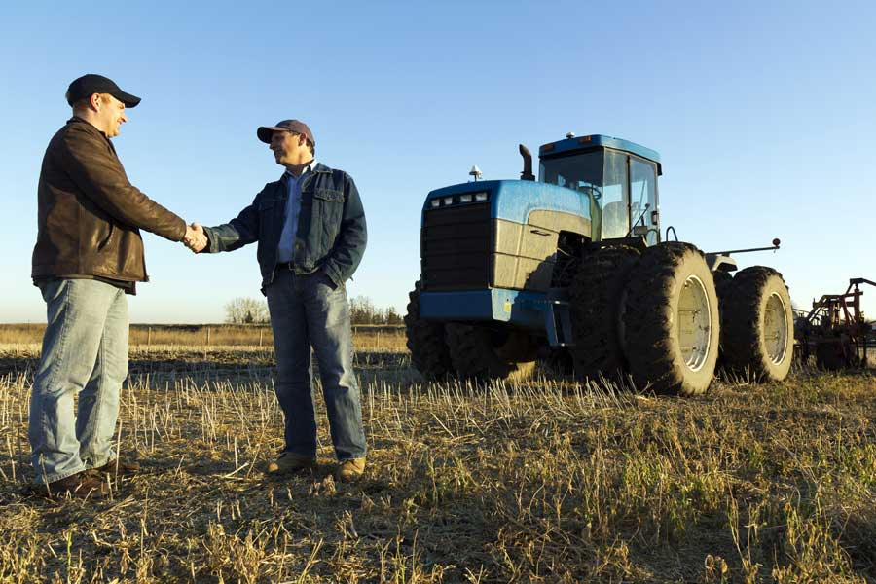
University Extension Role
Several faculty and extension educators work in “precision” ag, UAVs, sensors
Efforts are not unified, many projects overlap
New Precision Ag faculty hire on campus – program development is up to the hired candidate
Need for leadership and close collaboration

Slide 21
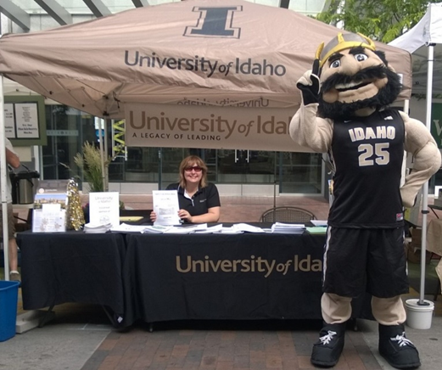
Thank you! Questions? Olga Walsh owalsh@uidaho.edu University of Idaho, Parma R&E Center Tel: (208)722-6701 Web: IDCrops (http://idcrops.blogspot.com/) Twitter: @IDCrops

