Slide 1
Tools for Improving Nitrogen Use Efficiency in Minnesota
Jeffrey Vetsch
Southern Research and Outreach Center
Waseca, MN
15th Annual International Nitrogen Use Efficiency Conference
7-9 Aug 2017, Baton Rouge, LA

Slide 2
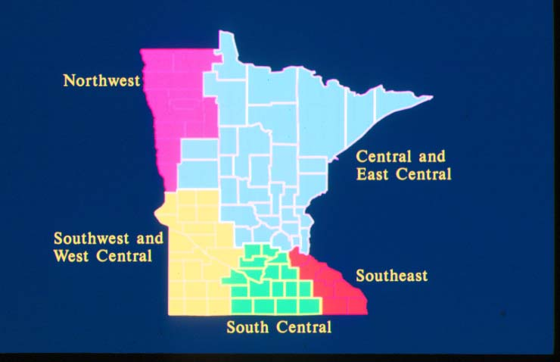
What tools are available? used?
MRTN (rate)
Other 3R’s (source, timing and placement)
Soil testing (PPNT and PSNT)
Sensors
Imagery
Models
Inhibitors and EEF’s
Yield goal based N recs

Slide 3
What are our goals for these tools?
Farmer: increase yield and profitability, risk and time management
Fertilizer dealer: increase yield, risk and time management, $
Society: environmental stewardship of land and water, ground and surface waters (N fertilizer rule)
U of M Scientists: ALL OF THE ABOVE

Slide 4
Effect of time of AA application and N-Serve on corn yield at Waseca from 1987-2001.
 | Time of N Application
Parameter | Fall | Fall+N-Serve | Spring
15-Yr Avg. Yield (bu/A) | 144 | 153 | 156
15-Yr Avg. FW NO₃-N Conc. (mg/L) | 14.1 | 12.2 | 12.0
15-Yr N recovery in grain (%) | 38 | 46 | 47
7-Yr Avg. Yield (bu/A)* | 131 | 146 | 158
* Seven years when statistically significant differences occurred.
Randall et al., 2003; Randall and Vetsch, 2005

Slide 5
Corn yield as affected by swine manure application timing and Instinct rate (Vetsch et al., 2017).
Randall et al., 2003; Randall and Vetsch, 2005
Notes:
MN ranks 3rd nationally in hog production with nearly 20 million marketed annually. Farmers prefer to apply N in fall, but 75% inorganic N content, nitrifies rapidly.

Slide 6
In-season Nitrogen Applications: How Late is Too Late?
Fabián Fernández,
Jared Spackman and Gabriel Paiao
Department of Soil, Water, and Climate
fabiangf@umn.edu
14th Annual International Nitrogen Use Efficiency Conference
8-10 Aug 2016, Boise, ID

Slide 7
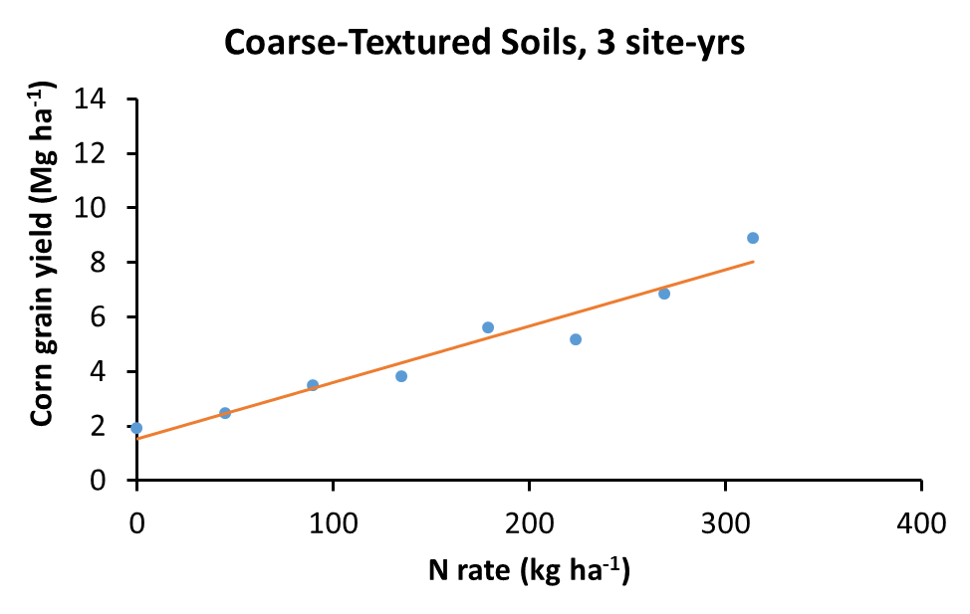
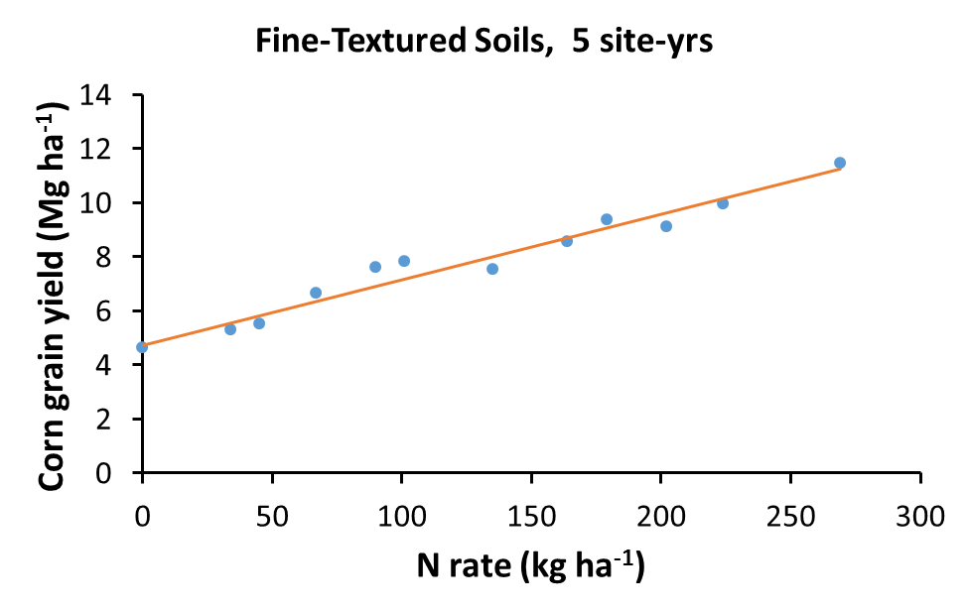
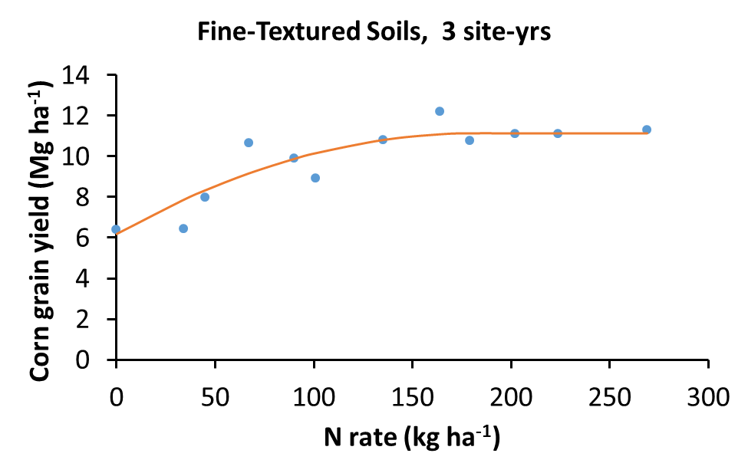
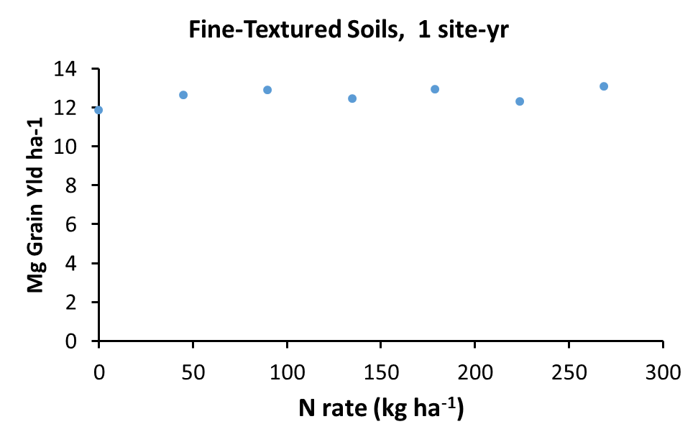
Becker 2014; 2015a,b
Clara City 2014; Waseca 2014 a,b; Waseca 2015 a,b
N applied at planting on
coarse textured soils
Much > normal rainfall,
MRTN under fertilized
Clara City 2015; Lamberton 2014; Theilman 2014
Lamberton 2014
Normal rainfall,
MRTN excellent
Non responsive
Notes:
MRTN success and lack there of; MRTN not used on coarse textured soils in MN (Rosen and Lamb); > normal rainfall (5-site-yr) MRTN under fertilized, normal rainfall (3-site-yr) MRTN excellent; 1-site-yr NO/LITTLE response to N

Slide 8
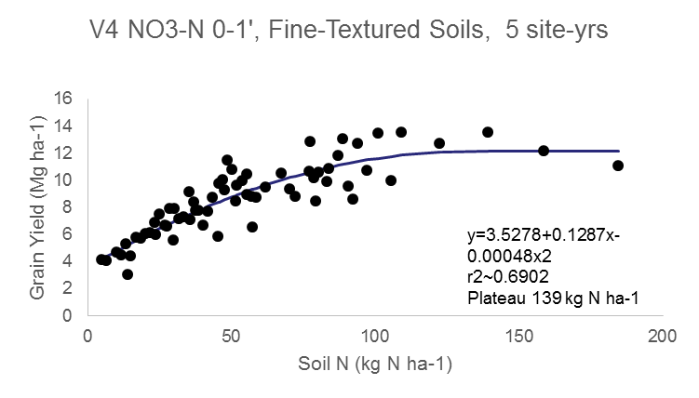
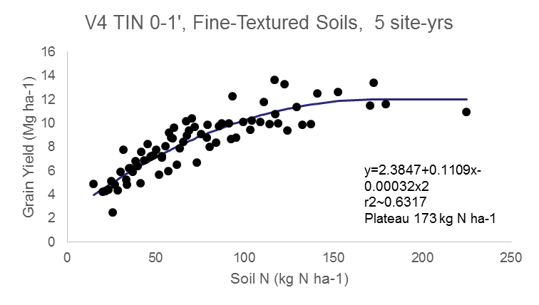
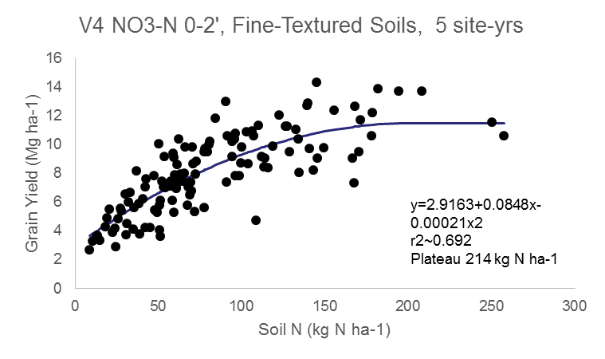
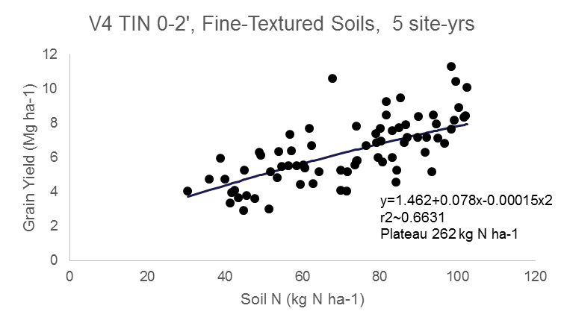
Nitrate
V4
TIN
Notes:
Soil data worked well at V4 (PSNT) on fine-textured soils, did not work on coarse textured and was worse at V8 PROBLEM: need lot’s of cores / samples due to within field variability, timing of sampling limited, A LOT OF WORK. V4 TIN 0-2’ WRONG X-AXIS

Slide 9

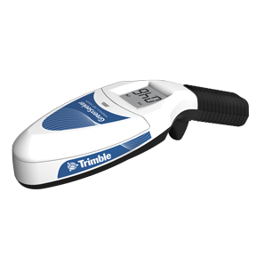
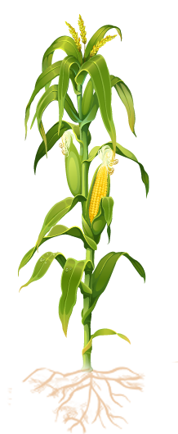

Can We Use Crop Sensors To Improve N Management?
Application Timing
Spatial Variability
Temporal Variability

Slide 10

Grain Yield Prediction – Sensor only
Notes:
WELL correlated with grain yield, even at V8 and V12

Slide 11
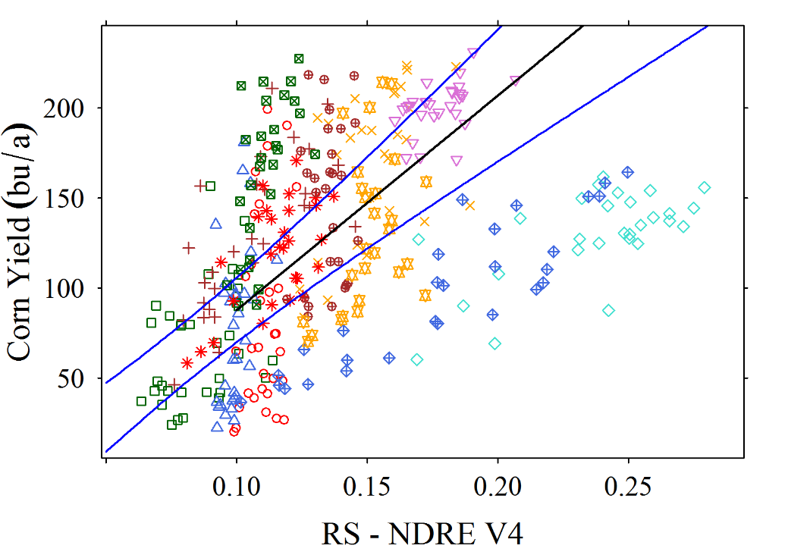
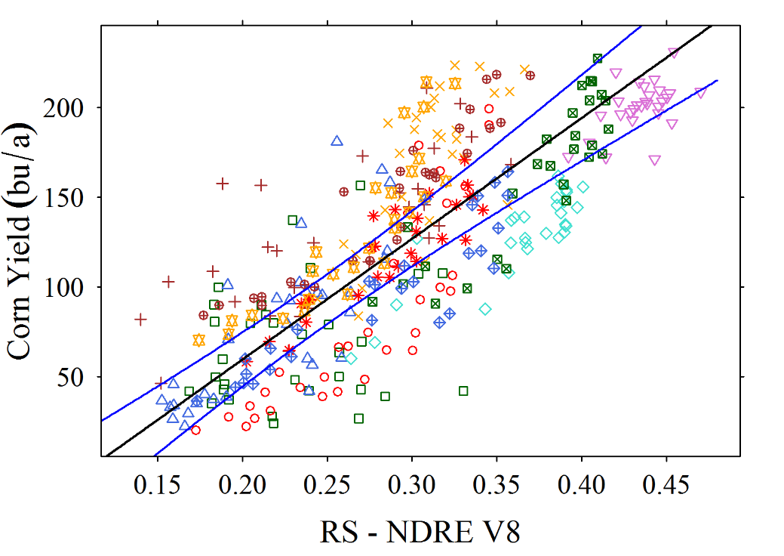
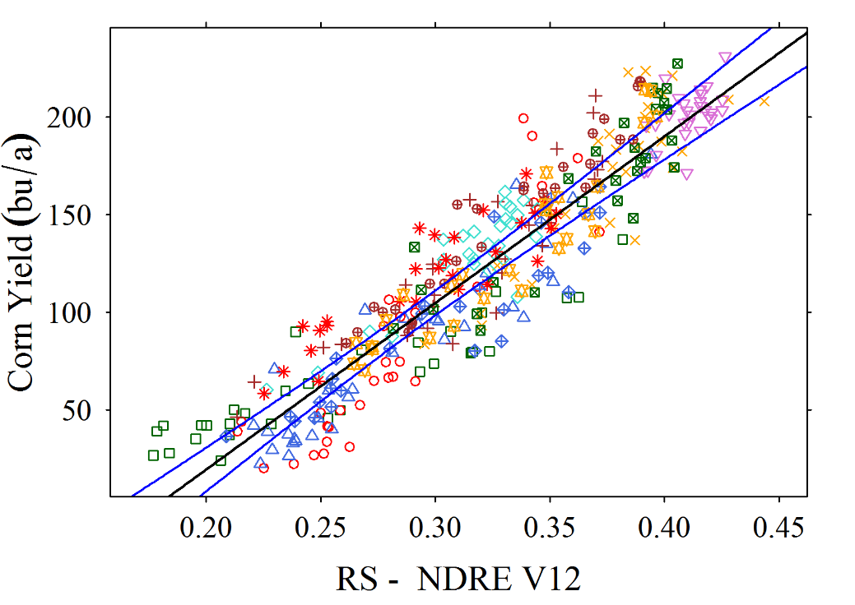
R²=0.63
R²=0.83
R²=0.92
Notes:
NDRE best, especially at V12; NDVI reaches saturation at V10-12 at our plant populations (34K+)

Slide 12
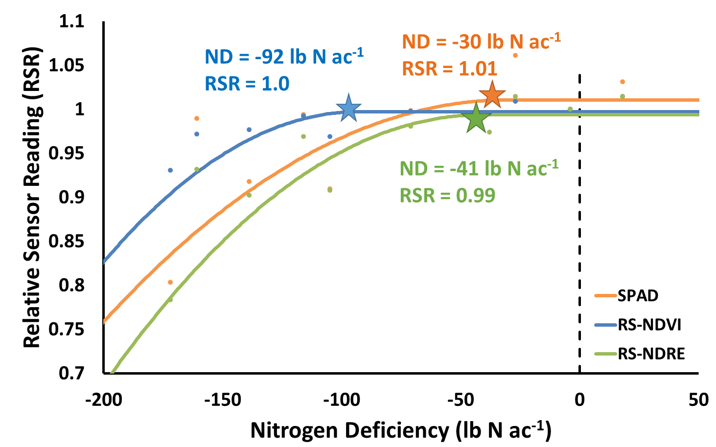
N Deficiency Determination – Sensor only –QPLoc – V8
Notes:
Well correlated with grain yield, but not a great predictor of N need at V8

Slide 13
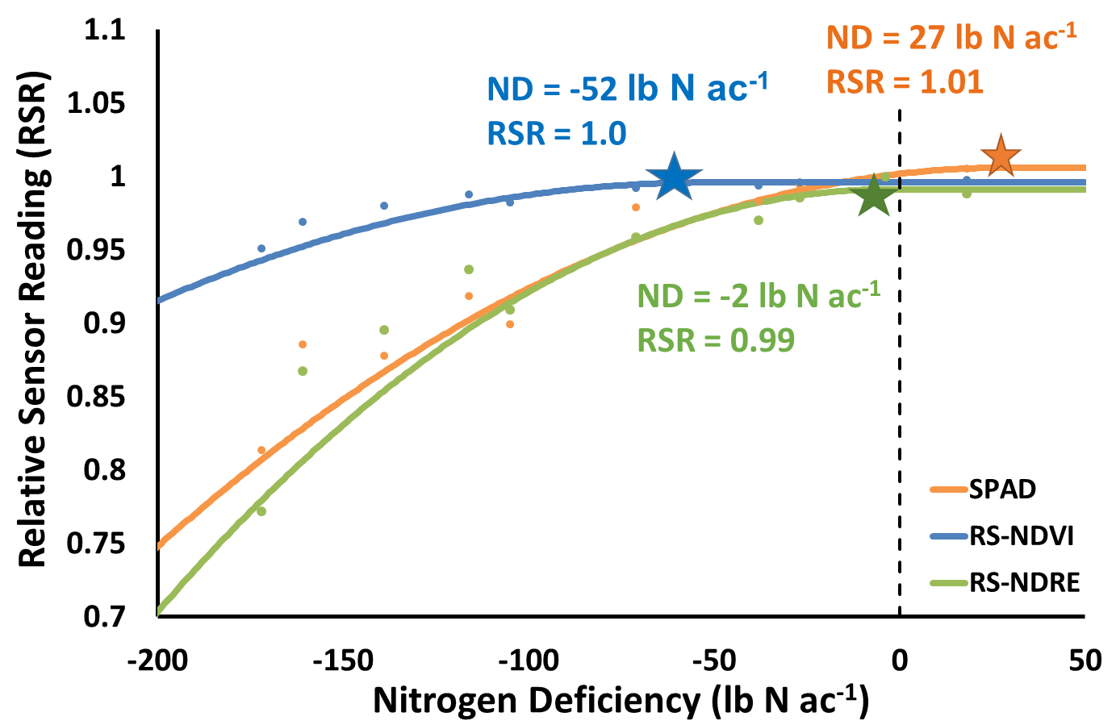
N Deficiency Determination – Sensor only – QPLoc – V12
Notes:
Much better at V12, except for NDVI. * are joint points of regression, but actual sufficiency critical level would be lower

Slide 14
Improving Sensor Measurements
Notes:
Soil data could dramatically improve sensor data at V4 and V8

Slide 15
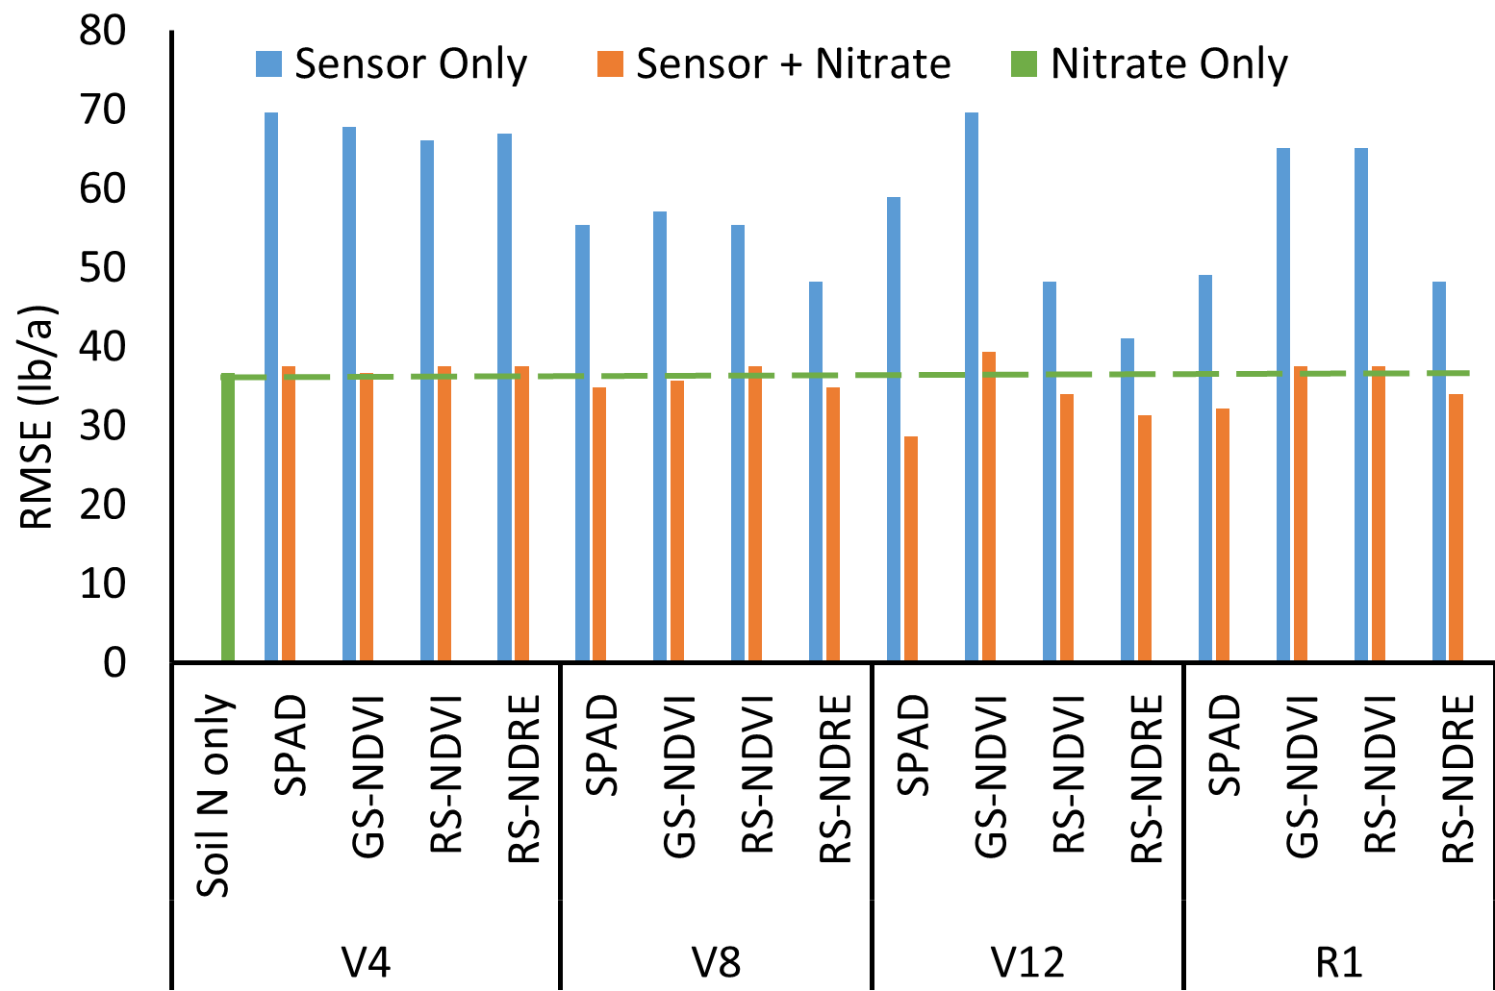
Utility of Soil Nitrogen to Improve Predictive Power of N Deficiency
Notes:
Sensor + Nitrate not a lot better than nitrate alone, but could collect sensor data much easier and at denser, use soil data at low density to improve.

Slide 16
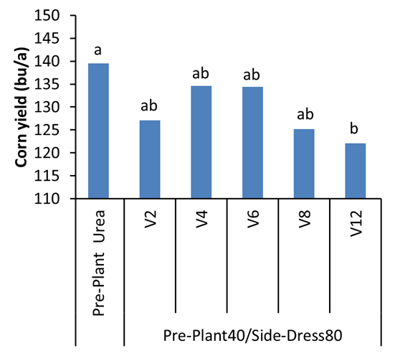
Lamberton, C-C at 120 lb N/a

Slide 17
Take Home Messages
Soil N is variable but it is an important tool
Canopy sensors can help us manage N:
  The earlier the sensing the greater the flexibility to apply nitrogen, BUT
  The earlier the sensing the lesser the predictive power
  The later the sensing the greater the predictive power, BUT
  The later the sensing the lesser the flexibility to apply nitrogen and greater potential for yield loss
Canopy sensor adjustments with soil N show promise
In-season N application is A tool

Slide 18
Impact of In-season Variable Rate Nitrogen Management on Corn Yield and Nitrate Losses in Minnesota
ASA, Phoenix AZ, 2016
Aicam Laacouri, David Mulla, Jake Galzki,
Grace Wilson and Jeff Vetsch

Slide 19
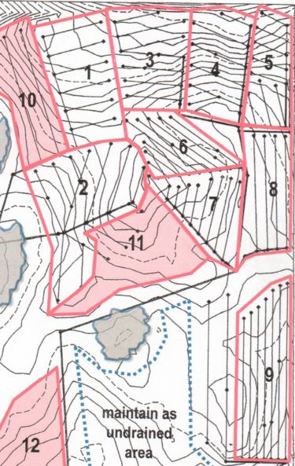
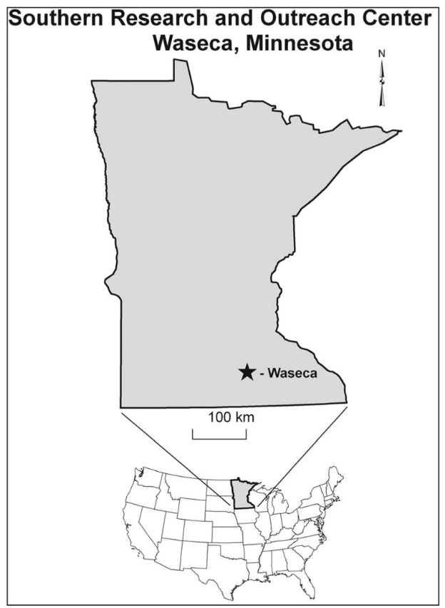
Study Area
Agricultural Ecology Research Farm, Waseca, MN 2016
Field plots with drainage
Notes:
Legend heading is incomplete

Slide 20
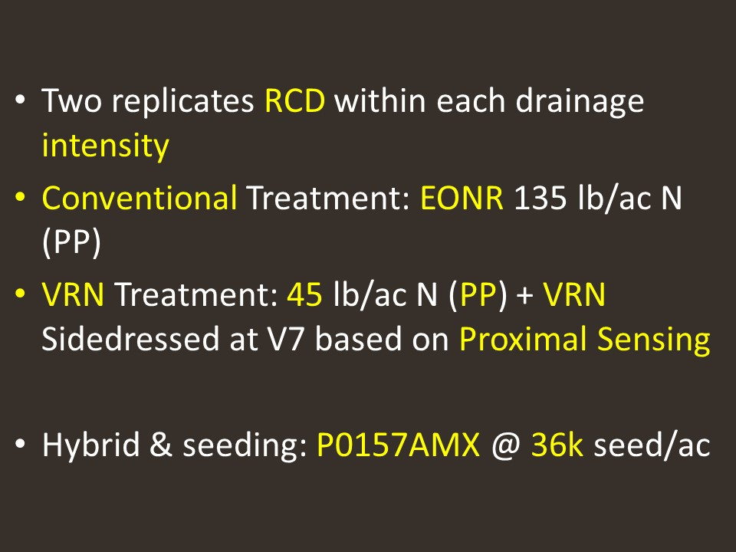

Slide 21
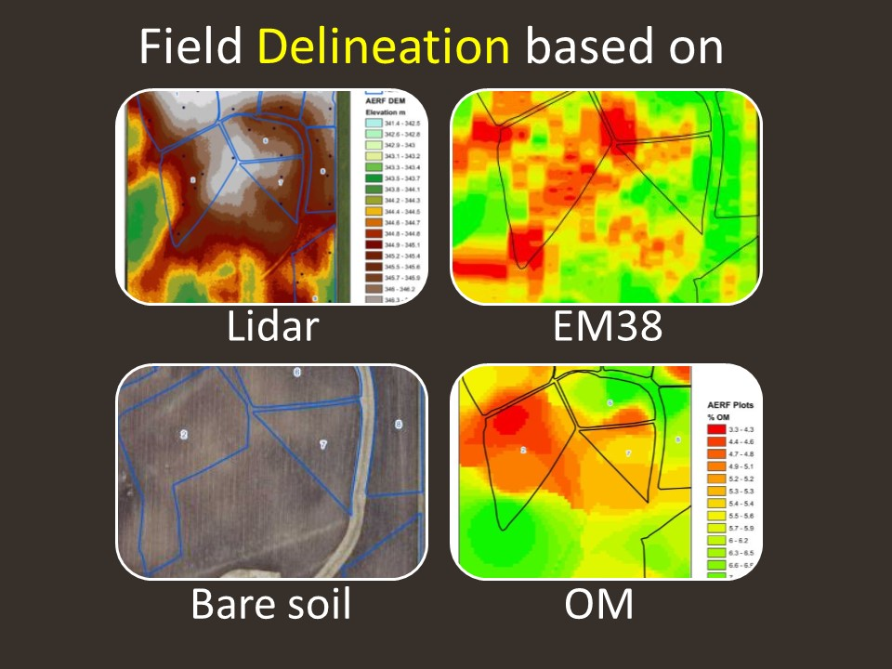

Slide 22
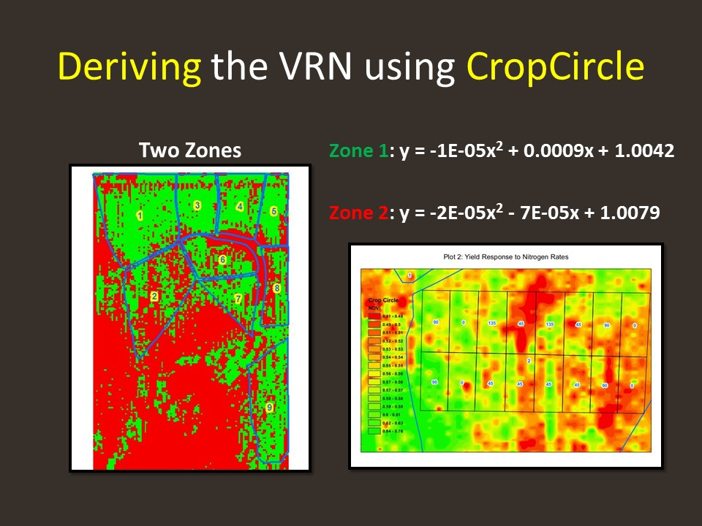

Slide 23
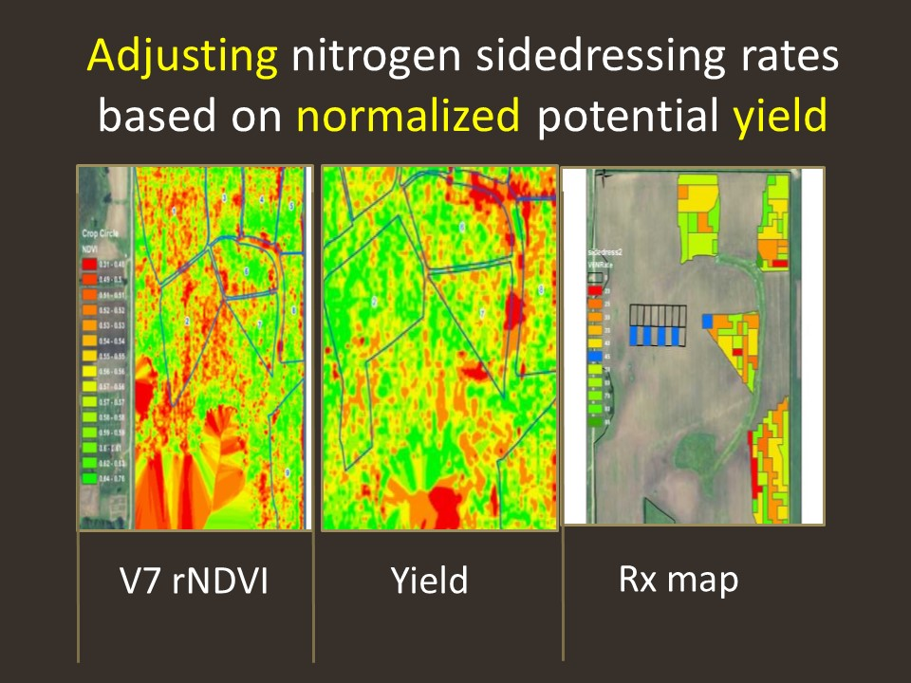

Slide 24
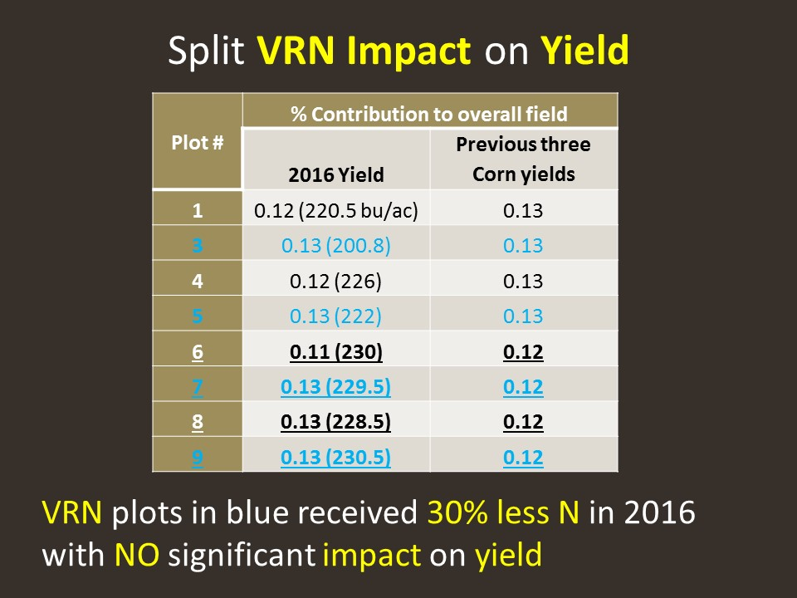

Slide 25


Thanks
U of M Nutrient Management Group
Graduate & Undergraduate Students, post Docs
Staff at Research and Outreach Centers
Funding sources

