Slide 1
How the adoption of the N-Rich Strip has changed N Management
Brian Arnall Precision Nutrient Management
Oklahoma State University

Slide 2
N Rich Strip Adoption
2003: OSU applied 62 NRS
2004: 300 NRS in Farmers Fields
2005: SBNRC released, 1000 NRS
2006: OSU applied 568 NRS 1,500 ac NRS by 1 cooperator alone estimated 230,000 acres under NRS
2007: 25 county educators reported having NRS
2011: Estimated 500,000 acres utilizing NRS
2016: Best guess estimate 1.0+ million acres in OK & KS

Slide 3
Nitrogen Rich Strip Pamplet
We commonly recommend that farmers apply ½ of the anticipated total N needed at planting and wait to make the decision on added N until the middle of the season. In general for winter wheat, if no differences can be visually detected prior to jointing (Feekes 6, Figure 4), it is unlikely that added N will result in increased yields. Alternatively if differences are large, there is a high demand for added N. When no differences exist between the N Rich Strip and the farmer practice it means one of two things.
Wait until early February or March to sense yield potential and apply top-dress N for winter wheat. Wait until the 8 or 10 leaf stage in corn to sense and apply fertilizer.

Slide 4
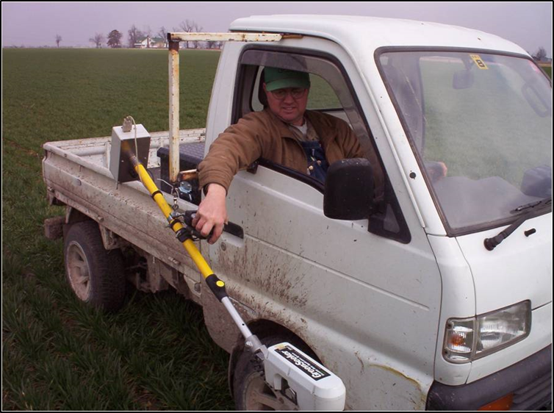
GDDs >0 the 80 Rule
Brents Rules
Apply 25 lbs N/ac at planting
Place High N strips (~150lbs N/ac) in each field prior to emergence. Mark with a flag on one end and write down location info.
Use handheld GreenSeeker unit to monitor NDVI as GDD’s approach 80.
Topdress as soon as GDD > 80.
Hagie STS12 w/ 100’ boom, UAN, streamer tips, FmX, RT-200
Record everything in a spreadsheet GreenSeeker log.xlsx

Slide 5
NRS and SBNRC Confidence
After a decade + a confidence in the YP model and SBNRC reached.
Annual reports of YP being within 5 bushel of combine records.
Research plots documenting SBNRC resulting increased NUEs and Yields over time.

Slide 6
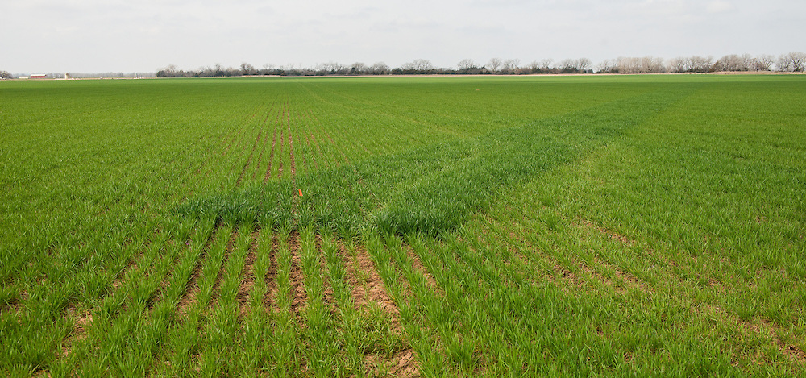
Market, Fert $, N-Rich Strips
Grain only producers during drought 2012 + looked to reduce input risk.
Grain prices of 2016 + is intensifying this.
The current move is to a three pass system.
Starter – 45-70 lbs DAP
Late fall early Spring Top-dress
Jointing Top-dress
They are only confident in this with use of N-Rich Strip

Slide 7
Case Studies
Four Producers and one Consultant
Been working closely with for past six plus years.
After the 2017 harvest we have looked at inputs and yields.
Grain yields running 50 to 90 bpa.
Some farms averaging 65+
Since Adoption of SBNRC and 3 pass system
Averaging 1.3-1.5 lbs N per bushel.

Slide 8
Our Challenge.
The YP model and SBNRC built on a 50/50 N management system
N recommendations being made near stem elongation 80+ GDDs>0
Because of the shift in management over the past three seasons more and more N-Rich Strips are showing up earlier.
35+ days, November- December.

Slide 9
Response at 39 GDDs > 0
 | Yield | RI Harv
Pre plant | 45 | 2.06
Check | 22
0 DAVD | 45 | 2.04
49 DAVD | 59 | 2.66
Best Prediction
YP0 = 89 YPN = 81
YPNx = 67
RI = 96

Slide 10
Response at 58 GDDs > 0
 | Yield | RI Harv
PrePlant | 57 | 1.56
Check | 37
0 DAVD | 71 | 1.92
42 DAVD | 83 | 2.26
Best Prediction
YP0 = 80 YPN = 66
YPNx = 58
RI = 96

Slide 11
SBNRC

Slide 12
Using An Agronomic Adjust
Telling producers, plan on a March sensing/application if weather holds.

Slide 13
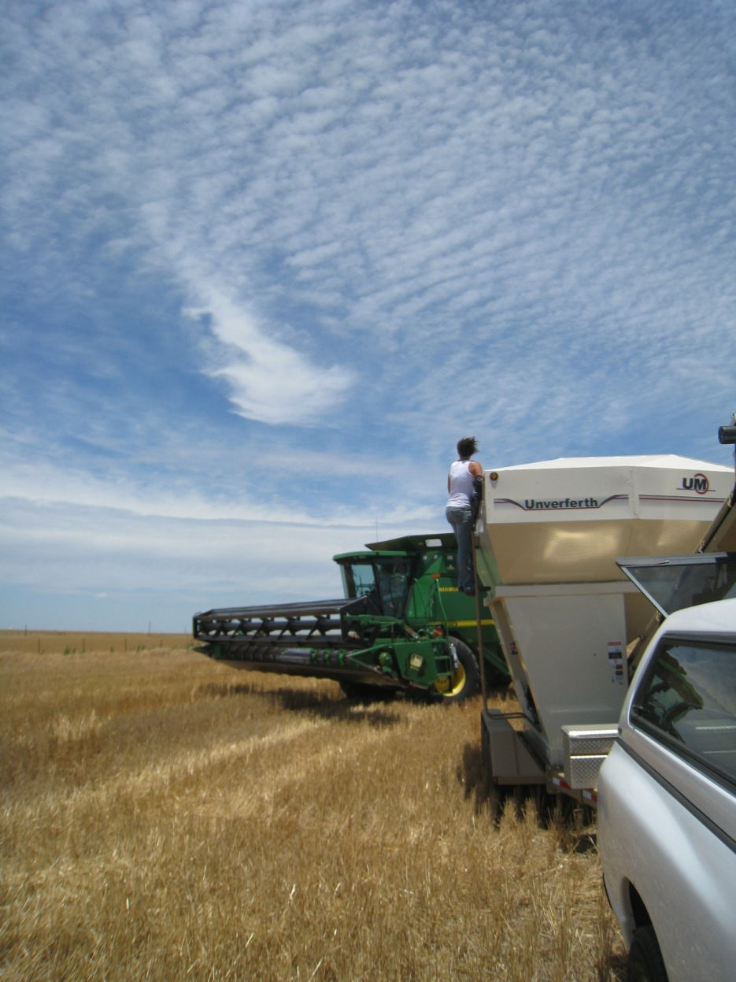
Brian Arnall
373 Ag Hall
405-744-1722
b.arnall@okstate.edu
Presentation available @
www.npk.okstate.edu
Twitter: @OSU_NPK www.Facebook/OSUNPK
YouTube Channel: OSUNPK
Blog: OSUNPK.com
www.Aglandlease.info

Slide 14
Yield and Protein
Feb 20
Feb 12
Mar 27
Mar 9

Slide 16
N timing Studies
Looking at delaying of N app after N-Rich strip visual Diff
One aspect, All 90 lbs N as NH4NO3, N-Rich ran out.
Did this so we could evaluate timing of app in the study.

Slide 17
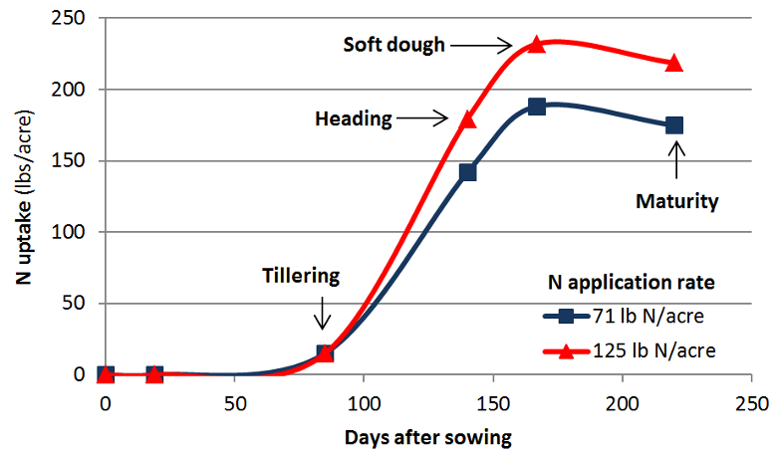
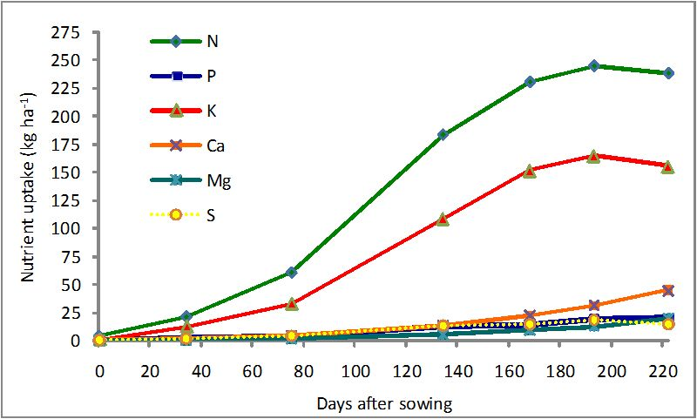
Uptake

