Slide 1
Opportunities for Sensor Based Nitrogen Management in Cereals
Tyler Lynch, Bruno Figueiredo, Jagmandeep Dhillon, Gwen Wehmeyer, Eva Nambi, Alimamy Fornah, Fikayo Oyebiyi, Robert Lemings, Everett Hrbacek, Elizabeth Eickhoff
August 7, 2017
Baton Rouge, LA

Slide 2


ORCID ID 0000-0001206-1105

Slide 3
”. Adoption is widespread: close to two million researchers have registered, over 200 systems have integrated ORCID iDs, and research funders have started to require iDs during the grant application process.
2015, ORCID iDs required. eLife, PLOS, and The Royal Society recognized the value of widespread ORCID adoption
Benefits:
improved discoverability of their works
single sign-on across journals and streamlined data entry
researchers can opt to have their ORCID record automatically updated when their papers are published, which in turn means that university and other systems can receive updates directly

Slide 4
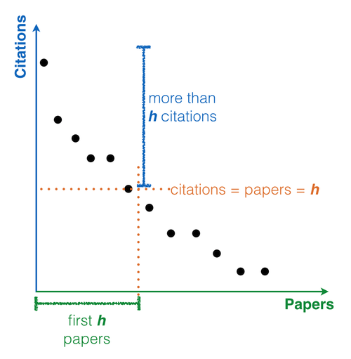

H-index
Hirsch, Jorge, .E. 2005. An index to quantify an individual’s scientific research output. Proc. Natl. Acad. Sci. 102(46): 16569-16572. DOI:10.1073/pnas.0507655102
Argentine Physics Professor, Univ. California
If a researcher has 15 papers, each of which has at least 15 citations, their h-index is 15
Web of Science
JS Schepers 33
NR Kitchen 30
RB Ferguson 26
DE Clay 22
JE Sawyer 22
JL Havlin 18
PC Scharf 16
JJ Camberato 14
Good work
Good questions

Slide 5
With the advent/acceptance of sensor based measurements, like NDVI, the challenge is to collect comprehensive readings over time, to “map” environments
A good method to better understand the differences in environment when many readings are collected (NDVI within a season, and over years)
Aerial collection of NDVI (promise of active sensors)

Slide 6
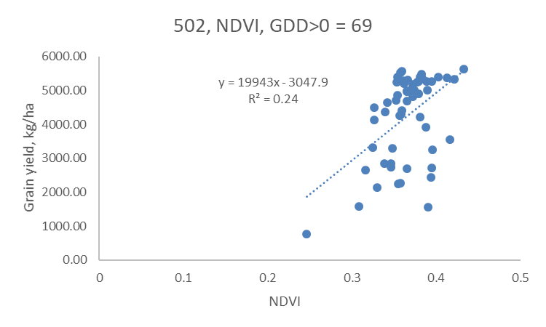
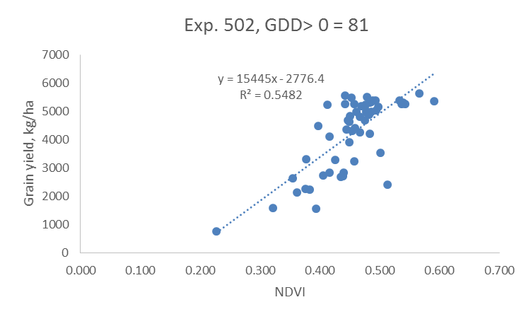
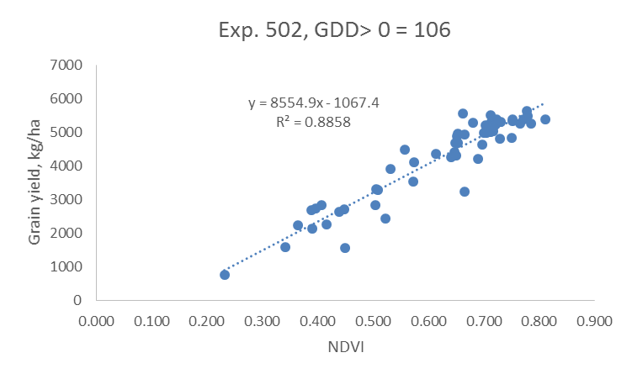
69
81
106
NDVI vs Yield, 2016

Slide 7
Figure 1. Correlation of NDVI versus winter wheat grain yield, for readings collected over the season where the number of days from planting to sensing where GDD>0 ranging from 64 to 149, and where GDD was computed as (Tmin+Tmax)/2 – 4.4°C, Stillwater, OK, 2016 and 2017.
Bruno Figueiredo, Jagmandeep Dhillon
Y = -1.21 + 0.02x, when x < 111, y = 0.82 when x > 111
r2 = 0.93

Slide 8
Figure 2. Correlation of NDVI versus winter wheat grain yield, for readings collected over the season where the number of days from planting to sensing where GDD>0 ranging from 48 to 143, and where GDD was computed as (Tmin+Tmax)/2 – 4.4°C, Lahoma, OK, 2016 and 2017.
Bruno Figueiredo, Jagmandeep Dhillon
Y = -0.95 + 0.02x, when x < 97, y = 0.92 when x > 97
r2 = 0.96

Slide 9
Applied Use of Climatological Data to Refine Optimum Times for Nitrogen Stress Sensing
Variable influence of the environment on early season plant growth, leads to variable yield levels, year to year. This study was conducted to determine the ideal point in the growth season where normalized difference vegetation index (NDVI) sensor readings were highly correlated with grain yield……
Averaged over two years (2016 and 2017), the optimum GDD>0 needed to detect the N These critical GDD values can in turn be reported on a day-to-day, by-location basis (mesonet.org) for producer use as the season progressed

Slide 10
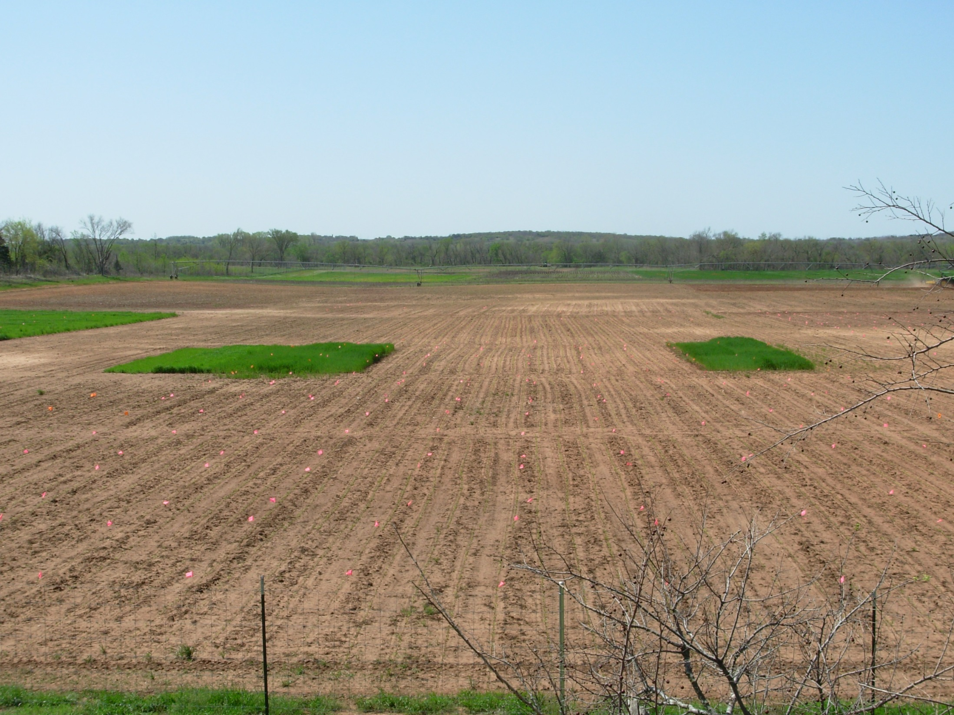
Indicator Crops, Jacob Bushong, Tyler Lynch

Slide 11
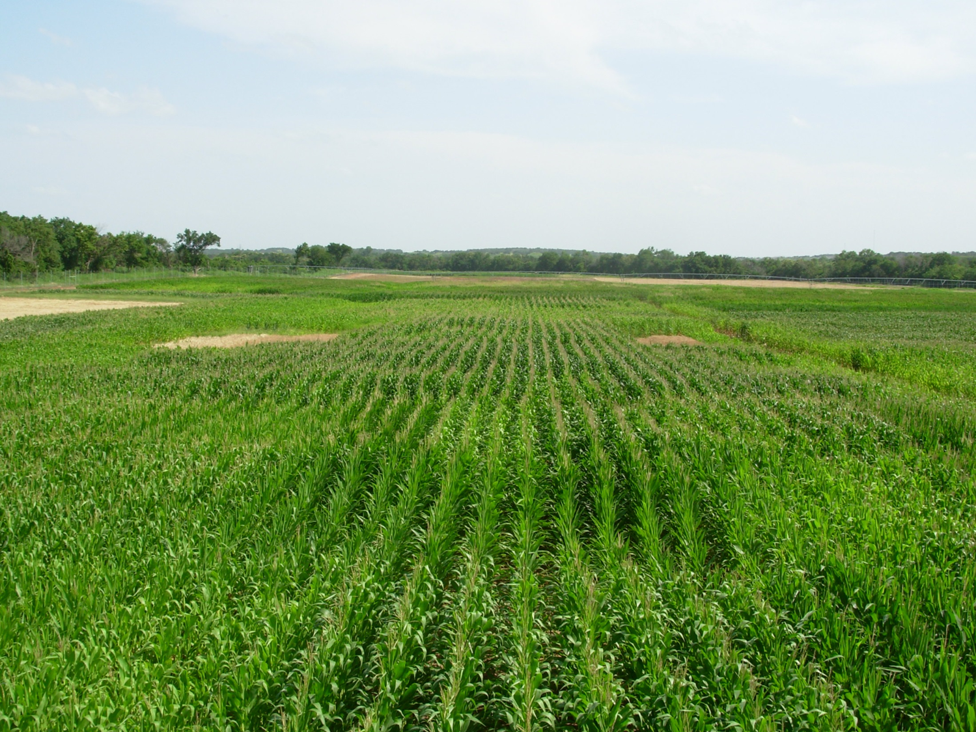
The use of indicator crops to predict the response of maize to N fertilizer is unprecedented and modifications to current maize N fertilizer recommendations could modernize N management strategies for all producers.
Influence of the environment

Slide 12
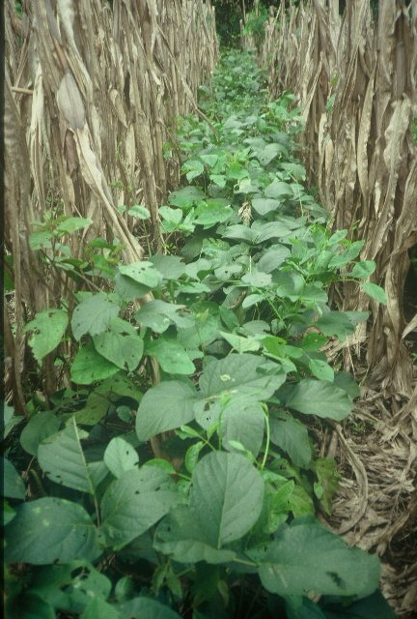
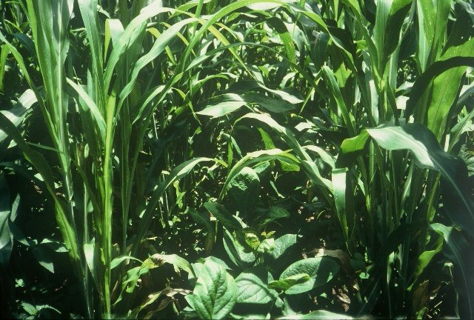
Legume interseeding, Central America

Slide 13
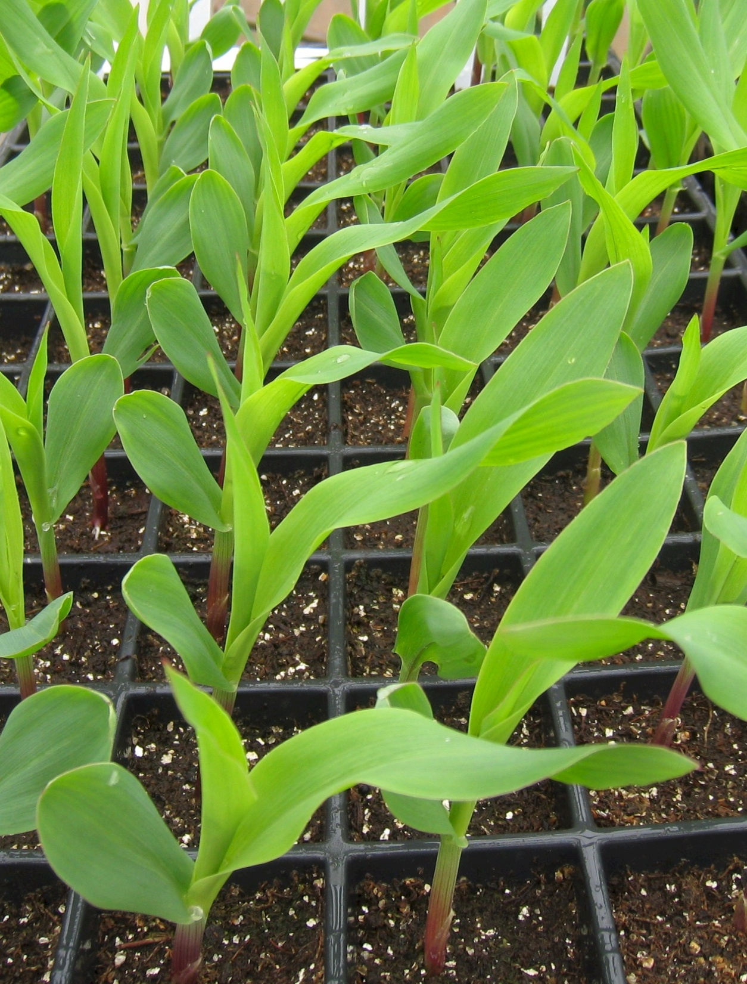

Slide 14
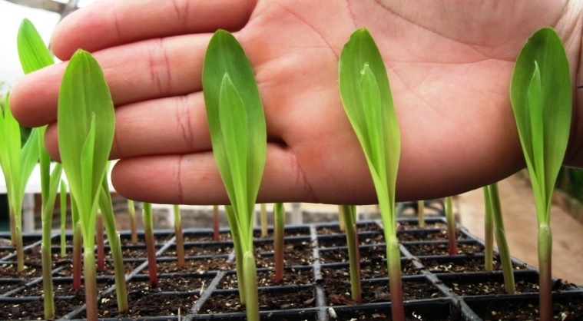
Precision Planting of Corn (Zea mays L.) to Manipulate Leaf Geometry
2011. Maize (Zea mays L.) Leaf Angle and Emergence as Affected by Seed Orientation at Planting. J. Exp. Agric. doi:10.1017/S001447971100038X.

Slide 15
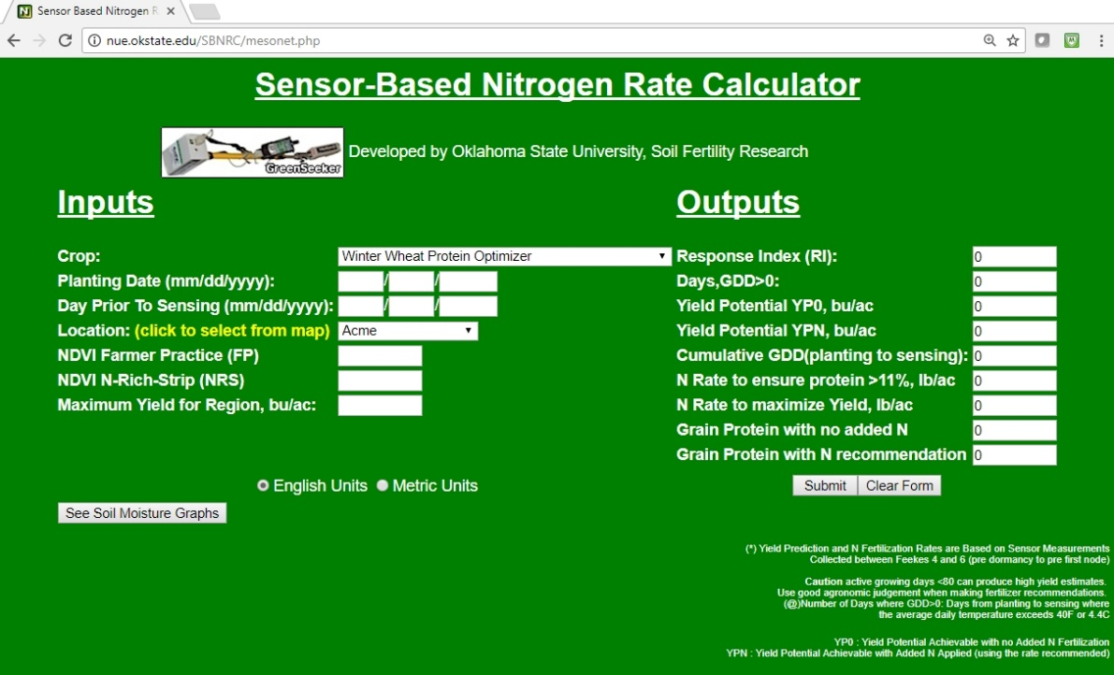
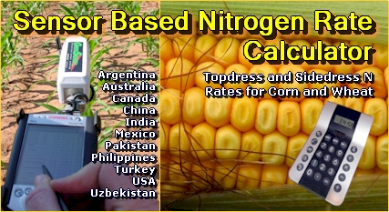
Predicting Grain Protein
Woolfolk, C.W., W.R. Raun, G.V. Johnson, W.E. Thomason, R.W. Mullen, K.J. Wynn, and K.W. Freeman. 2002. Influence of late-season foliar nitrogen applications on yield and grain nitrogen in winter wheat. Agron. J. 94:429-434.
Freeman, K.W., W. R. Raun, G.V. Johnson, R.W. Mullen, M.L. Stone, and J.B. Solie. 2003. Late-season prediction of wheat grain yield and grain protein. Commun. Soil Sci. Plant Anal. 34:1837-1852.
Macnack, Natasha, Bee Chim Khim, Jeremiah Mullock, and William Raun. 2014. In season prediction of nitrogen use efficiency and grain protein in winter wheat, Triticum aestivum L.. Commun. Soil Sci. Plant Anal. 00:1-15. DOI:10.1080/00103624.2014.904337.
Wyatt, Ethan, Jacob Bushong, Jeremiah Mullock, Natasha Macnack, Randy Taylor, and William Raun. 2014. Effect of adjuvant, nitrogen rate, and spray droplet size on protein content of hard red winter wheat (in press)
SBNRC, Option 4, Winter Wheat Protein Optimizer (2011)
Premiums (10 to 50 cents/bu) offered at terminal elevators/flour mill (transport distance)
Farmer's Grain Medford: premiums for wheat above 11.5 percent (Terminal only). Between 11.5 to 12.0 percent the premium was 15 cents and above 12.0 percent was 30 cents
ALSO discounting/docking 15 cents per bushel for wheat below 10.0 percent.
2017: Shawnee Milling offered 50 cents/bu above 11.0 % protein

Slide 16
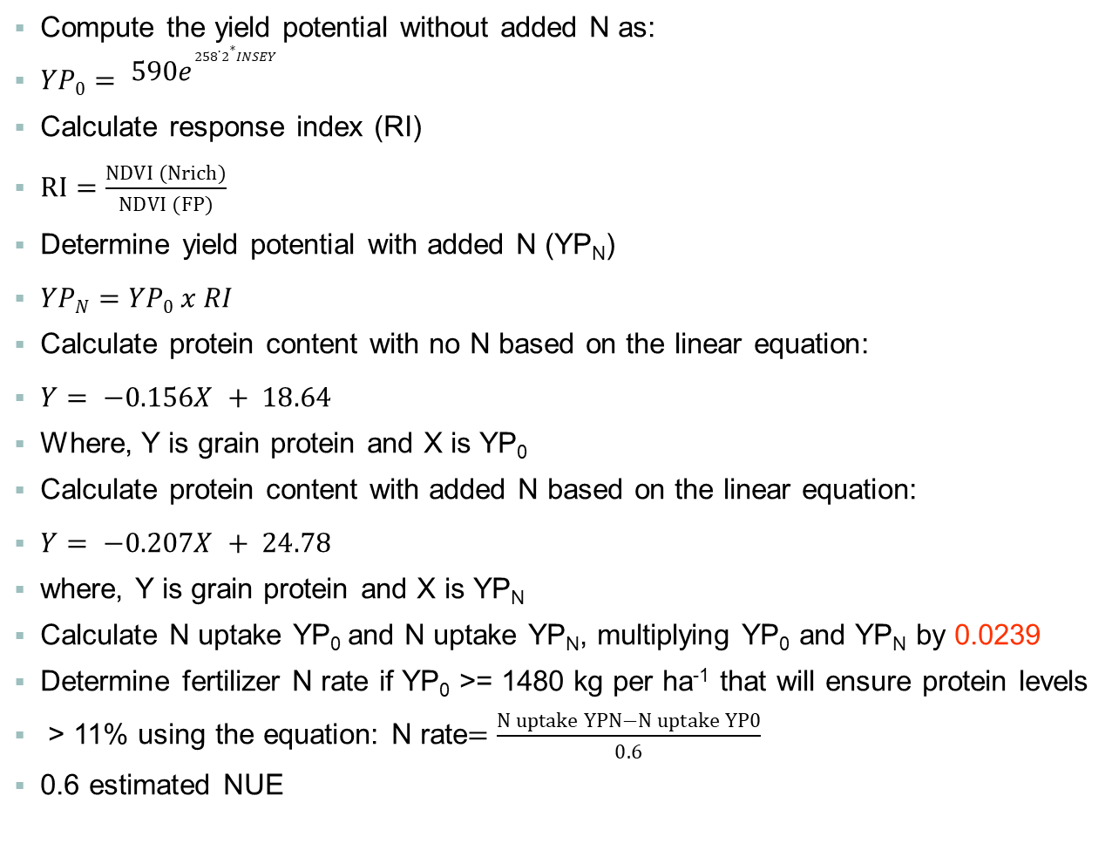
YPO= | (590*EXP(258.2*Insey))/1.12/60
YPN= | YPO* RI
Nrate= | (((YPN - YPO) * 60) * 0.0239/0.5)
Nrate protein>11 |  | IF(YPO>=22,(((YPN-YPO)*60)*0.0239/0.6))
Protein without N |  | ((YPO*-0.156)+18.638)
Protein with N |  | ((YPN*-0.207)+24.78)
Compute the yield potential without added N as:
$YP0= {590e}^{258.2∗INSEY}$
Calculate response index (RI)
$RI=\frac{NDVI (Nrich)}{NDVI (FP)}$
Determine yield potential with added N (YP_{N})
$YPN=YP0 x RI$
Calculate protein content with no N based on the linear equation:
$Y= −0.156X + 18.64$
Where, Y is grain protein and X is YP₀
Calculate protein content with added N based on the linear equation:
$Y= −0.207X + 24.78$
where, Y is grain protein and X is YP_{N}
Calculate N uptake YP₀ and N uptake YP_{N}, multiplying YP₀ and YP_{N} by 0.0239
Determine fertilizer N rate if YP₀ >= 1480 kg per ha⁻¹ that will ensure protein levels
> 11% using the equation: N rate$=\frac{N uptake YPN−N uptake YP0}{0.6}$
0.6 estimated NUE

Slide 17
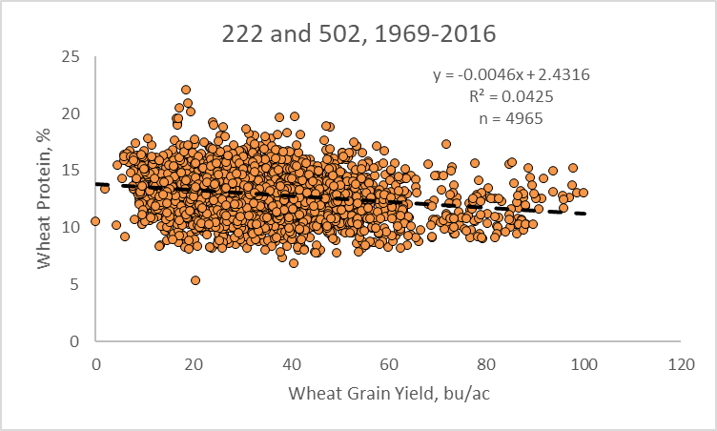
Works because we can predict yield potential

Slide 18
Value of Late Season N
Woolfolk, Agron. J. 94:429-434
Grain protein averaged over years and locations in control plots was 14.9% with 16.5 and 16.3%, respectively, for pre-flowering, and post-flowering
Foliar N applications just before and following flowering can significantly enhance grain N content and, thus, percent protein in winter wheat
Macnack,. 00:1-15. DOI:10.1080/00103624.2014.904337
In-Season Prediction of Nitrogen Use Efficiency and Grain Protein in Winter Wheat (Triticum aestivum L.)
NDVI and rainfall explained 45% of the variability in Grain Protein at F7 growth stage. Preplant N, NDVI, rainfall and growing degree days (GDD) combined explained 76% (r2 = 0.76) of the variability in GP at F3. Mid-season climatic data improved the prediction of GP and should be considered for refining fertilizer recommendations when GP levels are expected to be low.
Wyatt. (in press)
Use of the fine droplet size with a foliar N rate of 11.2 kg N ha⁻¹ applied post anthesis and with the addition of an adjuvant resulted in the highest grain protein concentration (13.8 to 14.8 % protein)

Slide 19
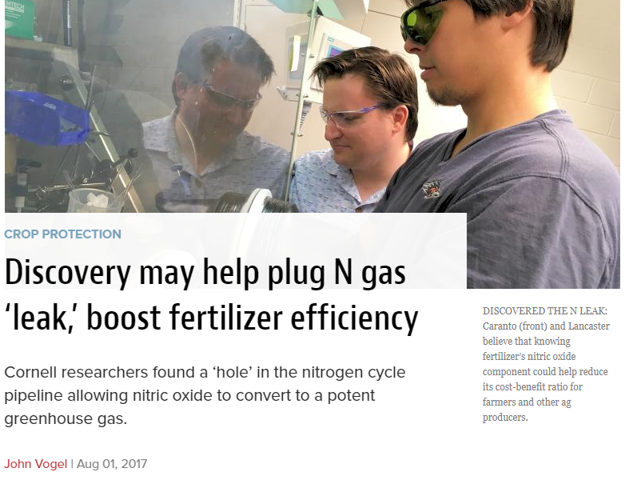
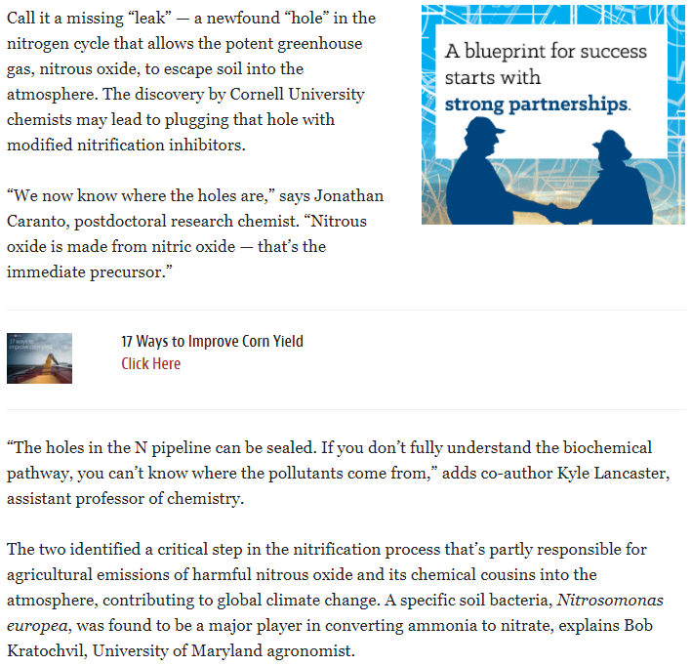
The two identified a critical step in the nitrification process that’s partly responsible for agricultural emissions of harmful nitrous oxide and its chemical cousins into the atmosphere, contributing to global climate change. A specific soil baacteria, Nitrosomonas europea, was found to be a major player in converting ammonia to nitrate, explains Bob Kratochvil, Univ. MD
Nitrous oxide is one of the first chemicals formed during that conversion. Released into the atmosphere, it interferes with ozone.

Slide 20
ATMOSPHERE
GLOBAL WARMING
15-40 kg/ha
N₂O
NO
N₂
INDUSTRIAL
FIXATION
LIGHTNING,
RAINFALL
CH_{4 ,} N₂O
N2 FIXATION
HABER BOSCH
PLANT AND ANIMAL
RESIDUES
SYMBIOTIC
NON-SYMBIOTIC
(1200°C, 500 atm)
MESQUITE
RHIZOBIUM
ALFALFA
SOYBEAN
BLUE-GREEN ALGAE
AZOTOBACTER
CLOSTRIDIUM
3H₂ + N₂ 2NH₃
MATERIALS WITH N
CONTENT > 1.5%
(COW MANURE)
MATERIALS WITH N
CONTENT < 1.5%
(WHEAT STRAW)
10-80 kg/ha
FERTILIZATION
PLANT
LOSS
AMINO
ACIDS
MICROBIAL
DECOMPOSITION
0-50 kg/ha
NH₃
IMMOBILIZATION
AMMONIA
VOLATILIZATION
AMINIZATION
ORGANIC
MATTER
HETEROTROPHIC
R-NH₂ + ENERGY + CO₂
BACTERIA (pH>6.0)
FUNGI (pH<6.0)
R-NH₂ + H₂O
pH>7.0
NH₂OH
AMMONIFICATION
FIXED ON
EXCHANGE
SITES
IMMOBILIZATION
R-OH + ENERGY + 2NH₃
Pseudomonas, Bacillus,
Thiobacillus Denitrificans,
and T. thioparus
N₂O₂⁻
MICROBIAL/PLANT
SINK
2NH₄⁺ + 2OH⁻
MINERALIZATION
+ NITRIFICATION
NO₂⁻
+O₂
DENITRIFICATION
Nitrosomonas
NO₃⁻
POOL
NITRIFICATION
OXIDATION STATES
DENITRIFICATION
LEACHING
LEACHING
VOLATILIZATION
NITRIFICATION
Nitrobacter
+ O₂
2NO₂⁻ + H₂O + 4H⁺
NH₃ AMMONIA -3
NH₄⁺ AMMONIUM -3
N₂ DIATOMIC N 0
N₂O NITROUS OXIDE 1
NO NITRIC OXIDE 2
NO₂⁻ NITRITE 3
NO₃⁻ NITRATE 5
TEMP 50°F
Joanne LaRuffa
Wade Thomason
Shannon Taylor
Heather Lees
Department of Plant and Soil Sciences
Oklahoma State University
ADDITIONS
LEACHING
LEACHING
LOSSES
LEACHING
OXIDATION REACTIONS
pH 7.0
0-40 kg/ha
REDUCTION REACTIONS

Slide 21
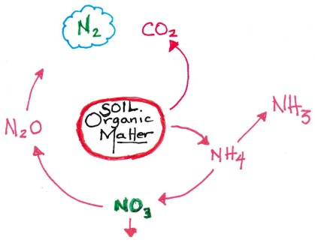
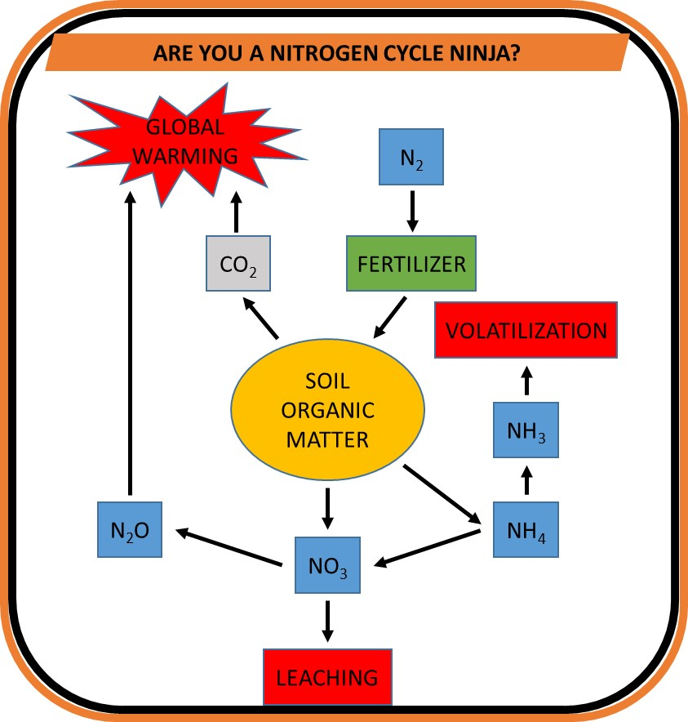
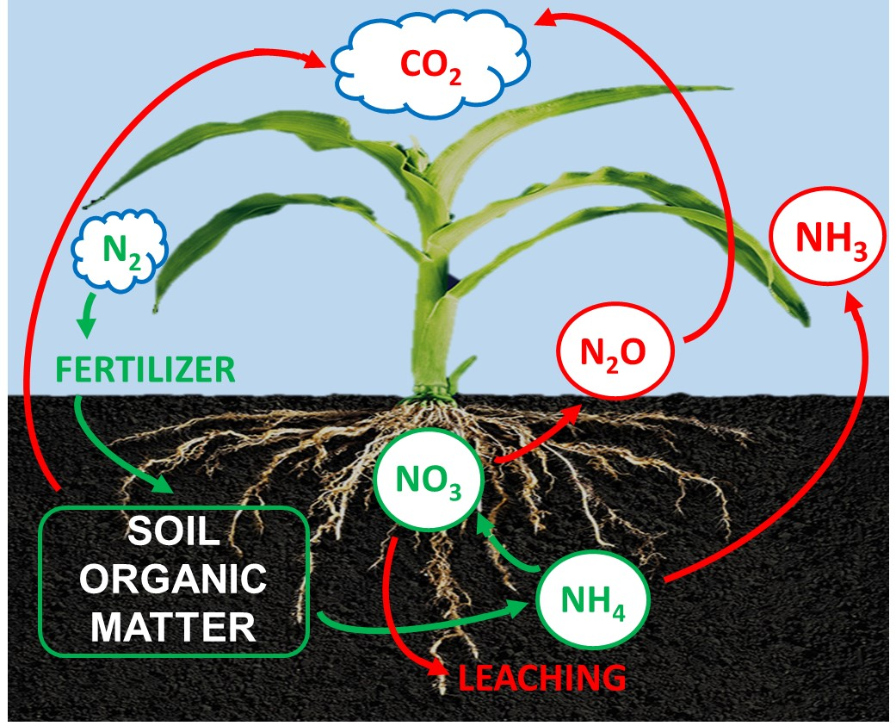
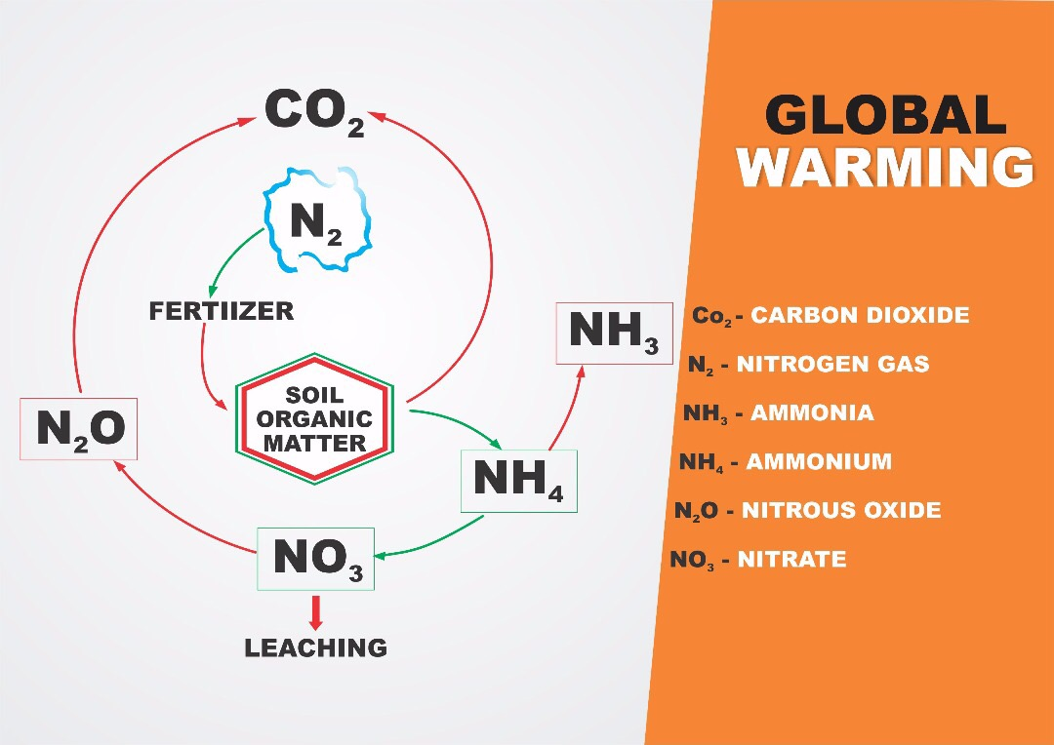
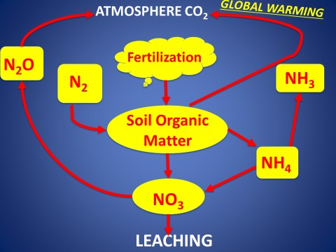

Slide 22
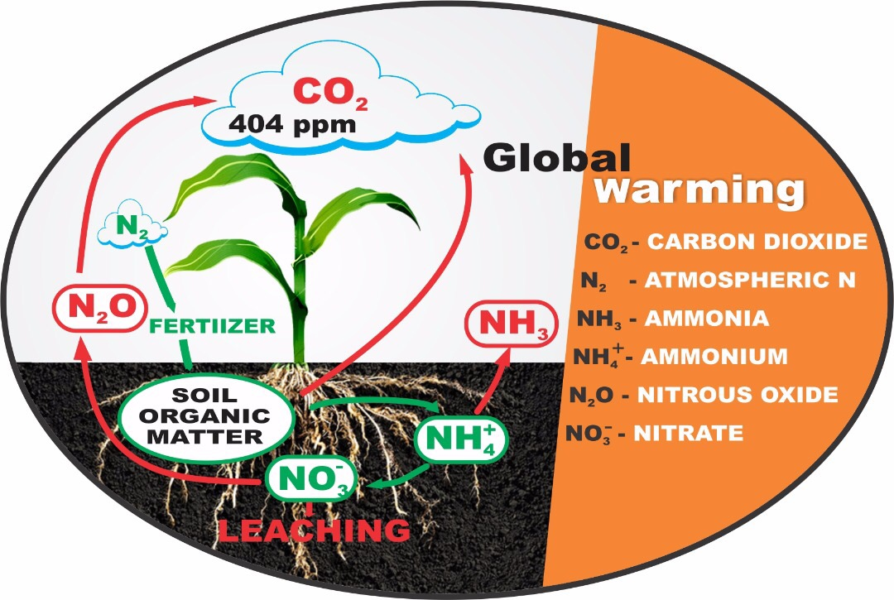

Slide 23
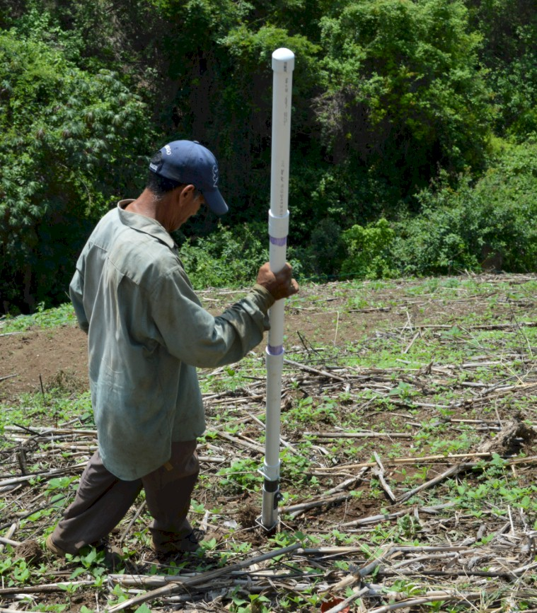


http://nue.okstate.edu/Hand_Planter.htm
Isn’t this a crop sensor?
Homogeneity of plant spacing
CV estimation
Disease recognition
Soil disturbance
Surface residue
Weed presence
Crop vigor,
Crop competition
Instantaneous risk assessment
GREEN SEEDER

Slide 24
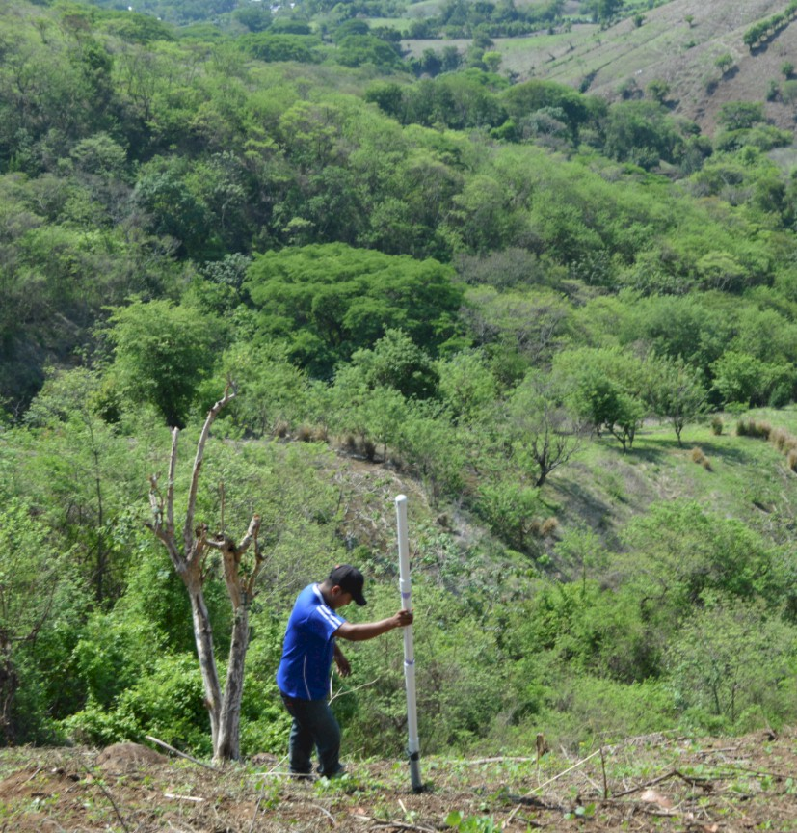
EL SALVADOR

Slide 25
OSU Hand Planter
Countries

Slide 26
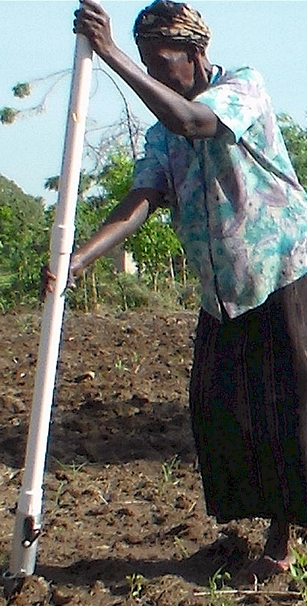
Modern researchers should therefore seek to understand the rationale behind traditional smallholder farmer behavior in technology use. J. Sust. Dev. 2012

Slide 27
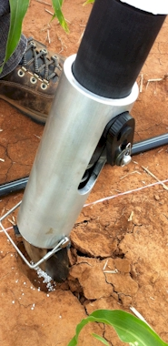
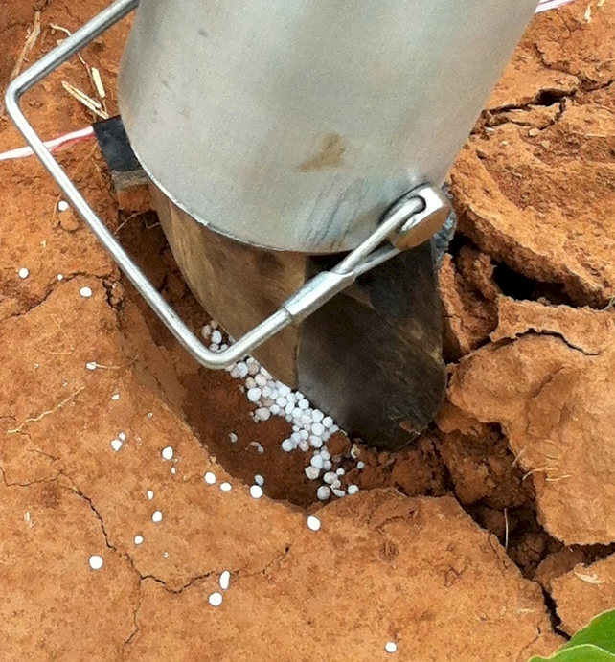
Mid Season Fertilizer N
Combined, Efaw and Perkins
Topdress N, Corn, V12 |  | 70,000 plants/ha
Methods | N, kg/ha | Mg/ha
Check | 0 | 6.6
Hand planter (0.9 g/plant) | 30 | 11.2
Hand planter (1.8 g/plant) | 60 | 10.6
Broadcast | 30 | 6.4
Broadcast | 60 | 7.0
Dribble urea | 30 | 9.3
Dribble urea | 60 | 7.8
Dribble UAN | 30 | 7.3
Dribble UAN | 60 | 10.4
SED = 1.81

Slide 28
Hand Planter (uses)
Mosquito abatement USEPA, Northfield, IL
https://www.epa.gov/mosquitocontrol
Squash production, Valley Center, KS
Pumpkin production, Stillwater, OK
Wildlife food plots,
Home gardeners
Mid-row, maize, coffee plantations, Colombia

Slide 29
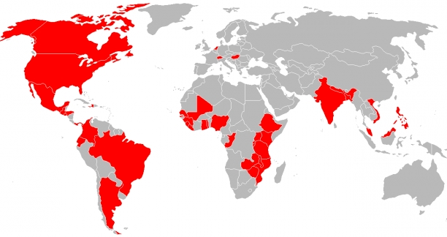
Greenseeder Hand Planter
Tyler Lynch, Bruno Figueiredo, Jagmandeep Dhillon, Gwen Wehmeyer, Eva Nambi, Alimamy Fornah, Fikayo Oyebiyi, Robert Lemings,, Elizabeth Eickhoff, Everett Hrbacek

Slide 30
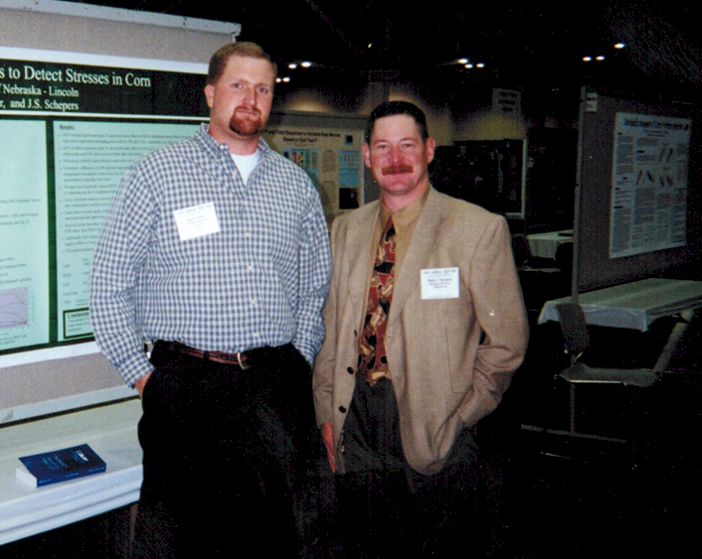
Dr. Kyle Freeman
Dr. Wade Thomason, ASA Fellow, 2017

Slide 31
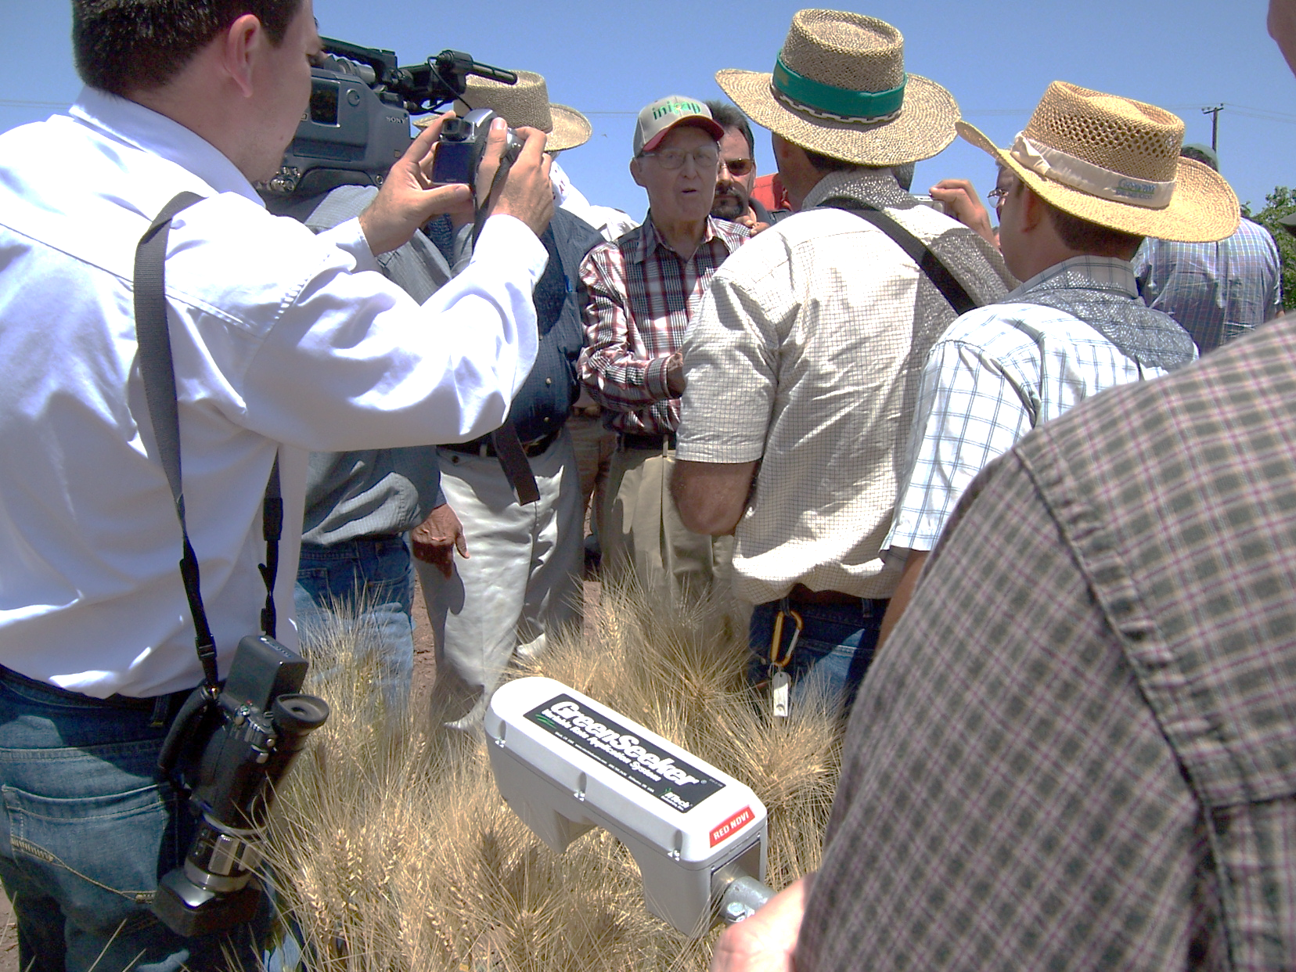
9
Dr. Norman Borlaug
April 16, 2007
Ciudad Obregon, MX
March 25, 1914
September 12, 2009
How do we want to be remembered?
Judicious use of resources

Slide 32

Thank you Brenda!

Slide 33
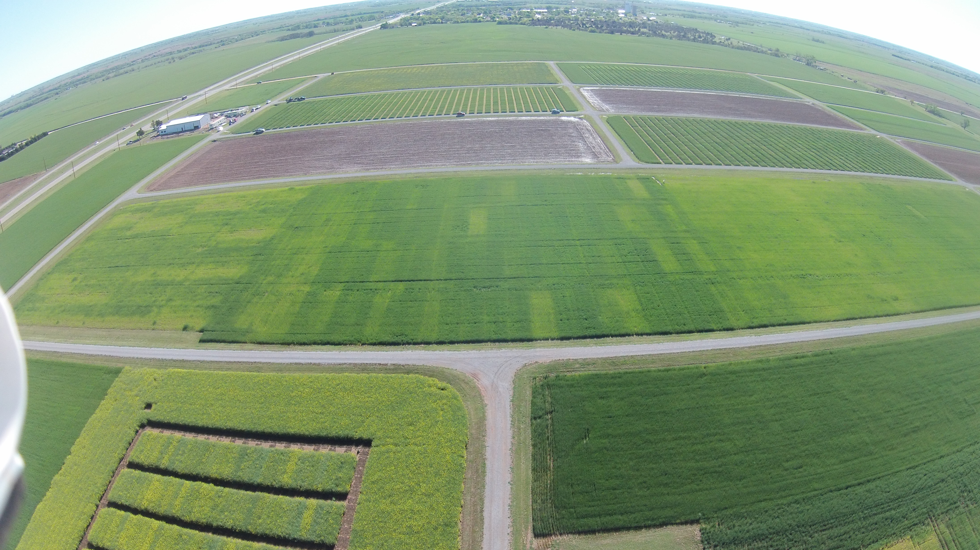
Experiment 502, 1970-present
Lahoma, OK

Slide 34
Institutional Memory
Would not have 502 and 222 had it not been for the Magruder Plots

Slide 35
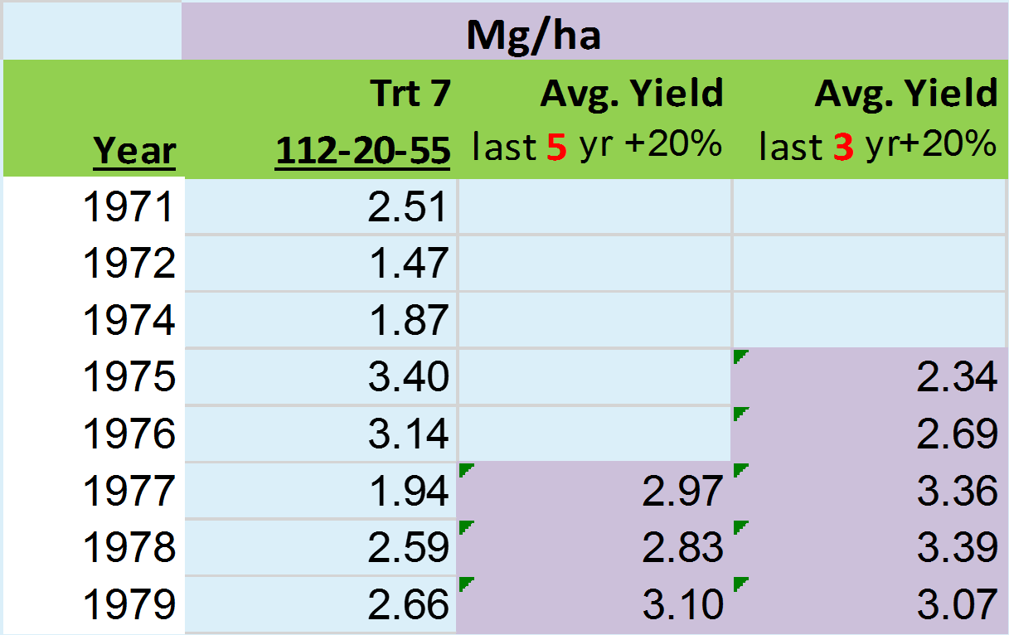
Yield Goals
Average of the last 3 or 5 years + 20% versus observed yield

Slide 37
