Slide 1

Impact of Late Nitrogen Application on Corn Yield and Spectral Reflectance
Results of Preliminary Studies in Alabama
Brenda V. Ortiz¹, Mariana Del Corso¹, Gregory Pate²
¹Auburn University
²Alabama Agriculture Experiment Station
15th Annual Nitrogen Use Efficiency Conference
Louisiana State University
August 7-9, 2017

Slide 2
Treatments and Layout
Treatment ID | Nitrogen rate & time of application | Growth state of application
1 | 60 lb N/acre | Planting
2 | 60 lb N/acre @ planting, 120 lb N/acre @ V6 | Planting + V6
3 | 60 lb N/acre @ planting, 180 lb N/acre @ V6 | Planting + V6
4 | 60 lb N/acre @ planting, 80 lb N/acre @ V6, 40 lb N/acre @ V12 | Planting + V6 + V12
5 | 60 lb N/acre @ planting, 140 lb N/acre @ V6, 40 lb N/acre @ V12 | Planting + V6 + V12

Slide 3
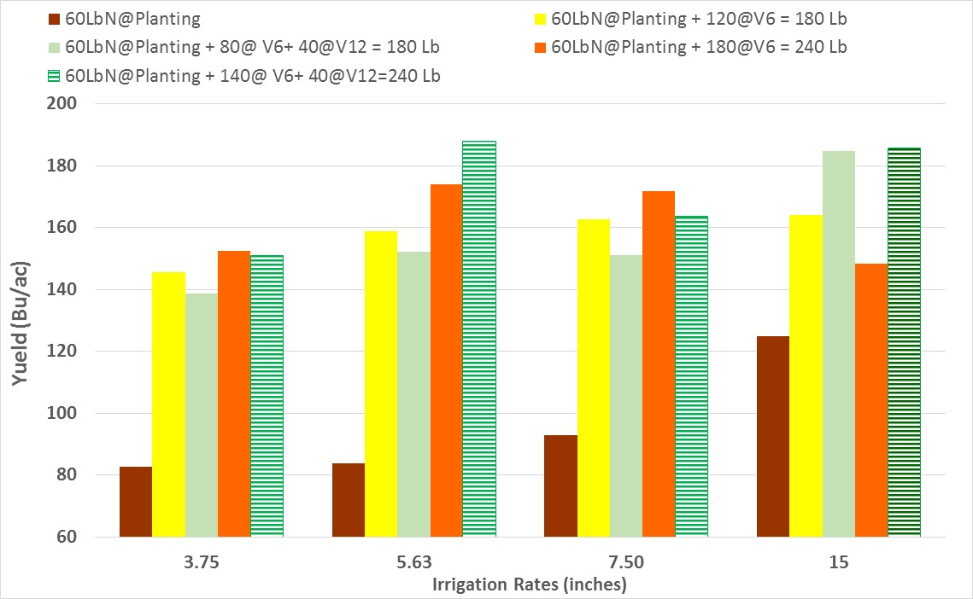
Yield differences between Nitrogen ( Rate/Timing) and Irrigation Rates
2016 season
V6&V12
V6

Slide 4
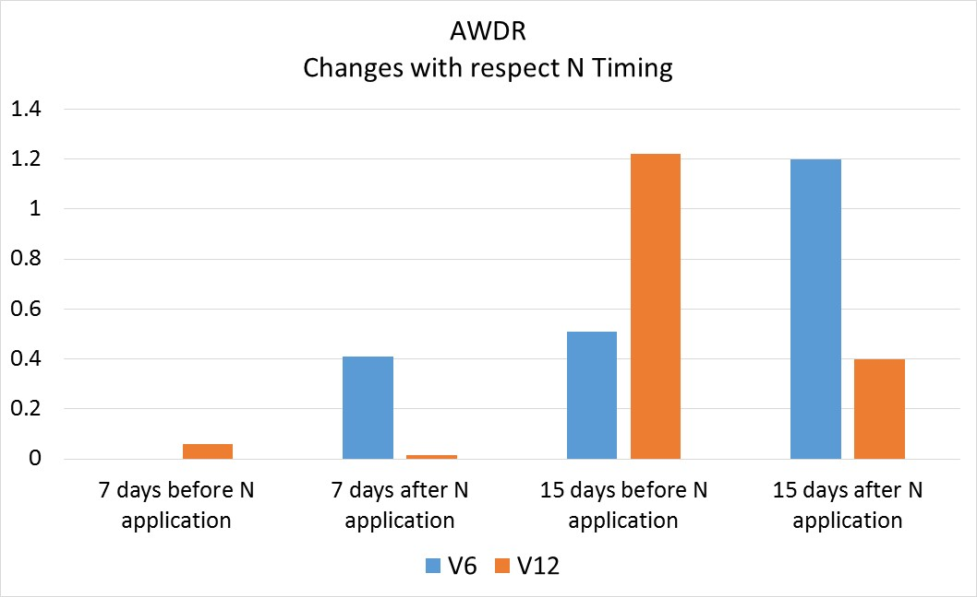

Slide 5
Yield differences between Nitrogen ( Rate/Timing) and Irrigation Rates
2016 season
If Irrigation is available, split N application @ V12 results on yield increase.
High N rates @ V6 → High risk for leaching
Abundant and well distributed rain prior to V12 applic. Favors N use

Slide 6
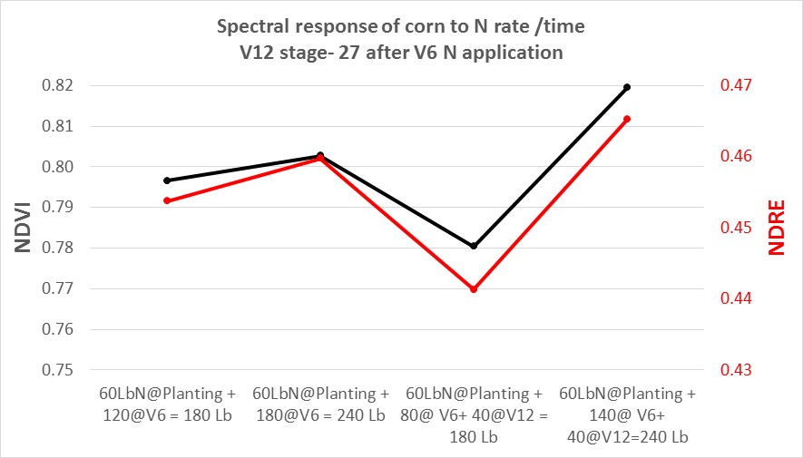
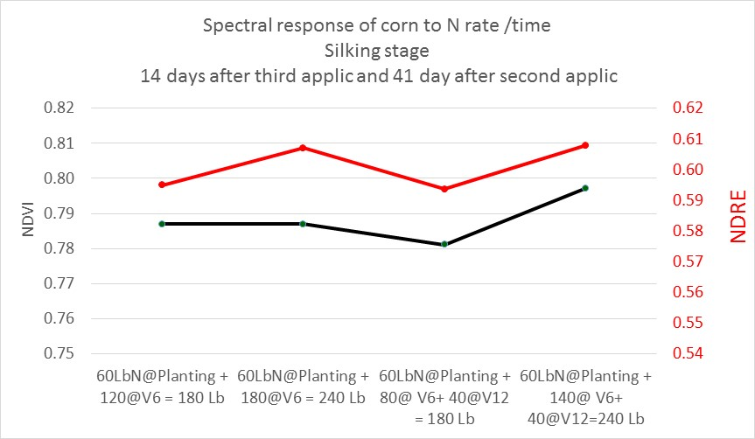
No Late N application Yet
180 240 140 200 Lb total so far
14 days after Late N applic (V12) – 41 days after V6 applic

Slide 7
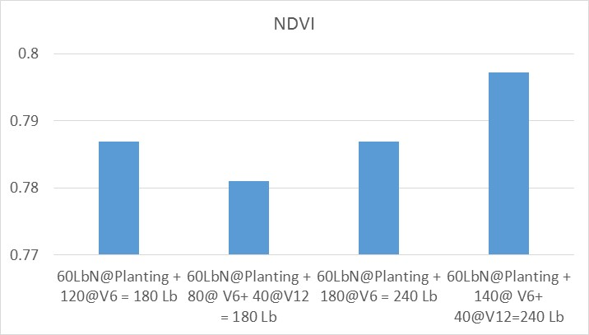
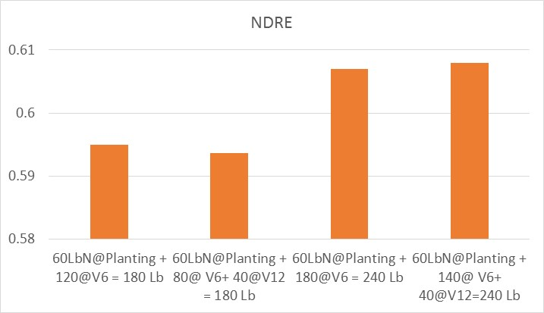
Spectral response of corn to N rate /time
Silking stage
14 days after third application and 41 day after second application

Slide 8
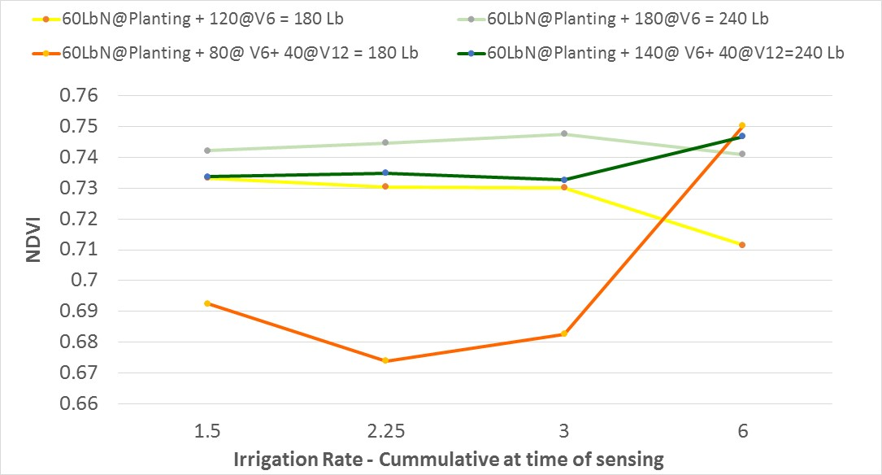
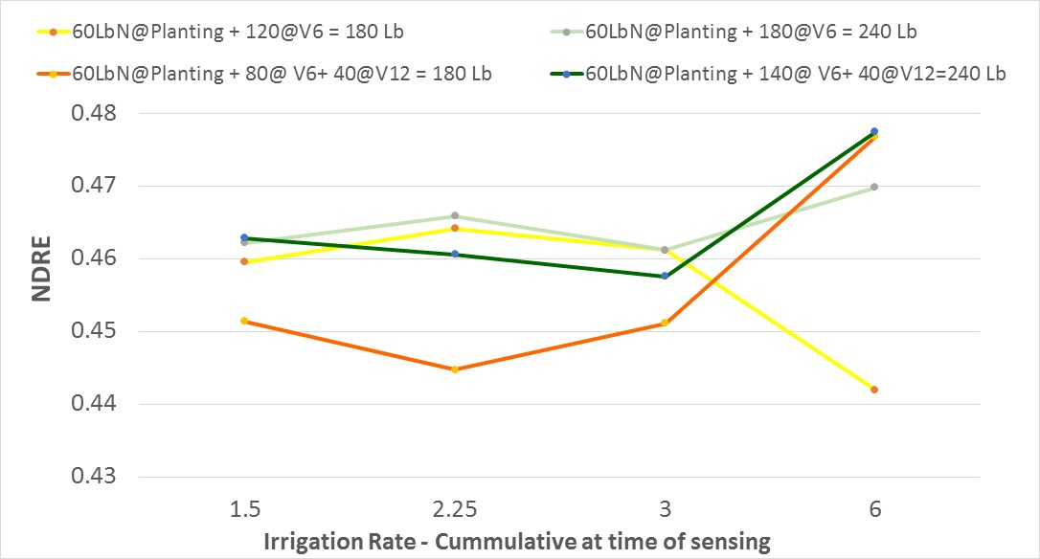
Milking

Slide 9
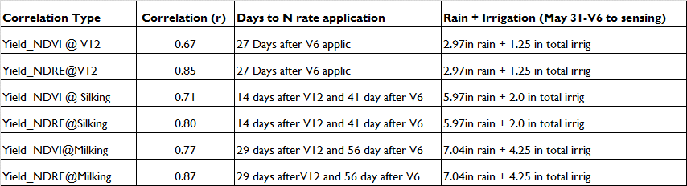
Correlation Analysis between Yield and Spectral Reflectance Data

