Slide 1
"A Quick 15 Years is the Key to the Next Five"
Jim Schepers
August 2003 First NUE Workshop (OSU)
Nebraska
Missouri
Iowa
Indiana
Illinois
Minnesota
North Dakota
Kansas
South Dakota
Oklahoma
Alabama
Idaho
Louisiana
15
August 2017 15th NUE Workshop (LSU)
5
? - ? - ?
August 2022 20th NUE Workshop

Slide 2
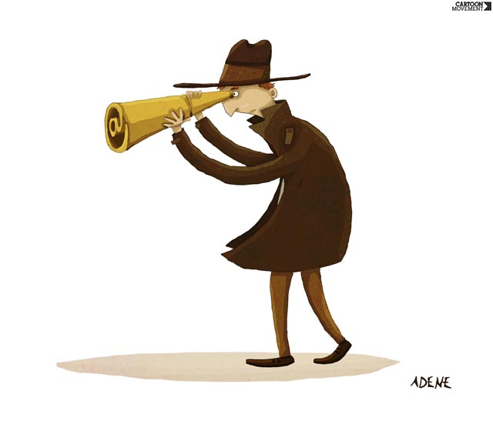
Before looking forward, it’s important to know where we’ve been
2017
Baby-Boomers
Graduate Students
Post Docs
Assistant Professors

Slide 3
Early 1980s VRA - granular based on grid sampling
No GPS
“Monitor leaf chlorophyll to understand nitrogen responses”
SI
20+
Late 1980s Data normalization strategy introduced
1990 Minolta SPAD meter commercialized
Early 1990s Yield monitor combines
Ag GPS
Mid 1990s Passive crop sensors (Li-Cor and OSU)
Early 2000s Active crop sensors (Holland Scientific and OSU)
August 2003 First NUE Workshop (OSU)
Wavebands
Vegetation Indices
Sensor Footprint
Sensor Orientation
15
Calibration
Spatial Resolution
Various Crops
New Sensors
Algorithms
August 2017 15th NUE Workshop (LSU)
5
? - ? - ?
Drones
August 2022 20th NUE Workshop

Slide 4
As a Retiree :
Would you like to do it over again?
If you were to do it over again, would you change anything?
As a Technology :
If we (you) were to do it over again, what changes would you make?
Perspective #1 (re-do)
Perspective #2 (20 : 20 hind-sight)
Literature Review
Approach
Personnel / Disciplines
Interpretation / Evaluation

Slide 5
How Do We Plan ?
Literature Review
Experiences
Objectives and Hypothesis
Products and Dissemination
Does the effort contribute to New Science or amount to a Me Too study ?
Literature Review
Experiences
Objectives and Hypothesis
Products and Dissemination

Slide 6
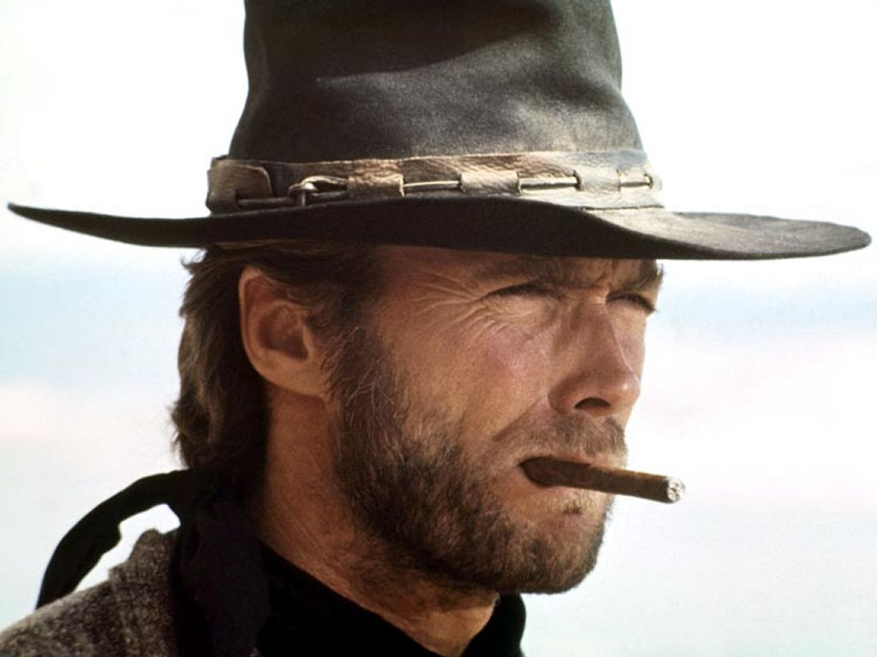
What do you think of when you see this picture ?
GOOD
The
BAD
The
UGLY
The
“ A picture is worth a 1000 words “

Slide 7
Another Picture
GOOD
The
N D V I
BAD
The
map
UGLY
The

Slide 8
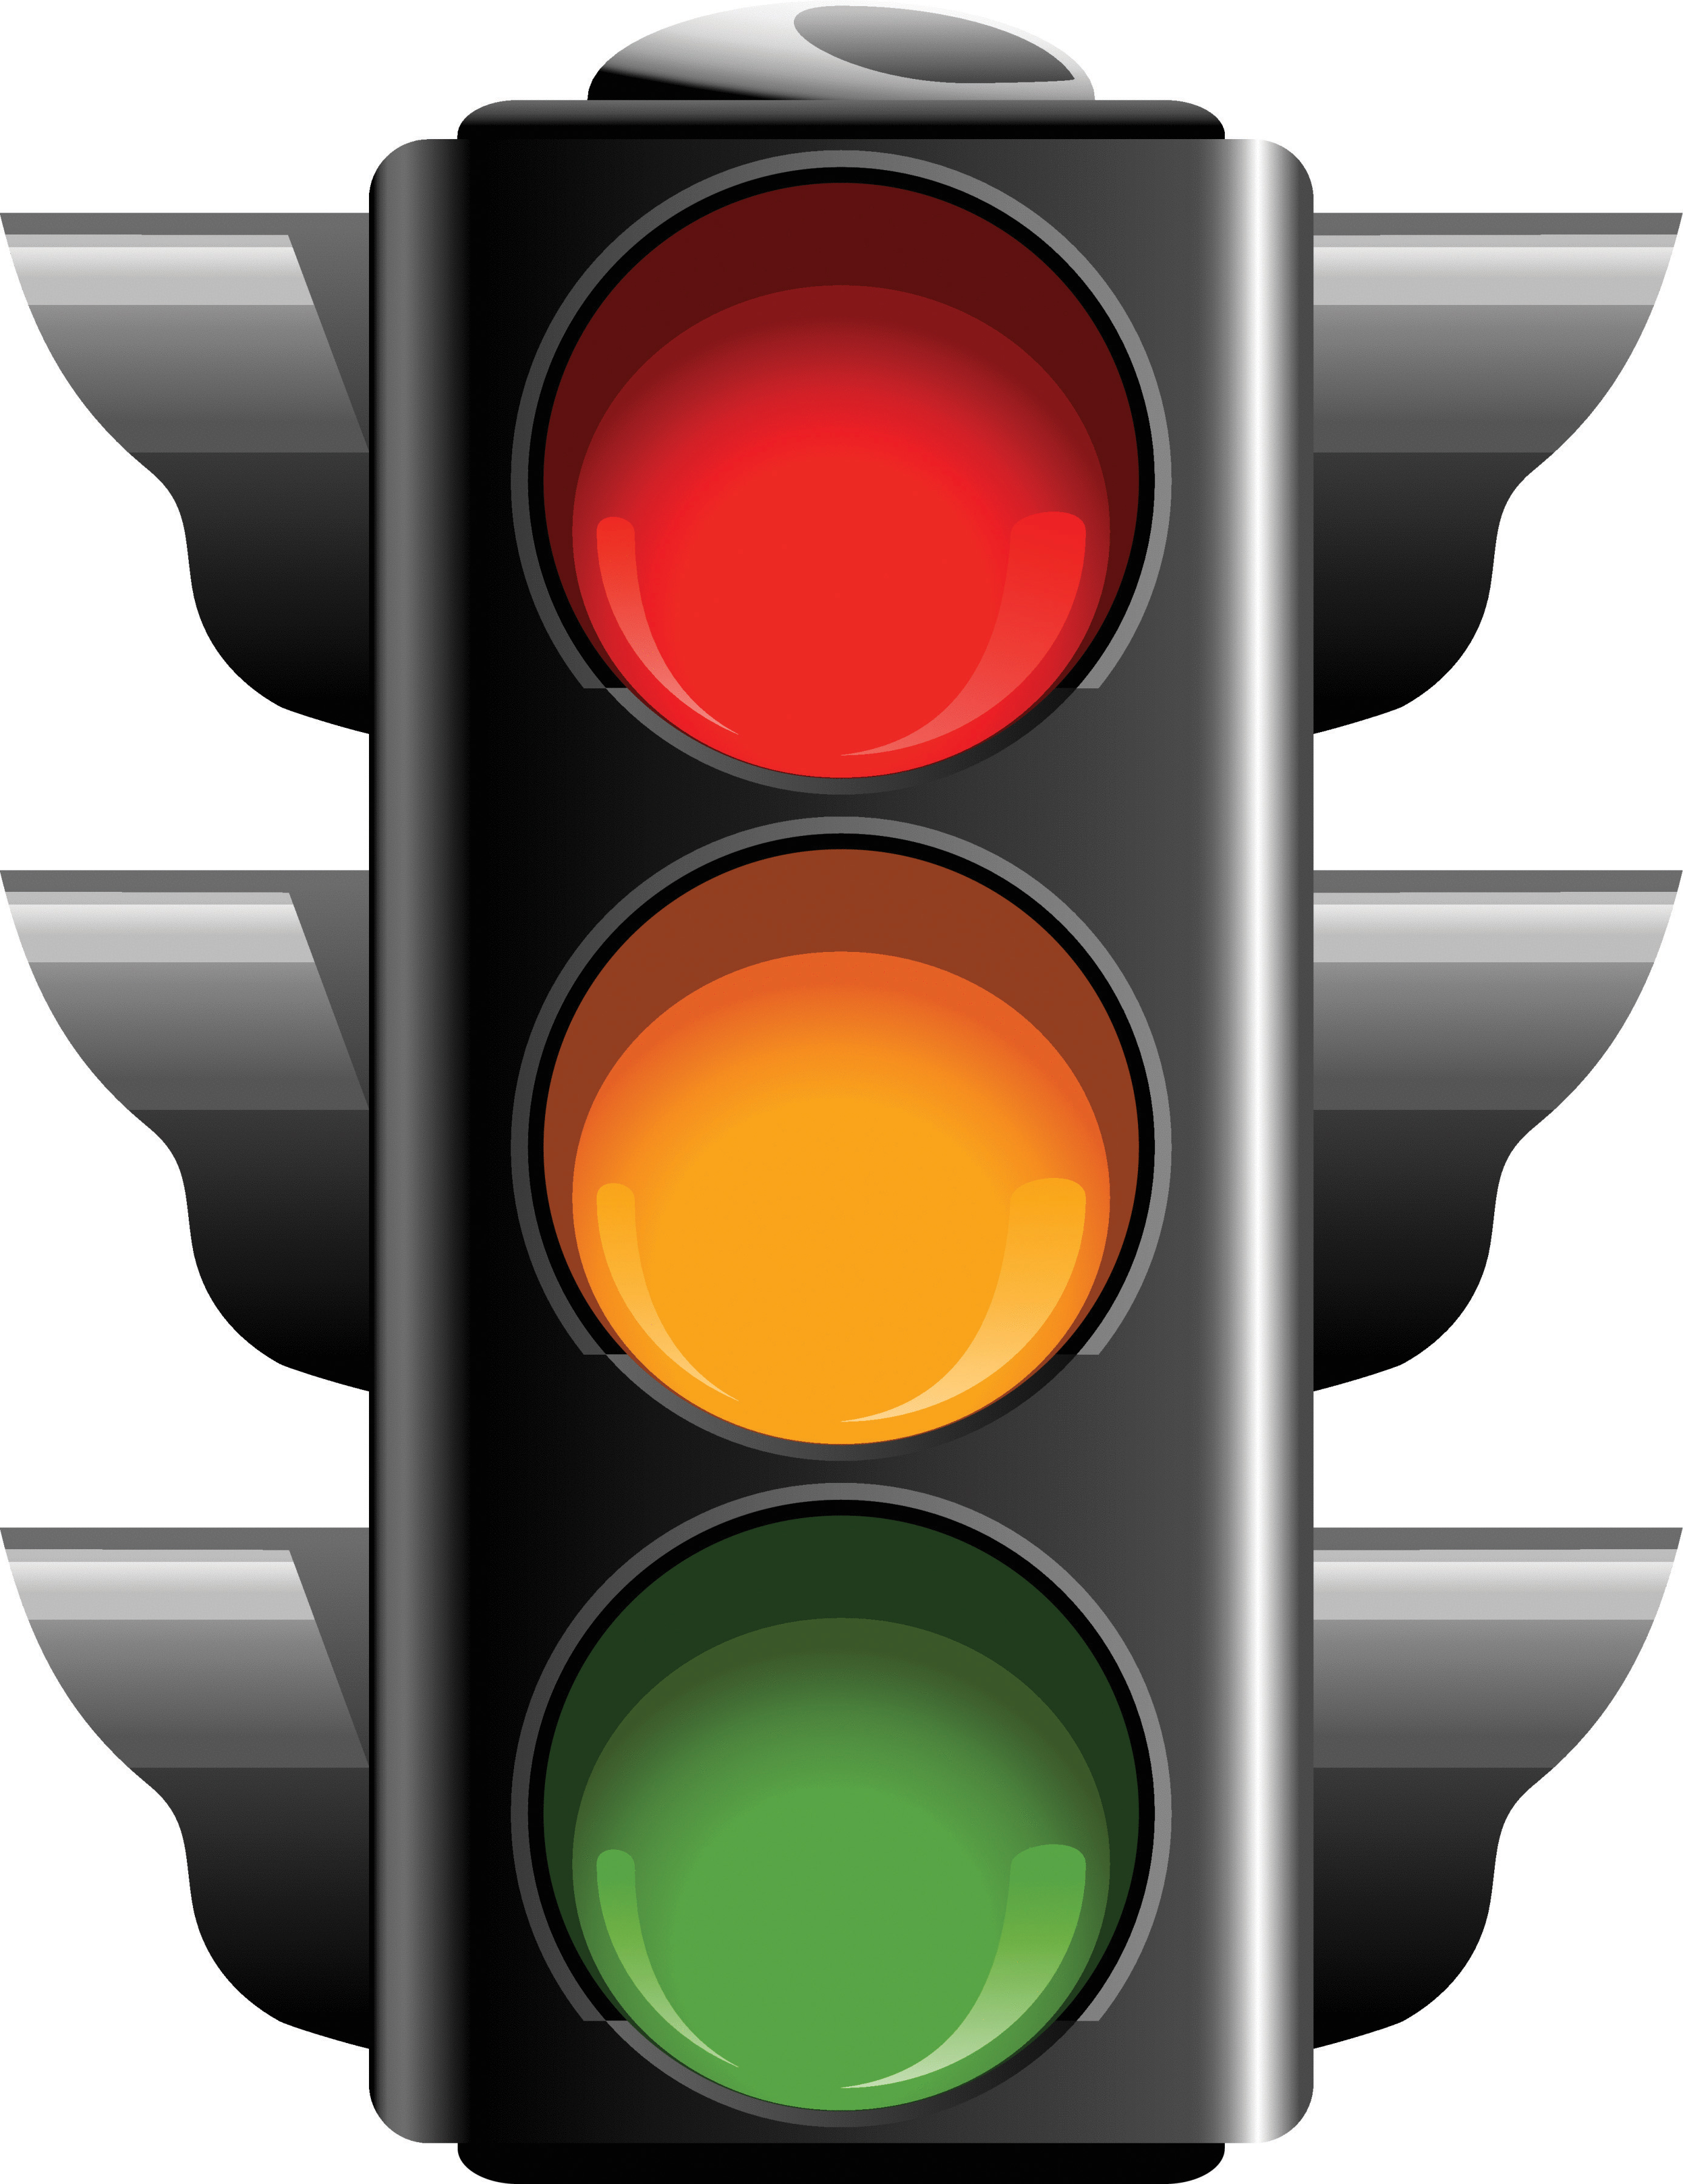
N D V I
Danger
UGLY
The
STOP
Light
Creep
Caution
BAD
The
GOOD
The

Slide 9
NIR – Red
NIR + Red
N D V I
=
GreenSeeker users – “free pass” (no access to red-waveband data)
Literature Review – “shame on you”
Other sensor users – opportunity to select appropriate wavebands

Slide 10
Sensitivity of Vegetation Indices To Various Chlorophyll Levels
Adapted from Gitelson et al. (1996)
LAI >~2.0
GreenSeeker
limitation

Slide 11
V12
NDVI
V6
Bare Soil Reference
V6 …….. R3
NIR - Red
=
NIR + Red
NDVI
Bare soil 28% 18% .22
V6 41% 5% .78
V12 44% 5% .80

Slide 12
V12
NDRE
V6
Bare Soil Reference
V2 …….. R3
NIR - RE
=
NIR + RE
NDRE
Bare soil 28% 20% .17
V6 41% 19% .37
V12 44% 18% .42

Slide 13
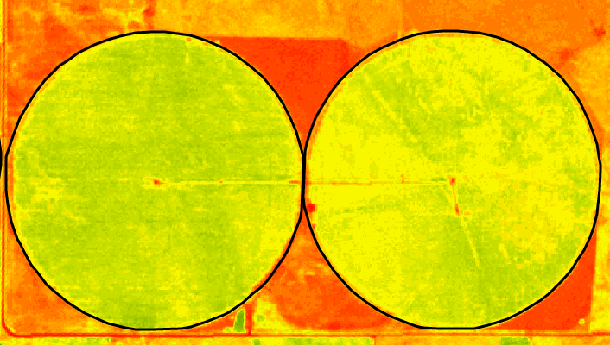
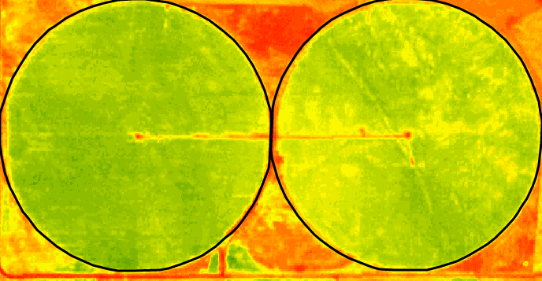
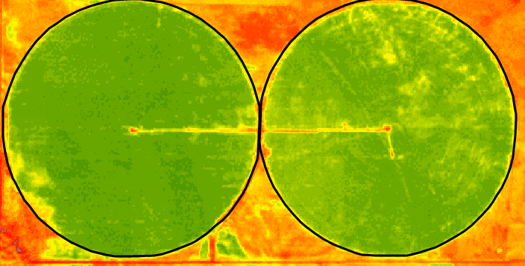
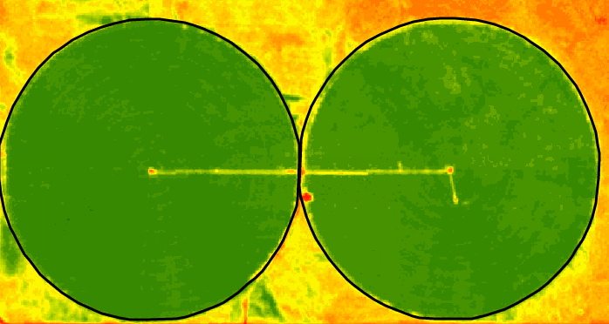
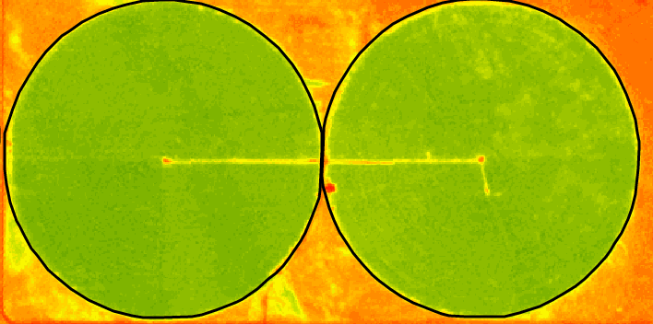
Imagery Time Series
Bare Soil
NDVI – June 19
NDVI – June 23
NDVI – June 28
NDVI – July 12
Red Edge – July 12
Source : Farmshots
High Low

Slide 14
NDVI Comparison
ClimateCorp
Aircraft
July 2, 2017
5-m resolution
V8
July 1, 2017
0.6-m resolution

Slide 15
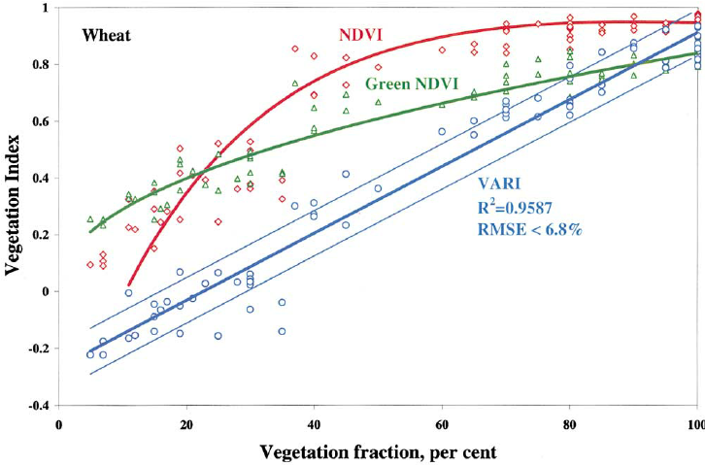
VARI =
(Green – Red)
(Green + Red – Blue)

Slide 16
T + 2, 3, 4 or 5
Knowledge gaps ?
What are producer needs ? (now or anticipated)
Trends in new technologies (drones, artificial intelligence)
Communicating science to users and consumers
Industry and governmental support for research
Environmental initiatives
New Science

Slide 17
Facts - Truths
Plants are a great bio-indicator (not only N)
Plant need for N nutrition will not be going away
The public seeks to be informed / needs educated / wants input
Need innovative ways to communicate science and technologies
The gap between hard science and applied science is widening
Guard against : “participation” degrees
marketing promises (ease, cost & do-it yourself imagery)
drone malpractice

Slide 18
N Management Challenges
Opportunities
Sensors
Drones
Cameras
Satellite imagery
Building
new science into research
Data processing
Algorithms

Slide 19
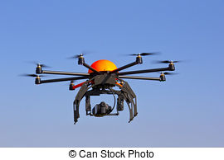
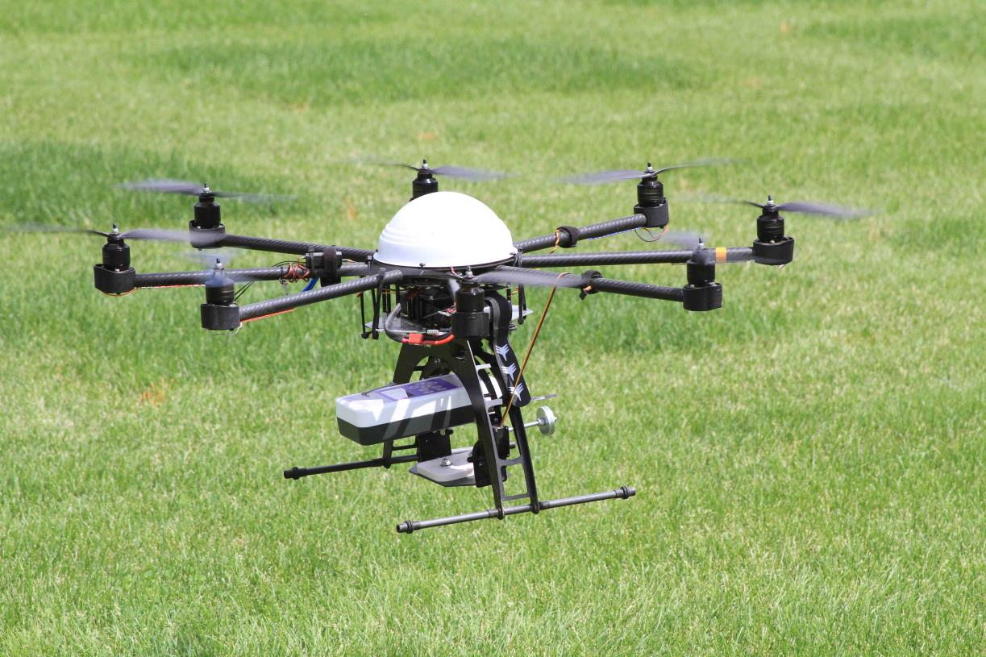
Drone-Based Imagery
Resolution Over-Kill
Another Option
For Example :
4” spatial resolution
~400,000 pixels / A
~63 million pixels / 160 A
Yield map has ~40,000 cells / 160 A

Slide 20
UAV
Imagery
Considerations :
Image overlap Time of day
Clouds Shadows
Vignetting Irradiation changes
Quantitative vs. Qualitative
“Good Enough”
“Good Enough”
“Good Enough”

Slide 21
Vignetting
Means : “light fall-off”
Effect : gradual darkening
Some More

Slide 22
Are you planning to use a drone to view your field ?
Are you paying for someone to image your field ?
Check out the following web site :
agribotix.com/blog/2015/12/12/vignetting-effects-illustrated/
Examples :
“time of day” images
over-sampling
vignetting
cloud cover

Slide 23
Drone Image Analysis
75% Overlap
Flight Path
Flight Path
pass #1
pass #2
pass #3
pass #4
pass #5
pass #6
4 images / pixel
# images / pixel
Vignetting Effect
Qualitative
vs.
Quantitative

