Slide 1
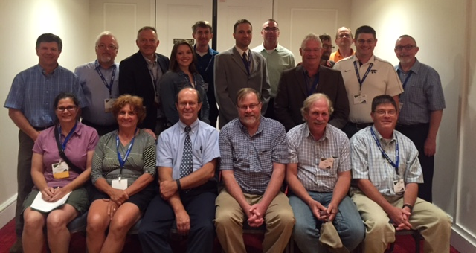
Workforce Development Precision Agriculture
Washington State
University of Missouri
Oklahoma State
University of Nebraska
Colorado State University
USDA-ARS
South Dakota State University
Purdue
Kansas State
International Soc. Pre. Ag (ISPA)
American Society of Agronomy
Ag-Idea
Auburn, ARS, Iowa Soybean Board
Raven Ind.,
IPNI, NDSU, Alabama A&M
West Hills College-CA,
McGill University, Canada
University Kentucky
California State University-Monterey Bay
Prepared by David Clay

Slide 2
Activities
Conducted a survey of employers and universities
Identify gaps in what is being taught
Held monthly planning meetings
Initiated a dialog with American Society of Agronomy, CCA program about a PA specialty
Wrote two text books
Practical Mathematics and Agronomy for Precision Agriculture
18 chapters completed and accepted
Precision Farming Basics
10 of 15 chapters accepted
Prepared a workshop for teachers for underserved students for summer 2018.

Slide 3
Precision Equipment Technician
128 Respondents
Employer Survey

Slide 4
Technical Support
Employer Survey

Slide 5
Agronomist
112 Respondents
Employer Survey

Slide 6
Please indicate the level of difficulty finding qualified applicants in the precision Ag employee
Employer Survey
130, 145, 124, 121, 32 Respondents

Slide 7
?
Question
Respondents

Slide 8
Precision Workforce Development Needed
Per Employers:
Low or deficient:
87% Math and statistics
62% Mapping
50% General Knowledge of PA
60% Effective recommendations

Slide 9
University Surveys
Identify course requirements
Identify list of topics that courses covered
What was the frequency that topics were covered
Entry Level vs. Advanced Level
What vocabulary is used to address certain topics

Slide 10
Colleges/Universities that shared syllabi

Slide 11
Prerequisites required to be enrolled: n=43
Prerequisites | #
No Prerequisites | 19
College Algebra | 8
Precision Ag (Intro) | 4
Junior or Senior Standing | 4
Physics | 3
Soils | 3
Graduate Standing | 3
Plant Pathology | 2
Prerequisites | #
GIS | 2
Farm Management | 2
Agribusiness | 1
Insect Biology | 1
Remote Sensing | 1
Statistics | 1
Basic Computing Class | 1

Slide 12
Topics Taught In Both Entry & Advanced Courses n=43

Slide 13
Topics Taught In Both Entry & Advanced Courses n=43

Slide 14
Topics Taught In Both Entry & Advanced Courses n=43

Slide 15
Conclusions: Key differences between employers and universities
Topics covered in PA Classes
GIS (79% classes)
Economics (69% classes)
VRT (65% classes)
Environment (53% classes)
Yield mapping (51% classes)
Employers
87% lacking in basic statistics
Not covered in PA classes
51% lacking in oral and written communication
52% lacking in Maps
50% lacking in PA knowledge
60% lacking in effective Agronomic Recommendations
Large gaps between employers
and universities
Basic current PA knowledge
Basic statistics for conducting
on-farm research
Problem solving in agriculture
Agronomic recommendations

Slide 16
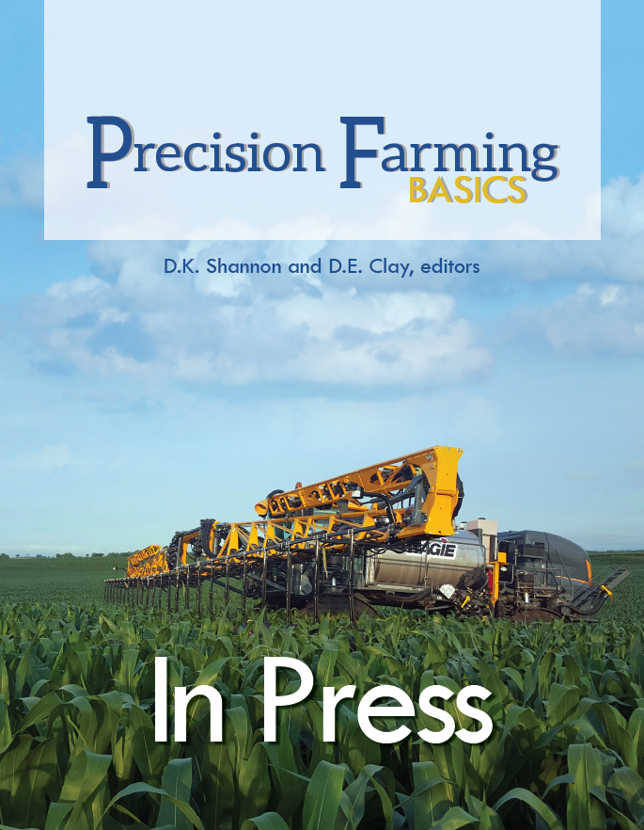
To address these limitations
New text book that highlights advances in PA
Text book that integrates Math, PA, Agronomic recommendations.
Include short video clips on select topics
Texts will be available through the ACSESS Digital Library
Royalties go into Tri-Society Precision Ag communities
Available January

Slide 17
Curricula
Mathematics
Teaching mathematics,
The use of models in problem solving,
Calculating economic optimum rates,
Mathematics of longitude and latitude
Agronomics
Chapters on fertilizers, understanding soil test results, scouting fields,
Determining the cost of production
Knowledge
GIS, GPS, yield monitors, variable rate equipment

Slide 18
Contacts
At Meeting:
Stephanie Bruggeman (grant coordinator/co-editor)
Multiple Authors: Terry Griffin, Newell Kitchen, Brian Arnall, James Schepers, Others?
After Meeting:
David.Clay@sdstate.edu
ShannonD@missouri.edu (Kent Shannon)
Stephanie.bruggeman@sdstate.edu

