Slide 1
Using polymer Coated Urea to Reduce N Loss, Increase Yields, and Grower Profits

Slide 2
Enhanced-Efficiency Fertilizers (EEF)
A fertilizer that has been modified in some way to
1) reduce nutrient losses to the environment and
2) increase nutrient availability for the crop.
From The Association of American Plant Food Control Officials (AAPFCO)
Notes:
This paraphrased from the AAPFCO (American Association of Plant Food Control Officials). AAPFCO is an association of state fertilizer control officials). It is not, of itself, a regulatory body, but is the organization where officials from the state department of ag, state chemists office, and/or university staff who regulate fertilizer labeling and inspections meet together to form uniform language, terms, labeling requirements, etc.
This definition has been in place more or less in its current form for about 15 years with some modifications over the years.
It includes two main requirements for an enhanced-efficiency fertilizer.
That the fertilizer reduces losses to the environment and
That the fertilizer increases nutrient availability.
Other AAPFCO policy statements further define this term to include slow and controlled release and stabilized fertilizers.

Slide 3
Why Nitrogen EEF’s?
Many proven technologies
Reduce nitrogen loss to the environment
Improve nutrient-use efficiency
Increase productivity and profitability
Simplify N management
EEFs are now, and will be, a large part of N management strategies.
Notes:
Many of the enhanced-efficiency nitrogen fertilizer technologies have been marketed for many decades. Slow-release fertilizers have been recognized since the early 20th century if not longer. Polymer coated fertilizers were introduced into the US market in the 1960s. N-Serve was introduced in the early 70s. Many are proven technologies that have been shown to decrease nitrogen losses by ammonia volatilization, nitrate leaching, or denitrification and to increase N-use efficiency.
A variety of benefits may be realized when these products are properly used in appropriate situations.
In the last 15-20 years, nitrogen EEFs have received much more attention with increasing concern for the impacts of N on the environment. They are now part of virtually every discussion on nitrogen management and will continue to grow in market share. They are valuable tools that growers should consider.

Slide 4
Conventional Soluble Nitrogen Fertilizers
Commonly used in all crops
Urea (dry)
Ammonium sulfate (dry)
Ammonium nitrate (dry)
UAN (liquid)
Anhydrous ammonia (gas)
Dissolve readily in water and readily available to plants
Supply N forms needed by all plants
Rapidly available
Readily change from one N form to another
Naturally subject to several loss mechanisms
Notes:
To better understand what an EEF is, we should first review what we mean by “reference soluble fertilizer”. These are the conventional water-soluble N fertilizers that are the standard materials used in virtually all cropping systems. Urea, UAN, anhydrous ammonia, and ammonium sulfate. We have listed ammonium nitrate, but since it’s no longer available in many markets, it may no longer be relevant for many.
These materials are water soluble and rapidly available. Rapidly available nitrogen fertilizers present special management challenges because of the potential for N to be lost from the soil by several mechanisms. They are also unstable and change rapidly from one form to another, which leads to potential loss mechanisms. They are not inherently “bad” fertilizers, but must be managed properly.

Slide 5
Fertilizer Solubility is Necessary
Plants take up ammonium (NH₄⁺) and nitrate (NO₃⁻)
Fertilizer must supply or convert to these forms
HOWEVER
Ammonium and nitrate forms may be subject to loss
Key to high efficiency is matching form, timing, amount, and placement to plant needs – 4Rs.
Goal: Provide what the crop needs, when and where it is needed, in a form the crop can use.

Slide 6
Two Basic Nitrogen Risks
Urea on the soil surface
Can be lost by volatilization as it converts to ammonium
Short-term risk
Nitrate in the soil
Can be lost by leaching
and denitrification from excess water
Season-long risk
Losses within a few days after surface application
Losses any time during season with rainfall or irrigation events
Notes:
There are many pathways or transformations nitrogen fertilizer may undergo upon application to the soil. Some of these may lead to losses from the soil to the environment. When conditions are conducive to any of the loss mechanisms, significant losses may occur in very short periods of time. Three major losses from the soil that may be of greatest concern are:
Ammonia volatilization from surface application of urea or improper application of anhydrous ammonia. This occurs when urea is not incorporated soon after application and volatilizing conditions occur. As urea converts to ammonia, some of the ammonia may be lost if this occurs at or near the soil surface. The transformation of urea to ammonia is rapid – typically complete within 24-48 hours.
Denitrification. This occurs from the nitrate-nitrogen form when soil becomes oxygen deficient. Anaerobic bacteria (bacteria that function in the absence of oxygen) convert nitrate-nitrogen (NO₃) to several nitrogen gases (such as N₂, NO, N₂O) that can diffuse out of the soil and be lost to atmosphere. Significant amounts of N may be lost in a short time if conditions are favorable to these processes.
Leaching of nitrate from the root zone. Nitrate is very mobile in the soil. When water moves down thru the root zone, nitrate may move with it. In permeable soils, nitrate-nitrogen may quickly move beyond the reach of plant roots when rainfall exceeds the soil’s water-holding capacity.
Immobilization is the conversion of NH4 and NO3 into organic forms by soil microbes. This is a temporary loss of plant-available nitrogen but is not a loss of N from the soil. Immobilized N will later be converted back to plant available N.
Erosion and runoff losses of N are generally less than other loss mechanisms as long as erosion is controlled by proper tillage and soil management. Maintaining adequate crop residue or plant cover can usually prevent these losses.

Slide 7
Where Does Your Nitrogen Go?
Volatilization
Denitrification
Ammonia
Ammonium
Nitrate
Urea
Ammonium
Sulfate
Ammonium
Nitrate
Leaching
UAN
Solution
Notes:
There are many pathways or transformations nitrogen fertilizer may undergo upon application to the soil. Some of these may lead to losses from the soil to the environment. Three major losses from the soil that may be of greatest concern are:
Ammonia volatilization from surface application of urea or improper application of anhydrous ammonia. This occurs when urea is not incorporated soon after application and volatilizing conditions occur.
Denitrification. This occurs from the nitrate-nitrogen form when soil becomes oxygen deficient. Anaerobic bacteria (bacteria that function in the absence of oxygen) convert nitrate-nitrogen (NO₃) to several nitrogen gases (such as N₂, NO, N₂O) that can diffuse out of the soil and be lost to atmosphere. Significant amounts of N may be lost in a short time if conditions are favorable to these processes.
Leaching of nitrate from the root zone. Nitrate is very mobile in the soil. When water moves down thru the root zone, nitrate may move with it. In permeable soils, nitrate-nitrogen may quickly move beyond the reach of plant roots when rainfall exceeds the soil’s water-holding capacity.

Slide 8
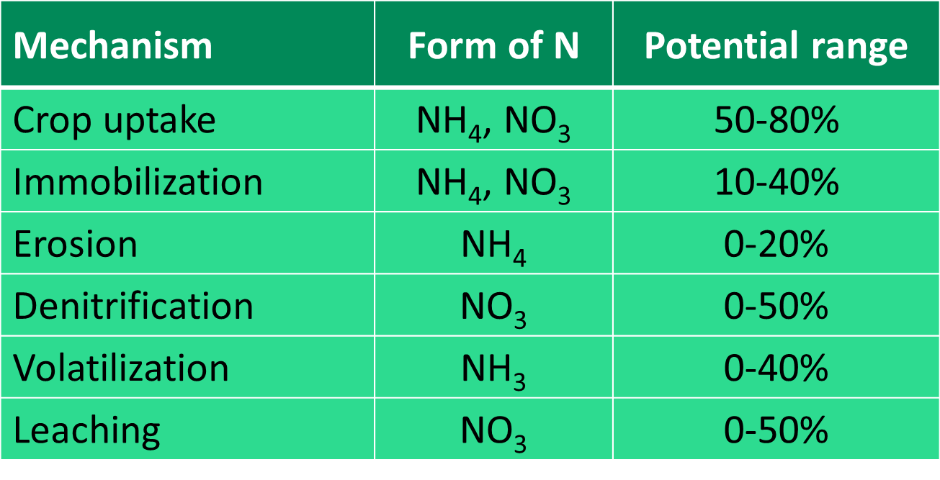
Natural Loss Mechanisms Reduce N-use Efficiency
Significant economic and environmental risk
Notes:
There are many pathways or transformations nitrogen fertilizer may undergo upon application to the soil. Some of these may lead to losses from the soil to the environment. When conditions are conducive to any of the loss mechanisms, significant losses may occur in very short periods of time. Three major losses from the soil that may be of greatest concern are:
Ammonia volatilization from surface application of urea or improper application of anhydrous ammonia. This occurs when urea is not incorporated soon after application and volatilizing conditions occur.
Denitrification. This occurs from the nitrate-nitrogen form when soil becomes oxygen deficient. Anaerobic bacteria (bacteria that function in the absence of oxygen) convert nitrate-nitrogen (NO₃) to several nitrogen gases (such as N₂, NO, N₂O) that can diffuse out of the soil and be lost to atmosphere. Significant amounts of N may be lost in a short time if conditions are favorable to these processes.
Leaching of nitrate from the root zone. Nitrate is very mobile in the soil. When water moves down thru the root zone, nitrate may move with it. In permeable soils, nitrate-nitrogen may quickly move beyond the reach of plant roots when rainfall exceeds the soil’s water-holding capacity.
Immobilization is the conversion of NH4 and NO3 into organic forms by soil microbes. This is a temporary loss of plant-available nitrogen but is not a loss of N from the soil. Immobilized N will later be converted back to plant available N.
Erosion and runoff losses of N are generally less than other loss mechanisms as long as erosion is controlled by proper tillage and soil management. Maintaining adequate crop residue or plant cover can usually prevent these losses.

Slide 9
Reducing Loss
Manage 4Rs – source, timing, rate, placement – to reduce risk.
Example 1: Split application to apply N closer to time of crop need
Example 2: Incorporate urea and UAN immediately
AND/OR
Alter the fertilizer to manage soil N form and timing
Example 1: Use controlled-release N to deliver N as needed
Example 2: Use nitrification inhibitor to slow conversion to nitrate
Notes:
We’ve described the N management challenges of conventional soluble fertilizers. There are two basic approaches: One can manage these fertilizers with the 4Rs. With careful management such as multiple applications and proper placement, they can generally be effectively managed, but risk of loss is still present and they require more operations and more careful management.
Another option is to use the various enhancements and additives that can reduce the risk of loss from the conventional materials. These are the materials called “enhanced-efficiency fertilizers”.
EEFs are not a substitute for 4R principles. EEFs can be misused and by so doing defeat their qualities and benefits. One should understand the N-loss mechanisms in play and all the different products to get the best result. The best solution is to use EEFs in combination with 4R practices.

Slide 10
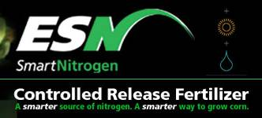
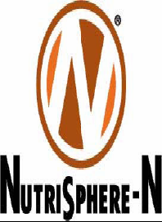
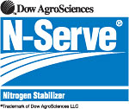
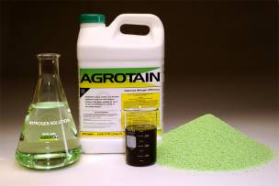
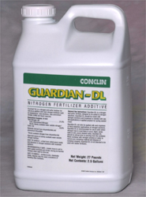
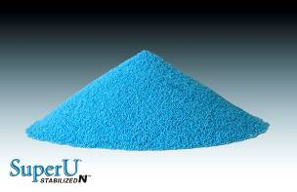
“Enhanced-Efficiency” Fertilizers
Many old and new products
Wide variety of formulations
Different modes of action for different objectives
Select the EEF that BEST solves the grower’s problem

Slide 11
Enhanced-Efficiency Nitrogen Fertilizers
Slow- and controlled-release
Release nitrogen by
physical processes
Release nitrogen by
chemical or biological processes
Control leaching, denitrification, and volatilization for a few weeks to many months depending on product longevity.
Polymer-coated
ESN
Methylene urea
Urea formaldehyde
Urea triazone
Coron
Nitamin/Nfusion
NPact
Trisert
Notes:
Slow- and controlled-release fertilizers are further subdivided into two categories – slow release and controlled release. In the US, these are not officially differentiated from each other, mostly because of tradition and other political and marketing reasons, although most of the rest world recognizes these as two categories of products representing different modes of action.
Slow- and controlled-release nitrogen fertilizers have been used in No. America for decades in turf, horticulture, nursery production and some in high value specialty crops. They have historically been limited in agriculture because of the high cost/unit of N. Because they allow only small amounts of N to be exposed at a time, they are effective in controlling all the loss mechanisms. Their period of efficacy against these losses is also greater than the chemical inhibitors. Their efficacy may range from as little as a few weeks to many months or even more than a year depending on product design and its intended use.
One group of products releases N by physical processes such as diffusion thru polymer coatings, such as with ESN. These are generally known in more technical circles and in other regions such as Canada, Europe and Asia as “controlled-release fertilizers”. They are unaffected by biological and chemical processes. Only recently with the introduction of ESN have these products had any significant presence in ag.
The other group of products releases nutrients by chemical and/or biological degradation. These are generally designated as “slow-release” fertilizers. Products such as “urea-reaction products” made by reacting urea with other nitrogen compounds to decrease the solubility or slow the availability of N are examples of “slow release fertilizers”. They must be degraded or decomposed by biological organisms or chemical reactions in order for the N to become availability. Thus they may be deemed somewhat less predictable than “controlled-release” fertilizers. The primary use of these materials in ag is the use of low-molecular-weight water-soluble compounds as foliar fertilizers. When used as a foliar spray, they don’t really behave as a slow-release fertilizer as these compounds are absorbed rapidly and metabolized directly by the plant. They do not require decomposition for foliar absorption. Most are used at only very limited rates because of their very high cost/unit of N. Their use is decreasing in No. America as more polymer-coated options become available.

Slide 12
Enhanced-Efficiency Nitrogen Fertilizers
Inhibitors/stabilizers
Urease inhibitors
Slow conversion of urea to NH₄
Nitrification inhibitors
Slow conversion of NH₄ to NO₃
Control volatilization
for 7-14 days.
Control leaching, denitrification for 4-8 weeks
NBPT
Agrotain
Nitrain/Nitrain Express
Limus
Arborite
Many others
Nitrapyrin
N-Serve
Instinct
DCD
Super U*
Agrotain Plus*
Guardian
Other Active
Ingredients**
Nutrisphere-N
Stay-N
N-Zone
*Contains both NBPT and DCD
** Mode of action less certain or less-well documented
Notes:
Slow- and controlled-release fertilizers are further subdivided into two categories – slow release and controlled release. In the US, these are not officially differentiated from each other, mostly because of tradition and other political and marketing reasons, although most of the rest world recognizes these as two categories of products representing different modes of action.
Slow- and controlled-release nitrogen fertilizers have been used in No. America for decades in turf, horticulture, nursery production and some in high value specialty crops. They have historically been limited in agriculture because of the high cost/unit of N. Because they allow only small amounts of N to be exposed at a time, they are effective in controlling all the loss mechanisms. Their period of efficacy against these losses is also greater than the chemical inhibitors. Their efficacy may range from as little as a few weeks to many months or even more than a year depending on product design and its intended use.
One group of products releases N by physical processes such as diffusion thru polymer coatings, such as with ESN. These are generally known in more technical circles and in other regions such as Canada, Europe and Asia as “controlled-release fertilizers”. They are unaffected by biological and chemical processes. Only recently with the introduction of ESN have these products had any significant presence in ag.
The other group of products releases nutrients by chemical and/or biological degradation. These are generally designated as “slow-release” fertilizers. Products such as “urea-reaction products” made by reacting urea with other nitrogen compounds to decrease the solubility or slow the availability of N are examples of “slow release fertilizers”. They must be degraded or decomposed by biological organisms or chemical reactions in order for the N to become availability. Thus they may be deemed somewhat less predictable than “controlled-release” fertilizers. The primary use of these materials in ag is the use of low-molecular-weight water-soluble compounds as foliar fertilizers. When used as a foliar spray, they don’t really behave as a slow-release fertilizer as these compounds are absorbed rapidly and metabolized directly by the plant. They do not require decomposition for foliar absorption. Most are used at only very limited rates because of their very high cost/unit of N. Their use is decreasing in No. America as more polymer-coated options become available.

Slide 13
Inhibitors / Stabilizers
Not slow- or controlled-release.
Reduce the amount/forms susceptible to loss
Protection time:
A few days for urease inhibitors
A few weeks for nitrification inhibitors
Specific benefits for the effective period of a product
24 – 48 hours
7 – 14 days
Urea
NH₄⁺
NO₃⁻
w/Urease Inhibitor
7 – 14 days
w/Nitrification Inhibitor
4 – 8 weeks
Notes:
There is a common perception among some users that nitrogen EEFs are all the same, which is certainly not the case. Inhibitors’ activity is specific to specific N transformation processes and do not substitute for each other. For example, a urease inhibitor such as Agrotain has no value against leaching loss. And DCD offers no protection against volatilization. Their benefits are relatively short-lived compared with most slow- and controlled-release fertilizers

Slide 14
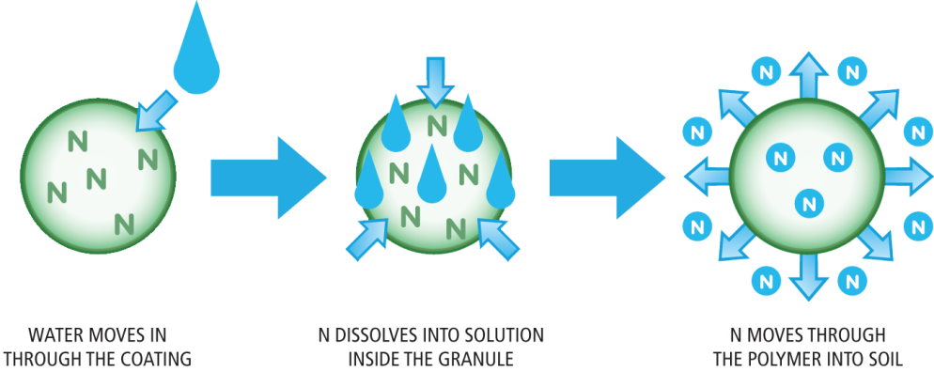
ESN’s Coating Controls N Release
Water moves in through the coating
N dissolves inside the coating
N moves through the polymer into the soil
Protects the nitrogen, increases N-use efficiency, protects the environment
Notes:
The drawing shows how ESN releases N. Water passes thru the flexible biodegradable polymer coating. The polymer coating doesn’t split open, wash off, or dissolve. As soil temperatures increase the release of N solution increases. This allows N to be available as the crop needs it in it’s life cycle. At cool temperatures, the crop grows slowly and needs less N; ESN releases slowly. As temperatures warm, the crop grows faster and ESN releases faster to more closely match plant demand.

Slide 15
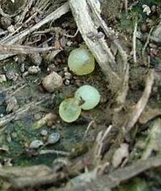
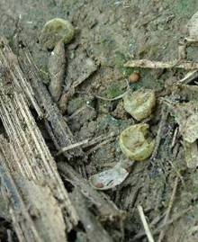
Protection You Can See
Partially dissolved
Empty
Solid
Completely dissolved
ESN shows your nitrogen protection is working
Notes:
The pictures are of actual stages the ESN goes thru during the growing season. The empty polymer coatings will break down into water, CO2, and ammonia in 18-24 months.

Slide 16
Longevity of N Transformations
ESN protects against all N loss mechanisms for the longest period of time
Notes:
This figures shows the approximate duration of different N transformations with and without inhibitors. ESN provides the longest protection against volatilization, leaching, and denitrification available on the market today. When evaluating which product to choose, it is important to know against which losses a product can protect and for how long. A cheaper product may not give you the protection you need. ESN provides the greatest protection for the longest period of time.
The important thing to take away from this slide is to protect your N investment.

Slide 17
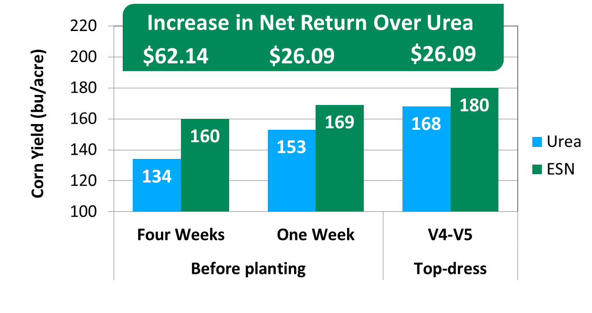
ESN Increases Yields for Flexible Application Times
ESN produces more yield, greater net return, and offers more application flexibility than conventional urea.
Source: Dr. K. Nelson, Univ of Missouri, Greenley
Notes:
Values are means of four site years; N sources broadcast at 150 lbs N/acre w/o incorporation.
ESN can provide benefits for a variety of application times. In this Missouri study, soils are often excessively wet in spring leading to high potential N loss. The further in advance of corn N uptake N is applied, the greater the susceptibility of conventional urea to loss. But ESN protects N thru these conditions. At this location, losses from pre-plant applications are primarily by denitrification. Losses from top-dress applications are from either denitrification and/volatilization. The closer to the time of corn N uptake the N is applied, the better conventional urea performs, but ESN out-yields urea for all applications times in the range tested in this study. This translates to greater net return. (In this study, ESN treatments are 100% of N from ESN).
The increase in net return over urea is calculated using the (yield increase x $3.50/bu) – (150 lbs N/ac x $0.20/lb N difference from urea). Net return values may appear slightly irregular because yield values are rounded from tenths of a bu/acre.
Due to the polymer coating, ESN will not burn the corn when applied topdress.

Slide 18
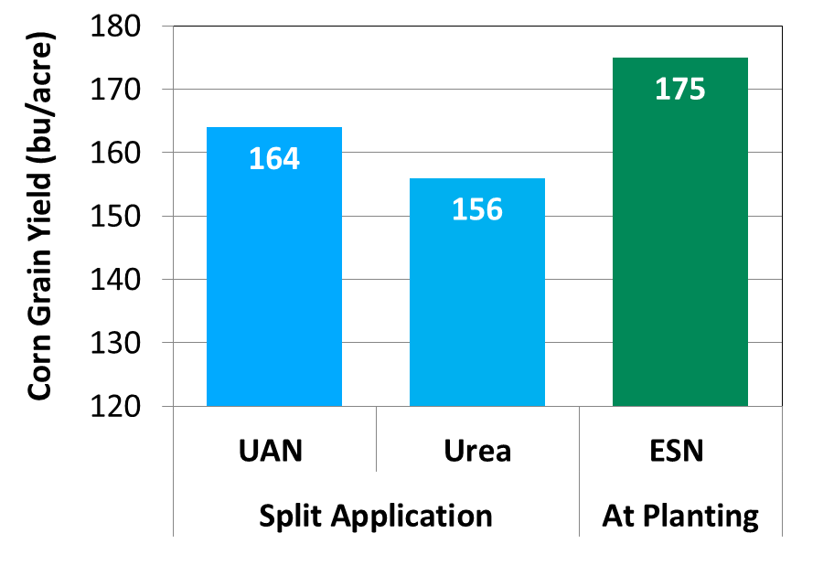
ESN Reduces the Number of Applications
Increased net return for ESN over UAN and urea
More corn/unit of N
+ flexibility & convenience
+ time, fuel, & labor savings
+ less nitrogen loss
= increased ROI and
peace of mind
$19.50
$39.50
A single ESN application at planting produced greater yields and profits than split application of conventional N fertilizers.
Source: Kansas State University.
Notes:
All treatments applied at 160 lbs N/acre. UAN and urea were split between 50% at planting and 50% side-dress. ESN was applied in one application at planting.
A single application of ESN before or at planting produces yields similar to or greater than split applications of urea or UAN solution. These yield increases of 19 bu/acre over urea and 11 bu/acre over UAN translate to greater net return with ESN. The increase in net return is calculated as (yield increase x $3.50/acre + savings of one application at $5/acre) – (160 lbs N/acre x $0.20 /lb of N over urea and $0.15/lb of N over UAN). Plus $5/acre application cost.
One of the major issues growers face when side dressing N is weather. If rains persist during this time and N cannot be applied in a timely matter, the corn crop will suffer and lose yield. ESN will give you the peace of mind that the N you paid for will be there when the corn crop needs it.

Slide 19
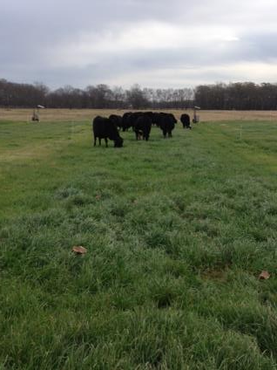
Grazings per season
ESN: 6
Urea: 5
Urea + Agrt: 5

Slide 20
Total Forage (lbs)
ESN: 5800
Urea: 4070
Urea+AT: 4680

Slide 21
ESN Increases Yields and Profits in Irrigated Cotton
Increase in Net Return vs Urea
$133.80
$158.40
$184.20
ESN produces more yield and greater net return than conventional urea.
Source: Dr. B. Golden, Mississippi State Univ, Stoneville, MS
.
Notes:
Study conducted at Stoneville, MS. Nitrogen applied at planting at 90 lbs N/acre. WHEN WAS N APPLIED?? AP OR SD
Net return calculation is based on average yield and N rate (90 lbs N/acre). Net return calculation assumes $0.60/lb lint; urea price of $350/ton ($0.38/lb N); ESN price of $511/ton ($0.58/lb N or $0.20/lb of N over urea).

Slide 22
Questions?

